Slide 1
BALKAN REGIONAL PLATFORM FOR
YOUTH PARTICIPATION AND DIALOGUE
Mostar, 29 October 2015

Slide 2
Regional research team for ALDA Balkan network
Slađana Petković
Marijana Rodić

Slide 3
Purpose and methodology
Purpose: To provide insight into regional youth policies focusing on youth participation and social inclusion of vulnerable youth
Research process :Descriptive comparative review of regional youth policies conducted through 3 phases:
Phase 1: DESK RESEARCH
Phase 2: FIELD RESEARCH
Survay through online Questionnaire (942 young people reached),
Focus groups with young people (8 in total),
Interviews with of stakeholders (21 in total)
Phase 3: DATA ANALYSIS AND REPORTING

Slide 4
Description of the sample
Gender
F: 64 %
M: 36 %
Age
Age 15 – 19 : 26 %
Age 20 – 25 : 40 %
Age 26 – 30 : 34 %
Occupation
Pupil : 17 %
Student : 38 %
Employed : 27 %
Unemployed : 18 %

Slide 5
Description of the sample
Place of Residence
Village : 17 %
Small town : 39 %
City: 44 %
Country
Bosnia and Hercegovina : 34 %
Montenegro : 12 %
Macedonia : 15 %
Serbia : 32 %
Kosovo : 7 %

Slide 6
Short overview of empirical data

Slide 7
YOUTH CIVIC PARTICIPATION AND ACTIVISM
Young people's participation in community oriented CSOs

Slide 8
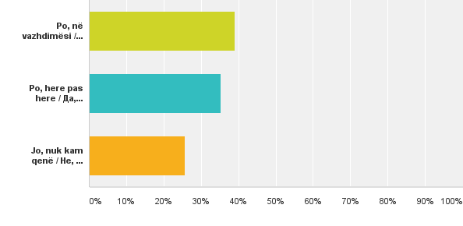
Young people ACTIVE in non-governmental organizations/ youth organizations
YES, continuosly : 39 %
YES, periodically : 35 %
NO, I do not participate: 26 %

Slide 9
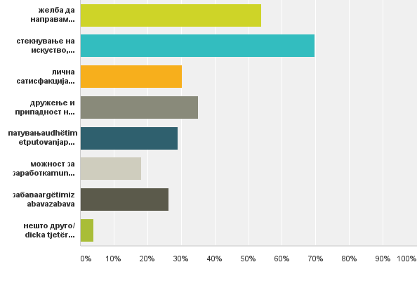
MOTIVATION of young people for participation in organizations
THE DESIRE TO MAKE THE CHANGE: 54%
THE ACQUISITION OF KNOWLEDGE, EXPERIENCE AND SKILLS: 70%
Personal satisfaction: 30%
Socializing and belonging to a group: 35%
Travel: 29%
Earnings potential: 18%
Fun: 26%

Slide 10
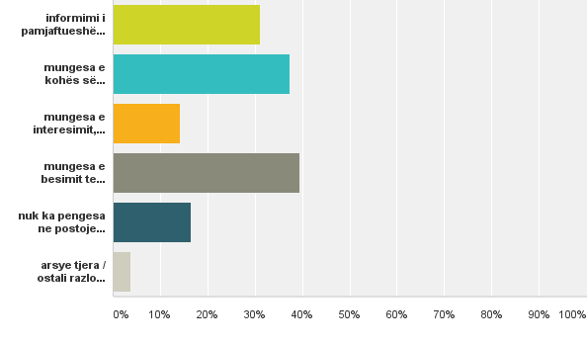
BARRIERS to active participation
1. Lack of TRUST in the state and the possibility of changes
2. Lack of FREE TIME
3. Lack of INFORMATION
4. Lack of interest, will and motivation
16% of young people stated that there are no barriers

Slide 11
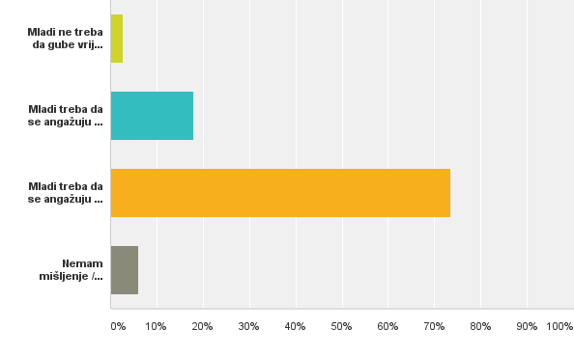
Should young popel be engaged in the non-governmental / youth organizations
73 % YOUNG PEOPLE SHOULD BE ENGAGED TO CONTRIBUTE TO SOCIAL CHANGE
18 % Young people need to be engaged if it will bring some benefit
3% Young people should not waste time on it

Slide 12
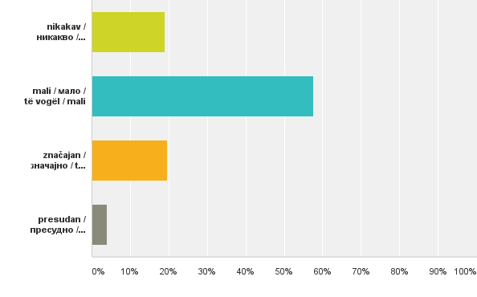
According to the opinion of young people THE IMPACT THEY HAVE ON SOCIAL CHANGE in local community / country is
20% significant impact
58% SMALL IMPACT
19% NO IMPACT

Slide 13
What do Young People Say
Young people are rarerly asked for anything, and even when asking their opinion, the same have no major impact on decisions.
Young people make small changes in the community, and there are examples of good practice of teamwork and cooperation, but the largest change is PERSONAL CHANGE.

Slide 14
How young people communicate with
decision makers

Slide 15
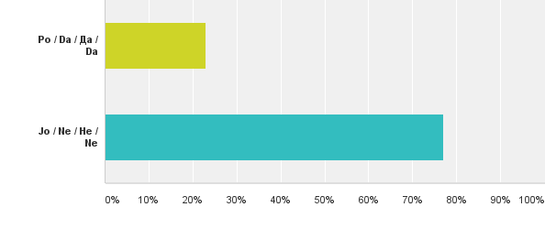
Young people use the Internet to communicate with the authorities and institutions
77 % do NOT use internet
23 % use
Reduced opportunities for young people from socially sensitive groups and young people from rural areas

Slide 16
Youg people use INTERNET for
expressing opinion in the
discussion of civil and political issues
73 % social networks
31 % media web sites
13 % blogs
Young people use 'TRADITIONAL‘
WAYS of expressing their opinion
in discussions on civil and
political issues
61 % do not use
20 % participate on public hearings and consultations
16 % public forums

Slide 17
Young people's engagement in VOLUNTARY ACTIVITIES

Slide 18
Young people participate in
volunteer activities in their
LOCAL COMMUNITY
69 % volunteer
Young people participate in
voluntary activities ABROAD
25 % had this experience
Most of them shorterm
volunteering

Slide 19
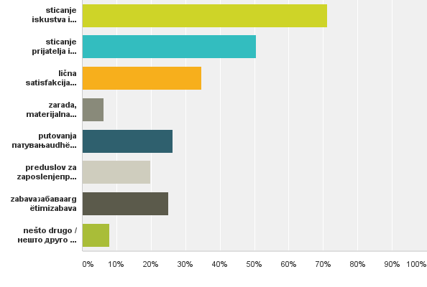
The MOTIVATION of young people for volunteering
The acquisition of knowledge, experience and skills: 71%
Making friends and associates: 51%
Personal satisfaction: 35%
Travel: 26%
Fun: 25%
Pree-condition for employment: 20%
Earnings: 6%

Slide 20
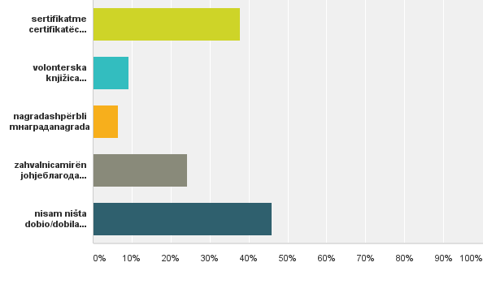
Volunteer experience is VALUED and how
46% DIDN'T GET ANYTHING
38% sertifikates
24% certifikate of thanks
9% voluntary card

Slide 21
YOUTH PARTICIPATION IN DECISION MAKING PROCESSES

Slide 22
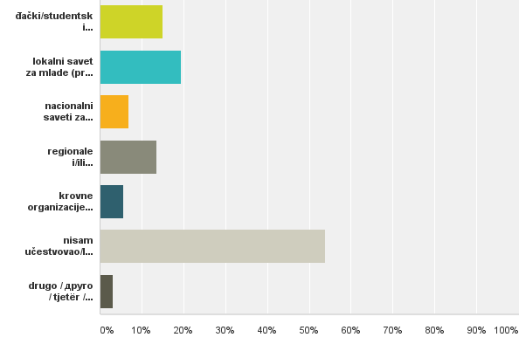
Young people participate in the FORMALLY RECOGNIZED STRUCTURES that represent the interests of young people
54 % - DID NOT PARTICIPATE
19 % - Local youth councils
15 % - Pupils/ students parliaments
13 % - National/regional umbrella organizations
7 % - National youth councils
6 % Umbrella youth organizations on European level

Slide 23
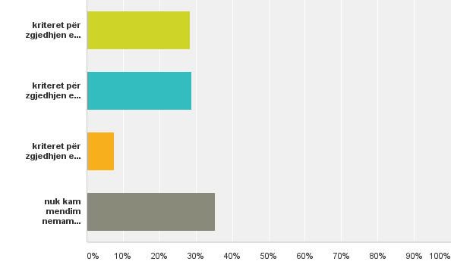
Are the CRITERIA FOR THE SELECTION OF YOUNG PEOPLE in representative structures clear and transparent, and consistently applied in practice
35% I HAVE NO OPINION
28% Criteria for the selection of young representatives are clear and transparent but is inconsistently applied
28% Criteria for the selection of young representatives are not clear and transparent

Slide 24
Does their community / country has the CONDITIONS FOR THE INCLUSION OF YOUNG PEOPLE IN DECISION-MAKING PROCESSES
64% considers that there are NO conditions

Slide 25
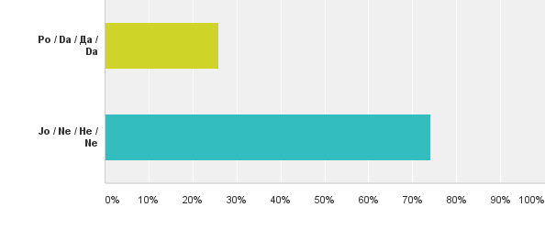
Are the young people INVOLVED in the decision-making process in the local community / country
74% were NOT involved

Slide 26
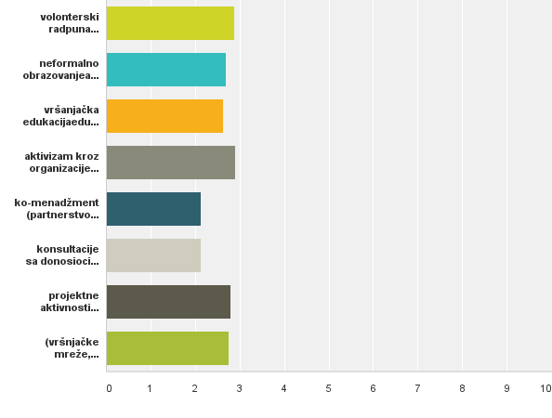
AREAS OF YOUTH PARTCIPATION young people are involved
VOLUNTEER WORK
Non formal education
Peer Education
ACTIVISM THROUGH ORGANIZATIONS / YOUTH CLUBS
CO-MANAGEMENT
CONSULTATIONS WITH DECISION MAKERS
PROJECT ACTIVITIES
PEER NETWORKS, PETITIONS, SUPPORT GROUPS, INTERNATIONAL MEETINGS)

Slide 27
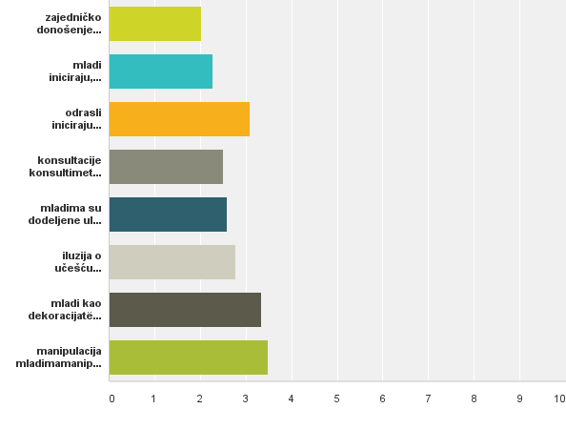
The QUALITY of youth participation in decision-making Roger Hart – Ladder of Youth Participation
joint decision-making on an equal basis
young initiate, decide and implement actions
ADULTS INITIATE ACTIVITIES
consultation
young people are assigned roles and tasks
the illusion of participation - "tokenize"
YOUNG AS DECORATION
MANIPULATION OF YOUTH

Slide 28
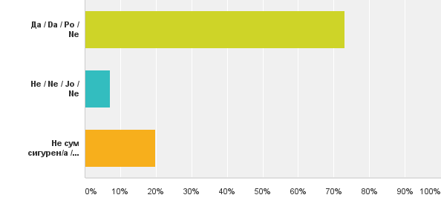
Does young people BELIEVE THEY CAN CONTRIBUTE TO THE CHANGE OF THEIR POSITION IN SOCIETY through involvement in youth policies
73% believes they CAN

Slide 29
HOW YOUNG PEOPLE ARE SEEN
The results show that there is a dual tendency:
Firstly, young people are perceived more as EQUAL PARTNERS AND RESOURCES IN SOCIETY by various CSOs,
While this was not the case when it comes to the local authorities and institutions. Majority of respondents believes that young people have a minor role in society, although there are structures for their participation ‘on paper’.
If young people could be perceived as equal, they must have certain KNOWLEDGE, be well INFORMED, but there is also a problem of MOTIVATION, and life without a goal.

Slide 30
YOUTH PARTICIPATION IN POLITICS
* youth branches of political parties
* elections

Slide 31
Opinion on the INVOLVEMENT
of young people in political
organizations
71% - young people SHOULD BE
ENGAGED to contribute to social
change
Young people ACTIVE in
the youth branches of
political parties
83% NOT active

Slide 32
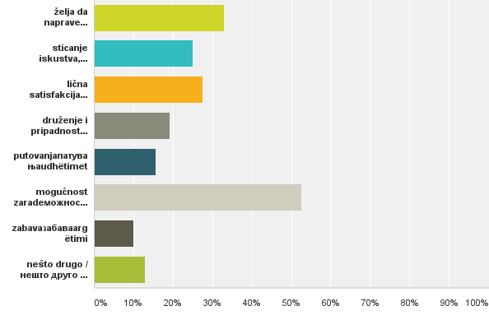
MOTIVATION for participation of young people in the youth branches of political parties
THE DESIRE TO MAKE THE CHANGE: 33%
The acquisition of knowledge, experience and skills: 25%
PERSONAL SATISFACTION: 28%
Socializing and belonging to a group: 19%
Travel: 15%
EARNINGS POTENTIAL: 52%
Fun: 10%

Slide 33
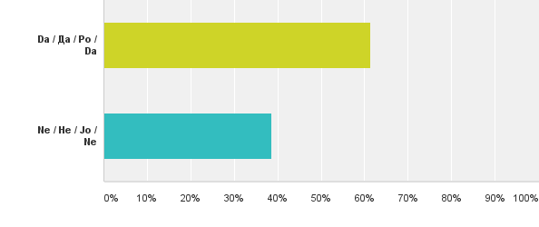
Young people PARTICIPATED IN THE LAST ELECTIONS at local / cantonal / regional or national level?
61% participate

Slide 34
YOUTH PARTICIPATION AND SOCIAL EXCLUSION

Slide 35
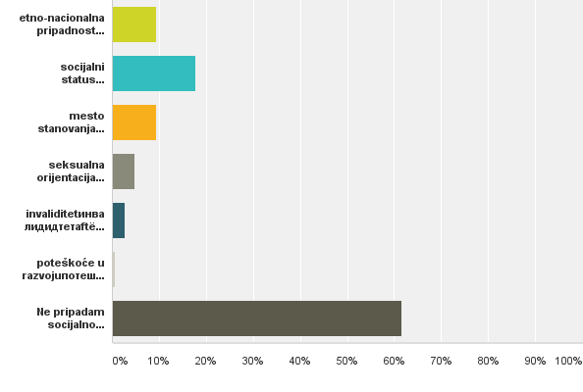
Belonging to the SOCIALLY VULNERABLE GROUPS
9% Ethno-national belonging (minorities)
18% SOCIAL STATUS
(low-income households, individuals who
are not included in the labor market /
education)
9% Place of residence
5% Sexual orientation
3% Disability

Slide 36
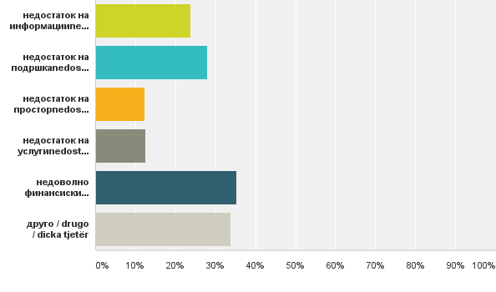
Young people who belong to socially vulnerable groups faced with OBSTACLES FOR ACTIVE PARTICIPATION in the community
35% INSUFFICIENT FUNDING
28% LACK OF SUPPORT
24% LACK OF INFORMATION
12% Lack of space
12% Lack of conditions

Slide 37
Thank you for attantion
More information will be available in
the report of the regional research team
Marijana Rodić and Slađana Petković
At ALDA network web page

