Slide 1
BEYOND BARRIERS A YOUTH POLICY SEMINAR ON SOCIAL INCLUSION OF YOUNG PEOPLE IN VULNERABLE SITUATIONS IN SOUTH EAST EUROPE Snapshot on the situation of youth in South East Europe Dunja Potočnik, The Pool of the European Youth Researchers Mostar, October 2015

Slide 2
Youth in SEE: Data
State statistical offices – harmonisation with the European methodology (Eurostat)
Shell youth survey: Albania, Bosnia and Herzegovina, Croatia, Kosovo, the Former Yugoslav Republic of Macedonia and Serbia.

Slide 3
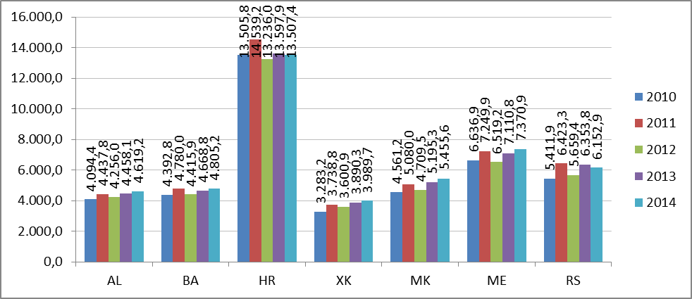
GDP per capita 2010-2014 ($)
*Source: World Bank: World Development Indicators

Slide 4
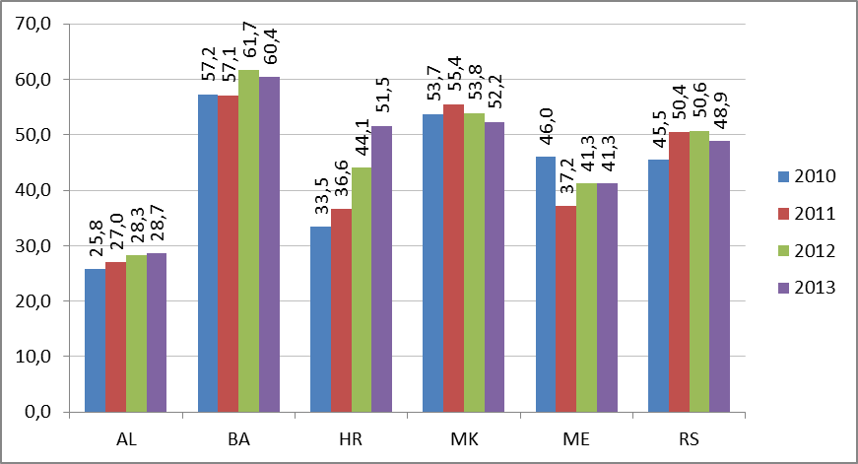
Youth unemployment rate (2010-2013)
*Source: World Bank: World Development Indicators
Kosovo 2013: 55,9% (source: LFS)

Slide 5
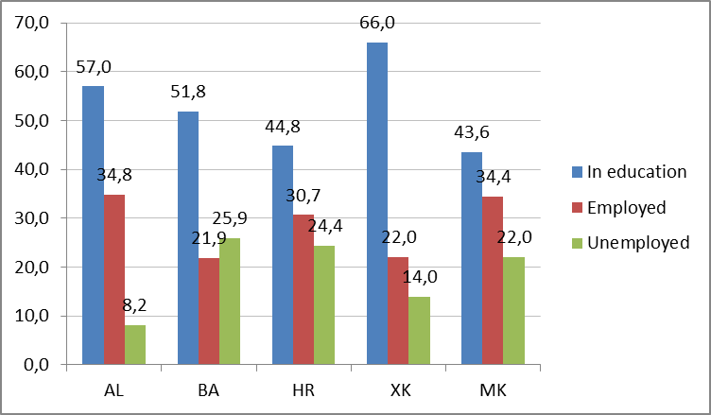
Socio-professional status
*Source: Shell national surveys

Slide 6
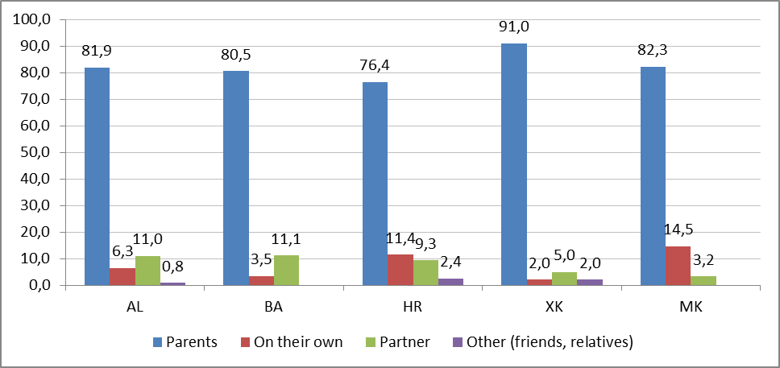
Living arrangements
*Source: Shell national surveys

Slide 7
Rank of the grounds of discrimination experienced by the youth (the first five ranked grounds)
*Source: Shell national surveys
 | COUNTRIES
 | AL | BA | HR | XK | MK
1. | Political affiliation | Religion | Economic status | Gender | Political affiliation
2. | Economic status | Economic status | Religion | Economic status | Ethnicity
3. | Residence | Educational level | Ethnicity | Religion | Gender
4. | Ethnicity | Ethnicity | Political affiliation | Ethnicity | Residence
5. | Gender | Residence | Educational level | Educational level | Sexual orientation

Slide 8
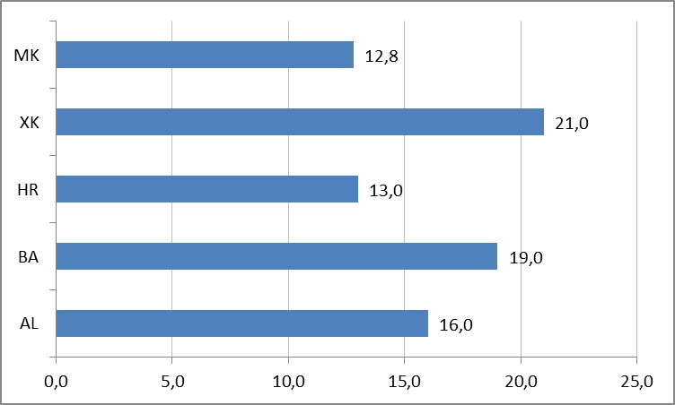
Share of young people engaged in voluntary activities in past 12 months prior to the surveys (%)
*Source: Shell national surveys

Slide 9
Trust towards institutions – the first five ranked institutions
*Source: Shell national surveys
 | COUNTRIES
 | BA | HR | XK | MK
1. | The police | The police | Religious leaders | NATO
2. | Religious institutions | Judiciary | The police | Judiciary
3. | Media | NGOs | Media | Army
4. | NGOs | Media | NGOs | The police
5. | Labour unions | Religious institutions | Judiciary | Banks

Slide 10
The major problems in the society – the first five ranked problems
 | AL | BA | HR | XK | MK
1. | Unemployment | Unemployment | Unemployment | Unemployment | Unemployment
2. | Poverty | Poverty | Poverty | Poverty | Poverty
3. | Job insecurity | Job insecurity | Job insecurity | Kosovo territory | Increased incidence of chronic diseases
4. | Environmental pollution | Justice | Insufficient fight against corruption | Environmental pollution | Job insecurity
5. | Increased incidence of chronic diseases | Insufficient fight against corruption | Justice | Job insecurity | Environmental pollution
*Source: Shell national surveys

Slide 11
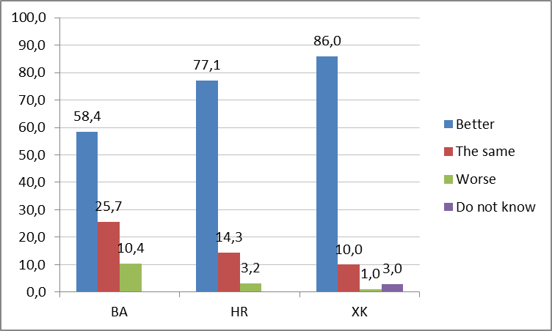
Personal optimism – perception of changes on a personal plan
*Source: Shell national surveys

