Slide 1
The 3rd Angle – Youth workers & Young people
Adina Marina Calafateanu,
Center for Sustainable Community Development, Romania
Pool of European Youth Researchers – PEYR

Slide 2

Do you work with REAL Young People? - Mostar to Malta:

Slide 3
Policies for THE OTHERS
“The other ones” - beneficiaries and programmes designed FOR them
Political, Social and Economic Exclusion & MULTIPLE EXCLUSION! – Cocktail 2.0!
Do young people AUTEHTNICALLY participate? Tokenism and Decoration vs. real participation.

Slide 4
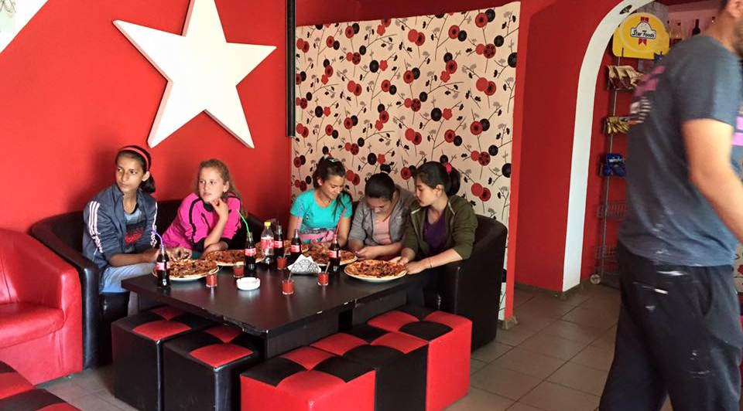
“La Dolce Vita” – Not again!

Slide 5
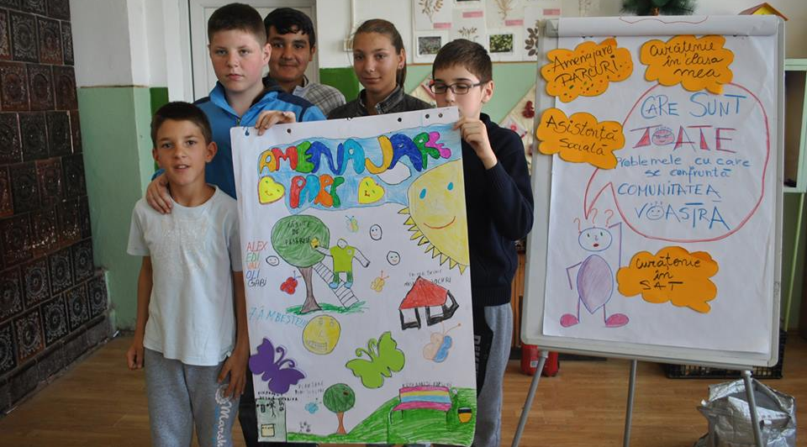
Ask young people – they know better!

Slide 6
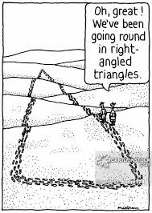
YW – Social Recognition: ‘I’ve got work to do!’

Slide 7
What do we need?
Who is working with young people? – Youth workers, youth leaders, project managers, educators? – RECOGNITION!
Constructive dialogue – WHO will initiate it? – Both sides – NGOs and/or Authorities.
Young people as resource – not looking at them through ‘the problem eye’
Cross-sectorial inclusive youth policies – local, national, regional, European level.

Slide 8
Youth workers’ perspective:
Participation – one of the eleven guiding principles for effective national youth policy (European Youth Forum) - Eleven Principles of a National Youth Policy –Structures adapted to to the local realities!
A multidimensional youth policy is needed to reduce barriers but reformulated through participatory mechanisms.
Youth-friendly services at the local level
Access to economic opportunities

Slide 9
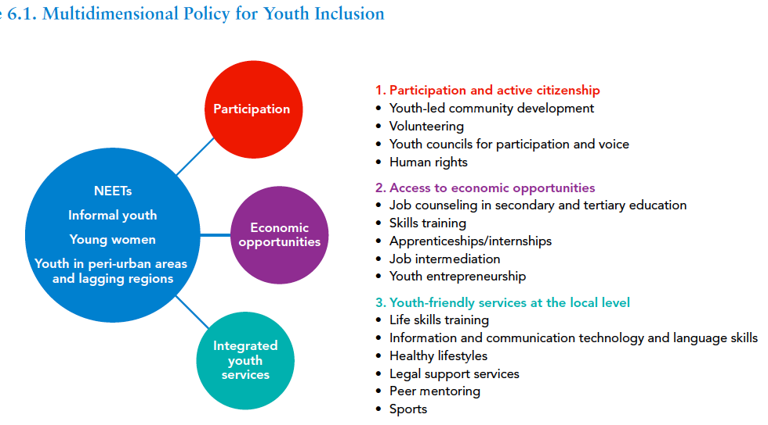
Multidimensional Policy for Youth Inclusion

Slide 10
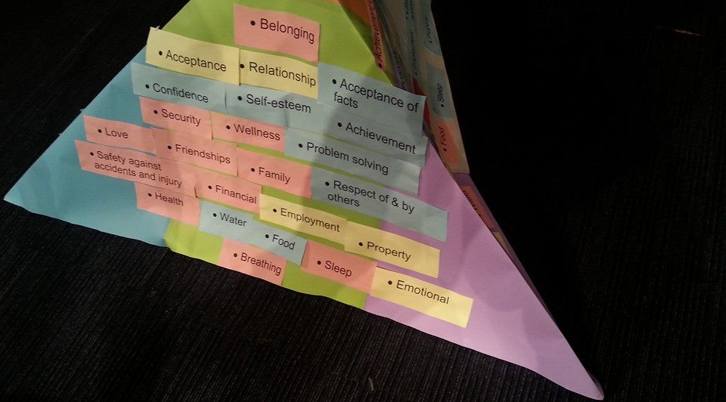
Inclusive Youth Policies:

Slide 11
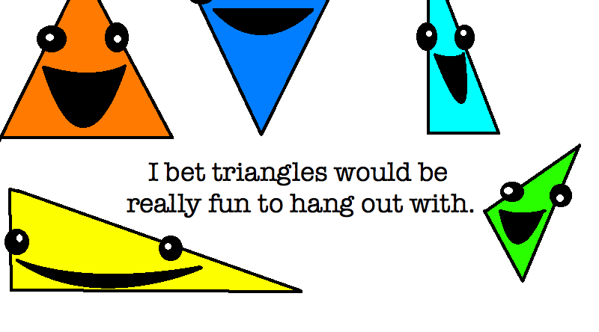
Nothing FOR youth, WITHOUT Youth!

