Slide 1
Towards Digital Literacy for the Participation of Young People in a Digital World
Dr. Nuala Connolly, UNESCO Child and Family Research Centre, National University of Ireland, Galway
Dr. Claire McGuinness, School of Information and Communication Studies,
University College Dublin

Slide 2
Asking the questions..
What is digital literacy? What does it look like?
What do we know about young people’s digital literacy in Ireland and Europe?
What do we know about young people’s experiences of opportunities and risks in the digital world?
Is there a role for our formal education system to support young people to participate in a digital world in a meaningful and safe way?
What new opportunities can our education system provide to support young people’s participation in a digital world? What can be done differently?

Slide 3
What is Digital Literacy?
“Digital Literacy as the range of skills, knowledge and understanding that young people need in order to participate fully and fairly in an increasingly digital landscape”
“Digital Participation recognises how technology and media offer opportunities for people to participate in new kinds of social activities, civic life, learning and work, and it also means recognising that technology and media must be challenged and questioned rather than accepted passively”
(Hague & Williamson, 2009)

Slide 4
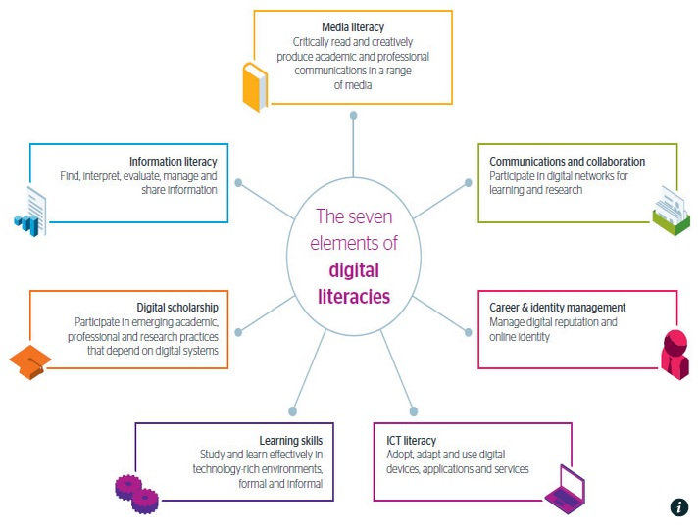
2014)
(JISC and Bonner McHardy,2014)
https://www.jisc.ac.uk/guides/developing-students-digital-literacy

Slide 5
Beetham and Sharpe (2010)
Identity
Practices
Skills
Access and Awareness
“I am”
“I do”
“I can”
“I have”

Slide 6
A Policy Imperative…
UNICEF Children’s Rights in the Digital Age
European Commission eLearning Initiative 2000
i2010 Strategy (Acess, eGovernment)
Lifelong Learning Programme (ICT)
Digital Agenda for Europe 2010 (Pillar VI)
European Commission DigComp Framework for Developing Digital Competencies in Europe 2013
Ireland:
National Digital Strategy 2013 (Schools Activity)
The National Strategy to Improve Literacy and Numeracy among Children and Young People 2011-2020
Teaching and Learning in Irish Higher Education: A Roadmap for Enhancement in a Digital World 2015-2017

Slide 7
Access to ICT: Home and School
In 2007 55% of households in the EU-28 had internet access. In 2014 this reached 81%
Broadband used by 78% of the households in the EU-28 in 2014, an increase of 36 percentage points since 2007 (Eurostat, 2015)
Between 3-7 students per computer on average in the EU, with laptops, tablets and netbooks pervasive in some countries
9 out of ten students are in schools with broadband
(Schoolnet, 2013)

Slide 8
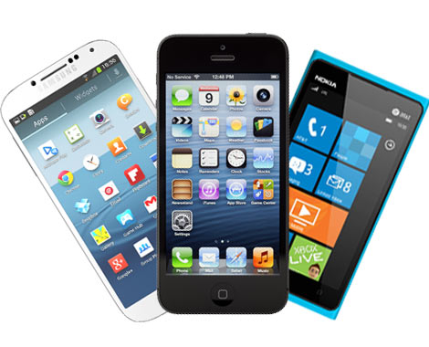
Access to ICT Ireland: Home and School
Smart phones are the devices that children are most likely to own or use to go online at least once a day. This is mainly at home.
The age of first Internet use is dropping-
as is the age children are given their
first smartphone
7% of Irish 9-16 year olds report using the Internet in school on a daily basis- rises to 16% for 15-16 year olds
(Net Children Go Mobile, 2011)
http://www.dit.ie/cser/media/ditcser/digitalchildhoods/NCGM_Ireland_initialfindingsreport_complete.pdf

Slide 9
Internet Use (School and Home)
Activities (Ireland)
Listening to Music
Watching Video Clips
Visiting SNS
Seeking Information
Played Games
Instant Messaging
Used Internet for School Work Apps
File Sharing
15-16 year olds
(Net Children Go Mobile, 2011)
http://netchildrengomobile.eu/reports/

Slide 10
Digital Natives?
Having physical and material access does not automatically lead to appropriation, as one has to develop several skills to use the medium concerned (Van Dijk, 2013)
While young people are conscious of and concerned about privacy (Lenhart et al., 2007), the “savvy” or know-how attributed to young people in the online environment often fails to translate to privacy knowledge (Hoofnagle et al., 2010)
Research identifies a growing disparity between young people’s information behaviour online and their perceptions of the risks associated with information disclosure (Acquisiti and Gross, 2009, Christophides et al., 2010)
Notes:
Van Dijk, J. (2013) A theory of the digital divide. in Ragnedda, M., & Muschert, G. W. (2013). The digital divide: The internet and social inequality in international perspective (Vol. 73). Routledge.
Lenhart, A., & Madden, M. (2007). Teens, privacy & online social networks: How teens manage their online identities and personal information in the age of MySpace. Pew Internet & American Life Project.
Hoofnagle, C.J, King, J., Li, S. & Turrow, J. (2010) How Different Are Young Adults from Older Adults When it Comes to Privacy Attitudes and Policy? Social Science Research Network, [Online], Available at: http://ssrn.com/abstract=1589864.
Christophides, E., Muise, A. & Desmarais, S. (2010) Privacy and Disclosure on Facebook: Youth and Adults’ Information; Disclosure and Perceptions of Privacy Risks, Paper for the Office of the Privacy Commissioner of Canada, [Online], Available at: http://www.psychology.uoguelph.ca/faculty/desmarais/files/OPC_Final_Report-Facebook_Privacy.pdf.
Acquisti, A. and Gross, R. (2009) ‘Predicting Social Security Numbers from public data’, Proceedings of the National Academy of Sciences [PNAS], 106 (27), pp. 10975-10980.

Slide 11
Digital Natives?
Young people
tend to overestimate their skills
are not aware of their skills gaps
are spending more time in engaged in digital lifestyle skills and not ‘workplace’ skills
do not have access to digital literacy education in a formal, structured manner
(ECDL, 2014)
20% young people having encountered things online they wish they hadn’t seen
43% young people unable to report abuse when they came across disturbing or negative content
(Net Children Go Mobile, 2011)
http://www.ecdl.org/media/TheFallacyofthe'DigitalNative'PositionPaper1.pdf
http://netchildrengomobile.eu/reports/

Slide 12
Levels of Digital Literacy are Rising- Slowly
(EU Kids Online, 2013)
http://eprints.lse.ac.uk/50228/1/__Libfile_repository_Content_Livingstone,%20S_Children%E2%80%99s%20use%20of%20online%20technologies%20in%20Europe(lsero).pdf

Slide 13
Skills unevenly distributed
Older teenagers, boys, and those from higher SES households have greater access to the internet
Middle class teenagers using the internet more frequently and for longer on an average day; similar findings hold for age, with older teens using the internet more.
However, boys do not differ from girls in amount of use (measured by frequency of use and time spent online on an average day)
The greater the young person’s online skills and self- efficacy, the more - rather than the fewer - risks they encounter online (Livingstone, 2010)
Notes:
Livingstone, Sonia and Helsper, Ellen (2010) Balancing opportunities and risks in teenagers' use of the internet: the role of online skills and internet self-efficacy. New media & society, 12 (2). pp. 309-329.

Slide 14
More Use, More Risk
(LSE, 2010)
http://www.lse.ac.uk/media%40lse/research/EUKidsOnline/EU%20Kids%20II%20(2009-11)/EUKidsOnlineIIReports/D4FullFindings.pdf

Slide 15
Supporting Literacy Skills
Support the growing policy demand for teachers, educational providers and even the industry, child welfare and other organisations to establish and expand digital literacy programmes so as to increase children’s Internet related competencies and thereby benefit from the opportunities
In addition to interventions designed to equalise access, interventions targeted at increasing specific skills will enhance the take-up of online opportunities (Livingstone & Helsper, 2010)
Desire to learn realised through informal and formal learning experiences
Key is the role of other people who can facilitate the development of digital skills ‘intermediaries’
(Eynon, 2014)
Notes:
Livingstone, Sonia and Helsper, Ellen (2010) Balancing opportunities and risks in teenagers' use of the internet: the role of online skills and internet self-efficacy. New media & society, 12 (2). pp. 309-329.
Eynon, R., & Geniets, A. (2015). The digital skills paradox: how do digitally excluded youth develop skills to use the internet?. Learning, Media and Technology, (ahead-of-print), 1-17.

Slide 16
Towards a National Framework..
eLearning, the provision of across-the-board access to high-quality online educational media, teacher training in educational technology, and the fostering of digital literacy at all levels of education
Recognition of digital literacy in primary and post-primary education (Junior and Senior cycles), noting the inclusion of explicit learning outcomes relating to the use of digital technologies to communicate, create, collaborate and manage student learning
Development of a national digital and information literacy framework, to include standards for these competencies across all sectors and all levels of education
(LAI Taskforce on Information Literacy, 2012)
http://edepositireland.ie/bitstream/handle/2262/74539/The_Library_Association_of_Ireland_Task_Force_on_Information_Literacy.pdf?sequence=1&isAllowed=y

Slide 17
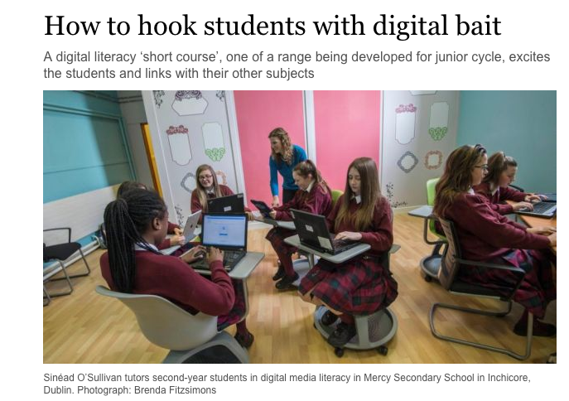
Irish School Context
Integrated language curriculum for primary schools under development, to embed development of digital literacy
A Junior Cycle short course has been available to schools from 2014 in the area of Digital Literacy which includes topics such as information literacy, personal safety online, digital storytelling, and online privacy

Slide 18
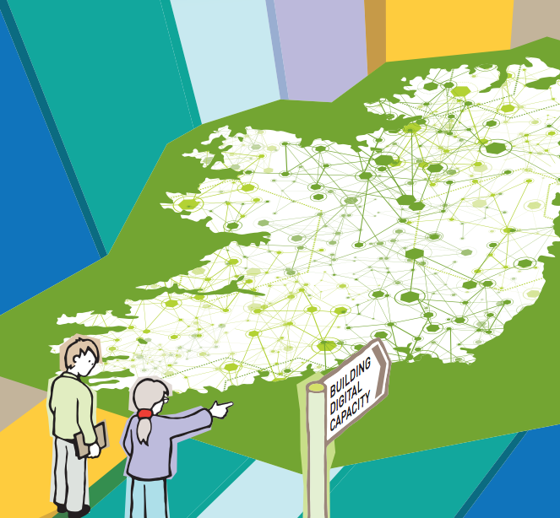
Irish Initiatives
Schools Digital Champions
A new schools “digital champions initiative” is currently being developed
Switch-On Digital Skills workshops for teachers launched across schools with a focus on how schools can take advantage of digital tools and online education resources to improve both the teaching and learning experience

Slide 19
CoderDojo
Research shows that that programming is now considered by people in Ireland to be just as important as learning mainstream subjects taught in school.
Of 1,000 adults questioned, two-thirds said learning coding is equally important as maths, science and languages.
One-third believe it is more valuable than the Irish language, with one-fifth believing it is a more important skill than maths.
Although coding is not taught in most Irish schools, children can learn it at Coderdojo clubs run by volunteers.
(Amarach Research, 2014)
http://www.amarach.com/blog/2014/10/coding-kids.html

Slide 20
Next steps
Literacy is Fundamental to children’s capacity to use digital media competently and to exercise their rights in and with digital media (UNICEF, 2010)
Enhanced knowledge is a strong predictor of promotive privacy behaviours online (Christophides et al., 2010)
Infrastructure related policies should be supported by capacity building towards digital literacy education and competencies and bridging the second level divide
Safety training should be matched to different groups in different contexts, with different level of harm
Young people who are digitally literate will be able to think carefully about what they are participating in and how the terms of their participation may be constrained or limited by a range of factors. They will be able to exercise choice in how they participate (Hague & Williamson, 2009)
Notes:
Christophides, E., Muise, A. & Desmarais, S. (2010) Privacy and Disclosure on Facebook: Youth and Adults’ Information; Disclosure and Perceptions of Privacy Risks, Paper for the Office of the Privacy Commissioner of Canada, [Online], Available at: http://www.psychology.uoguelph.ca/faculty/desmarais/files/OPC_Final_Report-Facebook_Privacy.pdf.
Hague, C., & Williamson, B. (2009). Digital participation, digital literacy, and school subjects: A review of the policies, literature and evidence. Futurelab.

Slide 21
#MakeGráTheLaw
#HomeToVote
#RegisterToVote
66,000 registered to supplementary electoral register, many first time voters

