Slide 1

Dobrovolnické centrum, o.s.
(Volunteer Center)
The Czech Republic

Slide 2

Association of Volunteer Center provides professional facilities for volunteers and promotes volunteering as a natural part of life.

Slide 3
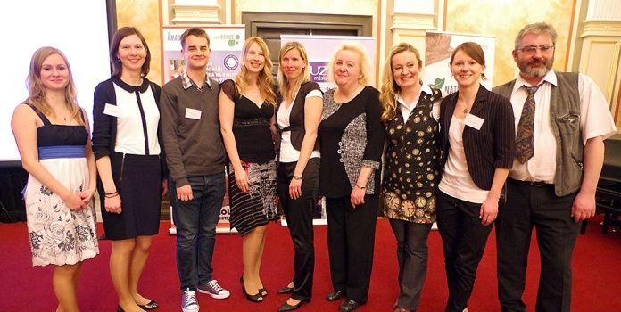
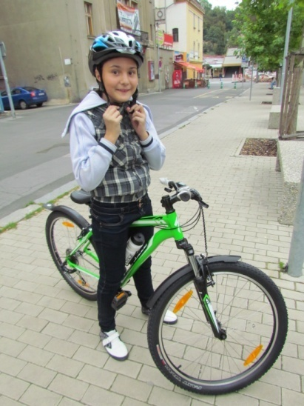

Established: 1999
We are a non-profit organization in Ústí nad Labem, region Ústí, NUTS-II, North West
Currently: 9 employees
1321 registrated volunteers

Slide 4

Volunteering areas:
Volunteering in Social Services
Volunteering in Health Care
Volunteering in Culture
Volunteering in Sport
Volunteering in Emergency Situations
European Voluntary Service

Slide 5
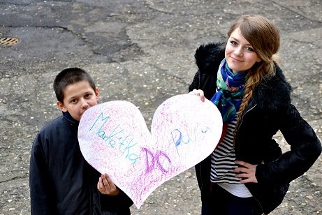
Volunteering in Social Services for Disadvantaged Families
Big Brothers - Big Sisters (5P)
1 big and 1 small friend
leisure time together
promoting self-confidence, communication development, establishing relationships
Program KOMPAS® (Communication, Friendship, Cooperation)
6 children and 2 volunteers, meeting once a week for 5 months for 2-3 hours
meaningfully spent leisure time: trips, sport, creative activities
Social Work with Families
help families with children aged 7-15 which are in a difficult life situations (e.g. poor financial and housing situation, unemployment, etc.)
assistance with the school preparation - 1 volunteer and 1 child

Slide 6
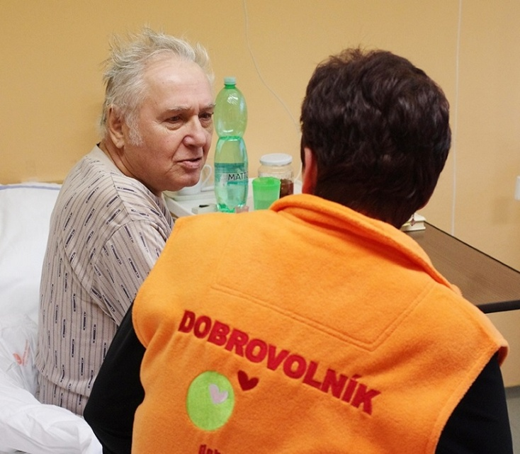
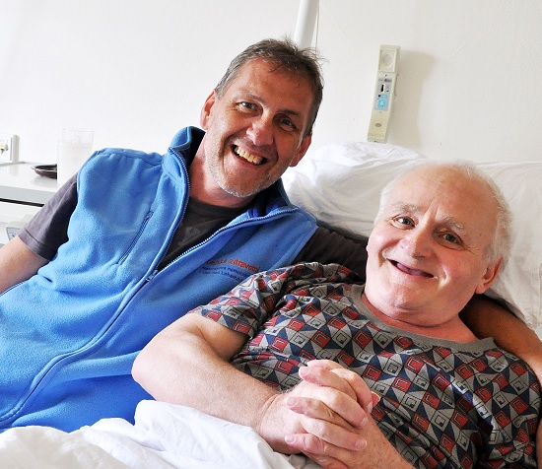
Volunteering in Health Care
This programme aims to bring more human contact into hospitals, to support patients‘ wellbeing and their attitude to active participation in their own recovery. Volunteer in hospital is a specialist for human contact.
Volunteer helps:
to improve patients‘ psychosocial condition
to promote interpersonal communication
to improve the overall atmosphere
Operating in five hospitals
Year 2013: 1290 volunteer‘s visits, 2157 hours

Slide 7
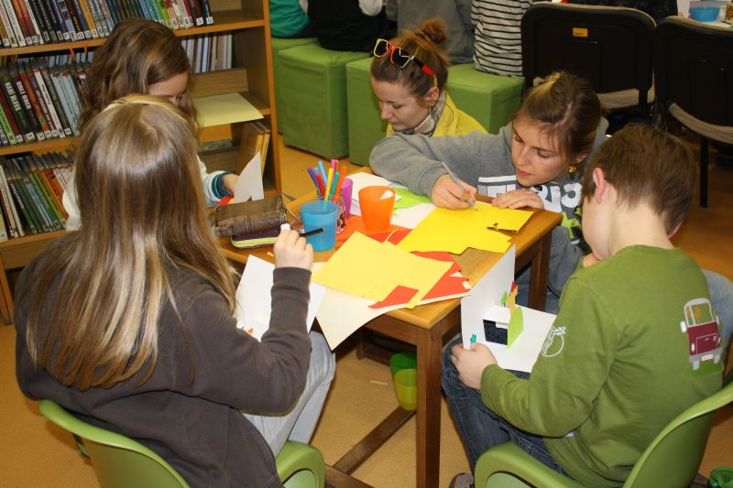
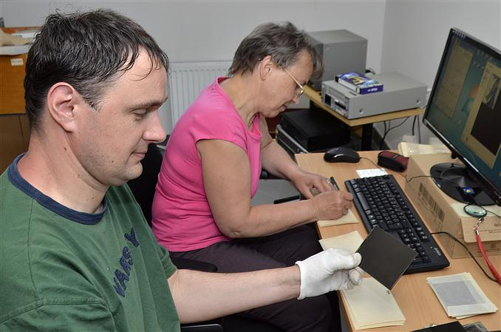
Volunteering in Culture
Museum and Library
Volunteer‘s activity:
assistance with thematic activities
digitization of photo materials
maintenance of the Reader's club for children
book service delivery for elderly and handicaped users
help with orientation and informing visitors
Statistics:
since 2011 were 48 volunteers involved (38 women, 10 men)
currently 25 active volunteers

Slide 8
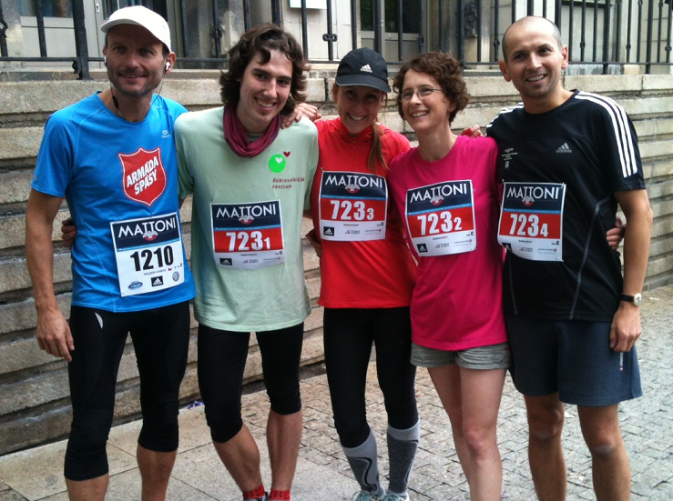
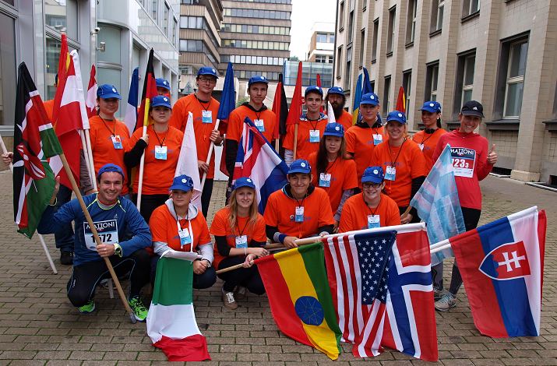
Volunteering in Sport
4 years of ½Marathon in Ústí nad Labem
(500 volunteers, 140 our volunteers)
DanceShock 2013: Street Dance Show World Championship Disco Dance World Cup (60 helping volunteers)
local small sport activities…

Slide 9
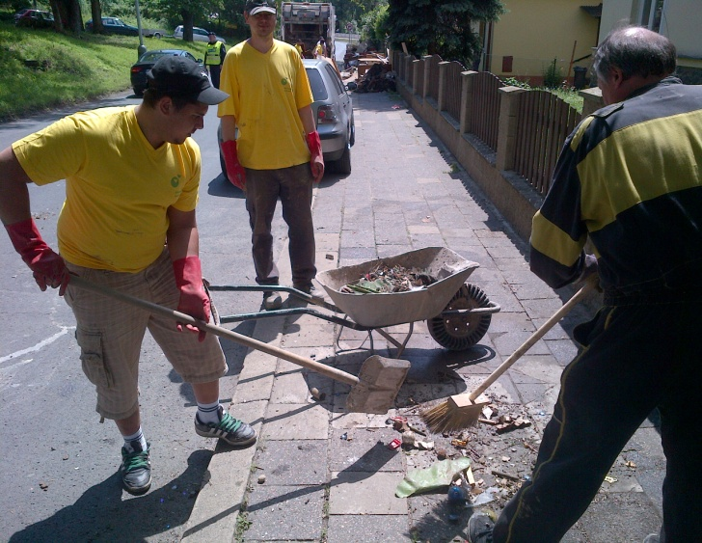
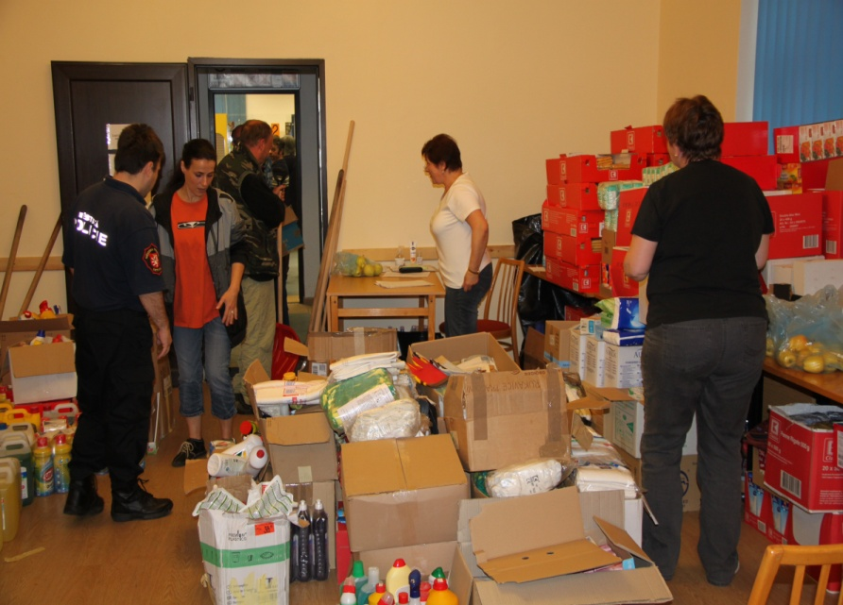
Volunteering in Emergency Situations
PANEL of humanitarian organizations since 2007
Floods 2006, 2009, 2013
What volunteers do?
clean up the damages
support in evacuation centers
provides psychosocial support

Slide 10
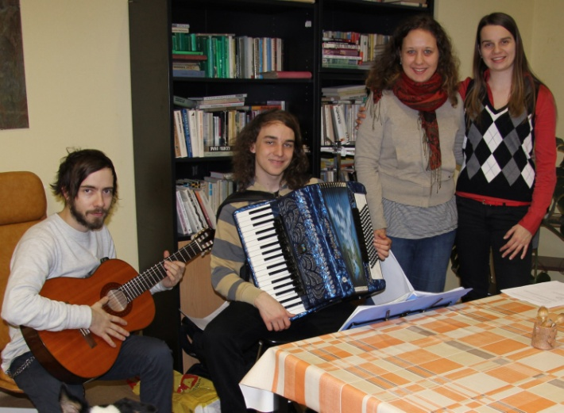
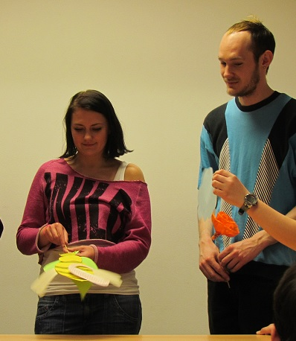
European Voluntary Service
since 1. 1. 2014 part of ERASMUS +
allows people under age 30 to participate in volunteer projects lasting from 2 to 12 months in the EU and in the partner countries
the goal is to develop solidarity and tolerance among young people
Statistics
Since 2007 we have hosted:
3 volunteers from Poland
1 volunteer from Georgia
2 volunteers from Germany
Since 2011 we have sent:
3 volunteers to Germany
1 volunteer to France, Poland and Slovenia
1 volunteer to Austria

Slide 11
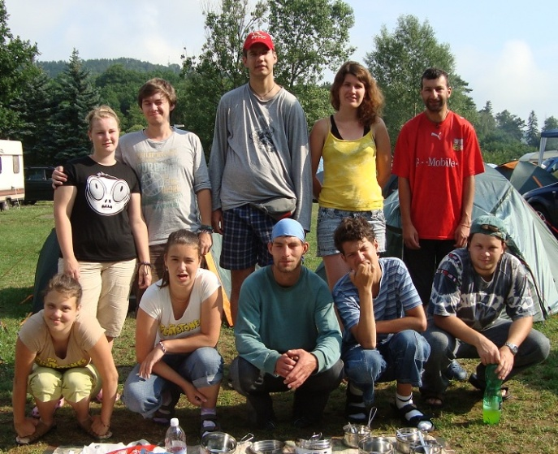
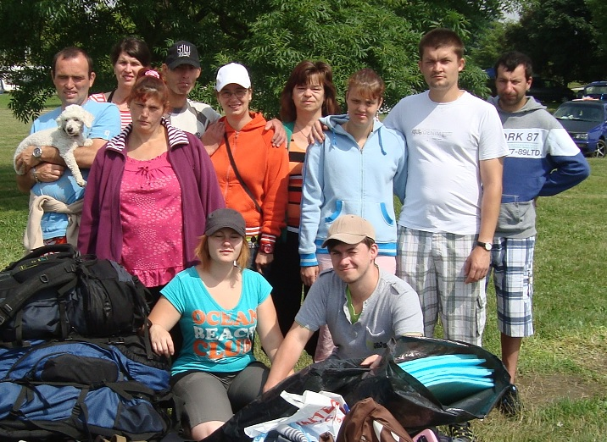
Sending Volunteers into Partner Organizations
Volunteer center sends volunteers into 18 partner organizations in Ústí region
Partner organizations:
Retirement home (5x)
Handicaped people (9x)
Center for families and children (6x)
Every year 140 volunteers

Slide 12
Our other activities …
Tinderbox (award for volunteers)
Course Strong parents - strong children®
Tourist Group - Puštíci
Trainings and courses for volunteers
Program Three Generations (3G)
Volunteer Centers‘ Council, North West
Cross-border cooperation
Cooperation with University Support Center UJEP
Active cooperation with Labour Office of the Czech Republic

Slide 13
Analysis of the status of volunteers for 2013
EXPERIENCES WITH VOLUNTEERING
YES | NO
25 | 64
NUMBER OF VOLUNTEERS
men | 23
women | 66
Total | 89
HOW TO FOUND OUT ABOUT THE VOLUNTEER CENTRE
FRIENDS | 42
IN SCHOOL, UNIVERSITY | 1
LABOUR OFFICE, SOCIAL DEPARTMENT | 1
INTERNET | 19
OTHER | 23

Slide 14
Analysis of the status of volunteers for 2013
YEARS OF BIRTH
OLDEST | 1943
YOUNGEST | 1999
1940-1949 | 2
1950-1959 | 4
1960-1969 | 6
1970-1979 | 15
1980-1989 | 17
1990-1999 | 45
SPHERE OF INTEREST
SENIORS | 32
PEOPLE WITH DISABILITIES | 19
CHILDREN, YOUNG PEOPLE | 43
CULTURE-MUSEUM AND LIBRARY | 34
HOSPITAL | 39
PEOPLE WITH MENTAL ILLNESS | 13
CRISIS SITUATION (FLOODS ETC.) | 24
OTHER | 7

Slide 15
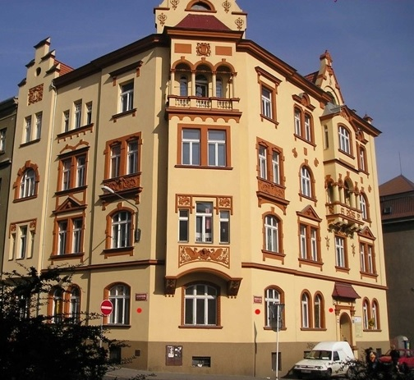
Contacts & where we are
address
Dobrovolnické centrum, o.s.
Prokopa Diviše 1605/05
400 01 Ústí nad Labem
The Czech Republic, Europe
phone & fax: +420 475 216 684
e-mail: dcul@seznam.cz
dcul@dcul.cz
contact:
Mgr. Lenka Černá - director
phone: +420 606 512 905
e-mail: lenka@dcul.cz
www.dcul.cz
facebook: Dobrovolnické Centrum
twitter: DobrovolnickéCentrum (@DCUsti)

Slide 16

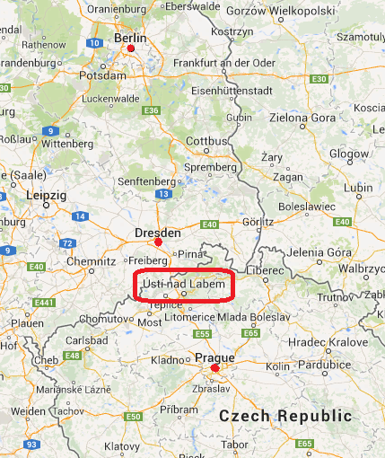

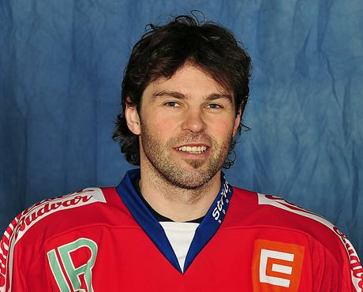
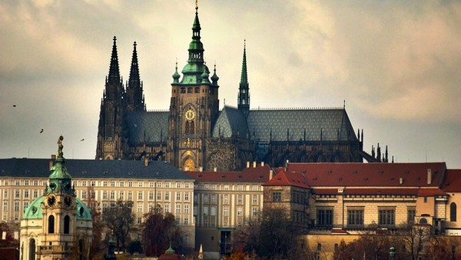

Slide 17

Thank you for your attention.
Have a nice day.
Mgr. Martina Vlková

