Slide 1
Youth Policy and Youth Volunteering in the Czech Republic
Ministry of Education, Youth and Sports
Karmelitská 7, 118 12 Praha 1 • tel.: +420 234 811 111
msmt@msmt.cz • www.msmt.cz

Slide 2
History of volunteering
Long tradition
Totalitarian communist regime (1948-1989) devalued volunteerism and turned voluntary work into obligatory socialistic collectivism
After the 1989, the democratic structure was fully restored and the massive development of independent associations from the area of ecology, human rights, humanitarian help, sport, youth work, social benefits, etc. appeared. Although the public is skeptical sometimes towards voluntary activity still, in the last twenty years we can trace positive tendencies that move the Czech volunteering towards European average also in this field.

Slide 3
CZ Youth Report 2013
Main findings:
22% of young people (15 – 30 year-old) were involved in an organised voluntary activity during last year and 23 % of them were formally rewarded for it
Only 1,5 % were abroad as volunteers
In comparison with other age categories young people tend to be involved in less regular, less active and short term voluntary activities
Main field of volunteering:
Sport
Youth work
Voluntary fire brigades

Slide 4
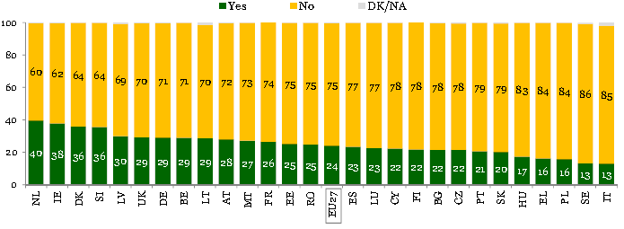
Youth Volunteering
Percentage of young people involved in organised volunteering
Source: Flash Eurobarometer YOUTH ON THE MOVE 2011

Slide 5
European Year of Volunteering 2011
Youth Department in charge of EYV activities
Goals of EYV:
To improve the conditions for volunteering
To increase the quality of volunteering
To acknowledge and to recognize voluntary activities
To enhance the awareness about the value and significance of volunteering

Slide 6
European Year of Volunteering 2011
Results
Web page www.volunteer.cz with a database of volunteering activities http://databaze.dobrovolnik.cz/
Law on volunteering service – since 2002, amendment 2013
Volunteering service
Sending org.
Hosting org.
Volunteer

Slide 7
Youth Policy Strategy 2014 - 2020
Strategic goal (1 out of 13)
„To create favourable conditions for volunteering of youth including the acknowledgement and recognition of voluntary activities“
Operational goals:
1) Support of voluntary activities
2) Enhancement of young people‘s awareness of volunteering opportunities and its benefits
3) Enhancement of quality of work with volunteers
Cross-sectoral cooperation including the Ministry of Interior

Slide 8
Thank you for your attention
Mgr. Michal Urban
Ministry of Education, Youth and Sports
Karmelitská 7, 118 12 Praha 1 • tel.: +420 234 811 134
Michal.Urban@msmt.cz • www.msmt.cz/mladez

