Slide 1
REPUBLIC OF ARMENIA Current state of play concerning your national volunteering strategies, programmes and examples of good practices in the field of volunteerism of young people 09th of September 2014 Prague, Czech Republic

Slide 2
Has been developed two drafts: 1 . In 2004 – Professionals for civil society NGO 2. In 2010 – Ministry of labor and social affairs
legal frameworks
No special low about volunteering
Reasons of postponing:
1. The contract based volunteering can restrict the process of organization of volunteering work,
2. There is no mechanisms to differentiate the volunteering and illegal works.

Slide 3
In December 2005 Republic of Armenia
ratified the European Convention on the Promotion of a Transnational Long-Term Voluntary Service for Young People,
which is assumed the obligation to promote and encourage volunteerism in Armenia.

Slide 4
In RA to encourage the work of volunteer activities President award the following titles. 1) Honorary volunteer of Republic of Armenia. 2) Year volunteer of Republic of Armenia.
Law of Charity
2002, RA
But the representatives of civil society do not consider this enough for promoting and encouraging volunteerism in Armenia.

Slide 5
Voluntary work is counted as a part of NGO’s contribution in program budget.
msy assistance to youth volunteerism
On-line grant system to youth NGO

Slide 6
Volunteerism in ra and int. cooperation
EVS in some numbers
 | Armenia | Azerbaijan | Georgia | Belarus | Moldova | Ukraine
waiting for accreditation | 0 | 0 | 0 | 0 | 0 | 0
in process of accreditation | 0 | 0 | 0 | 0 | 0 | 0
reaccredited | 4 | 2 | 7 | 1 | 6 | 9
negatively accredited | 13 | 2 | 8 | 1 | 13 | 6
positively accredited | 45 | 13 | 47 | 13 | 40 | 54

Slide 7
In results
The voluntarism is a fact in RA and largely is non formal.
The main directions of volunteer activities are:
corporate administration,
supporting to vulnerable groups,
community Development,
education,
protection of environment and cultural values.

Slide 8
Youth Bank Youth Cooperation Center of Dilijan www.yccd.am
Good practices
GLOW Girls Leadership and Empowerment Project 2014
Stepanavan Youth Center
www.stepyouthcenter.org

Slide 9
Youth Bank is a youth-led grant-making programme within a host organization, which channels money into projects that will improve the quality of life of local communities. The program is based on a model developed in Northern Ireland to help youth overcome conflict and poverty.
What is Youth Bank?

Slide 10
Youth Bank in Armenia
80 young people involved as member currently.
Since 2007, during the four grant-making cycles, YB committees have funded over 140 small-scale grant projects
More than three thousand young people volunteered to participated in these projects.

Slide 11
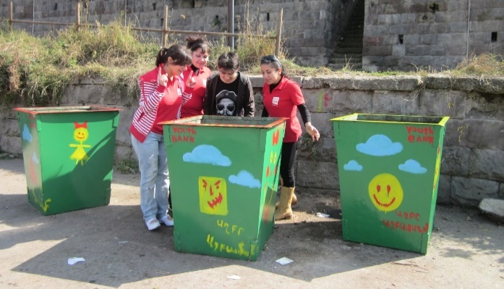
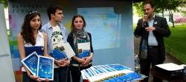
YB in Armenia- projects with YCCD NGO
Environmental Project-
“Happy trash bins” in Dilijan
“Hello Europe” Publication,
Youth-led grant competition
promoting European Youth Values

Slide 12
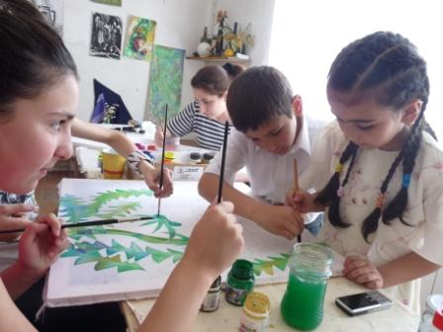
YB in Armenia- projects with YCCD NGO
Dilijan Art College pupils
doing handcrafting for charity
Cross-border projects between
Armenian and Turkish YBs

Slide 13
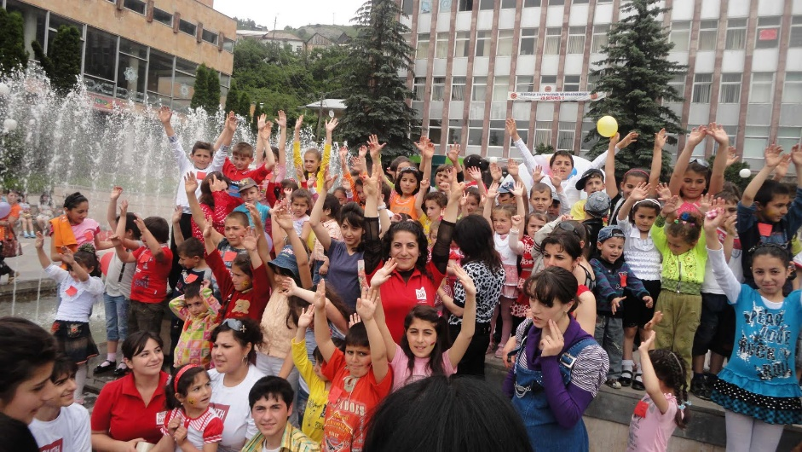
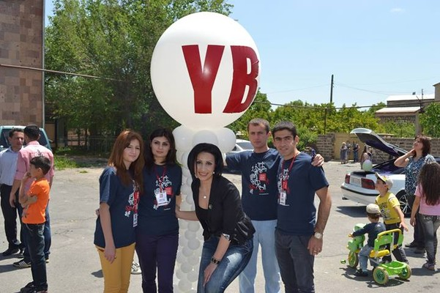
www.youthbankinternational.org

Slide 14
GLOW History Camp G.L.O.W. started in 1995 in Romania by Peace Corps Volunteers and local teachers to encourage young women “to become active citizens by building their self-esteem”.
Girls
Leading
Our
World

Slide 15
GLOW Summer school in Armenia 2008-2014 We are already 7 years old 44-66 participant each year

Slide 16
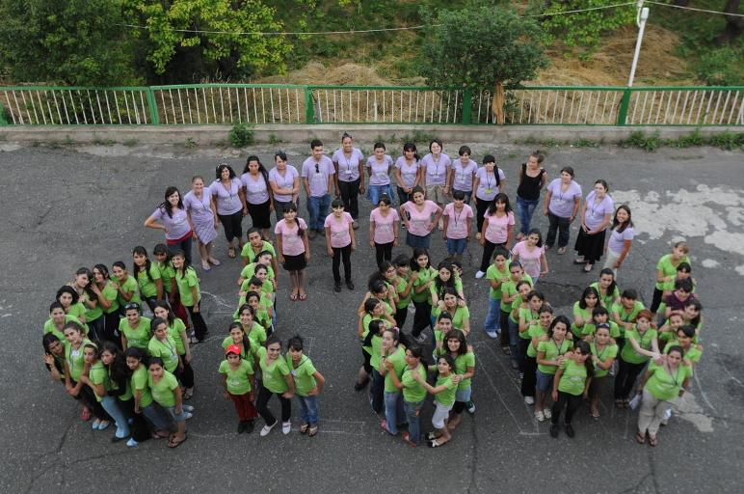

Slide 17
Main goals:
Enabling camp participants to build their leadership skills and self-esteem through group activities and interactive methods
Developing skills, attitudes and knowledge on various topics important for teenage girls (health, gender, career planning, leadership, volunteering, team work, etc.)
Educating girls about positive options for their future
Creating a network between the camp participants, and counselors.

Slide 18
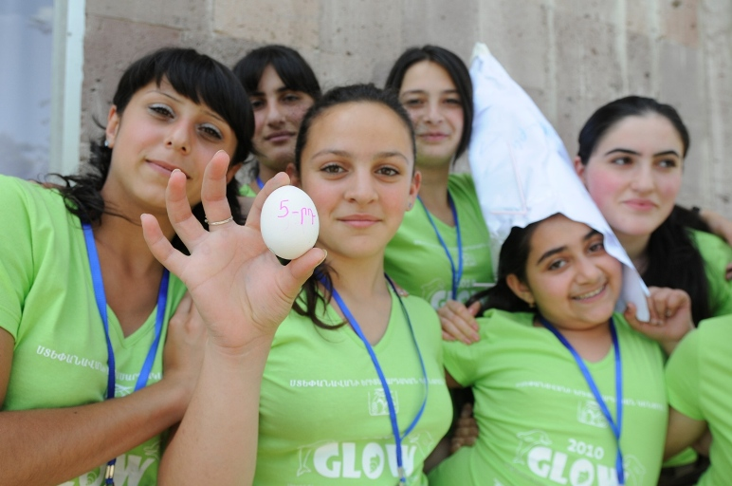
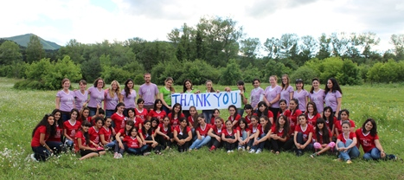
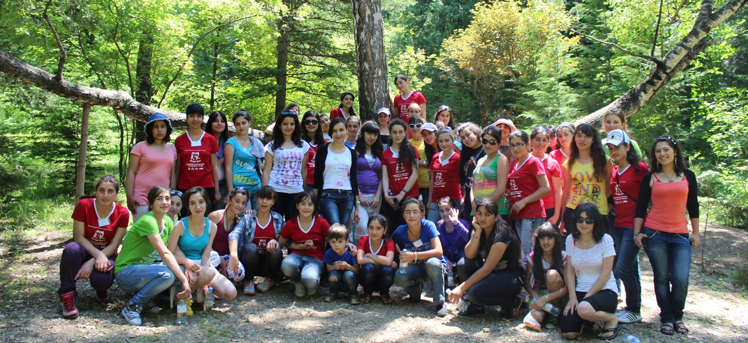
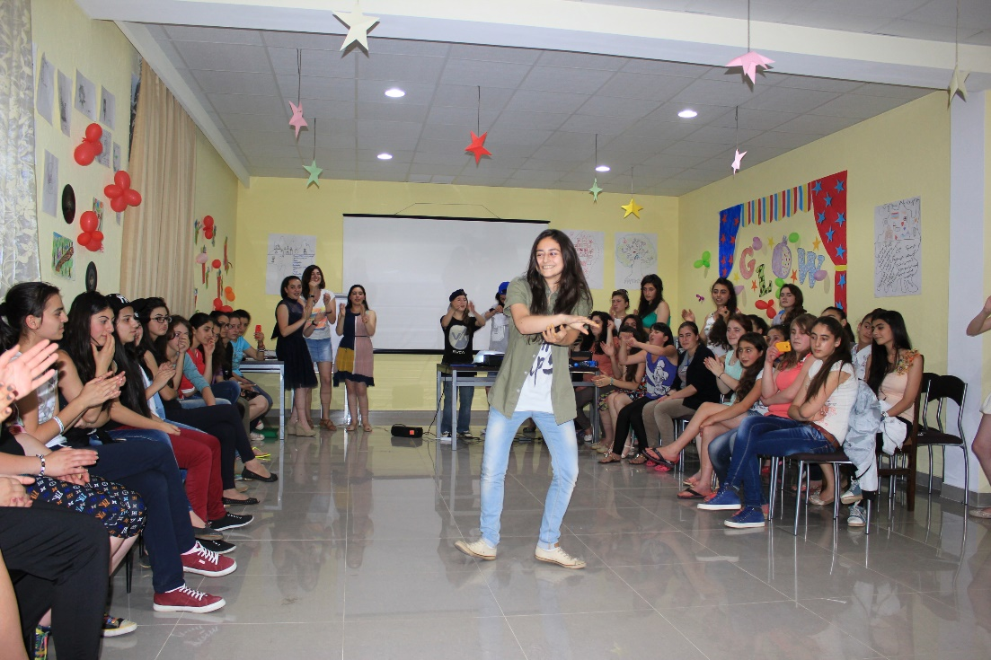

Slide 19
GLOW values
Honesty
Trust
Equality
Responsibility
Kindness
Respect for oneself and others
Advancement

Slide 20
Elements of GLOW project
Summer school (7-8 days in July)
Follow up activities (August-April)
GLOW Newspapers and blog
Peer education activities
Small community actions
Small grants program
Regional seminars
Essay Contest
Junior counselors
Etc.

Slide 21
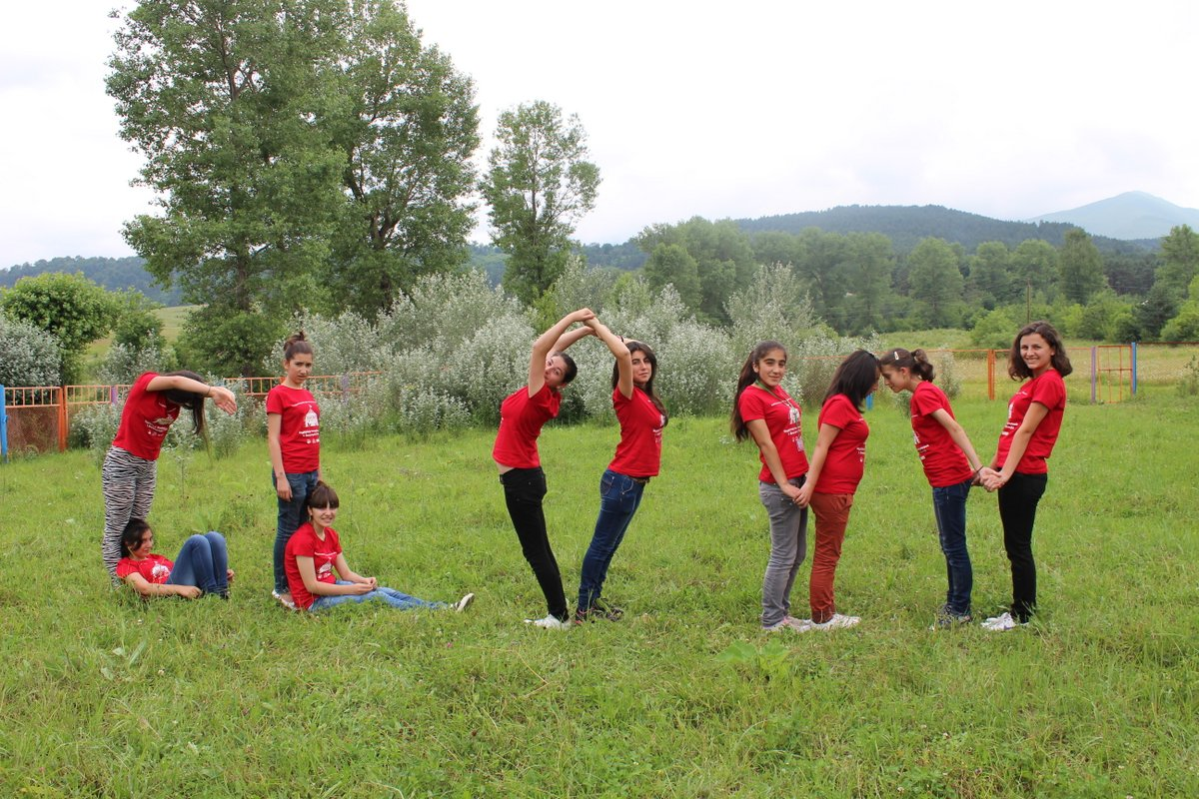

Slide 22
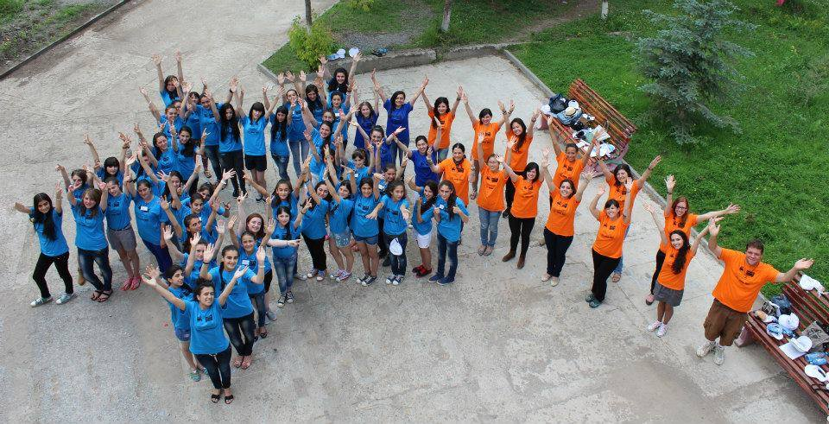
GLOW 2014

Slide 23
