Slide 1
Whispers of discontent behind the shouts of joy, and the increasing precariousness of lots and lots of young people
Dr Daniel Briggs
Professor of Criminology
Universidad Europea (Madrid, Spain)
Daniel.briggs@uem.es

Slide 2
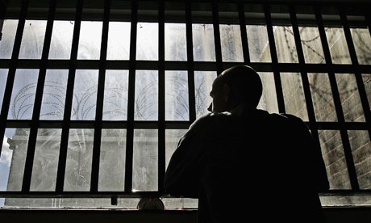
Excluded from school, involved in gangs, failed by youth services and now in prison
“It was kind of boring [the Youth Offending Team] but it was alright. They were supposed to keep my focus but I don’t really see how. It was more of a ting of keeping man in order. Whatever they told me, I already knew. They need to go past that. They don’t needed to ask me why am I doing this shit.”

Slide 3
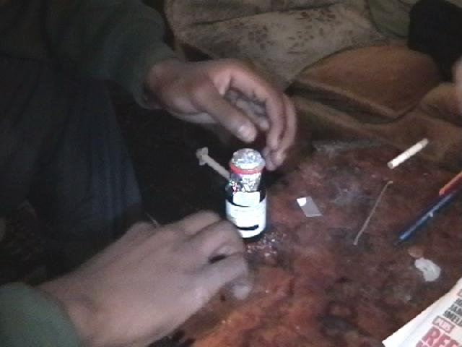
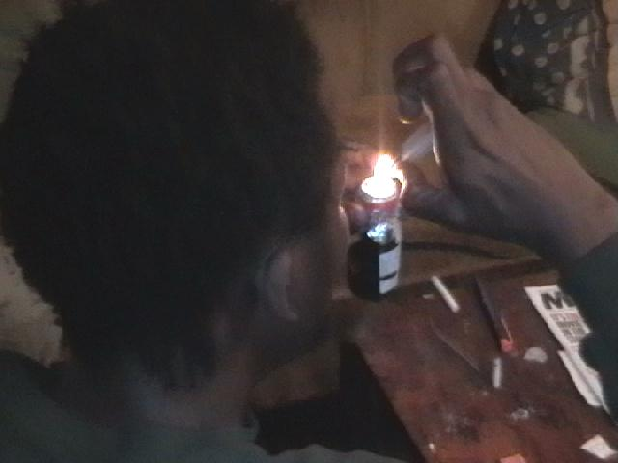
18, homeless and smoking crack cocaine
We [Blood and I] had to climb a wall near an old train bridge under some barbed wire and then almost jump down into what I think used to be a garage. It was slippery because it had been raining. I nearly fell by slipping on the bricks and wood. In the yard there were old tyres. There were flies buzzing around, and a strong smell of piss and shit. As we walked over the broken bricks and wood into the downstairs room, I saw a mattress in the corner and loads of fag butts on the floor. We went upstairs, or tried to, as there were stairs missing and you had to almost jump up. We pulled ourselves up with the help of a rope. Blood warned me to watch where I stood as there were needles and syringes everywhere. [Field notes]

Slide 4
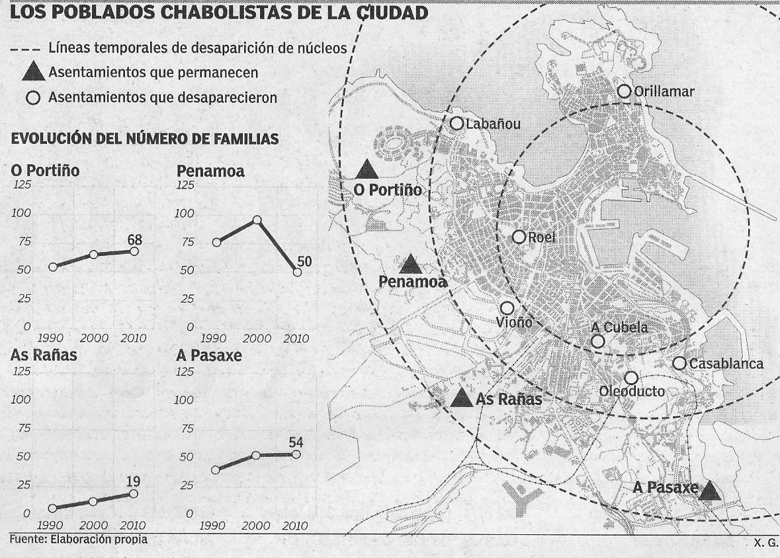
Gypsy communities in search of legitimacy and rights…

Slide 5
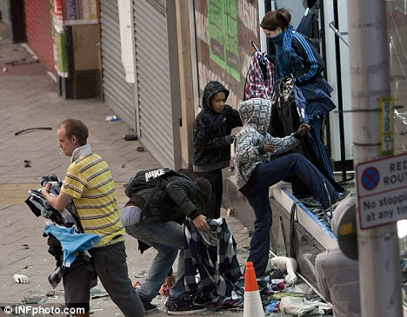
‘Protesting’ against the UK government…
Paul: We was getting BB messages about the next destination, who has got this, if you want it, we can get it. There was like loads of adverts. I was with my mates and we was all getting similar messages of people getting stuff: ‘This is what we have got’, ‘these are the goods if you are interested’; bags, trainers was a big one, paintings, computer things, games, clothes, anything really designer.

Slide 6
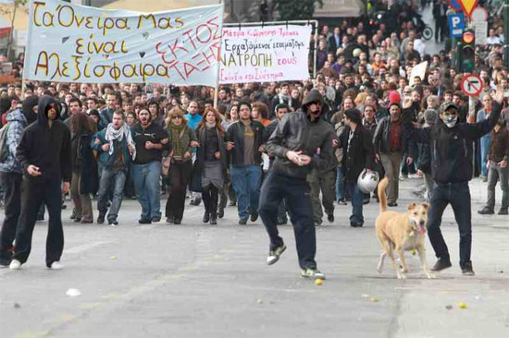
And in Athens…
Meanwhile, on the other side of the square, near to the Constitution building, the crowds made explosive surges towards the police who stood defensively, fending off the protestors with large swipes of their batons. The banners bobbed up and down between the many Greek national flags which were being waved by the protestors. Drums were beating and new chants emerged…Then, to my left, I saw more police with batons and riot uniform engage in another attempt to enter into the lower half of the square the parallel road. They walked like a human wall, ten wide and 15 or 20 so long, single file behind each other. The crowd threw stones, bricks, whatever they could find at them while the stray dogs aimlessly jogged around, somehow keeping out of the line of fire. There seemed to be no clear pattern to the rioters’ attacks; only that they were in response to the tear gas. Even then, most protestors were ready, either having their own homemade face protection or gas masks. [Field notes]

Slide 7
Then its home to the television
Alberto: When politics disappears, as it has, people lose interest. They are in limbo, they are left with their thoughts, with rubbish television or Madrid Vs Barcelona. Here [in Spain] the political system doesn’t work.

Slide 8
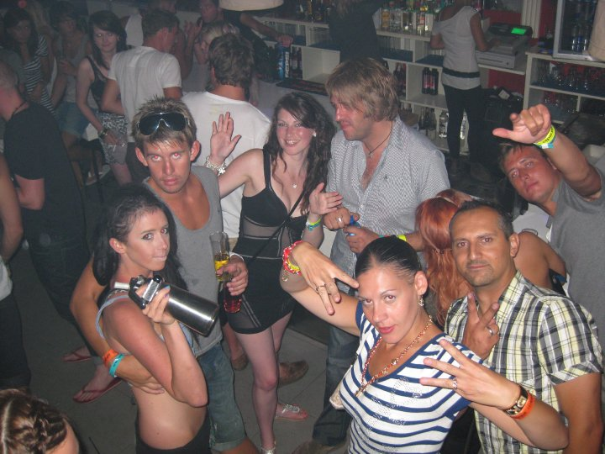
Or a holiday…
Will: We don’t want everyone to know about like the petty stuff like them licking each others’ balls and that.
Dan: Petty stuff like licking balls?
Will: Yeah, the guy that pisses himself, Stevie, he licked his [Bob’s] ball bag in one bar on West End [everyone bursts out with laughter]
Marcus: Licked his scrotum and then sucked it under his foreskin.
[They all laugh]
On research duty

Slide 9
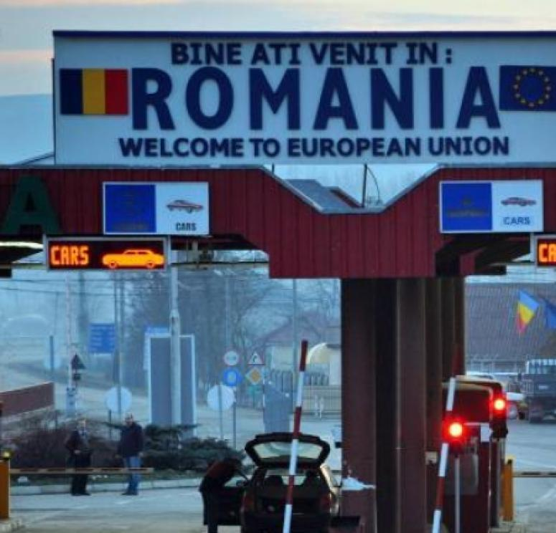
Hope for the future?
Marian: The [Romanian] government is shit. The politicians, the government, they do nothing for Romanian people. They only want money for them. I used to like daily life in Romania, the country and everything but ‘what can I do?’ [about job prospects]. In Spain and Italy, the economy is dead. Zero. They have a lot of debts. The Spanish and Italian people, they come here to England to work.

Slide 10
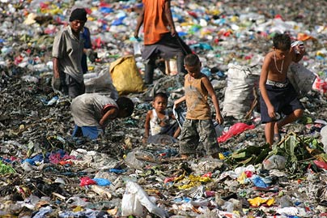
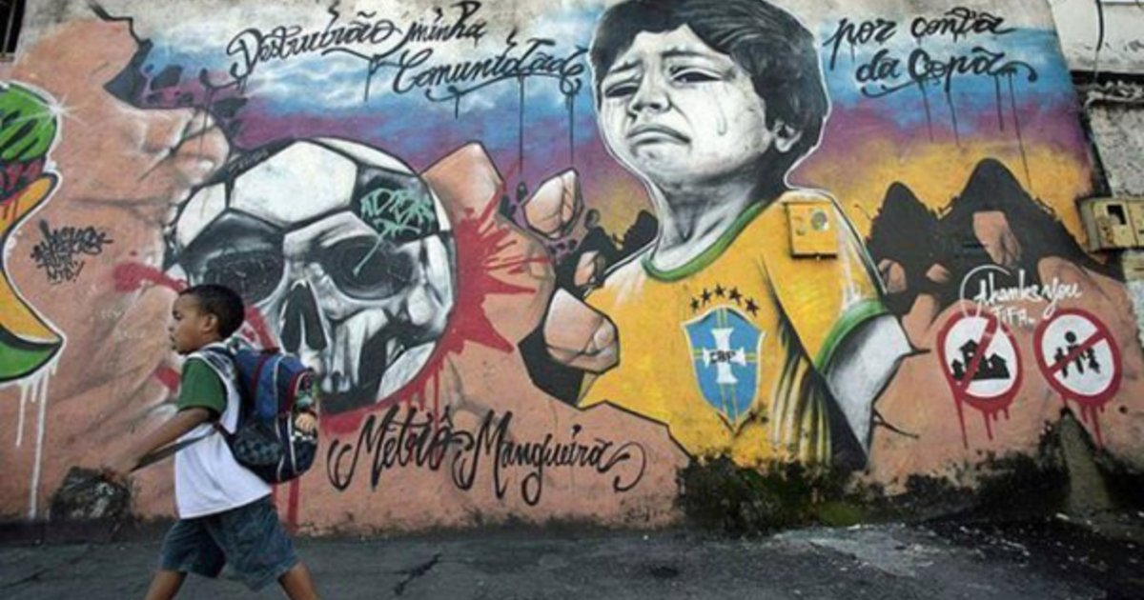
Main barriers vulnerable young people face
Most vulnerable
Borderline vulnerable
Middle bracket

Slide 11
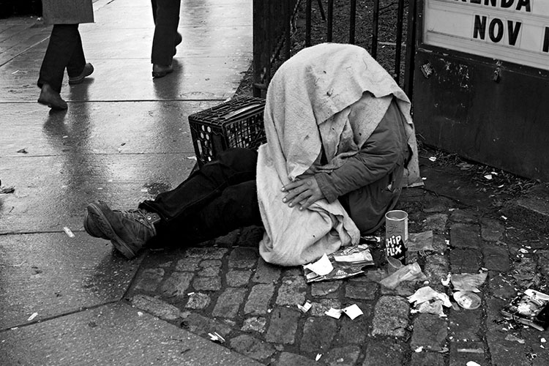
1. Most vulnerable
Not coming to the attention of services until its too late, receiving less support, increasingly exposed to a sharper experience of poverty and social exclusion in a meritocratic society where they are expected to exercise their own capacity to escape their own destitution;
Uunable to enable change because they are politically disenfranchised.

Slide 12
2. Borderline vulnerable
A growing precariat (Standing, 2011), increasingly exluded not only from the labour market but also from social welfare support and housing;
Mostly unable to make a collective response for change because they are politically disoriented.

Slide 13
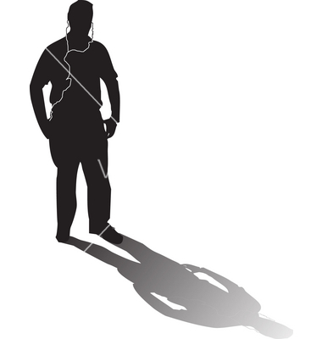
3. Middle bracket
A generation of young people losing political gumption and subservient to individual meritocracy and consumerism as ‘the being-in-the-world’; plugged into ipods concerned more about themselves and how they look;
Kept distant from politics and the real problems of the world as they are politically blinded.

Slide 14
Supporting vulnerable young people
Major shift in the global trajectory currently dedicated to free market economics – destroying domestic/local economies and increasing competition within the ‘borderline bracket’ (immigration heightens tensions);
Radical shift in ‘democratic’ political ideologies as the guiding light for fair and just societies (politics are not doing enough justice to young people or their futures);
Taking care with rhetoric which places all emphasis for gaining work on the individual and does not recognise structural constraints which impede individual decision-making - the ideology of equipping young people for the job market;
Ensuring policy affects the street-level experience of young people;
Undertake appropriate evaluations of schemes and engagement strategies;
Engaging what has been mentioned in the Mapping of Barriers for Young People in vulnerable situations.

Slide 15
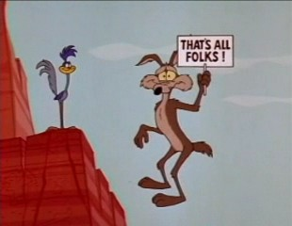
Thank you. Your questions and comments welcome. Daniel.briggs@uem.es

