Slide 1
Social inclusion of young people
Robert Anderson, Anna Ludwinek
LCQL Advisory Committee
Eurofound
September 25th, 2014

Slide 2
Social inclusion of young people
Objectives in 2013– three original components
To provide an overview of the impact and the consequences of youth long term unemployment for the individual and the society
To identify innovative support systems that provide a range of services for young people that do not focus only on formal labour market participation
To examine financial support systems available in the MSs
EQLS Policy Brief – Social situation of young people in Europe – March 2014
Youth Guarantee – ongoing

Slide 3
Social inclusion of young people
Process which ensures that those at risk of social exclusion gain the opportunities and resources necessary to participate fully in economic, social and cultural life and to enjoy a standard of living and well-being that is considered normal in the society in which they live. EC, Joint report on social inclusion, 2004
Notes:
This is how the social inclusion has been broadly defined by the European Commission back in 2004. it is a definition that has been used by stakeholders and policymakers and is also being applied to young people.

Slide 4
Youth in Europe today
The impact of the recession and its aftermath on young people has attracted significant attention in recent years
The focus has so far mainly been on labour market inclusion
Situation of young people has worsened beyond the labour market and has more broadly affected their social inclusion
Youth are the group most at risk of poverty and social exclusion Invisibility/Lack of comparable data on specific subgroups
Some indicators available on health, housing, education, participation (besides employment, NEET and AROPE)

Slide 5
Trend of relevant youth exclusion indicators

Slide 6
Young people 15-29 at risk of poverty and social exclusion

Slide 7
Perceived social exclusion of young people 2007 and 2011

Slide 8
Perceived social exclusion – what is behind it
Few young people feel excluded from the society
Many say life has become too complicated they can’t find their way
Many lack recognition and value

Slide 9
Perceived social exclusion
Young people living with

Slide 10
Diversity
One in four is at risk of poverty and social exclusion
One in five is unemployed
One in six is NEET
One in eight is an early school leaver
One in twelve lives in a severely deprived housing situation
One in twelve perceives their health as bad or very bad
Significant country variations in terms of unemployment, risk of poverty and NEETs rates

Slide 11
EU policy context
Europe 2020 flagship initiatives:
Youth on the move – … to facilitate the entry of young people to the labour market
Employment guidelines - support for young people, particularly for those not in employment, education or training (NEET), in cooperation with the social partners, including early intervention when young people exit employment (Guideline 8)
European platform against poverty – social innovation for most vulnerable (disabled)
Social Investment Package (2013)
Investment in human capital starts at very early age
Early-school living as an entry point to address broader social exclusion
Negative impact for health and well-being of long-term unemployment

Slide 12
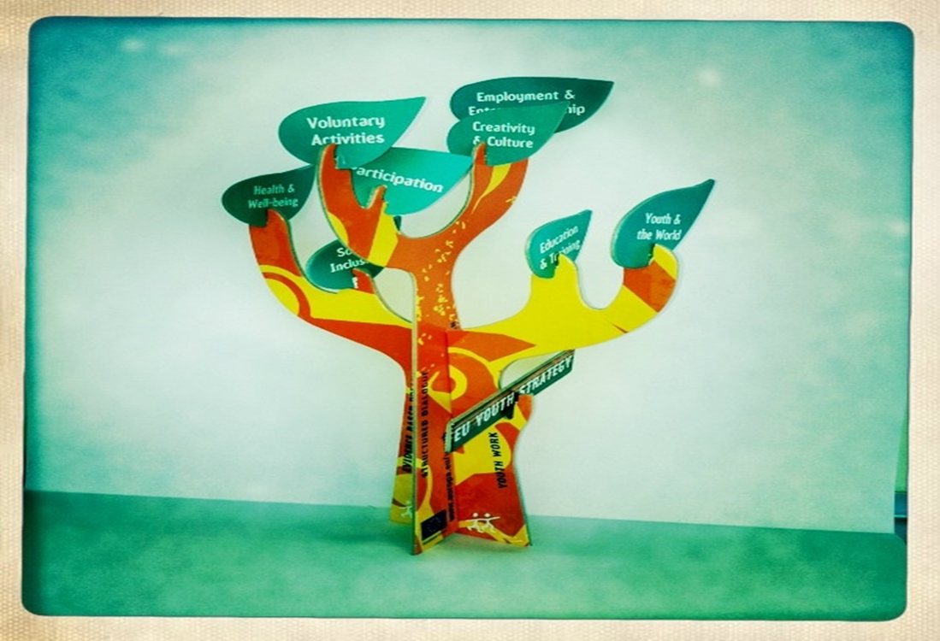
EU Youth Strategy, 2010-2018
Create more and equal
opportunities for all young
people – in education
and the labour market
Promote active citizenship,
social inclusion
and solidarity of all young
people – support for youth
work ‘to promote civic
participation, volunteering,
personal development’

Slide 13
EU Policy context
Council resolution - EU Work Plan for Youth 2014-2015 – May, 2014
youth work, non-formal/informal learning; cross-sectoral cooperation on youth; access to rights, autonomy, active citizenship
Study on youth work quality system
Cross-sectoral youth policy-making at national level - interim report on best practices and recommendations
Flash Eurobarometer 375: EU Youth: participation in democratic life + Council conclusions

Slide 14
EF research
11 EU Member States
Taking into account:
levels of social exclusion and rates of poverty
employment, education and welfare regimes
Good and bad performers included
SE, IE, FR, ES, BG, DK, UK, NL, CY, SI, LV

Slide 15
Framework
Identification
Originating in an act of pub/priv authority
Designed to be permanently available
Assessment
Social investment
Implemented
Providing tangible benefits
Representing promising practice
Youth empowerment
Effectiveness and impact
Transferability
Innovativeness
Individualising or structure-oriented
Preventative or compensatory
Governance and partnership arrangements
Tool (services, allowances, other facilitations)
Sector
Classification

Slide 16
Key features of measures for social inclusion of young people
Sectors and entry points: mentoring, counselling and social support, volunteering and civic engagement, education and housing the most widespread in our sample
limited number of sports, ICT entry points,
limited gender focus of youth policies
Tools based on human relations (information, advice, counselling, capacity building) further assisted by tools based on the provision of resources (financial assistance, facilities)
Governance - The vast majority of measures feature a private non-profit organisation as lead partner
Prevalence of measures available at national level
Notes:
Due to multidimensional nature of social inclusion a range of possible sectors or entry points were identified
Most covered at least two or three sectors. Majority of measures featured element of mentoring, counselling meaning that regardless of the origins of social exclusion providing guidance often alongside other service is important. Second most prominent was volunteering and civic engagement.
Measures can use variety of tools to address social inclusion. Most used information, guidance and advice, capacity building, few used financial assistance, or provision of facilities)

Slide 17
Key features of measures for social inclusion of young people
Preventative or compensatory, but often also a mix
Preventative – oriented towards larger populations
Compensatory nature determined by the target group
Individualizing –or structure oriented - Walther and Pohl, 2005) (or both) – moving away from the “deficit model”
Adjustment of local planning to strengthen young people’s participation in democratic life – soft infrastructure development
Unlocking barriers to social inclusion by developing of capacities and competences of adults who work with young people
Notes:
Preventative – preventing disadvantaged by addressing key background factors, compensatory – reacting to specific issues, repairing the problems
Focus on empowerment, participation
Compensatory - determined by the groups: supporting young people where risky transition already happened and is seen as defining characteristic of social exclusion, others address longstanding issues arising from status in the society (disabilities), gender, thirdly defined by mode of support (sport, legal aid)
Mix – defined geographically, target specific (bulgaria, leaving institutional care)
More individual measures than pure structure oriented, some that are a mix

Slide 18
Working typologies
Type 1: Place-based social inclusion measures, with a focus on civic participation and community development - grounded in neighbourhood, usually focus on social or environmental issues
Type 2: Personalised training and life skills programmes, with a focus on educational and social inclusion - offering disadvantaged youth pathways for successful transitions. Often with education focus
Type 3: Information, awareness-raising and advocacy measures, with the aim of tackling structural barriers to social inclusion – developing skills as peer advocates, evaluators, knowledge to tackle barriers to inclusion.
Type 4: Training and capacity building measures for professionals working with socially excluded young people
Type 5: Experimental policy or funding initiatives
Notes:
1 – grounded at local level, aim to increase participation in decision making. Run by NGO, structure oriented
2 – alternative education, time bound, involve coach, have certificate build in, health support
3 – gathering evidence to highlight the case for policy and funding reforms, service improvement
5 – helping young people with the design, implementation of new innovative projects

Slide 19
Assessment of measures
Social investment
Innovativeness
Transferability
Youth empowerment
Effectiveness and impact
Notes:
First two address specific issue with EU youth strategy, effectiveness key evaluation criteria, then social innovation and mutual learning.

Slide 20
Assessment - Social investment
Resourcing: no clear trend of public investment; financial constraints
Targeting not through traditional approaches used for welfare benefits (e.g. means testing), but other methods that are more suitable to the multidimensional nature of needs: interviews, social services referrals, groups difficult to reach
Conditionality not as regularly understood, emphasis on motivation; moral obligation and individual responsibility, social pressure
Access kept simple and relatively free from bureaucracy to ensure target groups are reached - outreach, removing barriers, digitalisation
Personalisation – personal development plan, counselling
Notes:
Social investment – vital for young people, following criteria are linked with SIP
Targeting and conditionality seen as two requirements to activate and enable people mostly in need
Targeting not focusing on benefits but on complex interventions, open approach to participation especially for groups difficult to reach

Slide 21
Assessment - Youth empowerment
Motivation and participation are critical for successful inclusion
Motivation – individualisation of transitions, right terms, supportive environment, measurable progress to end goal
Role of trusted intermediaries/change agents/peer advocates
Sometimes attitudes within official institutions and amongst the wider community including employers a barrier
Dedicated space for young people - as a motivational feature
Few measures completely youth-led, but a collaborative or consultative approach in implementation in most of them
Notes:
Measures were assessed against approach to empower young people, motivation and participation were used.
Motivation – often young people lack trust in adults, institutions stemming from previous negative experiences these must be overcome to successfully motivate young people to enagge..

Slide 22
Assessment - Effectiveness and impact
Outcomes and impacts
Monitoring in most measures
Different types of outputs
High levels of satisfaction confidence and self-esteem
Physical and mental health outcomes, life skills
Educational re-engagement (some employment outcomes)
Improved public and professional attitudes towards young people; public authorities & employers, community
Constraining factors
‘crisis’ often required to trigger reform
Risk of substituting employment outcomes – is structural reform sometimes being avoided?
Challenges for achieving and sustaining young people’s participation at scale
Shortfall in evidence required to validate outcomes
Notes:
Effectiveness and impact as a traditional evaluation criteria.
Participation data the most common looking at starters and completers.
Outputs number of young people trained, new training materials, new projects, new youth led initiatives, as assessments, progress reviews, testimonials less popular
Well-being linked with tackling social isolation, loneliness, repairing relations with peers or family

Slide 23
Assessment - Innovativeness
A number of provisions have developed new approaches and methods to address existing needs and new partnership and funding arrangements are visible
Only a small number of measures have identified and addressed new social needs – challenging economic environment.
New collaborations and new funding schemes
Measures that seem innovative in one national context not always hold up when put to transnational comparison.
Notes:
Innovativeness also highlighted in SIP, it talks about the ned of social policy to adapt to new challenges.
New approaches –particularly in the field of youth counselling
Collaboration – includes non traditional services, legal, civil, military

Slide 24
Assessment - Transferability
Conditions for transferability
Financial stability
Active participation in design and implementation
Challenging public attitudes
Policy and regulatory compliance
Notes:
Transferability important for mutual learning.
Challenging 3 elements taken into account. Transferability ofmeasure, methodology or trying to distil conditions for transferability
Policy and regulatory compliance – to what extent structural requirements are factored in example of education related programmes

Slide 25
Examples of good practices
Network Young Streets - Slovenia
Neighbourhood based, empowering young people to tackle social problems, street-based approach, development of social networks
Prince Trust Team Programme - UK
Twelve week personal development course for young unemployed. Work experience, community projects to improve confidence, leadership, communication
Power is with you – Bulgaria
Equipping young people employed in social services with special psychosocial knowledge for counselling and supporting disadvantaged youth
Cyberhouse – Denmark
Service providing online counselling
Second Chance Schools - France
Education provision, using innovative teaching methods, social and employability skills development for drop outs
Paja – Netherlands
Participatory audit service (bottom-up) through young homeless people that are in frequent contact with different services

Slide 26
Policy pointers
More attention needed at EU level towards social exclusion of young people, beyond the ‘unemployment’ issue
Promising practice developments do exist and warrant more support in terms of public investment
Need for more systematic evaluation of practices, in terms of their long-term effects on young people’s life chances
Personalisation, focus on motivation, and addressing multi-dimensionality of needs are key features with potential for wider application (including within the field of employment…)
Resistance of adults to the participation of young people needs to be addressed
Need to make initiatives more inclusive, and avoid reproducing under-representation of disadvantaged groups

Slide 27
Next steps
Discussion on the consolidated report encompassing all parts of the project
SPC thematic report on youth exclusion – EF contribution
New European Commission – composition/portfolios

Slide 28
Thank you
rma@eurofound.europa.eu
alu@eurofound.europa.eu

