Slide 1
Conference on the role of youth work in supporting young people in vulnerable situations Malta, 25 – 28 November 2014
maria pisani

Slide 2
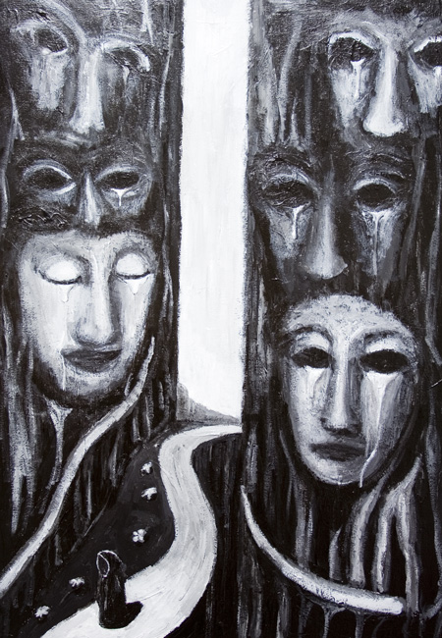
Vulnerable youth in Malta?

Slide 3
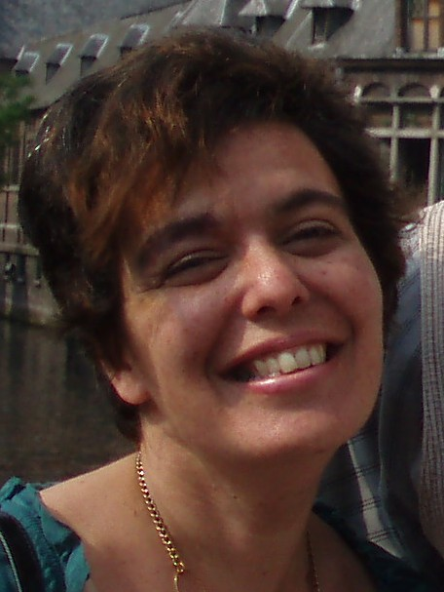
Mar, you’ve got ten minutes!

Slide 5
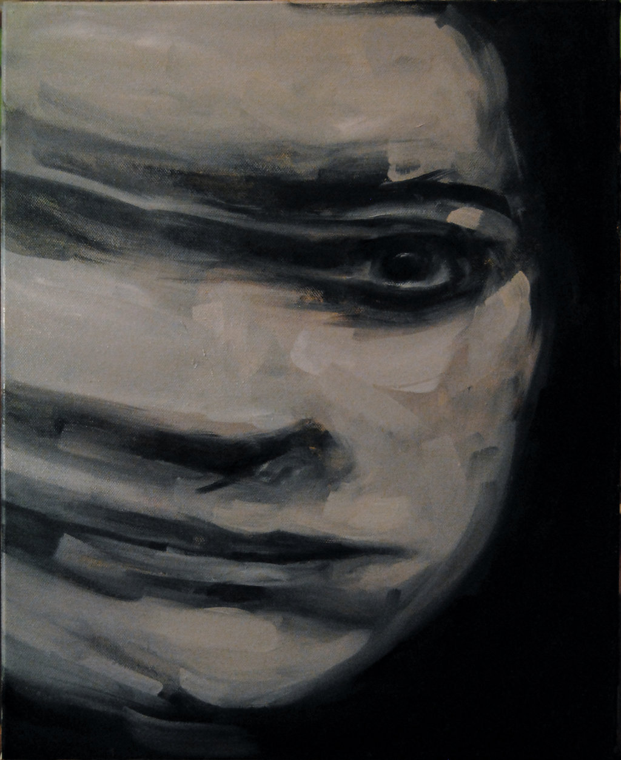
humanize

Slide 6
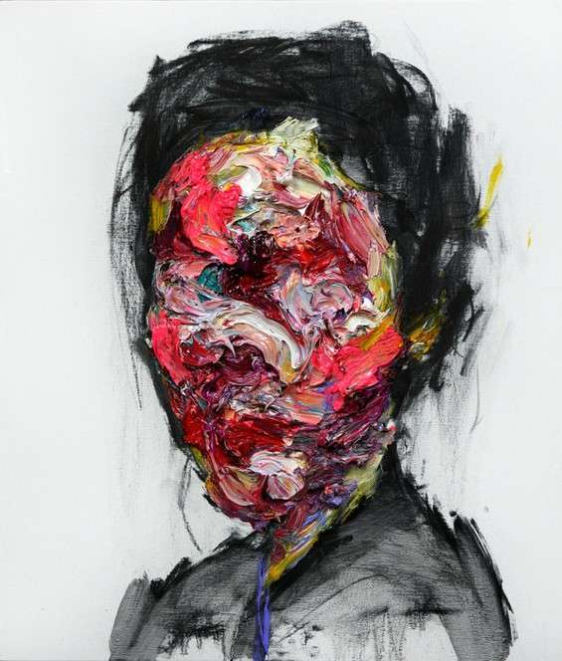
Where is their voice?

Slide 7
Any discussion on vulnerable youth and youth work must engage in issues related to social justice
Unapologetically political

Slide 8
power

Slide 9
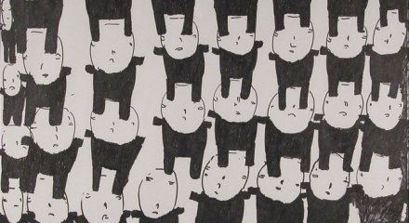
agency and structure
perceptions
relationships
access to resources

Slide 10
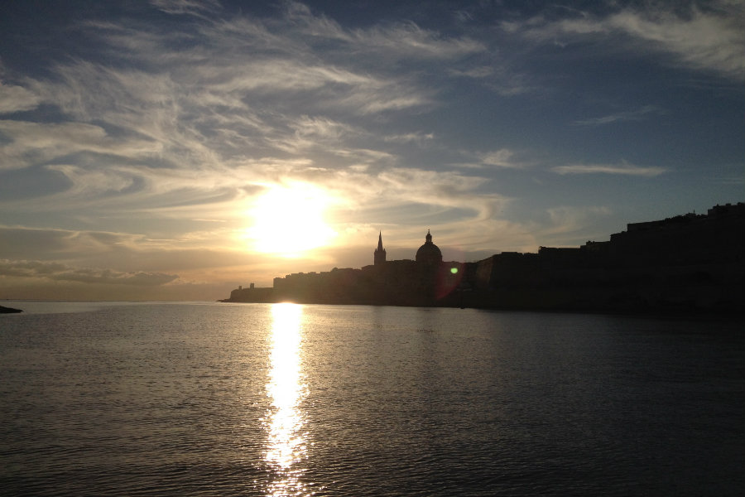

Slide 11
The ‘at risk of poverty or social exclusion rate’ (ARPE) for young people experienced an increase from 12.5% in 2006 to 19.6% in 2012, whereas severe material deprivation rose from 4.3% to 9%.

Slide 12
Life on a rock…
risk of poverty or social exclusion rate tends to be higher among certain social groups, the risk also tends to be disproportionately distributed across different geographical areas

Slide 13
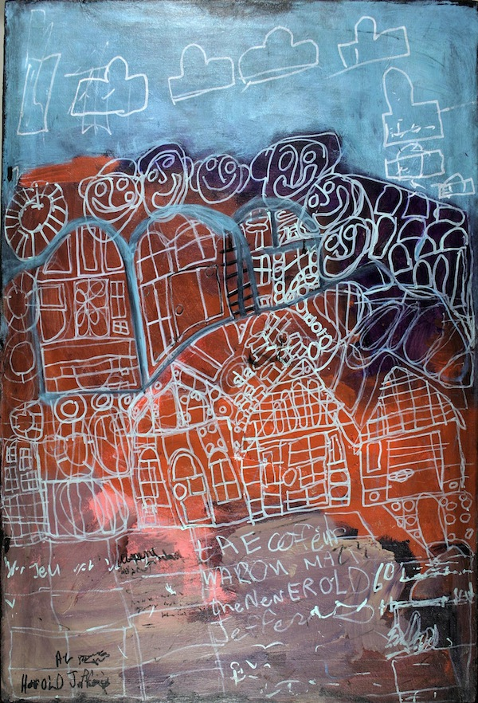
22,801 children live at risk of poverty or social exclusion.
13,000 live in households with an annual income of €6,500. 3,000 live in households with an annual income of €8,800.

Slide 14
12% of students who are at risk of poverty and social exclusion attain an upper secondary and post-secondary tertiary education 27% of students who are at risk of poverty and social exclusion, attain only a primary education digital literacy??

Slide 15
the proportion of young disabled people (aged 18-24) leaving school early in Malta was 48.9%, compared to 30.1% for non-disabled people (ANED, 2009)

Slide 16
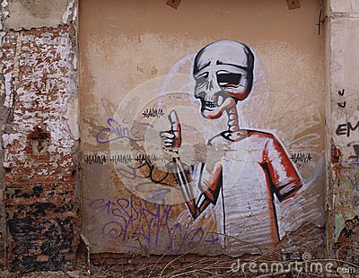
Youth Unemployment Rate in Malta averaged 14.97 Percent from 2000 until 2014

Slide 17
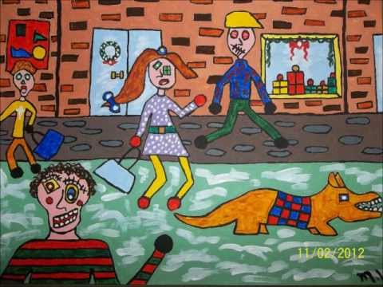
Poverty
Exploitation
Making work ‘pay’

Slide 18
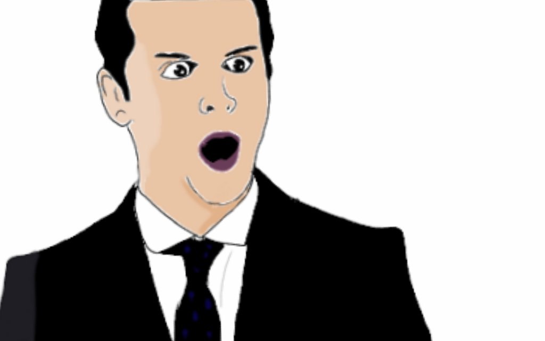
While teenage pregnancies went down to 21% in 2010 from 24% in 2008, in 2010 a total of 624 women of all ages gave birth outside marriage
156 of these - nothing short of 25% of these children - were born to so-called 'unknown fathers‘
Moral panic
Poverty
Social exclusion

Slide 19
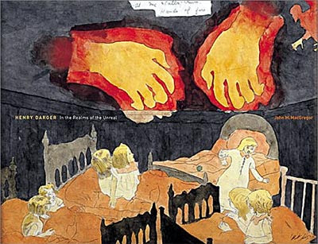
Young people in care
There are over 430 children in out-of-home care, excluding children of asylum seekers
transitions

Slide 20
Young People in Care
Crisis management
Reactive measures
Punishment culture
Call for a new philosophy of care
(National Commission for Child Policy & Strategy, 2014)

Slide 21
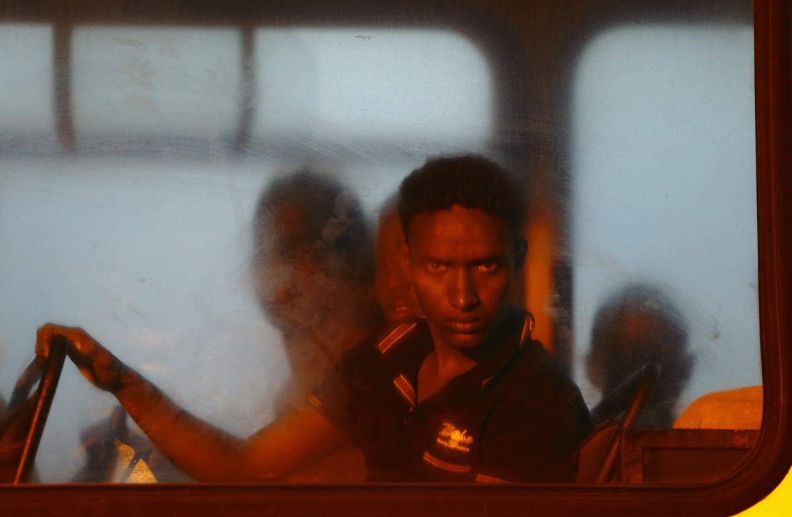
Illegal bodies

Slide 22
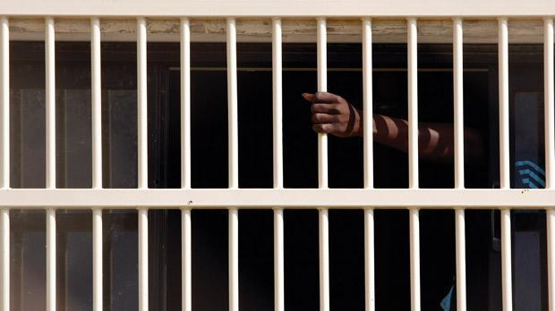
Majority of migrants in Malta from the EU
Asylum seekers – war and conflict
Young people
25% under the age of 18

Slide 23
Detention up to 18 months
Social exclusion and poverty
Racialized discourse
Racism
Right to rights?
Citizenship Assumption

Slide 24
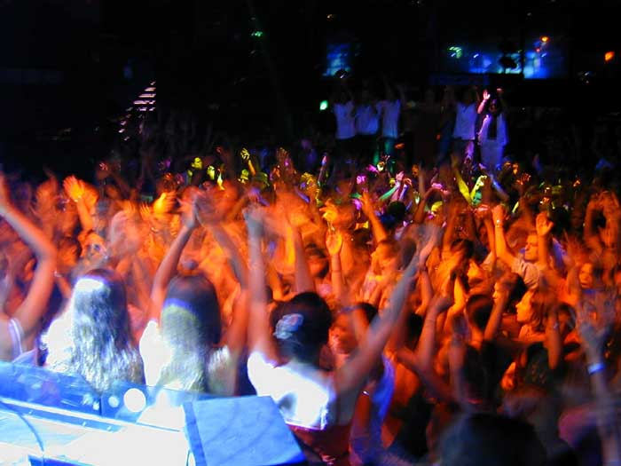

Slide 25
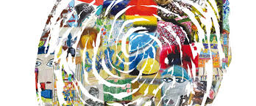
Age
Gender
Social class
Locality
Ability
LGBTI
Race/Ethnicity
Legal status
Others?

Slide 26
Can the young person speak?
Will the young person be heard?
Transformation?
Youth Work?

Slide 27
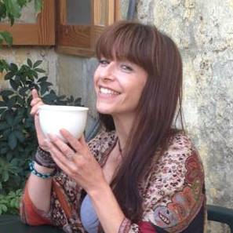
Mir, over to you …

Slide 28
thank you

