Slide 1
THE ARMY CADET FORCE

Slide 2
AIM
TO PROVOKE!

Slide 3
OBJECTIVES
To provide an overview of who and what we are.
Give an insight into how we benefit young people.
To show our relevance to the issues being addressed by this conference.

Slide 4
QUESTION?
What do you think a military youth organisation looks like?

Slide 5
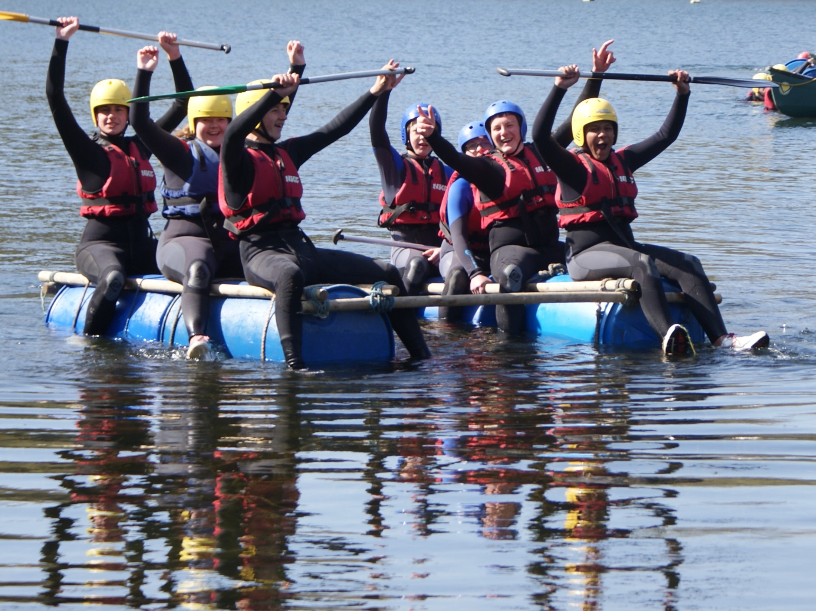

Slide 6
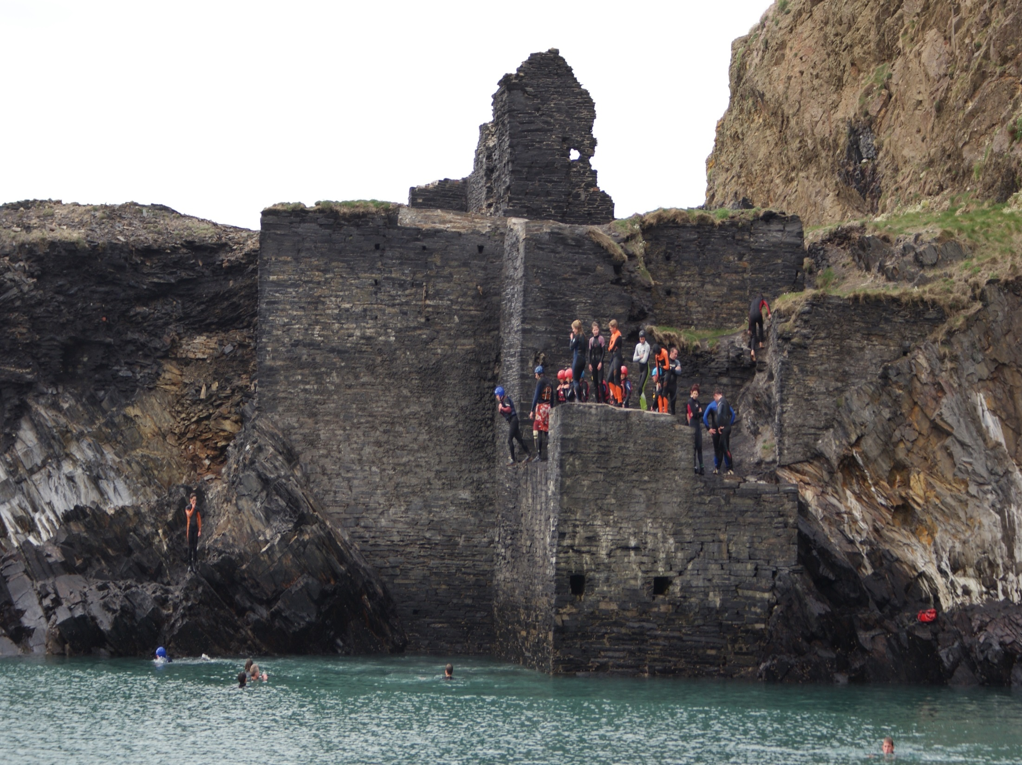

Slide 7
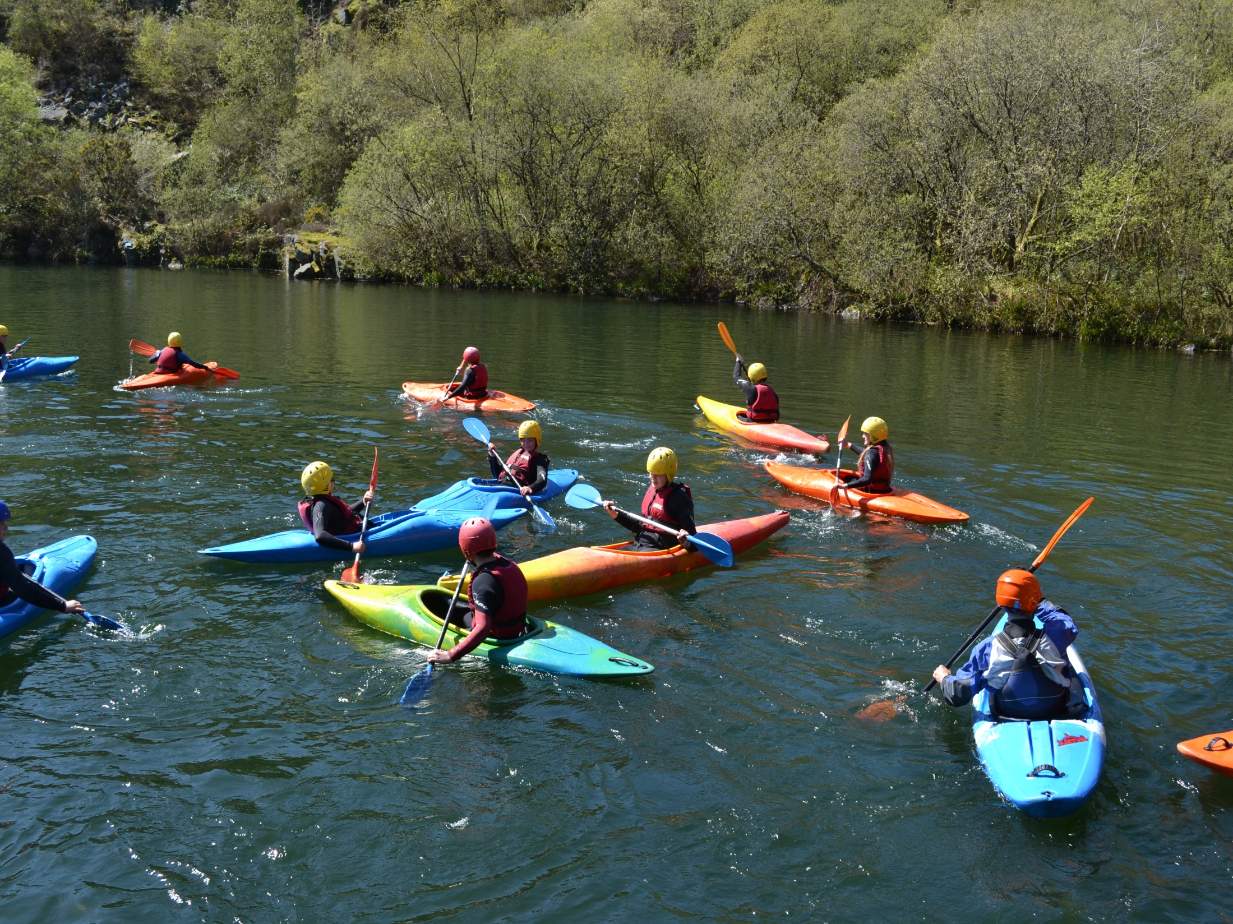

Slide 9
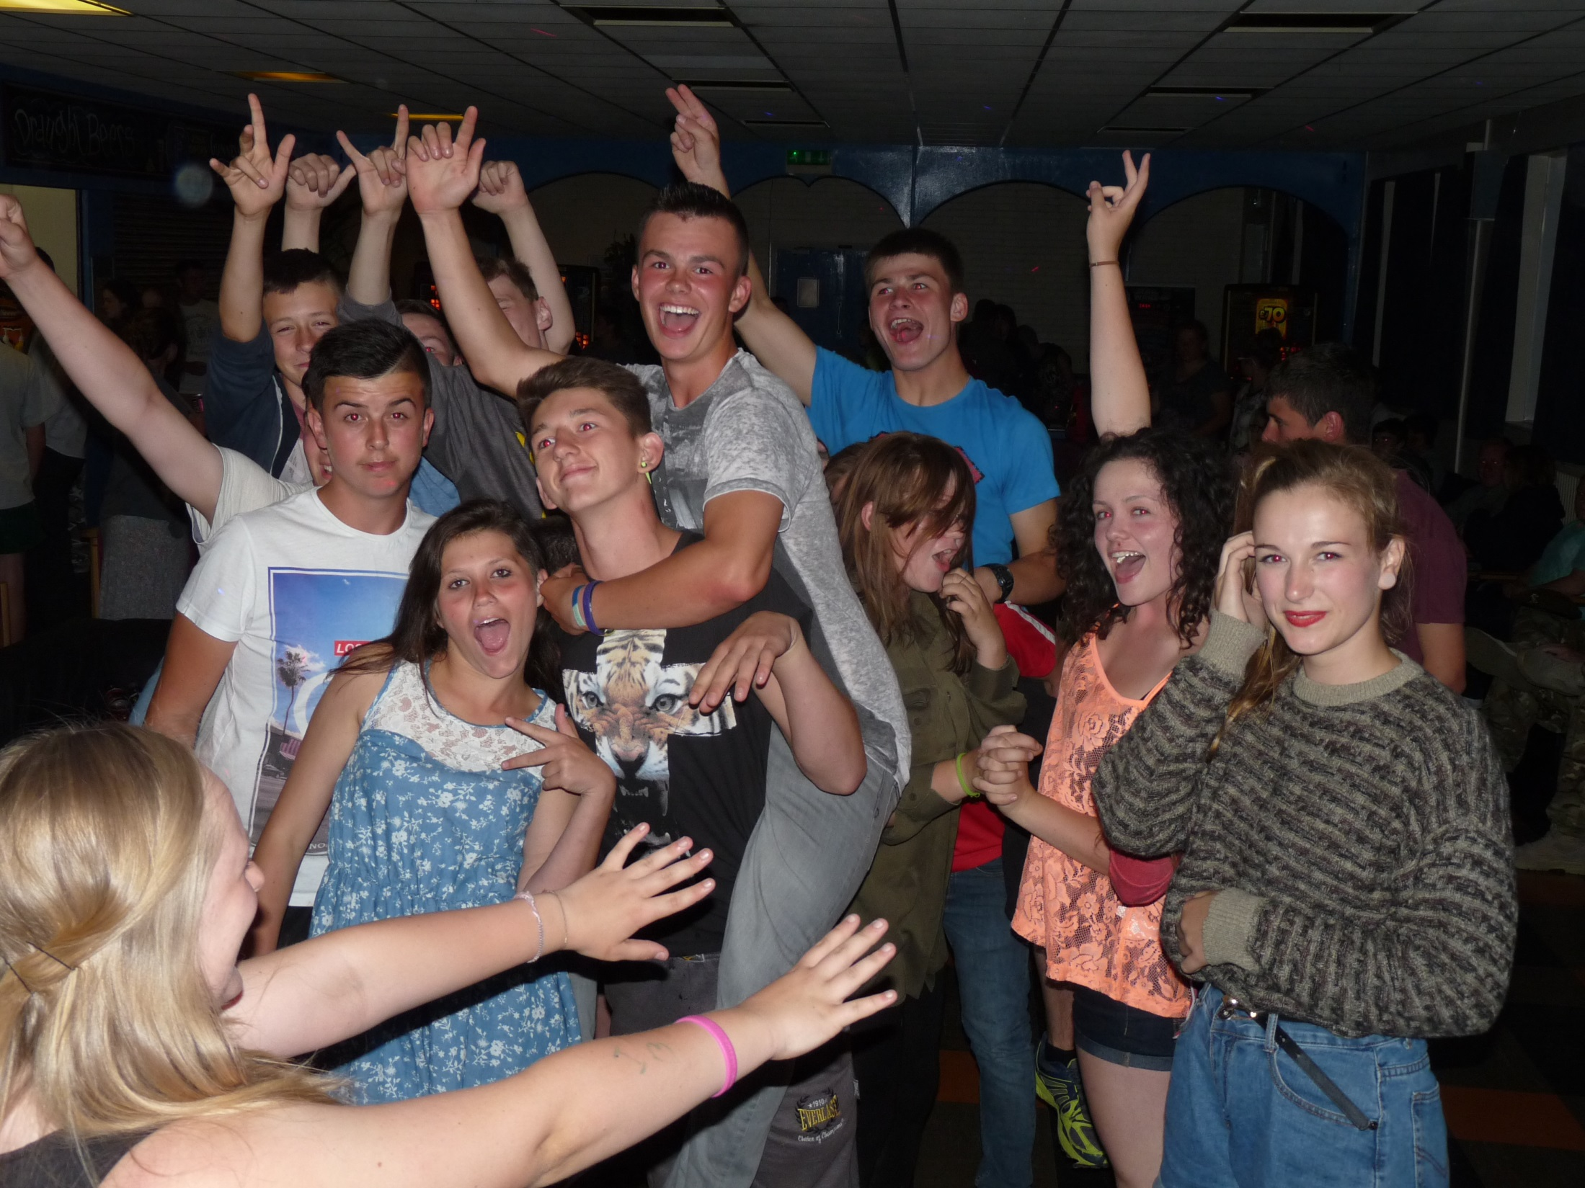

Slide 10
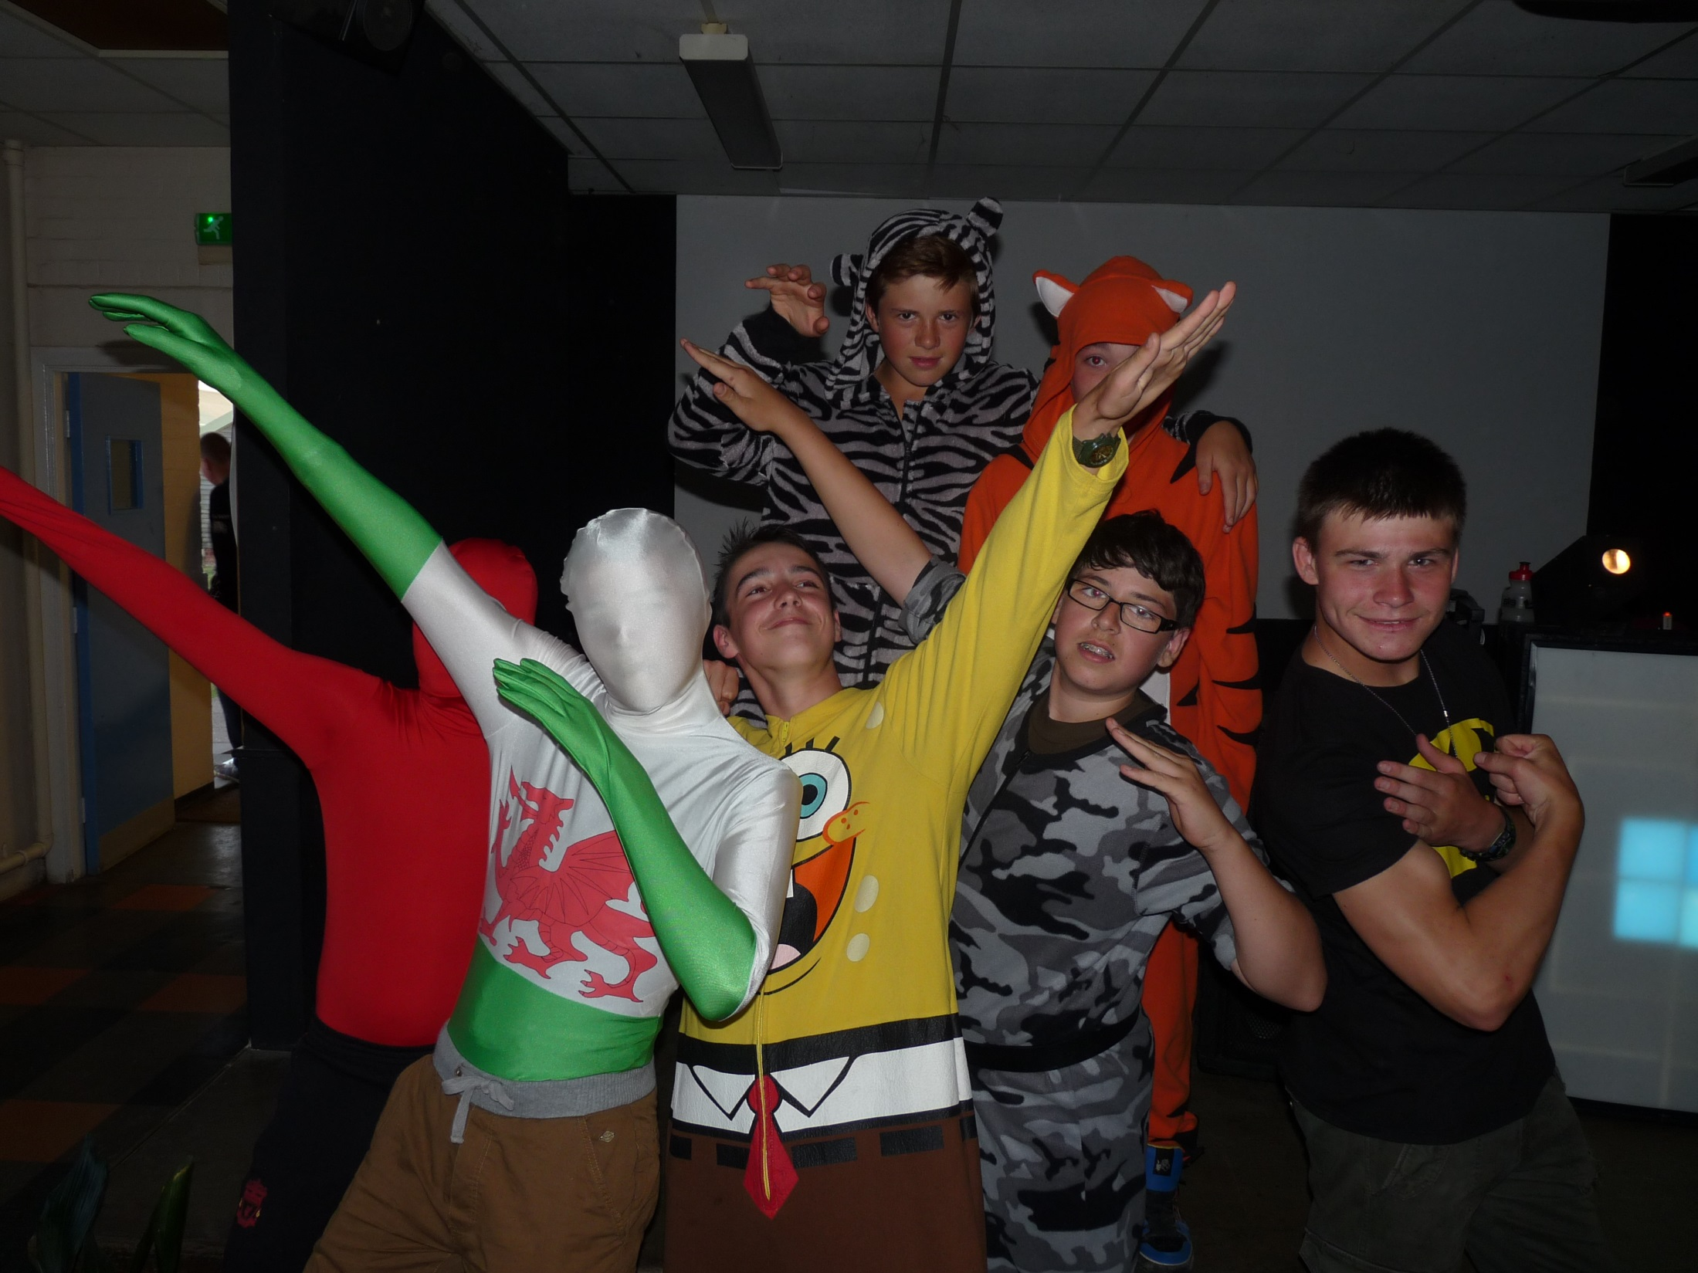

Slide 12
Or were you expecting something more like this?

Slide 18
THE REALITY
We do both
And much more!

Slide 19
SO WHAT ARE WE ?
A national voluntary youth organisation.
Sponsored by the Army and provide challenging military, adventurous and community activities.

Slide 20
CHARTER
To inspire young people to achieve success in life with a spirit of service to the Queen, their country and their local community, and to develop in them the qualities of good citizens

Slide 21
WHAT WE DO
Provide progressive cadet training, often of a challenging and exciting nature, to foster self confidence, self reliance, initiative, and a sense of service to others.
Encouraging the development of personal powers of practical leadership and the ability to work successfully as a team

Slide 22
WHAT WE DON’T DO
Not part of the Regular or Reserve Army.
No commitment to serve.
No commitment to join.
Not conscripts.

Slide 23
HOW WE ACHIEVE THIS
Progressive
Structured training
Informal non formal learning opportunities.
Recognition.

Slide 24
VALUE OF THE MILITARY ETHOS?
Military and Youth Work seemingly contradictory?
Octavia Hill

Slide 26
OCTAVIA HILL
“There is no organisation which I have found that influences the boys so powerfully for good as that of our cadets… and if such ideals can be brought before the young lad before he gets in with gang of loafers it may make all the difference to his life”

Slide 27
WHAT WE DO
Syllabus
Cadet Experience

Slide 28
THE SYLLABUS
Map Reading
First Aid
Drill, turnout and military knowledge
Skill at Arms
Signals
Field craft
Cadet in the Community
Physical recreation

Slide 29
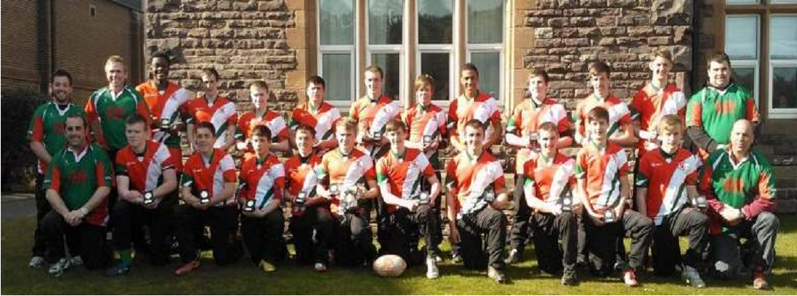

Slide 30
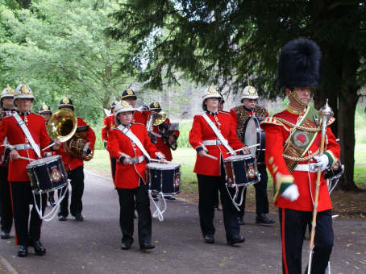

Slide 31
THE CADET EXPERIENCE
DofE Award Scheme
Vocation Qualification (BTECH)
First Aid
Challenge
Opportunity
Cameraderie

Slide 32
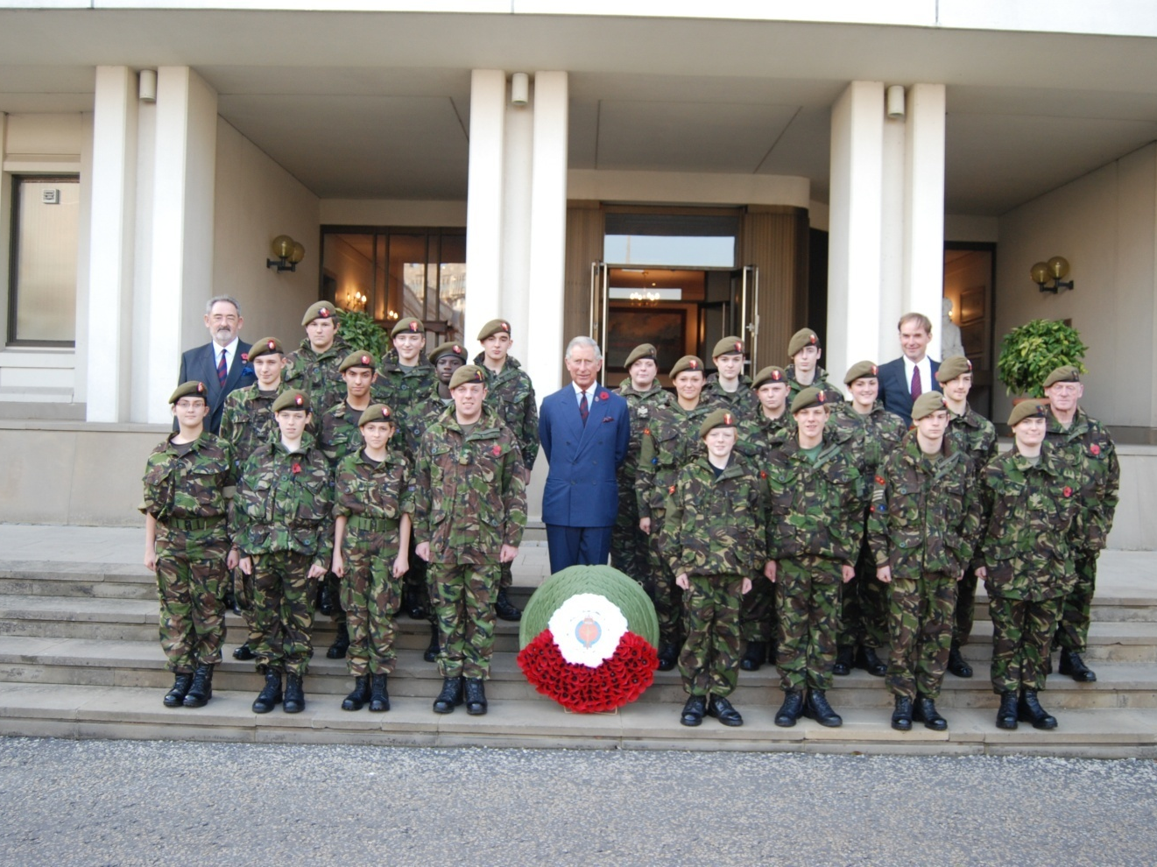

Slide 33
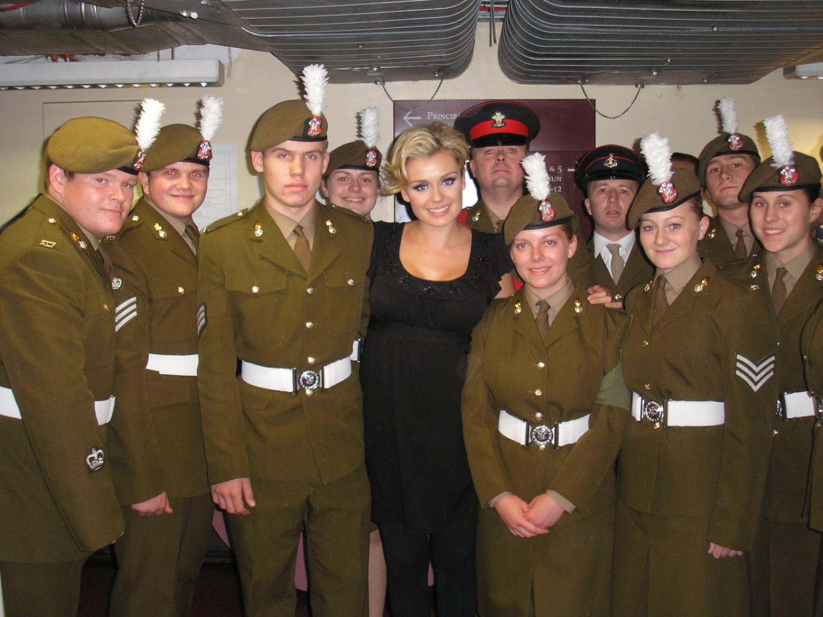

Slide 36
RECOGNITION

Slide 39
RELEVANCE
Our History - Octavia Hill, Social Reformer. Not just a fan of the miltary.
Open access
Government policy / support to Cadets.

Slide 40
BARRIERS TO ENTRY
Government policy
Ethos
Values and standards

Slide 41
BARRIERS TO ENTRY
All cadets and adults in the ACF of whatever rank, gender, religion or ethnic origin must be accorded fair and equal treatment.

Slide 42
BARRIERS TO ENTRY
All reasonable efforts must be made to facilitate the social inclusion of the disabled in the ACF.

Slide 43
VALUES AND STANDARDS
The ACF mirrors the Army’s values and standards;
Selfless Commitment.
Courage (morale).
Discipline.
Integrity.
Loyalty.
Resect for others.
Lawful.

Slide 44
REAL LIFE EXAMPLES
Sex Offender
Learning difficulties
Immigrants
Asperger's
Foster care and care homes
Second chances

Slide 45
???
QUESTIONS,
QUESTIONS?

