Slide 1
A Demographic Snapshot of Young Maltese People

Slide 2
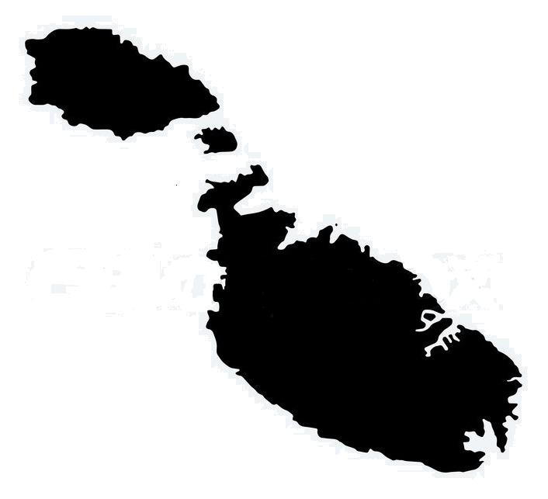
Population

Slide 3
Population
Total population – 417,432

Slide 4
Population
Total population – 417,432

Slide 5
Population
Young people (13-30 population) - 101,476

Slide 6
Population
52,288 Males & 49,188 Females

Slide 7
Education & Training

Slide 8
Education & Training
Compulsory schooling 5 – 16

Slide 9
Education & Training
Compulsory schooling 5 – 16
99% of the 10-24 yr olds are literate

Slide 10
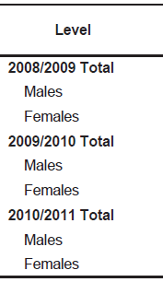
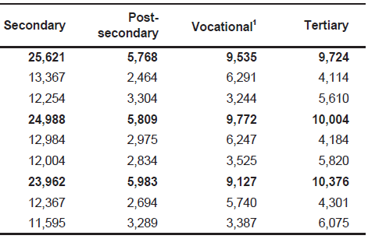
Education & Training

Slide 11
Education & Training

Slide 12
Education & Training
20-24 yr olds who complete post-secondary education is nearly 60%

Slide 13
Education & Training
20-24 yr olds who complete post-secondary education is nearly 60%
The gender gap - 20% more males

Slide 14
Education & Training
20-24 yr olds who complete post-secondary education is nearly 60%
The gender gap - 20% more males
More females however finish tertiary education

Slide 15
Education & Training
20-24 yr olds who complete post-secondary education is nearly 60%
The gender gap - 20% more males
More females however finish tertiary education
15% of 15-29 yr olds travel abroad to study

Slide 16
Education & Training
20-24 yr olds who complete post-secondary education is nearly 60%
The gender gap - 20% more males
More female however finish tertiary education
15% of 15-29 yr olds travel abroad to study
About 22% are early school leavers

Slide 17
Employment & Entrepreneurship

Slide 18
Employment & Entrepreneurship
%age

Slide 19
Employment & Entrepreneurship
At the height of the recession the unemployment rate of the 16-65 yr olds in Malta peaked at 7%.

Slide 20
Employment & Entrepreneurship
At the height of the recession the unemployment rate of the 16-65 yr olds in Malta peaked at 7%.
During the same period youth unemployment reached 14.7% and decreased to 14% in 2012.

Slide 21
Employment & Entrepreneurship
At the height of the recession the unemployment rate of the 16-65 yr olds in Malta peaked at 7%.
During the same period youth unemployment reached 14.7% and decreased to 14% in 2012.
The NEET population grew from 1,400 in 2009 to 2,200 in 2012.

Slide 22
Employment & Entrepreneurship
At the height of the recession the unemployment rate of the 16-65 yr olds in Malta peaked at 7%.
During the same period youth unemployment reached 14.7% and decreased to 14% in 2012.
The NEET population grew from 1,400 in 2009 to 2,200 in 2012.
Two thirds of NEET population in Malta hold an education level of ISCED level 2 at best.

Slide 23
Employment & Entrepreneurship

Slide 24
Employment & Entrepreneurship

Slide 25
Employment & Entrepreneurship
70% more males between 15-24 yrs in entrepreneurial employment

Slide 26
Health & Well-being

Slide 27
Health & Well-being
The majority of young people aged 20-29 are healthy. However 5.5% have suffered from a long‐term illness and/or health condition and 3.2% have some form of disability.

Slide 28
Health & Well-being
The majority of young people aged 20-29 are healthy. However 5.5% have suffered from a long‐term illness and/or health condition and 3.2% have some form of disability.
Almost 9% of the young people in Malta are obese.

Slide 29
Health & Well-being
15-16yr olds reported low levels of lifetime cannabis and non-prescription tranquillisers use

Slide 30
Health & Well-being
15-16yr olds report low levels of lifetime cannabis and non-prescription tranquillisers use
Cigarettes was also reported lower than the average of their European counterparts.

Slide 31
Health & Well-being
15-16yr olds report low levels of lifetime cannabis and non-prescription tranquillisers use
Cigarettes was also reported lower than the average of their European counterparts.
Alcohol consumption however was higher, and the same was true for binge drinking.

Slide 32
Participation & Voluntary Activities

Slide 33
Participation & Voluntary Activities
Only a small minority of the 18-30 cohort appear to have a strong commitment to a political parties.

Slide 34
Participation & Voluntary Activities
Only a small minority of the 18-30 cohort appear to have a strong commitment to a political parties.
However the level of interest in politics appears to be still strong. Voting in elections (local, national and European) among young people, aged 18-30 years, is particularly high at an average of 76%.

Slide 35
Participation & Voluntary Activities
Only a small minority of the 18-30 cohort appear to have a strong commitment to a political parties.
However the level of interest in politics appears to be still strong. Voting in elections (local, national and European) among young people, aged 18-30 years, is particularly high at an average of 76%.
Involvement in youth organisations and volunteering are not as common as might be desired. Around 6% of the 13-31 year olds are active in youth clubs or youth organisations.

