Slide 1
Social situation of young people in Europe
Anna Ludwinek
Research Manager
Eurofound
November 26, 2014

Slide 2
European Foundation (Eurofound)
Established in 1975
First EU Agency
(DG Employment & Social Affairs)
Tripartite Board (Govs, employers, trade unions)
‘To provide information, advice and expertise – on living and working conditions and industrial relations in Europe – for key actors in the field of EU social policy on the basis of comparative information, research and analysis’

Slide 3
Youth in Europe today
The impact of the recession and its aftermath on young people has attracted significant attention in recent years
The focus has so far mainly been on labour market inclusion
Situation of young people has worsened beyond the labour market and has more broadly affected their social inclusion
Youth are the group most at risk of poverty and social exclusion Invisibility/Lack of comparable data on specific subgroups
Some indicators available on health, housing, education, participation (besides employment, NEET and AROPE)

Slide 4
Trend of relevant youth exclusion indicators

Slide 5
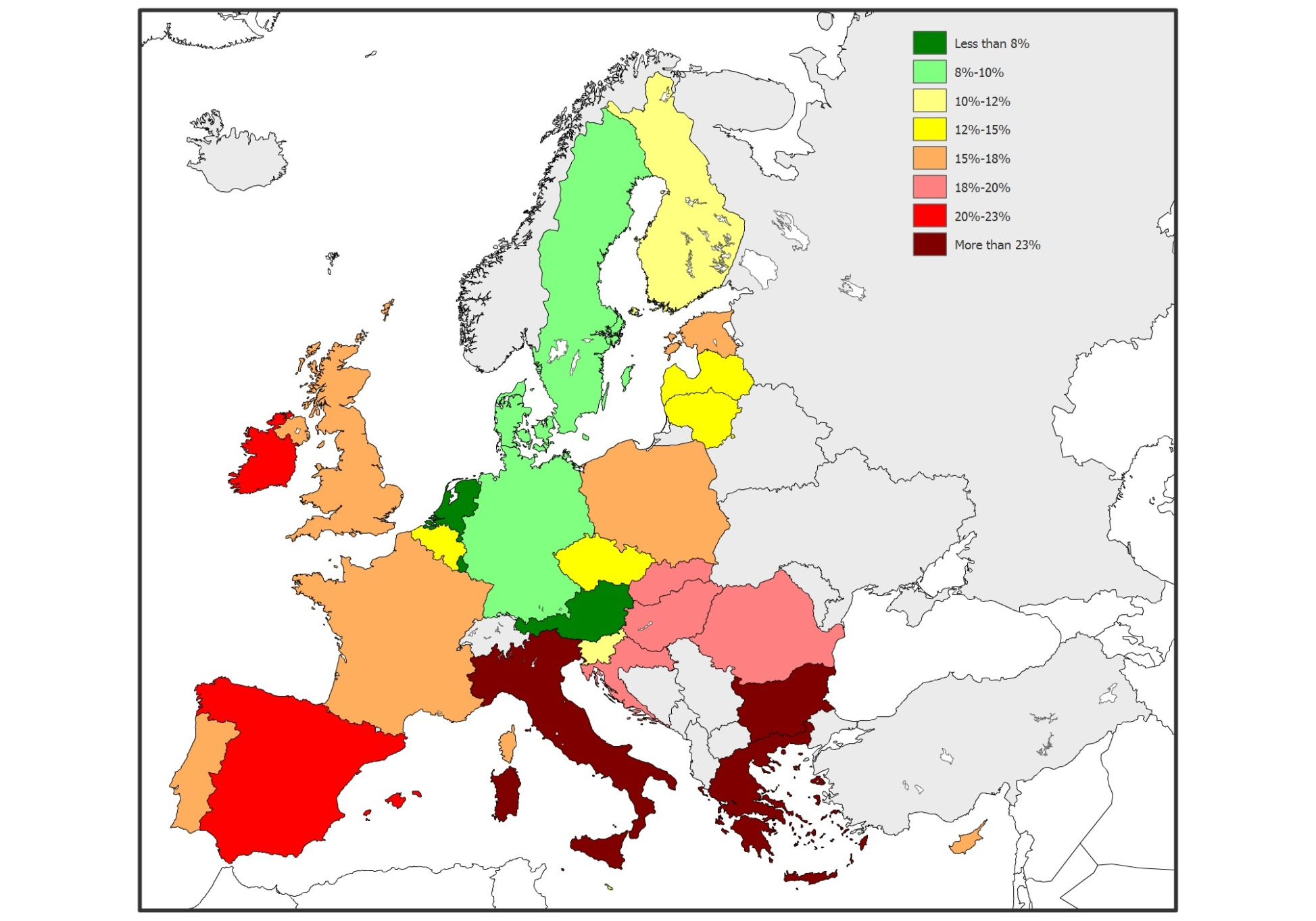
Not in Employment, Education and Training
7.8 million aged 15-24 – 13.2%
6.8 million aged 25-29 – 17.5%
14.6 million under 30 – 15.5%
2011/12 decrease in:
AT, DE, IE, LT, LV, MT
2011/12 increase in:
Elsewhere, but especially:
NL,SI,PT,CY,GR,DK,ES,SE

Slide 6
Young people 15-29 at risk of poverty and social exclusion

Slide 7
Diversity
One in four is at risk of poverty and social exclusion
One in five is unemployed
One in six is NEET
One in eight is an early school leaver
One in twelve lives in a severely deprived housing situation
One in twelve perceives their health as bad or very bad
Significant country variations in terms of unemployment, risk of poverty and NEETs rates

Slide 8
Perceived social exclusion – what is behind it
Few young people feel excluded from the society
Many say life has become too complicated they can’t find their way
Many lack recognition and value

Slide 9
Proportion of young people living with their parents

Slide 10
Serious deprivation
Serious deprivation (cannot afford to keep house warm, buy meat or fish, buy new clothes) increased by 6% between 2007 and 2011
Unemployed, inactive and young people living with their children and with their parents - most vulnerable

Slide 11
Proportion of young people experiencing serious deprivation, 2007 and 2011

Slide 12
Mental wellbeing
Young people report better mental wellbeing than other age groups
Decrease in mental wellbeing – SE, IE
Increase in mental wellbeing – DK, IT

Slide 14
Social participation and volunteering

Slide 15
Trust in the government

Slide 16
Trust in state pension – social protection systems

Slide 17
Trust in state pension – social protection systems – young vis a vis other age groups

Slide 18
Thank you
alu@eurofound.europa.eu

