Slide 1


SCOTLAND HOUSE, BRUSSELS
20-21 OCTOBER
Youth Perspectives in Contemporary Europe
New Tasks for Research and Policy

Slide 2

Here to Stay? Rural Youth’s Transitions Before and After the COVID-19 Pandemic
Francisco Simões
Assistant Researcher (Cis-Iscte, Portugal)
Chair of the European Rural Youth Observatory
Member of the Pool of European Youth Researchers
YOUTH PERSPECTIVES IN CONTEMPORARY EUROPE
OCTOBER 2025

Slide 3



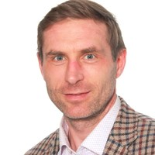
Team
Antonella Rocca
Adina Serban
Francisco Simões
Marti Taru
YOUTH PERSPECTIVES IN CONTEMPORARY EUROPE
OCTOBER 2025

Slide 4

OCTOBER 2025
Francisco Simões // Possibly 1986
YOUTH PERSPECTIVES IN CONTEMPORARY EUROPE

Slide 5
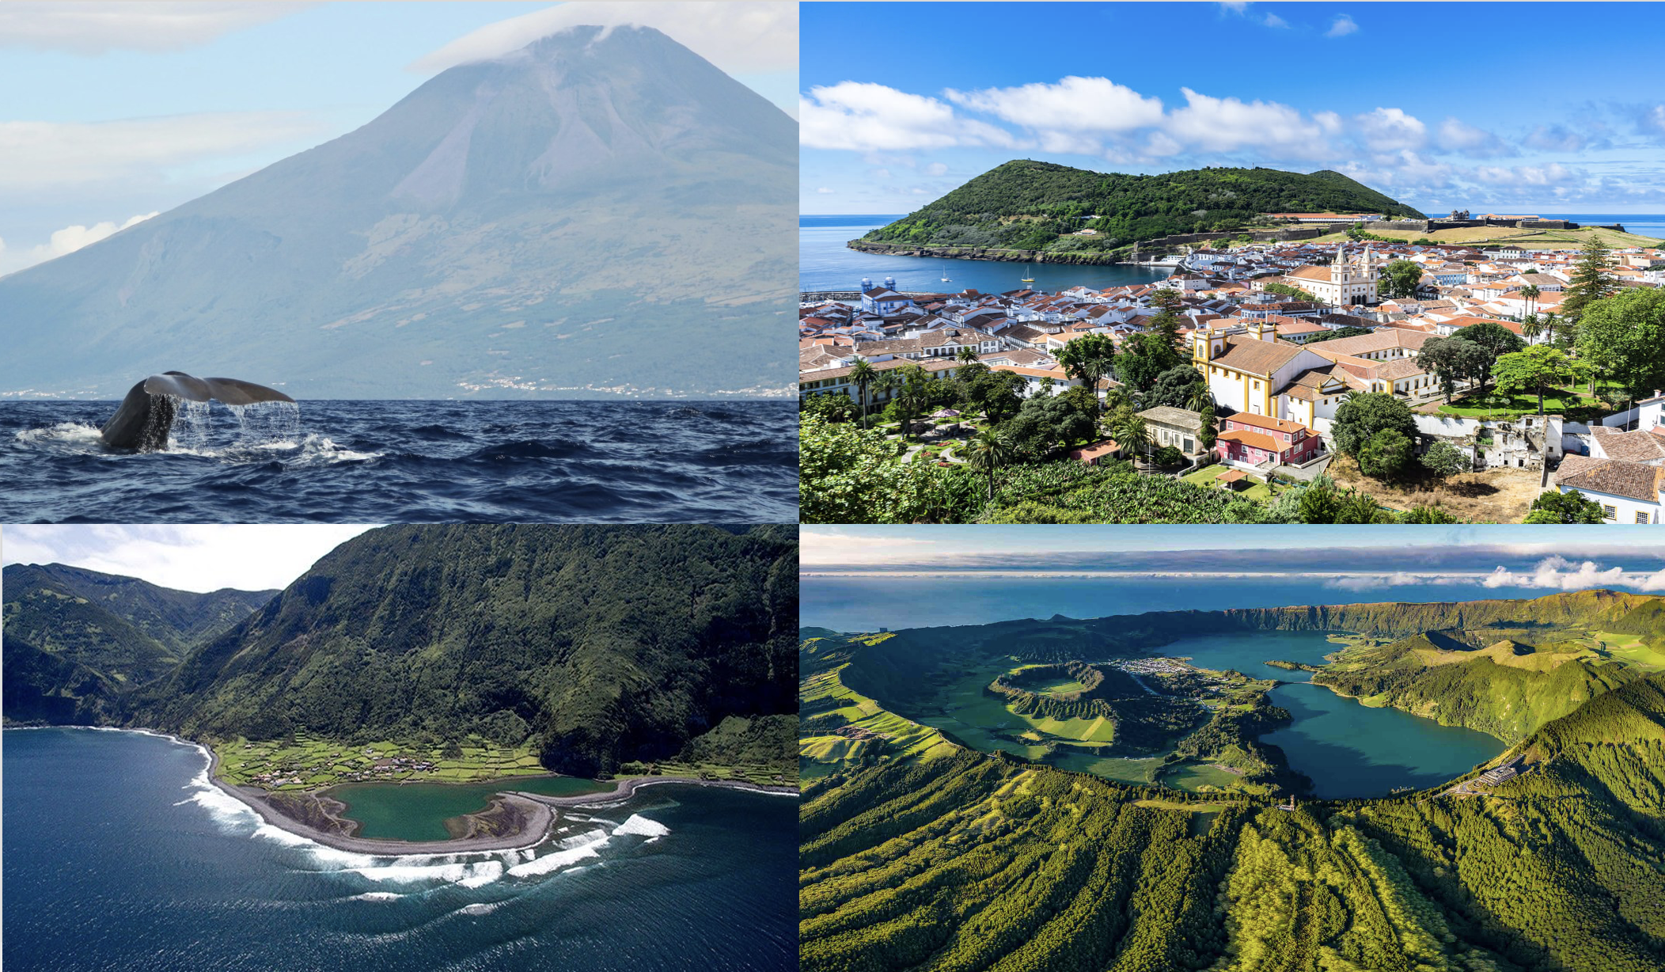
YOUTH PERSPECTIVES IN CONTEMPORARY EUROPE
OCTOBER 2025

Slide 6
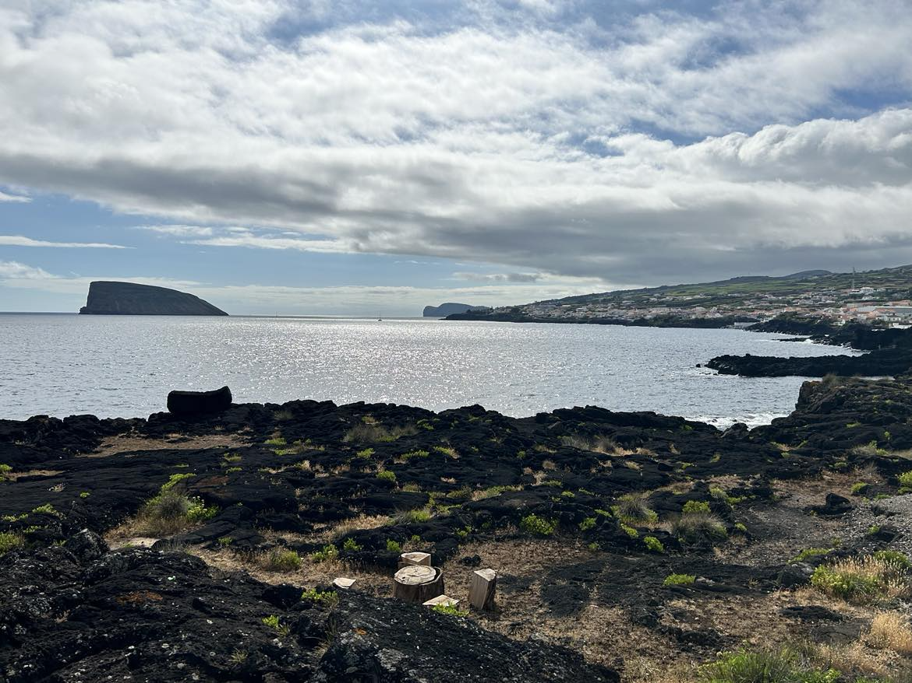
YOUTH PERSPECTIVES IN CONTEMPORARY EUROPE
OCTOBER 2025

Slide 7


Context of the study
Maybe there is some momentum building for this…
Policy // CoE level
Policy // EU level
Research
Recommendation of the Committee of Ministers to member States of the Council of Europe on the social, economic, and political participation of rural youth (7th of May 25).
YOUTH PERSPECTIVES IN CONTEMPORARY EUROPE
OCTOBER 2025

Slide 8
OCTOBER 2025
Goals of the study
(a) To examine the situation of rural youth aged 18-30 across European countries at the level of the Council of Europe in the pre- and post-COVID period (2019/2023)
(b) To inform policymaking at European, national, and regional levels.
YOUTH PERSPECTIVES IN CONTEMPORARY EUROPE

Slide 9
Study dimensions
Education
Support Systems
Youth Participation
Text
Employment
Mobilities
Leisure, Culture and Sports
Text
Text
YOUTH PERSPECTIVES IN CONTEMPORARY EUROPE
OCTOBER 2025

Slide 10
Study dimensions
DRIVERS
Education
Support Systems
Youth Participation
Text
Employment
Mobilities
Leisure, Culture and Sports
Text
Text
YOUTH PERSPECTIVES IN CONTEMPORARY EUROPE
OCTOBER 2025

Slide 11
Study dimensions
DRIVERS
Education
Support Systems
Youth Participation
Text
OUTCOMES
Employment
Mobilities
Leisure, Culture and Sports
Text
Text
YOUTH PERSPECTIVES IN CONTEMPORARY EUROPE
OCTOBER 2025

Slide 12
YOUTH PERSPECTIVES IN CONTEMPORARY EUROPE
OCTOBER 2025
Levels of Analysis
Institutional
Set-up
Trends
Policies
Programs
Youth
Perspectives

Slide 13
YOUTH PERSPECTIVES IN CONTEMPORARY EUROPE
OCTOBER 2025
Levels of Analysis
Constrained Citizenship: Youth receive limited state support and rely heavily on family, facing considerable barriers to financial independence and delayed adulthood. Countries: Armenia and Romania.
Uncertain Citizenship: Youth receive limited state support and face unstable (sometimes expanding, sometimes constraining) labour markets causing unpredictable paths to independence. Countries: Croatia, Italy, Malta, Portugal, Serbia, and Spain.
Progressive Citizenship: The state provides support for youth (although it varies), with inclusive labour policies and clearer paths to independence. Countries: Austria, Estonia, France, Germany, Ireland, and Lithuania.
Institutional
Set-up

Slide 14
YOUTH PERSPECTIVES IN CONTEMPORARY EUROPE
OCTOBER 2025
Levels of Analysis
Trends
Baseline statistics for all dimensions
Use of public data (Eurostat, Eurobarometer)
Period 2019-2023 or 2019-2022 (upon data availability)

Slide 15
YOUTH PERSPECTIVES IN CONTEMPORARY EUROPE
OCTOBER 2025
Levels of Analysis
Policies
Analysis of policy packages at the national level
Focus on multiple, intersecting policy domains (rural development, youth policy, etc.)
Searching for communalities/differences

Slide 16
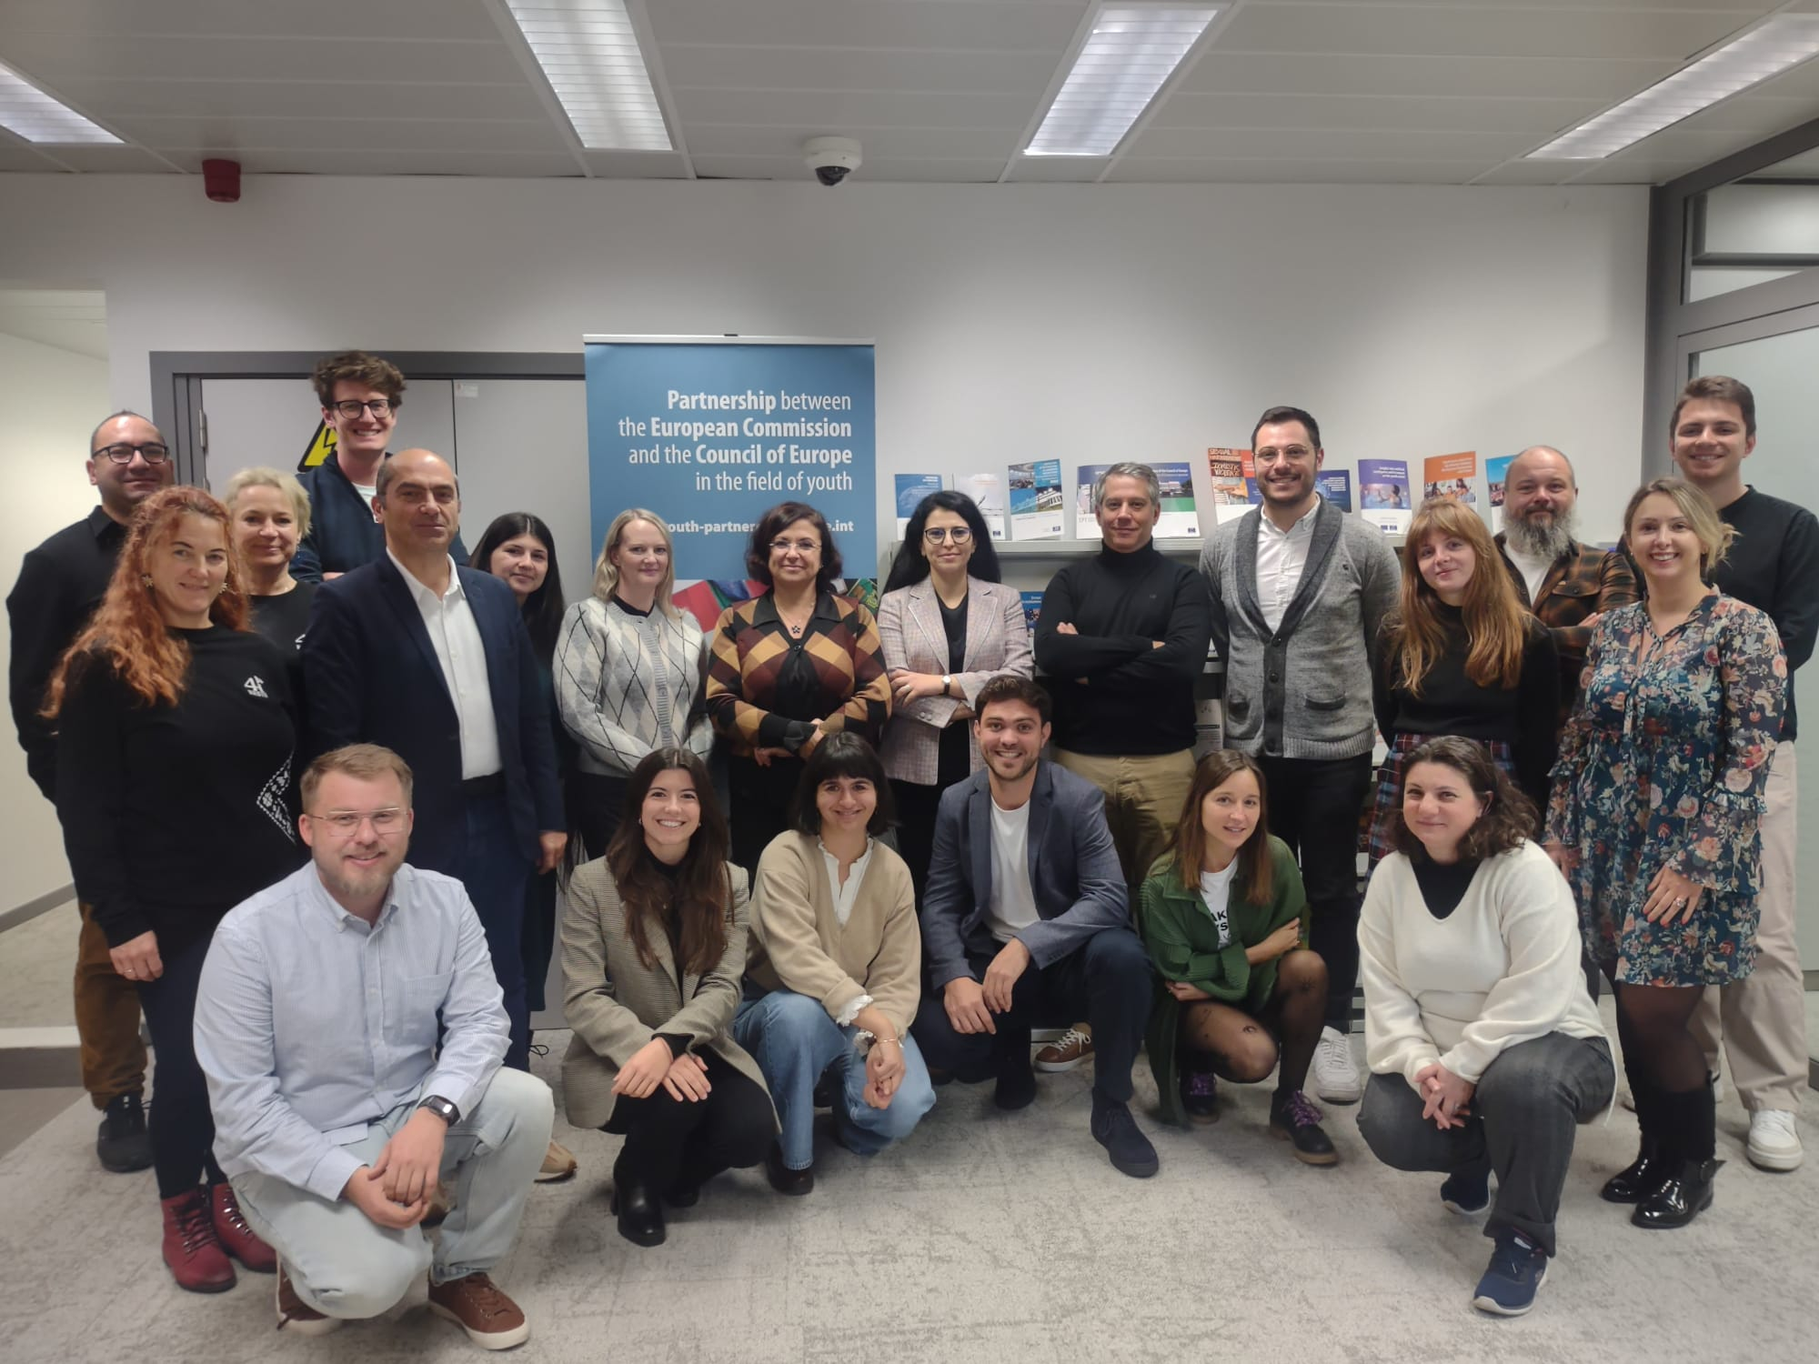
YOUTH PERSPECTIVES IN CONTEMPORARY EUROPE
OCTOBER 2025
Levels of Analysis
Programs
Workshop in Brussels, November 2024

Slide 17
YOUTH PERSPECTIVES IN CONTEMPORARY EUROPE
OCTOBER 2025
Levels of Analysis
Online questionnaire
Translated into 18 languages
Covered the 6 dimensions
Distributed between Oct 24 and Jan 25
Youth
Perspectives

Slide 18
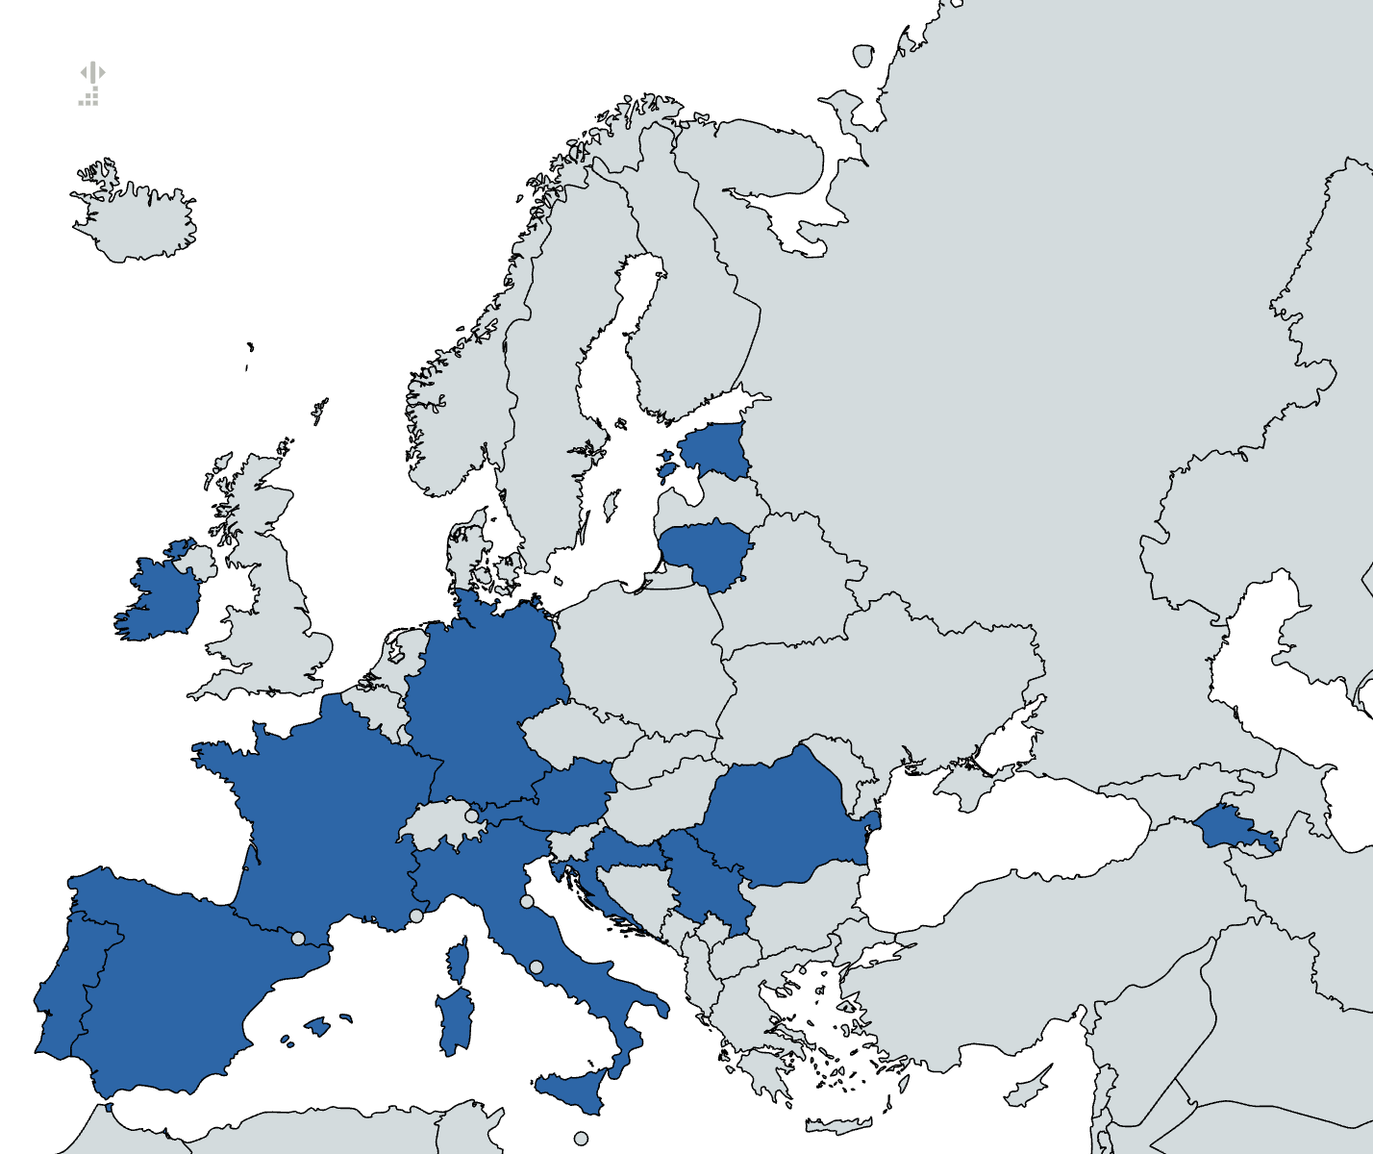
YOUTH PERSPECTIVES IN CONTEMPORARY EUROPE
OCTOBER 2025
Coverage
Armenia
Austria
Croatia
Estonia
France
Germany
Ireland
Italy
Lithuania
Malta
Portugal
Romania
Serbia
Spain

Slide 19

YOUTH PERSPECTIVES IN CONTEMPORARY EUROPE
OCTOBER 2025
Coverage
Armenia
Austria
Croatia
Estonia
France
Germany
Ireland
Italy
Lithuania
Malta
Portugal
Romania
Serbia
Spain
All levels of analysis: the remaining countries were analyzed in terms of institutional set-up, trends and youth perspectives.

Slide 20
OCTOBER 2025
Key results
YOUTH PERSPECTIVES IN CONTEMPORARY EUROPE

Slide 21

OCTOBER 2025
Key results
YOUTH PERSPECTIVES IN CONTEMPORARY EUROPE

Slide 22
YOUTH PERSPECTIVES IN CONTEMPORARY EUROPE
OCTOBER 2025
Key results // Education
Education is not a priority for rural youth
True
False: most of the participants were studying or shared their expectation to keep improving their knowledge/skills
Only for some groups: For instance women are more interested in continuing to study

Slide 23
YOUTH PERSPECTIVES IN CONTEMPORARY EUROPE
OCTOBER 2025
Key results // Education
Education is not a priority for rural youth
True
False: most of the participants were studying or shared their expectation to keep improving their knowledge/skills
Only for some groups: For instance women are more interested in continuing to study

Slide 24
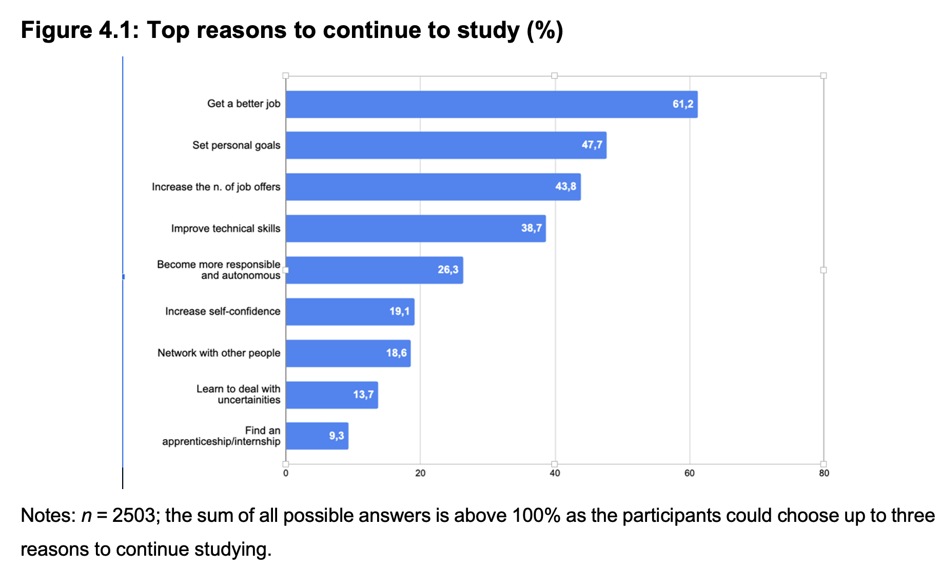
YOUTH PERSPECTIVES IN CONTEMPORARY EUROPE
OCTOBER 2025
Education | On the spotlight

Slide 25
YOUTH PERSPECTIVES IN CONTEMPORARY EUROPE
OCTOBER 2025
Key results // S. Systems
Perceived levels of support are higher among rural youth in countries with more uncertain transitions to adulthood
False: levels of perceived support are high everywhere
False: Levels of perceived support are somewhat average irrespectively of the country
True

Slide 26
YOUTH PERSPECTIVES IN CONTEMPORARY EUROPE
OCTOBER 2025
Key results // S. Systems
Perceived levels of support are higher among rural youth in countries with more uncertain transitions to adulthood
False: levels of perceived support are high everywhere
False: Levels of perceived support are somewhat average irrespectively of the country (4 to 4.2 by clusters of countries)
True

Slide 27
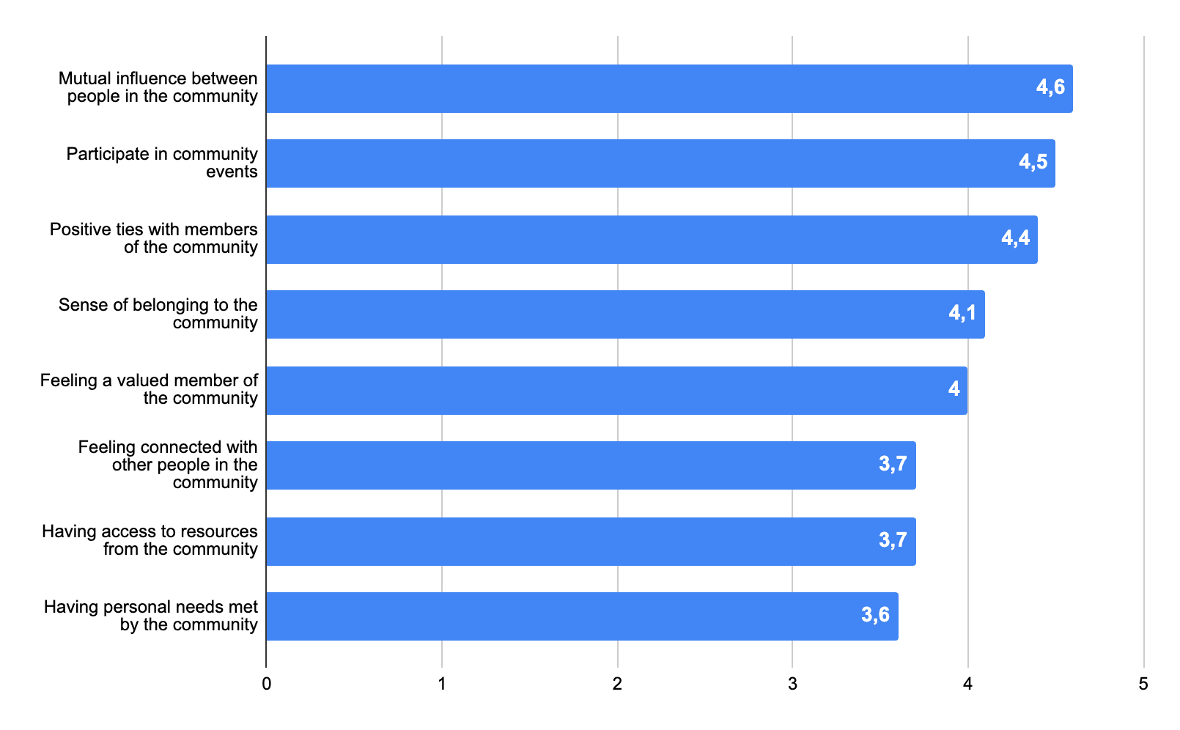
YOUTH PERSPECTIVES IN CONTEMPORARY EUROPE
OCTOBER 2025
Key results // Education
S. Systems | On the spotlight
Notes: n = 2331; average scores, scale 1 – strongly disagree - to 6 – strongly agree

Slide 28
YOUTH PERSPECTIVES IN CONTEMPORARY EUROPE
OCTOBER 2025
Key results // Participation
Formal participation grows with age and is a bit stronger among rural young men
True
False: Rural young women are much more engaged
False: younger rural youth are much more engaged

Slide 29
YOUTH PERSPECTIVES IN CONTEMPORARY EUROPE
OCTOBER 2025
Key results // Participation
Formal participation grows with age and is a bit stronger among rural young men
True
False: Rural young women are much more engaged
False: younger rural youth are much more engaged

Slide 30
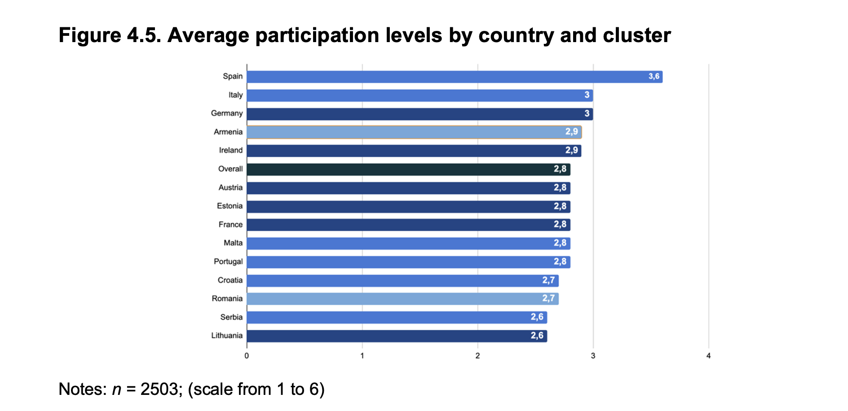
YOUTH PERSPECTIVES IN CONTEMPORARY EUROPE
OCTOBER 2025
Key results // Education
Participation | On the spotlight

Slide 31
YOUTH PERSPECTIVES IN CONTEMPORARY EUROPE
OCTOBER 2025
Key results // Employment
Factor most often associated with finding a job
Having good contacts
Prior work experience
Having a good education
Being an entrepreneur

Slide 32
YOUTH PERSPECTIVES IN CONTEMPORARY EUROPE
OCTOBER 2025
Key results // Employment
Factor most often associated with finding a job
Having good contacts (55%)
Prior work experience (53%)
Having a good education (42%)
Being an entrepreneur (14%)
None of the above: having a car! (60%)

Slide 33
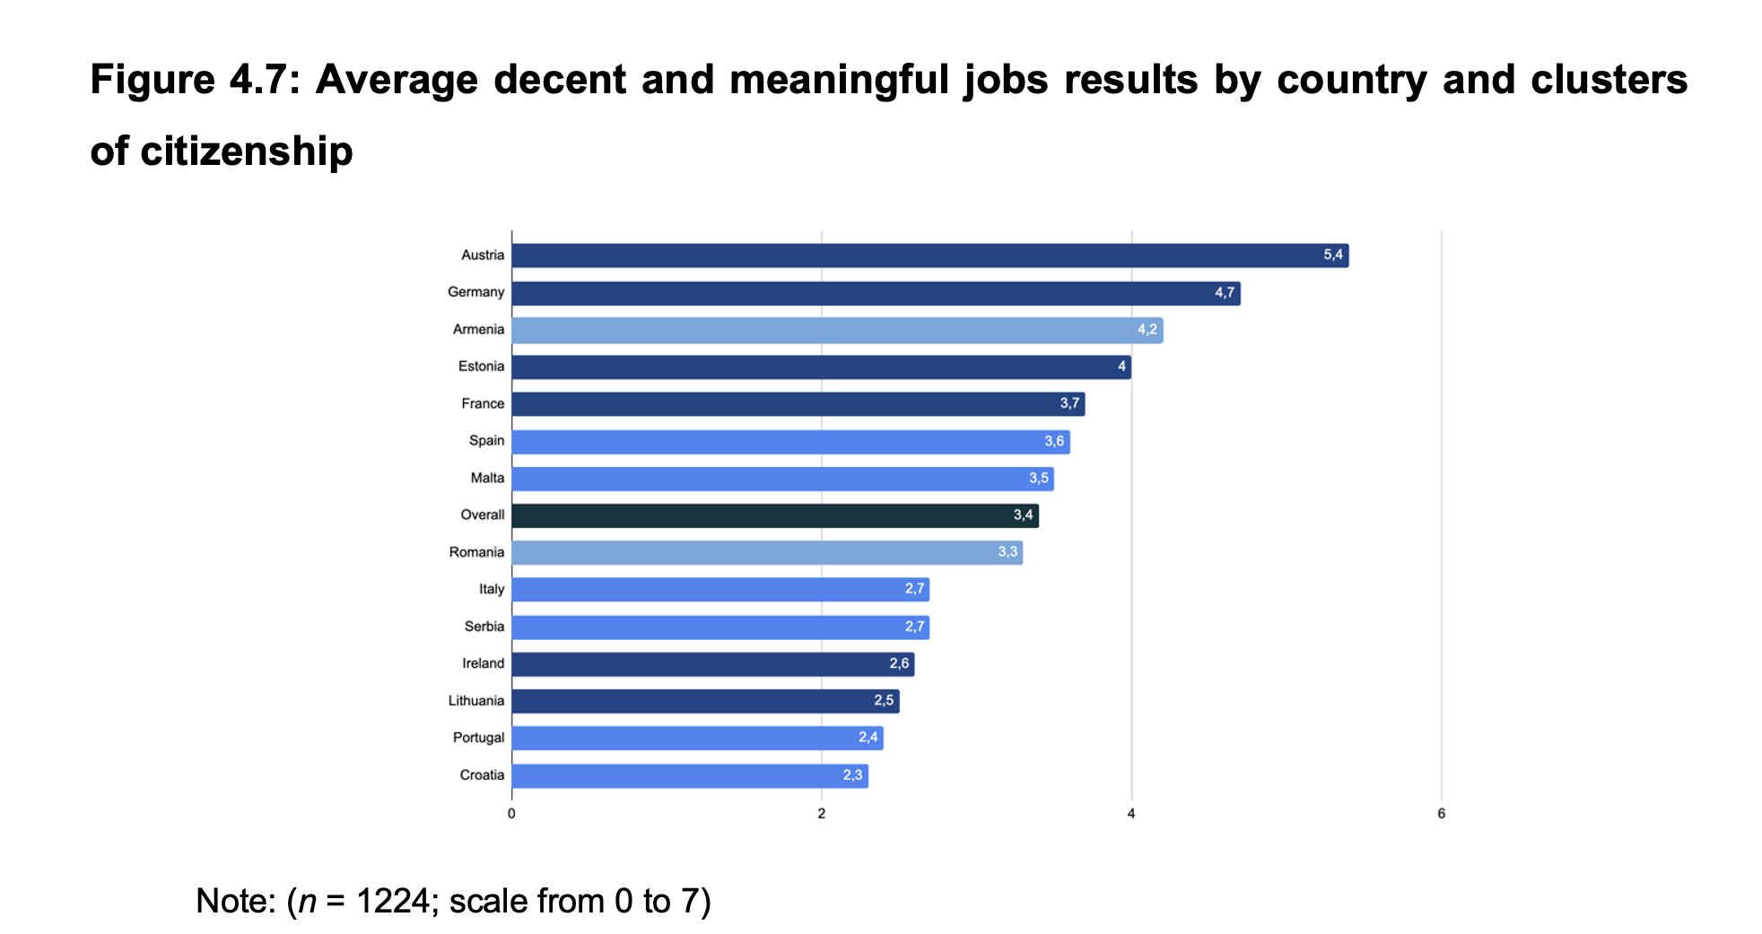
YOUTH PERSPECTIVES IN CONTEMPORARY EUROPE
OCTOBER 2025
Key results // Education
Employment | On the spotlight

Slide 34
YOUTH PERSPECTIVES IN CONTEMPORARY EUROPE
OCTOBER 2025
Key results // Mobilities
Top reason to stay
Not having enough financial resources
Staying close to family and friends
Preferring the country lifestyle

Slide 35
YOUTH PERSPECTIVES IN CONTEMPORARY EUROPE
OCTOBER 2025
Key results // Mobilities
Top reason to stay
Not having enough financial resources (25.8%)
Staying close to family and friends (31.6%)
Preferring the country lifestyle (19.1%)

Slide 36
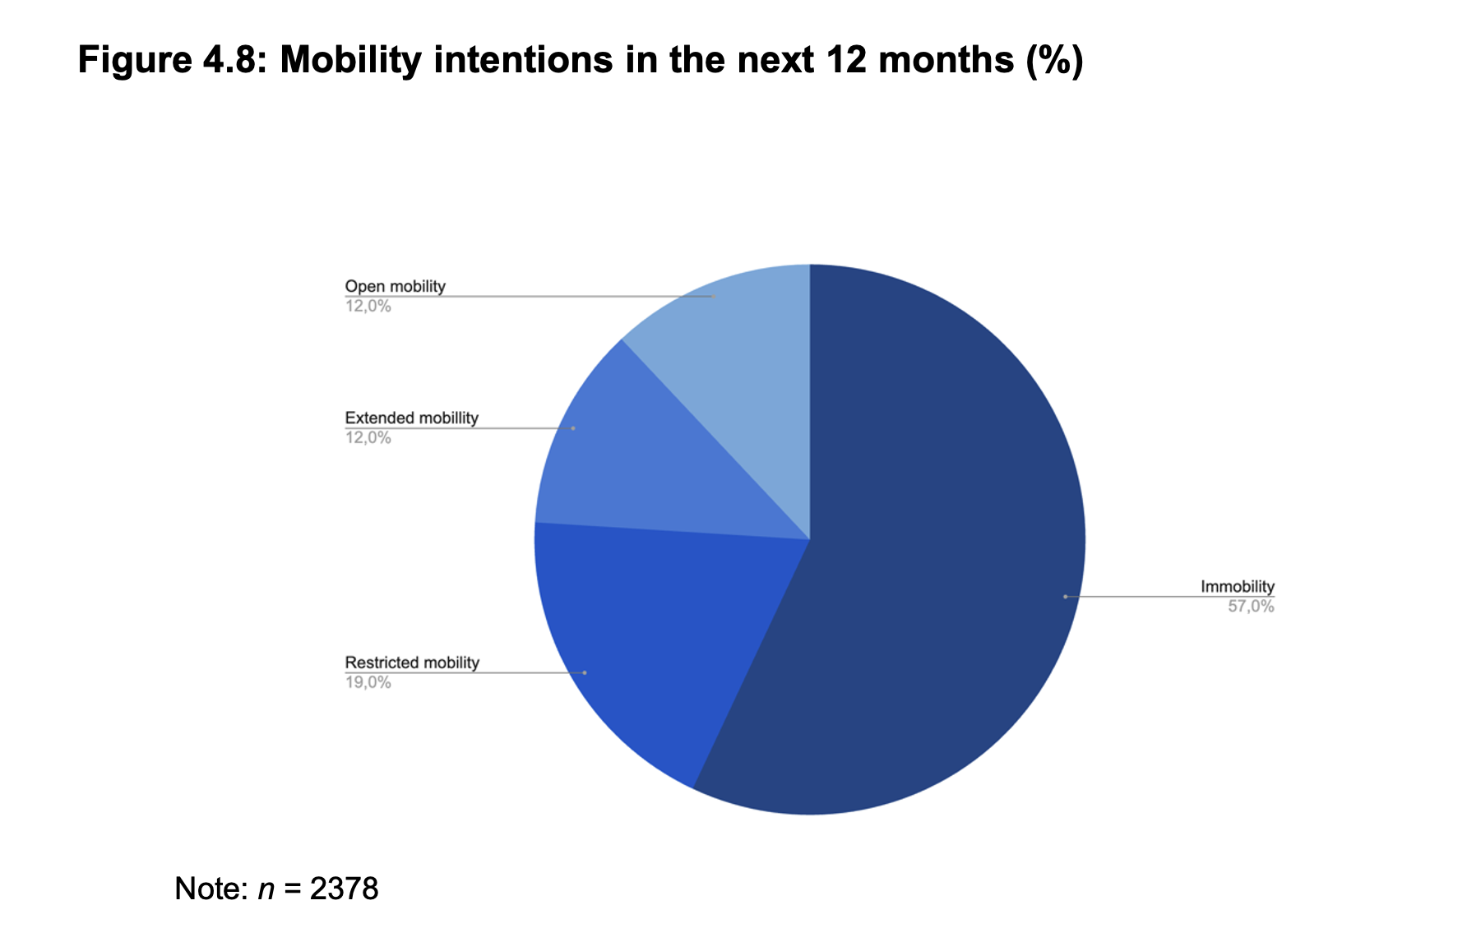
YOUTH PERSPECTIVES IN CONTEMPORARY EUROPE
OCTOBER 2025
Key results // Education
Mobilities | On the spotlight

Slide 37
YOUTH PERSPECTIVES IN CONTEMPORARY EUROPE
OCTOBER 2025
Key results // Leisure, culture & sport
Overall, cultural, leisure and sports infrastructure is more often used by…
Younger rural youth (18-24)
Younger men (18-24)
Older women (25-30)

Slide 38
YOUTH PERSPECTIVES IN CONTEMPORARY EUROPE
OCTOBER 2025
Key results // Leisure, culture & sport
Overall, cultural, leisure and sports infrastructure is more often used by…
Younger rural youth (18-24)
Younger men (18-24)
Older women (25-30)
None of the above

Slide 39
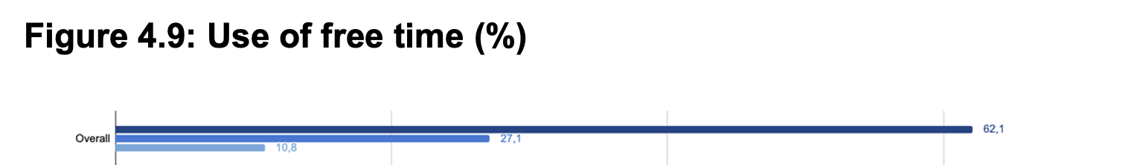
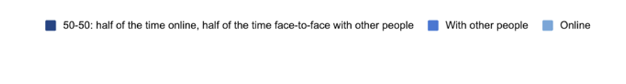
YOUTH PERSPECTIVES IN CONTEMPORARY EUROPE
OCTOBER 2025
Key results // Leisure, culture & sport

Slide 40
Higher decent and meaningful jobs ratings
What is more often associated (across countries /clusters) with rural youth:
Greater likelihood to stay in rural areas
Greater use of culture, leisure and sports facilities
Stronger satisfaction with living in a rural area
YOUTH PERSPECTIVES IN CONTEMPORARY EUROPE
OCTOBER 2025

Slide 41
Higher decent and meaningful jobs ratings
What is more often associated (across countries /clusters) with rural youth:
Greater likelihood to stay in rural areas
Greater use of culture, leisure and sports facilities
Stronger satisfaction with living in a rural area
4x4 Table | 16 correlations in total
YOUTH PERSPECTIVES IN CONTEMPORARY EUROPE
OCTOBER 2025

Slide 42

YOUTH PERSPECTIVES IN CONTEMPORARY EUROPE
OCTOBER 2025

Slide 43
Education
Support Systems
Youth Participation
Text
Gender
Age
SES
Text
Text
YOUTH PERSPECTIVES IN CONTEMPORARY EUROPE
OCTOBER 2025

Slide 44
Support Systems
Youth Participation
Age
SES
Text
Text
YOUTH PERSPECTIVES IN CONTEMPORARY EUROPE
OCTOBER 2025

Slide 45
Support Systems
Age
Text
YOUTH PERSPECTIVES IN CONTEMPORARY EUROPE
OCTOBER 2025

Slide 46
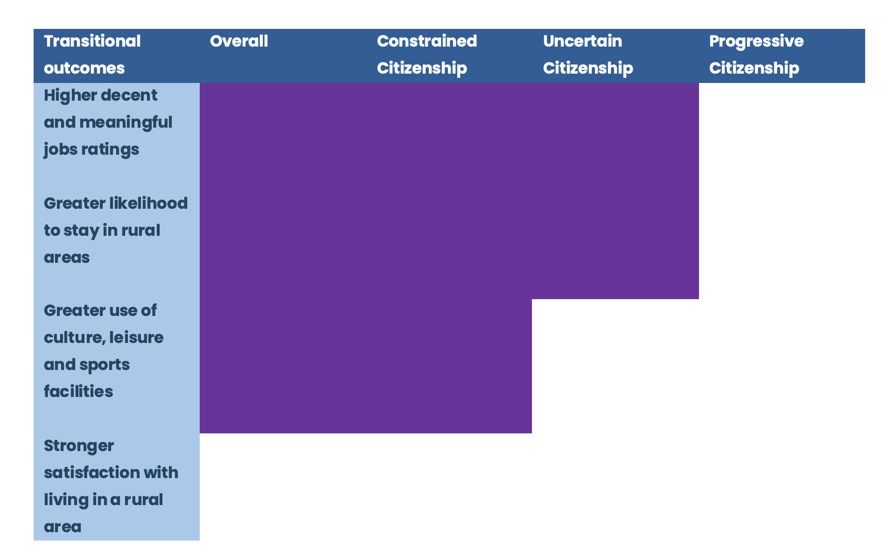
Text
YOUTH PERSPECTIVES IN CONTEMPORARY EUROPE
OCTOBER 2025

Slide 47
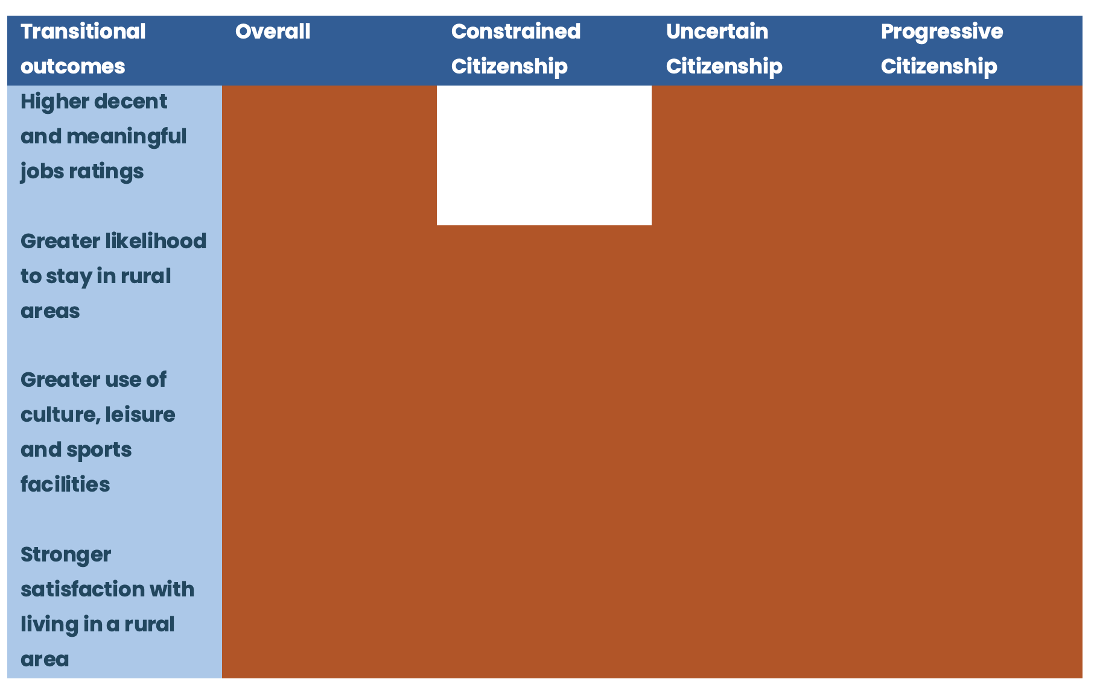
Text
YOUTH PERSPECTIVES IN CONTEMPORARY EUROPE
OCTOBER 2025

Slide 48

OCTOBER 2025
Main conclusions
& policy recommendations
YOUTH PERSPECTIVES IN CONTEMPORARY EUROPE

Slide 49
YOUTH PERSPECTIVES IN CONTEMPORARY EUROPE
OCTOBER 2025
Main conclusions & policy recommendations
Transitional trends in rural areas are mixed with room for progress. Promote coordinated public service delivery and digital inclusion tailored to rural needs. Use hybrid outreach strategies to engage disadvantaged youth effectively.
Policy measures do not target rural youth as a priority group. Mainstream rural youth in national and EU policies through vertical coordination and targeted programs. Strengthen rural youth focus in Erasmus+ and broader policy packages.

Slide 50
YOUTH PERSPECTIVES IN CONTEMPORARY EUROPE
OCTOBER 2025
Main conclusions & policy recommendations
3. Practices and projects show a lively youth sector, but lack coordination. Create permanent rural youth think-tanks and long-term funding for local organizations. Foster regional cooperation and research partnerships to scale best practices.
4. Transitional drivers: more education, moderate informal support, low youth participation. Support rural school clusters and flexible VET models adapted to local economies. Boost youth representation in local governance and fund co-creation spaces.

Slide 51
YOUTH PERSPECTIVES IN CONTEMPORARY EUROPE
OCTOBER 2025
Main conclusions & policy recommendations
5. Rural youth have an occupation, but jobs lack meaning. Improve mobility and public employment services tailored to rural realities. Incentivize decent jobs in circular, cultural, and remote work sectors.
6. Thinking of moving outside rural areas? Actually, rural youth want to stay. Enhance short-term mobility options and rural-urban linkages. Expand Erasmus+ and national exchange programs to support commuting and return mobilities.

Slide 52
YOUTH PERSPECTIVES IN CONTEMPORARY EUROPE
OCTOBER 2025
Main conclusions & policy recommendations
7. Free time is a matter of making the most of nature. Invest in multi-use youth-run centers and subsidize urban cultural access. Decentralize cultural funding to support rural initiatives.
8. Above all stands the role of informal support. Fund intergenerational cooperation and youth-adult collaboration in rural governance. Leverage community ties to design inclusive, sustainable rural youth programs.

Slide 53
YOUTH PERSPECTIVES IN CONTEMPORARY EUROPE
OCTOBER 2025

Slide 54
Here to Stay? Rural Youth’s Transitions Before and After the COVID-19 Pandemic
Francisco Simões
Assistant Researcher (Cis-Iscte, Portugal)
Chair of the European Rural Youth Observatory
Member of the Pool of European Youth Researchers
Thank you for your attention
YOUTH PERSPECTIVES IN CONTEMPORARY EUROPE
OCTOBER 2025

