Slide 1
Who is doing what in youth work development in Europe? Research findings
Frederike Hofmann-van de Poll
Dragan Atanasov

Slide 2
Goals and Methodology
Research “Mapping European Youth Work Ecosystems”
Who? What? With whom? How?
Aim: contribute to the deeper understanding of European youth work by
identifying European actors active in implementing the EYWA
identifying their initiatives, programmes and projects
analysing interactions, synergies and overlaps between them
Methodology
Desk research
Interviews
(ESG – EYWC – named)
Analysis
Validation
Report
Observation

Slide 3
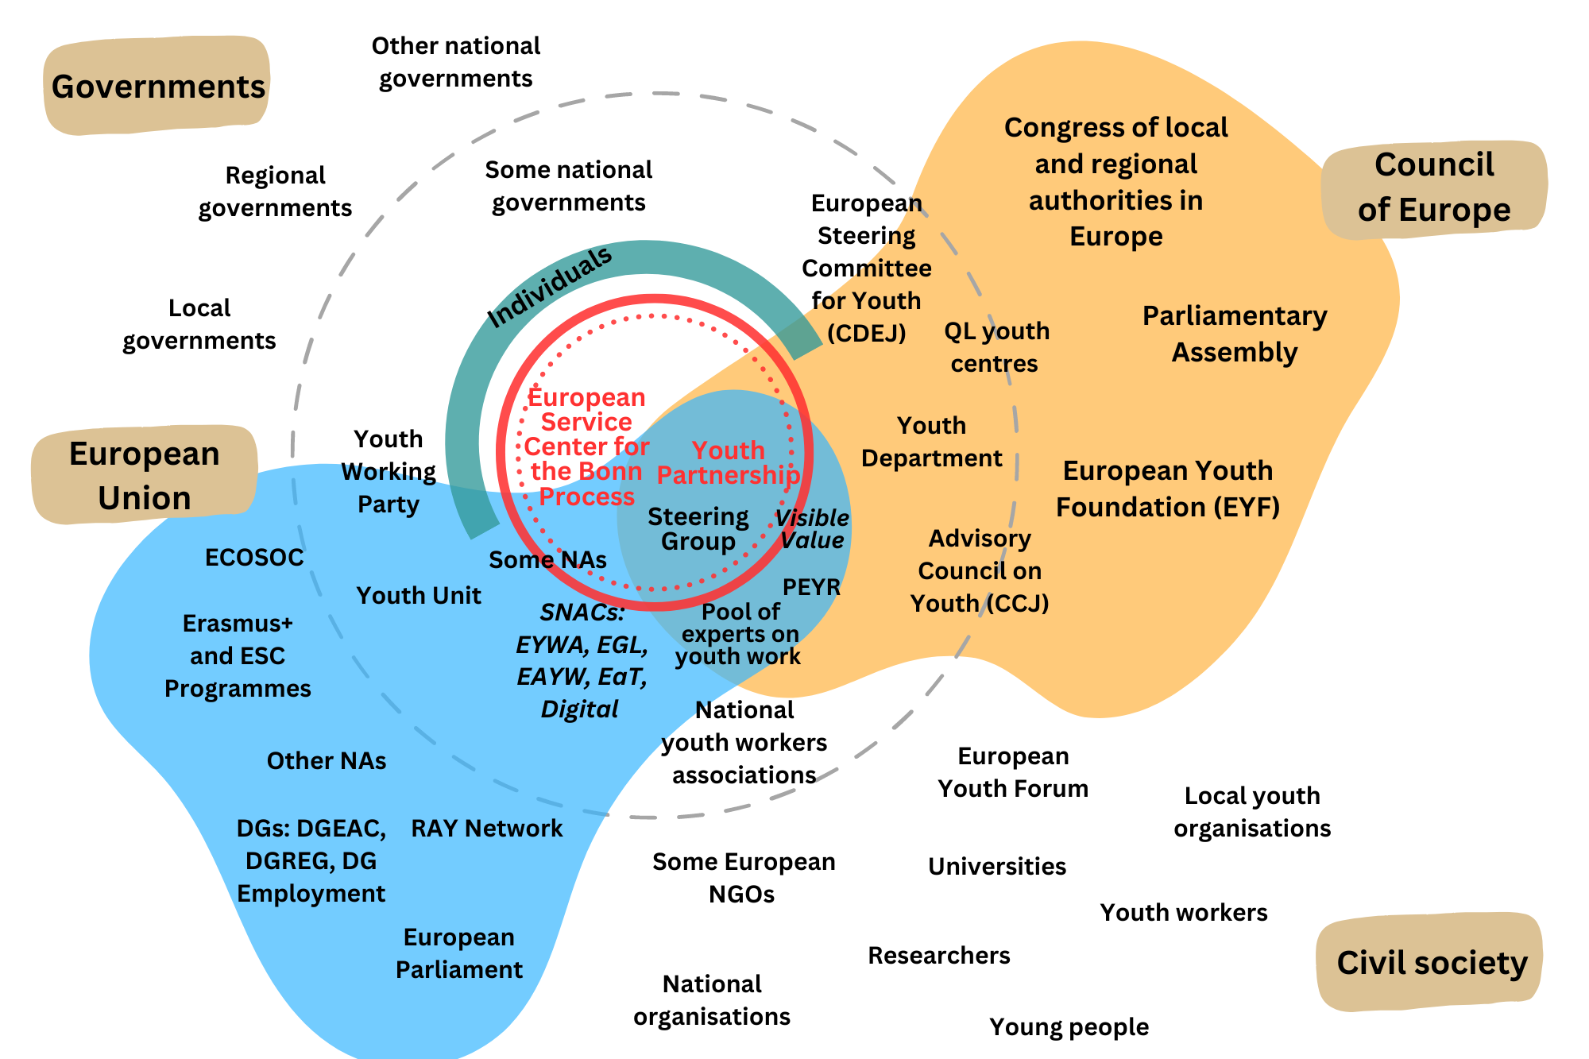

Slide 4
Questions for Discussion
What is missing in the ecosystem?
What expectations do you have towards the ecosystem actors?
How do expectations and reality relate to each other?

Slide 5
Contact
Thank you for your attention!
Dragan Atanasov
atanasov.dragan@gmail.com
Dr Frederike Hofmann-van de Poll
hofmann.frederike@gmail.com

