Slide 1
WELCOME TO THE BONN PROCESS.

Slide 2
Growing youth work in Europe: support for the Bonn Process at European level.
Visible Value Symposium: Growing youth work in Europe, 31 May – 1 June 2023.

Slide 3
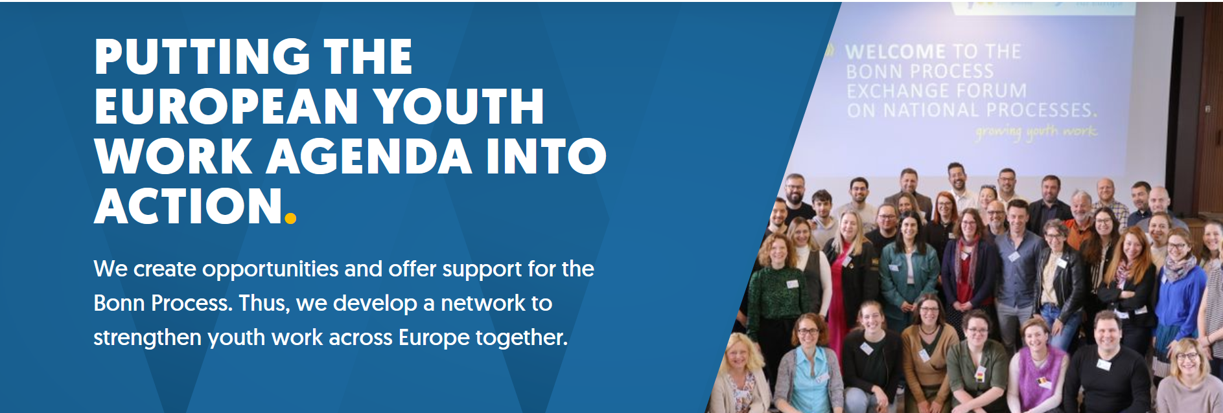
The European Service Centre for the Bonn Process.
The European Service Centre for the Bonn Process is a unit within JUGEND für Europa, German National Agency for the EU youth programmes Erasmus+ Youth and European Solidarity Corps.
Our tasks:
provide information and networking opportunities
support the national processes
support the community of practice in Europe, especially via the EU youth programmes
contributing to thematic impulses and knowledge-building

Slide 4
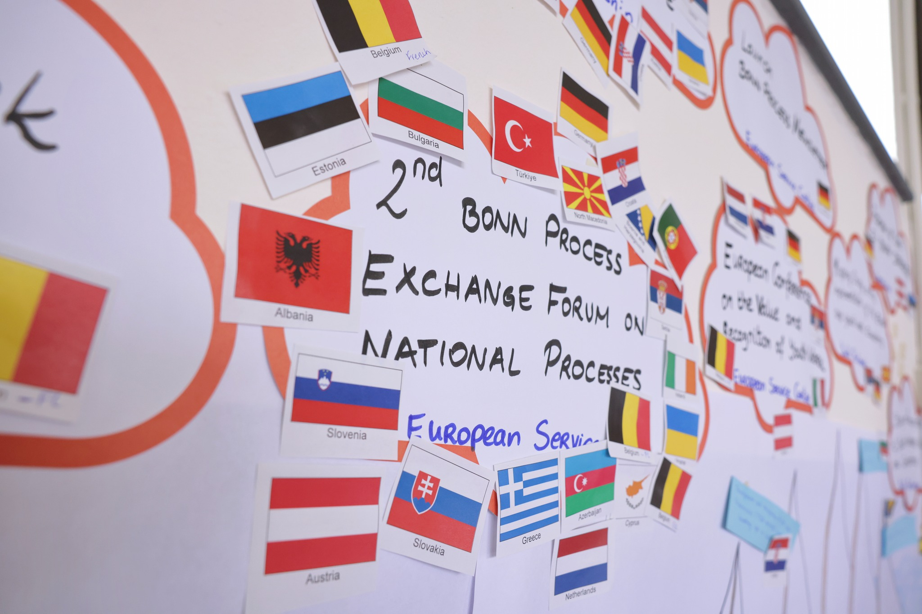
Support for national processes
Activities for national contact persons and other national key stakeholders
Bonn Process Exchange Forum for national processes​
Bonn Process Coffee talks
Materials

Slide 5
Support for the community of practice across Europe
Stay informed and become more visible
Bonn Process website (www.bonn-process.net)​
Newsletter and Social Media
Make your work visible via the Bonn Process channels
Get involved in your national process
Find out what’s going on in your country
Participate in national youth work events
Design your own activities and lobby for your work
Organise your own activities to develop a certain aspect of youth work further (e. g. seminars, conferences, materials)
Refer to the Bonn Process when speaking about your work (Final Declaration of the 3rd European Youth Work Convention)
Connect to others and create movement
Join events related to the Bonn Process​
Join and/or create working groups on your relevant topic
Contribute your experience to the European debate

Slide 6
Implementation instruments for the Bonn Process at European level: the EU youth programmes
The European Solidarity Corps
promotes cross-border and local activities that benefit the community. By promoting voluntary engagement and practised European citizenship among young people, the European Solidarity Corps (ESC) sends a clear signal for a Europe based on solidarity and social responsibility.
Erasmus+ Youth
promotes non-formal and informal learning mobility and active participation of young people, as well as co-operation, quality, inclusion, creativity, and innovation at the level of youth organisations and policies.
Inclusion & Diversity
Environmental protection, sustainable development and climate protection
Digital transformation
Participation in democratic life

Slide 7
Contact
European Service Centre for the Bonn Process
at JUGEND für Europa (National Agency for the EU programmes Erasmus+ Youth, Erasmus+ Sport and European Solidarity Corps in Germany)
Website www.bonn-process.net and Bonn Process Newsletter
Facebook; Instagram; Youtube
Direct contact: bonn-process@jfemail.de (team: Elke Führer and Alicia Holzschuh)
More information about the European Service Centre for the Bonn Process
7

Slide 8
THANK YOU FOR YOUR ATTENDANCE.

