Slide 1
Growing the community of practice on national level
The case of Romania

Slide 2
Youth Workers Conventions in Romania
December 2021
May 2022
January 2023

Slide 3
Youth Workers Declaration - 2022
Education and career paths
Support for youth work
Legal and financial frameworks

Slide 4
Advocacy from national to European level

Slide 5
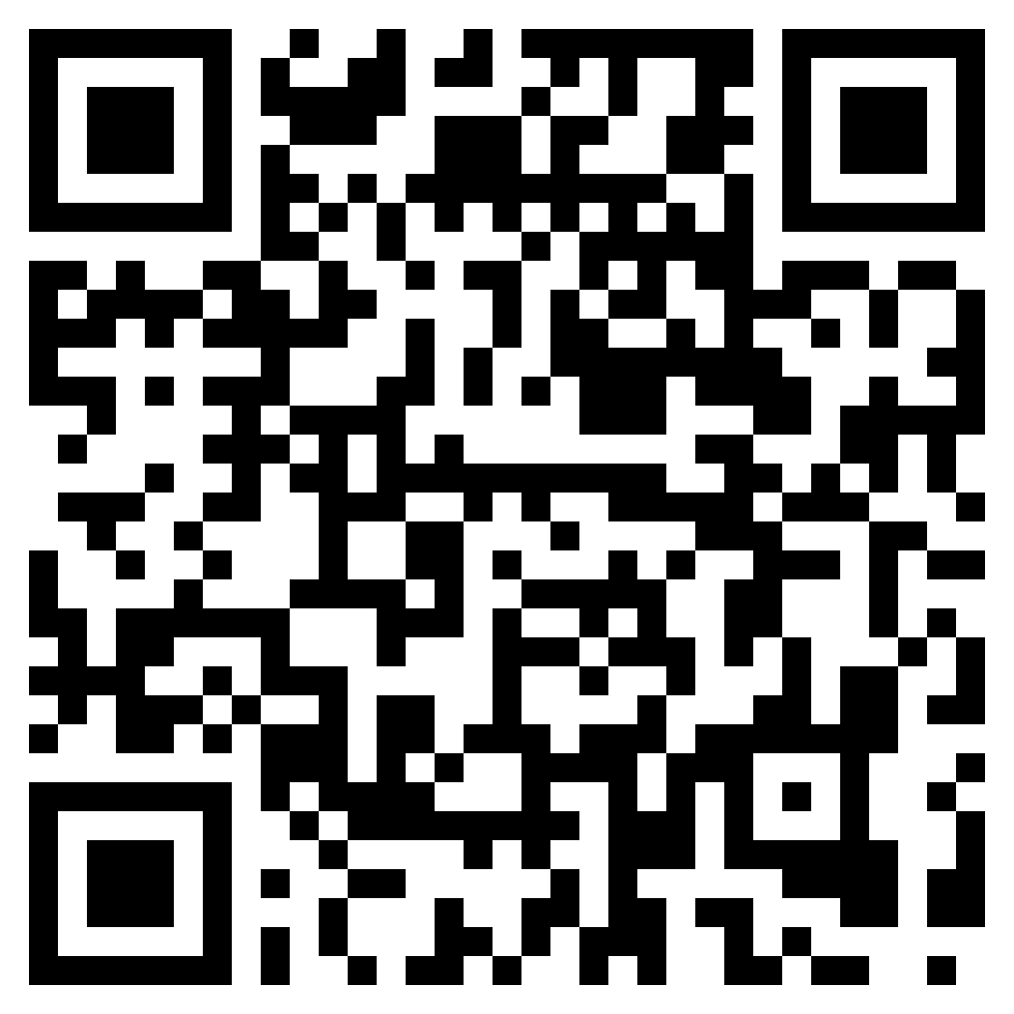
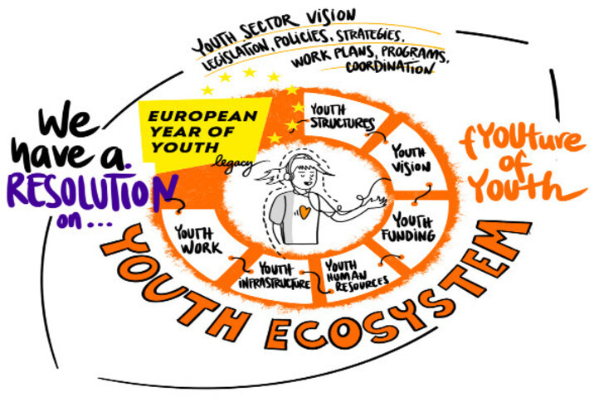
Resolution on the fYOUture of YOUth EcoSystems
Sign the petition!

