Slide 1
OTP Fáy András Foundation
”
8th of November, 2022
Budapest
Anikó Bátori

Slide 2
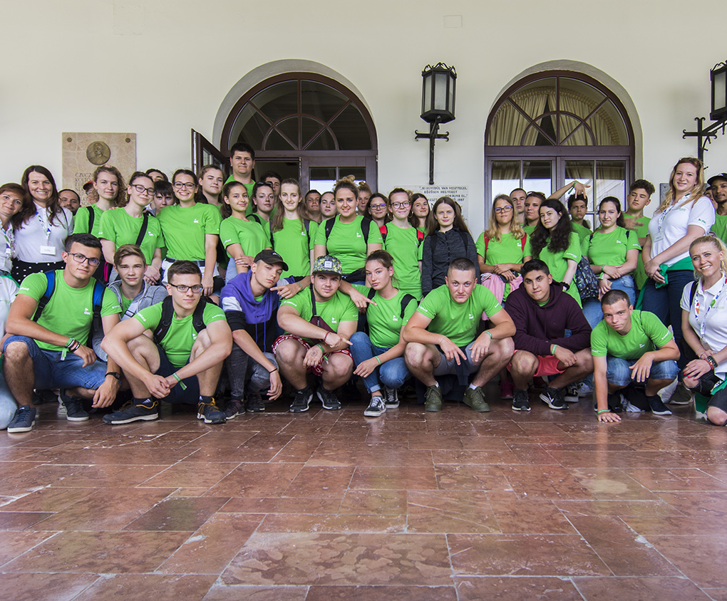
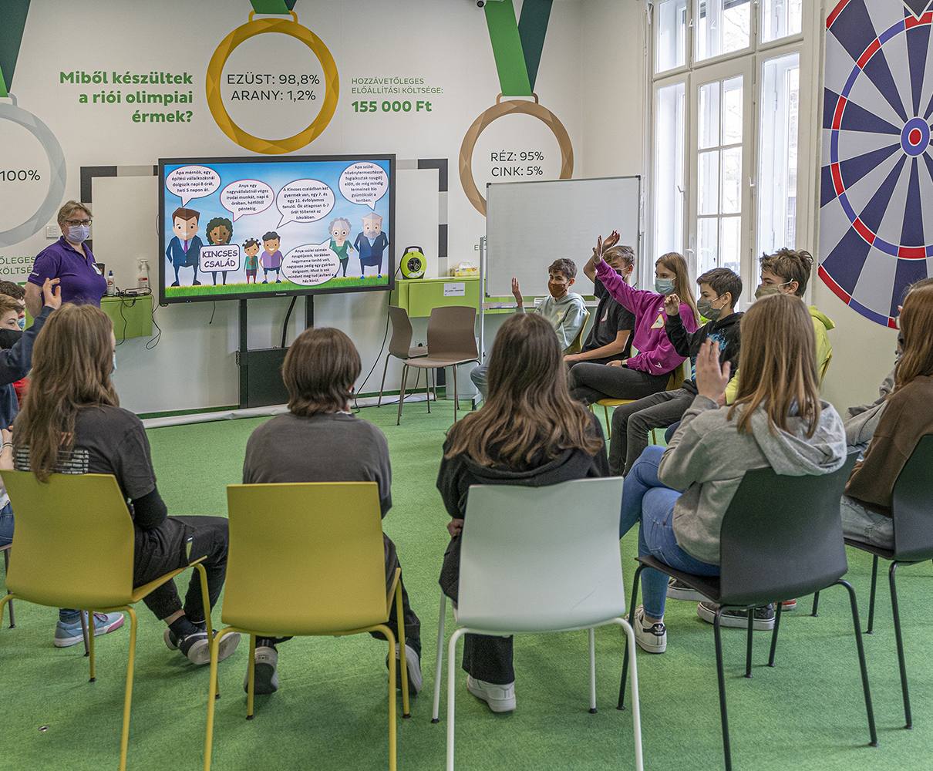
The goal of the 30-year-old OTP Fáy András Foundation is to develop future-oriented thinking, especially in financial field among the participants of the young generation.
Training target groups: primary and secondary school students, young adults (university students, students participating in vocational training).
Approximately 20,000 students take part in in our free, attitude-shaping courses every year. Our educational programs and products have received numerous national and international recognitions.
Training areas and topics: financial awareness, economic knowledge, career planning- and guidance, sustainability, and development of other social competencies that are essential for a successful life.
Training methodology, teaching materials: Self-developed training content based on practice-oriented, experience-based teaching methodology, which is also available in the form of face-to-face and digital trainings (e-learning, interactive streams).

Slide 3
Target groups
Youth
Adults
Young adults, university students, vocational training participants, NGOs, national companies
Teachers
Financial literacy teachers
Primary and high school students
Notes:
Kinek:
Fiatalok, felnőttek, tanárok

Slide 4
Program for adults
Knowledge transfer
Developing attitudes
Sharing best practices
Our aim is to help participants to reach the most essential financial goal: to create their own and their family’s financial well-being
The structure and the content is based on OECD recommendations and our expert’s experiences
Our method:

Slide 5
Themes and topics
Money and transactions | Incomes and expenses | Financial safety and risk reduction | Savings and Investments
The engine of cash flow: the bank Means of payment Sources of danger related to the movement of money: financial predators | The movement of money in our daily lives: earnings The movement of money in our daily lives: expenses Psychology of advertising Financial self-care | The psichology of risk-taking Financial risks Insurance and risk | Savings Investing and risk reduction Infesting forms Long-term self care: retirement
Loans | Financial landscape
Everything you have to know about loans Loan as a short-, medium and long term investment Debt management | Financial actors The role of the state in the economy Economic regulations and consumer protection Enterprises
Introduction
Where to go with financial questions?

Slide 6
Universities
Vocational training institutions
NGOs
Individually
Partners and implementation options
Notes:
In universities: implemented in the curriculum as a compulsory element or as supplementary – Business administration, Teacher training, Media and Communication,
VTI: implemented in the curriculum
NGOs: as a program for developing the volunteers financial wellness and wellbeing, as a program that is available for the NGOs target group
Companies: OTP Hungary as a basic knowledge course about finances for new employees, as an element of their

Slide 7
About the program
Free financial education package developed by the OTP András Fáy Foundation
It does not require prior knowledge
It can be done on a mobile device, tablet or laptop
Time required to complete the program: 6 topics approx. 12 hours, one topic approx. 60 – 90 minutes, it is also possible to work on a topic, at your own pace, with interruptions
Access: possible in the Foundation’s LMS or in the partner institution's own LMS
Implementing and organising the program can be done by independently
It can also be integrated into other internal training programs or corporate employer programs (cafeteria).

Slide 8
The participants will …
understand the basic financial processes and concepts in everyday life.
know the financial services, identify which one to use for what purpose.
be able to manage his/her finances independently
be more confident in solving financial problems and making the right financial decisions in different life situations.
meet financial obligations. They will learn to follow long-term financial plans corresponding with their life goals.
understand the importance of information, control and thinking - "Inform and think before you decide on your finances"!
find it easier to navigate the world of work, manage their income correctly, and start/continue building their independent life path with more confidence.
receive a certificate for completing the basic financial literacy training.

Slide 9
Workshop
Make groups of about 3-4 people
and let’s find out how we can support the young generation in becoming financially literate and independent!
In the next 20-25 minutes we will have a workshop and discussion about implementing the Financial Literacy program in your organisation, country, etc.

Slide 10
What are the most pressing financial issues among youths and young adults?
Collect and agree on 3 main issue.

Slide 11
How would you implenet a financial literacy program in your organisation, country, etc?

Slide 12
How would you motivate the young generation to participate in a financial literacy program?

Slide 13
Questions & Answeres
aniko.batori@otpfay.hu

