Slide 1
Expert meeting on higher education in youth work
20-23.9.2022 Helsinki
Päivi Marjanen

Slide 2
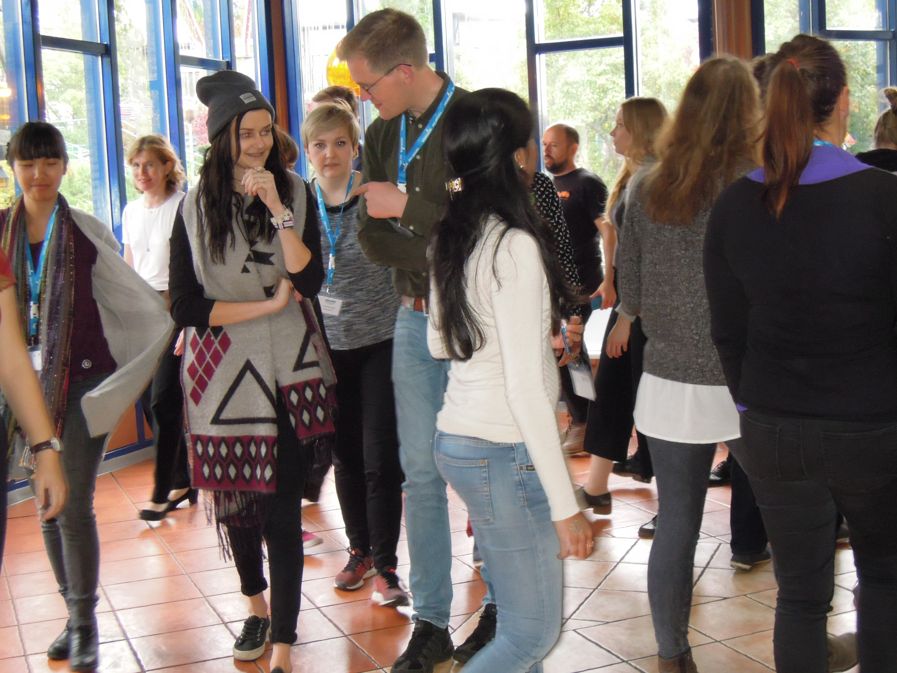
Cooperation internationally in HEI’s

Slide 3
Why international collaboration is important?
Jadranka Vukovic Johnsson European Comission:
Cooperation improves quality
Antje Rothemund
Council of Europe: International youth work solves problems

Slide 4
Next steps
What kind of collaboration we have now?
What kind of collaboration we hope in the future?
What kind of collaboration improves the lives of young people in Europe?
My dream is…

Slide 5
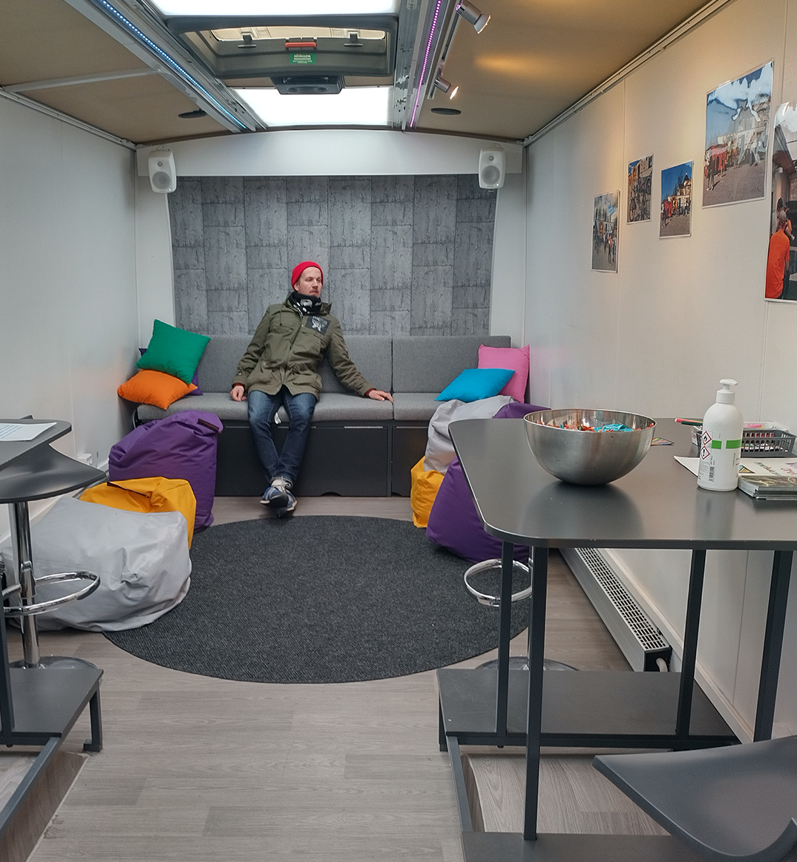
Wauto, Finnish mobile youth work

Slide 6
Forms of cooperation
Common research,
Joint degree programs,
Development of practices ,
Seminars
International webinars for students
…

Slide 7
Themes 1 and 2
1. Current phenomena in the context of European youth work
The idea of this workshop is to find tools to share information and seek cooperation on new phenomena and contexts of youth work in Europe. The aim is to strengthen together our anticipation knowledge of European youth work.
2. How to develop a new higher education study programme for youth workers?
The aim of this workshop is to change ideas and experiences about youth work studies and develop new contacts and contents

Slide 8
Themes 3 and 4
3. Promotion of higher education in youth work in European level
The aim of the workshop is to discuss:
- how higher education institutions can better showcase their knowhow in youth work education
- how can we promote together the value of youth workers HE in Europe
4. European Universities
The aim of this workshop is to discuss European Universities Initiative and explore possibilities it offers to
the development of youth work education in higher education.

Slide 9
Next steps
Schedule
11.00 – 11.55 Team works
11.55-12.10 Discourse

