Slide 1
HEIs Networking – words from the ‘somewhat wise’ …
Hilary Tierney
Maynooth University

Slide 2



Slide 3


Slide 4








Slide 5



Slide 6





Irish Youth Work Educators Forum

Slide 7
YWEF – Community of Practice (2016)
Purpose:
provide networking & collegial space to discuss/act on issues related to the provision professional education & training of youth work practitioners
provide a platform for HEIs to engage with NSETS
develop a strong & authoritative voice from within the HEI youth work education and training sector.

Slide 8
Terms of Reference
Explore
‘Signature Pedagogy’ in professional youth work education and training
professional endorsement
process of professional formation
what role we can play in the promotion & development of quality youth work practice
opportunities to articulate, promote, research and publicise the profession and approaches
relating to other ‘social professions’
Develop
develop and articulate standards of good practice in professional education & formation
standards of good practice and input into & influence NSETS
Examine
the opportunities to promote Youth Work as a profession

Slide 9
Membership, Meetings and Co-ordination
Membership
Membership open to all colleges offering NSETS endorsed programmes
staff who contribute to professional programmes youth work/practice skills/professional formation
Meetings
Three online meetings per year and one face-to-face
Co-ordinating group /Conveners
Two nominees from each HEI to co-ordinate work of YWEF and convene meetings.
primary commitment to transparency and consensus decision making

Slide 10
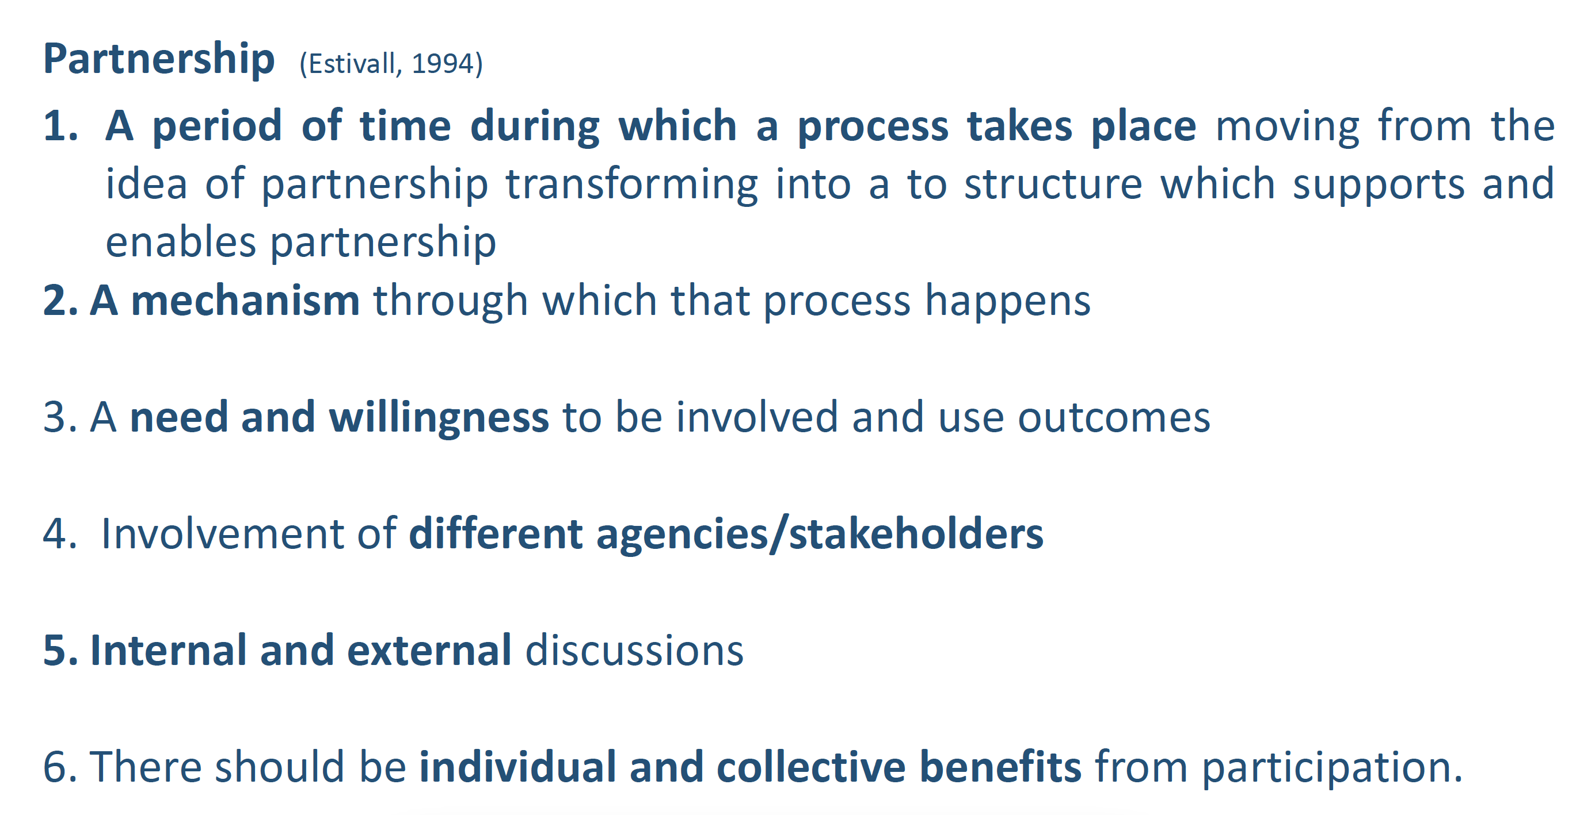

Collaboration and Partnership
1. Show Up
2. Show Willing
3. Put yourself in the ‘way of the work’
4. Take risks
5. Don’t be afraid to ‘not know’
6. Ask for help
7. Have fun!

