Slide 1
PLA on higher education in youth work 20-23 September, Helsinki
The Portuguese State of Play

Slide 2

The IPDJ is the Government agency that has among its competencies the execution of an integrated youth policy, namely with youth and student associations. It supports youth associations, volunteerism, promotes of citizenship, occupation of free time, non-formal education, youth work, among others.
https://ipdj.gov.pt/

Slide 3

Legislation
Constitution of the Portuguese Republic
Article 70 - (Youth): all Portuguese legislation on youth is subordinate to this article of the Constitution, which defines the specific rights and duties for youth.
There is no specific law in Portugal regarding youthwork, there are several scattered laws, always under article 70.

Slide 4
In Portugal the entity with competence for qualification and vocational education is the National Agency for Qualification and Vocational Education, (ANQEP, I.P.).
This Agency classifies the Youth Worker (Técnico de Juventude) at level 4 within the european qualification framework, describing their role as: intervening in the design, organization, development and evaluation of projects, programs and activities with and for young people, through methodologies in the field of non-formal education, facilitating and promoting citizenship.
Youth workers obtain their certification in professional schools that promote dual certification.
https://catalogo.anqep.gov.pt/qualificacoesDetalhe/7322

Slide 5

In terms of higher education, 8 different institutions offer bachelor degrees in sociocultural animation.
As for post-graduate studies, there is at least one course in Youth Studies at the Universidade Aberta, whose objectives are mainly focused on analyzing and understanding youth contexts, namely from a sociological, educational, psychological, Social Service and Social Policy perspective, youth work can be addressed, but it is not the central theme.
https://portal.uab.pt/alv/cursos_alv/estudos-juvenis/

Slide 6

Finally, at PhD level, with the aim of producing scientific knowledge on youth, there is the Permanent Observatory on Youth, a research and study programme of the Institute of Social Sciences of the University of Lisbon, since 1989.
https://www.opj.ics.ulisboa.pt/

Slide 7
Conclusion
In Portugal, the concepts of youth work and youth worker apply to Técnicos de Juventude, who take their certification in professional schools which promote double certification.
At the higher education level, the closest we can find to a degree in youth work is, probably, the socio-cultural animation degree.
In Portugal, there is no specific law to frame youth work.

Slide 8
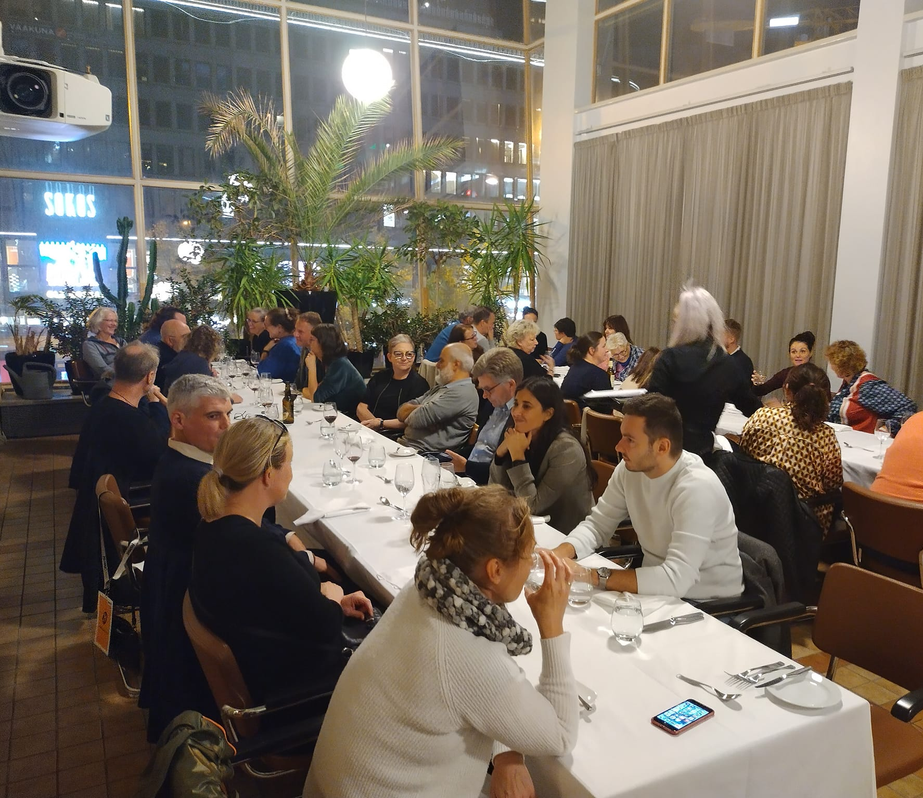
THANK YOU!
miguel.martins@ipdj.pt

