Slide 1
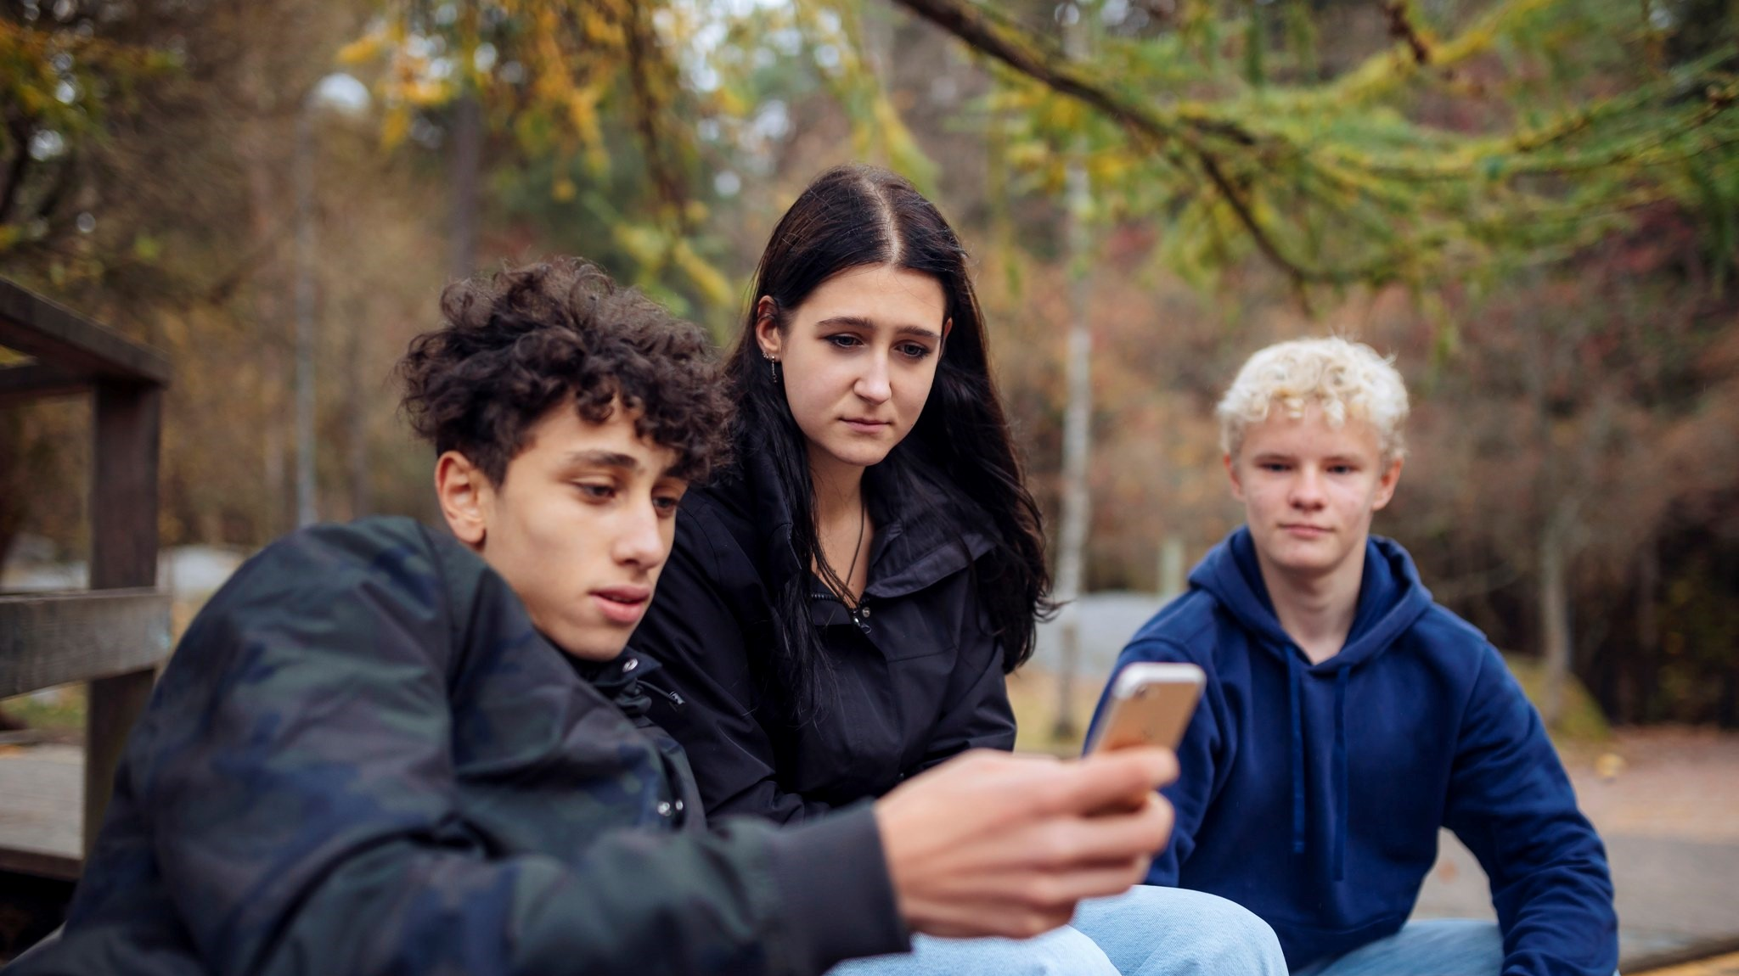
Since 2011
Mental Health Promotion in
Youth Work
Elina Marjamäki
Mental Health Promotion of Young People
Youth Work Competence Centres
MIELI Mental Health Finland

Slide 2
MIELI Mental Health Finland
Non Governmental Organisation (NGO)
1897 The world’s oldest mental health association ☺ 125 yrs
Promoting mental health by:
Politics, policies, curriculas
Mental health training and material for all age groups 0-100
Help and support; national crisis help line 24/7, Crisis chat for young people, suicide prevention, support groups, crisis help for immigrants, live and online
Volunteer-based work and active citizenship

Slide 3
OUR MISSION: is to increase every adult’s understanding that they have the power to positively impact on mental health of every child and young person every day and we should build safe environments where mental well-being is supported and taught.

Slide 4

The importance of every day, basic level
became visible during pandemic
Psychiatric
Services
Therapy guarantee law is in the process, Low threshold therapy,
Easy access to therapy services → Walk-In Psychology Services in Helsinki Health Care for ages 13 →
Prevention
Early recognition of the problems, Help services, crisis services, services should be raedily available if problems occur
Promotion;
Mental health skills in National core curricula for basic education 2014, Student welfare law 2013, Early Education Curricula 2013, National Youth Work and youth policy 2020–2023;
National centres of expertise for youth work,
Parental support and child health clinics
Everyone can and should do this.
The stronger the base, the less need for corrective services
Notes:
Ruohonjuuritason työ on kaikkein tärkeintä ja jokainen pystyy siihen.
Ohjaamojen työ myös vihreää..rajapinnassa
Mielenterveyden edistäjä ei toimi ”parantajan” roolissa sillä promootion ala on lääketieteellisen määrittelyn ja hoidon tuolla puolen.
Ihmistä lähestytään voimavaroin varustettuna kokonaisuutena. Arkikontekstit tulevat keskiöön.
Riskiryhmien kartoittamisen sijaan edistämistyössä edistetään ja vahvistetaan kaikkien ihmisten terveystekijöitä.
Kun vaikutetaan koko ikäryhmään, se vaikuttaa myös huonompiosaisiin. Lapsen köyhyys työryhmästä esimerkki: mitä enemmän on karsittu yleisiä tukia ja panostettu erityistukiin, on huomattu, että apu tulee liian myöhään.
Mitä vahvempi harmaa kaikille tarkoitettu palvelu on sitä vähemmän tarvitaan erikoishoitoa

Slide 5
The importance of every day, basic level became visible during pandemic
Psychiatric
Services
Therapy guarantee law is in the process, Low threshold therapy,
Easy access to therapy services → Walk-In Psychology Services in Helsinki Health Care for ages 13 →
Prevention
Early recognition of the problems, Help services, crisis services, services should be raedily available if problems occur
Everyone can and should do this.
The stronger the base, the less need for corrective services
Promotion;
Early education, Schools, Youth work, Libraries, Communal places, Swimming halls, Hobbies, Sports, Rehabilitation centres, Day centres etc.
Notes:
Ruohonjuuritason työ on kaikkein tärkeintä ja jokainen pystyy siihen.
Ohjaamojen työ myös vihreää..rajapinnassa
Mielenterveyden edistäjä ei toimi ”parantajan” roolissa sillä promootion ala on lääketieteellisen määrittelyn ja hoidon tuolla puolen.
Ihmistä lähestytään voimavaroin varustettuna kokonaisuutena. Arkikontekstit tulevat keskiöön.
Riskiryhmien kartoittamisen sijaan edistämistyössä edistetään ja vahvistetaan kaikkien ihmisten terveystekijöitä.
Kun vaikutetaan koko ikäryhmään, se vaikuttaa myös huonompiosaisiin. Lapsen köyhyys työryhmästä esimerkki: mitä enemmän on karsittu yleisiä tukia ja panostettu erityistukiin, on huomattu, että apu tulee liian myöhään.
Mitä vahvempi harmaa kaikille tarkoitettu palvelu on sitä vähemmän tarvitaan erikoishoitoa

Slide 6
Finnish politics promoting mental health;
2014: Mental health skills in the National Core Curricula for Basic Education https://www.oph.fi/en/statistics-and-publications/publications/new-national-core-curriculum-basic-education-focus-school
New law of compulsory education until 18 yrs of age
2004: Health Education: new compulsory school subject
2018-19 and 2020-24 National Youth Work and Youth Policy Programme; mental health promotion as one of the goals of youth work
The Finnish model
for leisure activities
2004
2013
2018-19 and 2020-24
2014
2015
2020-30
2019
2020
PALOMA Center of Expertise in Refugee Mental Health Work
2013 Student Welfare Law: New focus on promotion of the wellbeing and whole school approach
2015: Mental well-being in the Early Childhood Education Plan
National Mental Health Strategy 2020–2030
https://julkaisut.valtioneuvosto.fi/handle/10024/162234
Notes:
The environments in which children and young people grow significantly influence their mental health. Good mental health in children and young people is supported when society:
creates secure conditions for family-life and in other formative environments also during societal change,
ensures that each child has equal opportunities for self-esteem, mental health skills, learning and feelings of achievements,
gives each child equal opportunities for engaging in safe recreational activities which promotes their development,
safeguards the rights of vulnerable children and young people and those in challenging life circumstances
reduces childhood poverty in families
reduces social exclusion of children and young people.
https://thl.fi/en/web/migration-and-cultural-diversity/contact/paloma-center-of-expertise-in-refugee-mental-health-work
n 2020–22, implementation will focus on developing services, launching a suicide prevention program and increasing mental health skills in people’s everyday environments as part of a wider promotion of well-being and health.

Slide 7
National Mental Health Strategy 2020–2030
https://julkaisut.valtioneuvosto.fi/handle/10024/162234
The environments in which children and young people grow significantly influence their mental health.
Good mental health in children and young people is supported when society:
creates secure conditions for family-life and in other formative environments also during societal change,
ensures that each child has equal opportunities for self-esteem, mental health skills, learning and feelings of achievements,
gives each child equal opportunities for engaging in safe recreational activities which promotes their development,
safeguards the rights of vulnerable children and young people and those in challenging life circumstances
reduces childhood poverty in families
reduces social exclusion of children and young people.

Slide 8
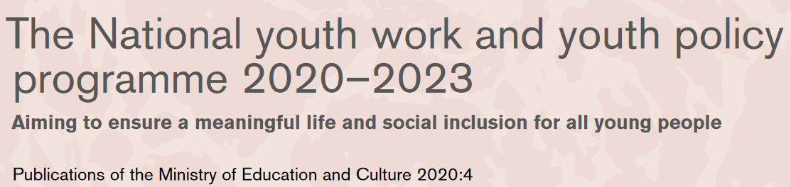
https://julkaisut.valtioneuvosto.fi/bitstream/handle/10024/162381/OKM_2020_4.pdf?sequence=1&isAllowed=y
Young people emphasized the importance of mental health.
Mental health promotion is written in the programme and it is one of the tasks of youth work.

Slide 9
Ministry of Education and Culture finances:
Six National Competence Centres for youth work: MIELI Mental Health Finland is working in 3 of them
Municipal youth work
School youth work
Targeted (outreach) youth work
One of the many tasks of youth work is to promote mental health.
Cooperation, listening, supporting, skills

Slide 10
MENTAL HEALTH PROMOTION IN NATIONAL YOUTH WORK AND YOUTH POLICY PROGRAMME
National youth work and youth policy programme 2018-20 and 2020-2024
Youth Work Centres of Expertice (6):
Mental health promotion in 3 of them:
  Communal youth work competence centre
  Outreach youth work competence centre
  School Youth Work competence centre
https://julkaisut.valtioneuvosto.fi/handle/10024/162381
Notes:
The national youth work and youth policy programme (VANUPO) is a statutory cross-administrative programme adopted by the Government every four years with the aim of improving the conditions in which young people live and grow. In this programme, the Government defines its youth policy objectives and the measures for attaining them. In addition, it sets out the policies for youth work, including the priorities of national youth work centres of expertise as well as the national objectives for European and international activities in the youth field. The programme is adopted as a Government resolution.
There are themes like digitality, every day life skills, and six others, that go through all the subjects.. So that every teacher should teach these skills and consider the themes no matter if it’s math, history or music… Every day life skills include a lot themes that strenghten mental health, like emotional and social skills and so on..
Opetussuunnitelma 2016:
Mielenterveystaidot vuosiluokilla 1-9
Varhaiskasvatuksen suunnitelma 2017 :
(turvallinen kasvu- ja oppimisympäristö, jossa opitaan sosioemotionaalisia ja mielen hyvinvoinnin taitoja)
Yhteisöllinen oppilashuolto; jokaisen aikuisen vastuulla on hyvinvoinnin edistäminen, ei vain ongelmiin puuttuminen vaan kokonaisvaltainen edistäminen,painopiste siellä
psykologien rooli
psykologian kurssit koulussa: lukion kurssit
Mitä oppilaat kaipaa? Millaista psykologista tietoa? Mitä opet on kommentoinu? Miten vaikuttaa? Jokainen voi opettaa. Oleellista on myös omat taidot. Kukoistava yhteiskunta, ihmiset
Mielenterveyden suojatekijät Marjaana Pelkonen, suojatekijät yhteisöllisen opiskeluhuollon lähtökohta, jokaisen vastuu

Slide 11
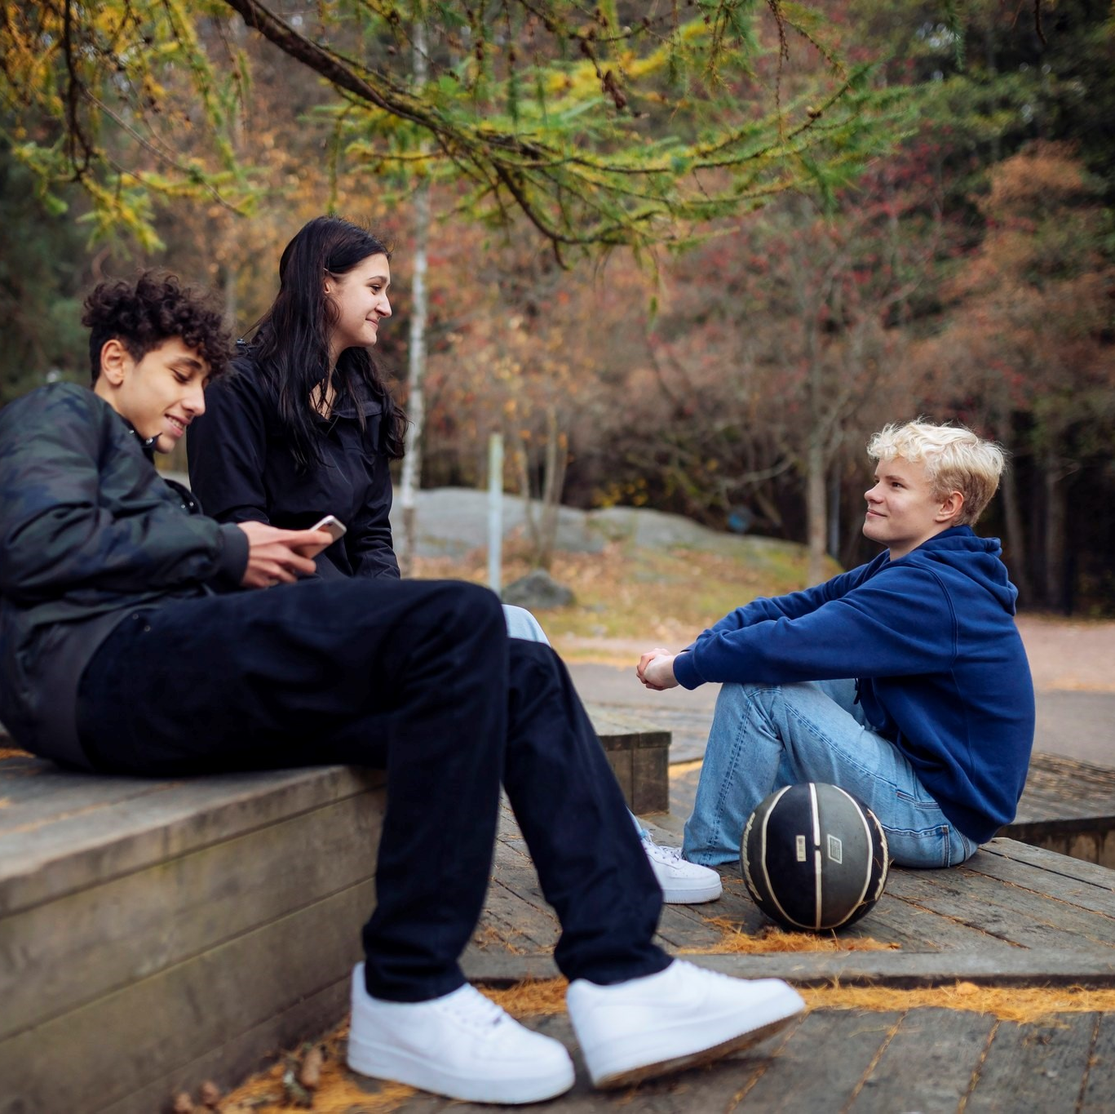
We AIM to increase adults’:
Knowledge and understanding of
Mental health as a positive resource and skill which we can teach, learn, support and strengthen
Risk and protective factors of mental health
Means to strengthen mental health
Importance of reducing stigma towards mental health problems and challenges
Awareness of ones own attitudes about mental health
Skills and motivation
To teach and strengthen mental health skills
To listen and to engage
To raise a concern and support
To know when and how to find help and support
Notes:
KNOWLEDGE AND UNDERSTANDING
mental health as a resource,
mental health as a part of overall health,
protective and risk factors of mental health,
ways to strengthen mental health,
attitudes and perceptions toward mental health
SKILLS
to teach and strengthen mental health skills
to engage and listen
how to ask, listen and support if concerns arise
know when and how to direct to receive help
mielenterveydestä terveyden osa-alueena,
mielenterveyden suoja- ja riskitekijöistä,
keinoista vahvistaa mielenterveyttä,
mielenterveyteen liittyvien asenteiden ja käsitysten tiedostaminen
opettaa ja vahvistaa mielenterveystaitoja
kohdata ja kuunnella
ottaa huoli puheeksi ja tukea
saattaa avun piiriin

Slide 12
BUT IN THE PAST WE SAW MENTAL HEALTH ONLY AS
Depression
Bipolar disorder
Schitzophrenia
Psychosis
Other disorders and illnesses
Notes:
KNOWLEDGE AND UNDERSTANDING
mental health as a resource,
mental health as a part of overall health,
protective and risk factors of mental health,
ways to strengthen mental health,
attitudes and perceptions toward mental health
SKILLS
to teach and strengthen mental health skills
to engage and listen
how to ask, listen and support if concerns arise
know when and how to direct to receive help

Slide 13
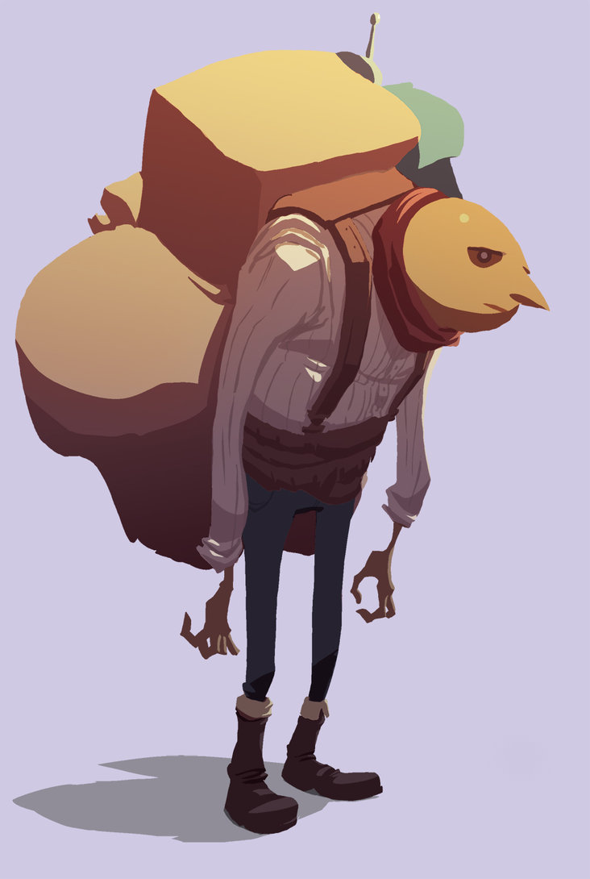
And this was a heavy burden
…for professionals to handle
It caused a lot of:
Fear
Anxiety
Resentment
Stigma
Notes:
Growth mindset motivation

Slide 14
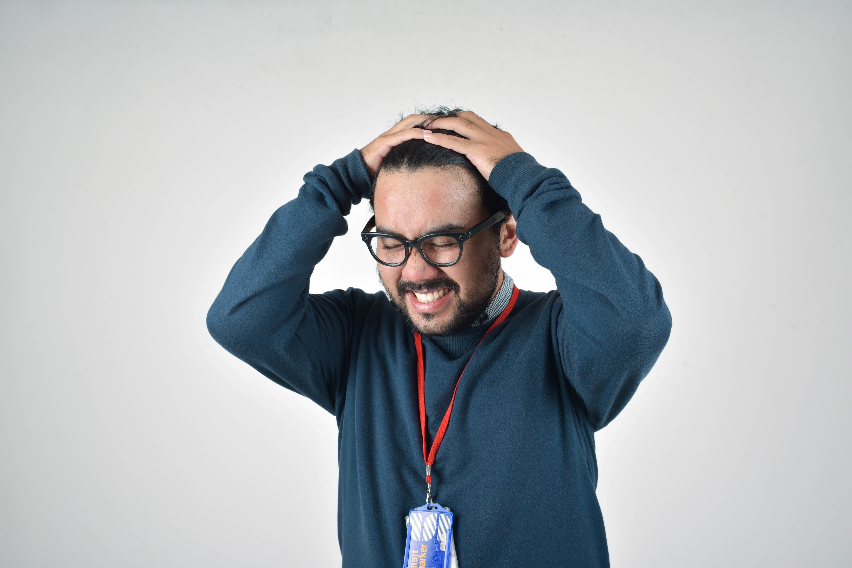
AND THIS PARADIGM MADE ADULTS FEEL ABOUT MENTAL HEALTH:
Fixed mindset about mental health; you either have mental health or you don’t have
Feelings of overwhelm and hopelessness
Too many problems, I can’t fix them → I give up
I am not interested in children’s wellbeing
I don’t have time to care
I am here to teach, not to be a doctor or social worker!
Notes:
Growth mindset motivation
Focus was on the problems

Slide 15
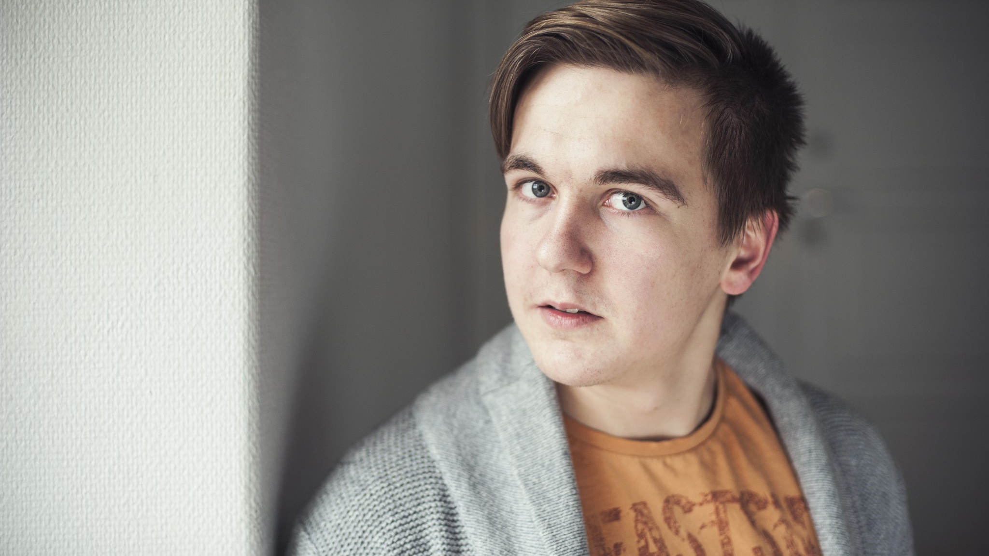
So we needed to create a new way of thinking about mental health

Slide 16
New paradigm for mental health
Mental Health is a life skill that you can always
  learn,
  teach,
  support and
  strengthen
Everyone has mental health even if they have mental health problems or difficult life situations or crisis
Everyone needs mental health even if we don’t have mental health issues or problems
Mental Health is the foundation for well-being

Slide 17

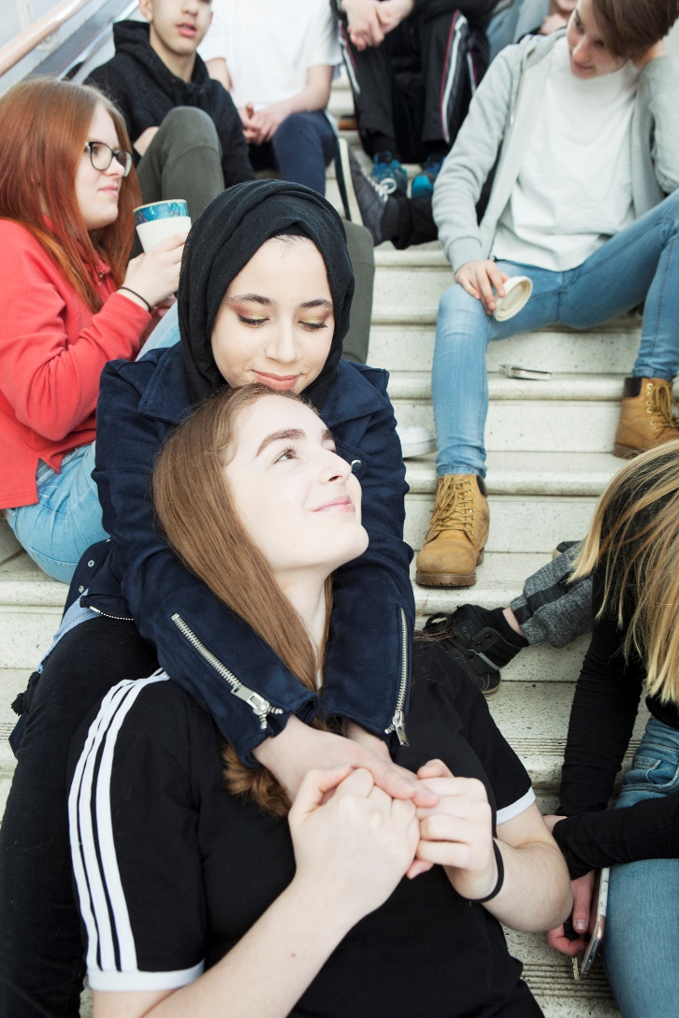
The idea of mental health as SKILL
GROWTH MINDSET
Daily routines and healthy habits
Emotional skills; Recognition, expressing, accepting emotions, empathy and assertiveness
Friendships and interaction skills →Preventing bullying and loneliness, safe groups
Coping skills
Self knowledge, self appreciation, strengths
Values and attitudes
Safety net and knowledge about places to get help from
Stress management and recovery skills
Mindfulness and relaxation skills
Dreams, optimism, goals
Participation and inclusion
Important skills for both young
and adults
MOTIVATION
OPTIMISM
CREATIVITY
Notes:
Lisää määritelmät mielenterveystaitoihin.

Slide 18
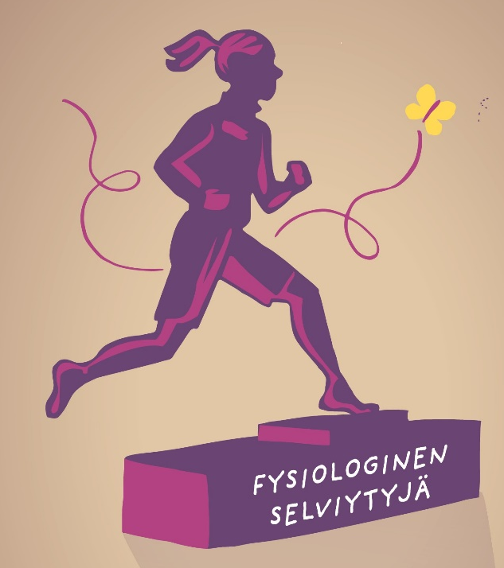
PRACTICING mental health skills with young people
Every day life offers us many opportunities to practice mental health skills
We can practice different skills depending on what are the needs of the young people you work with
  Do we need to discuss about the values?
  How about the interaction skills? Do we need to sharpen them?
  Emotional skills? Do we need to have a power-hour for emotions?
  What about coping skills? How do we talk about and practice different coping skills with young people?
  Is it time to breathe and learn some new relaxation skills?
  Shall we focus on positive self-talk this week?
  Should we pay special attention on the strengths of young people this week?
  Is there a need to find out what are our dreams and goals?

Slide 19

→ THIS CREATES GROWTH MINDSET ABOUT MENTAL HEALTH: LET’S GET TO WORK!
Joy and optimism increases
I can:
support
strengthen
teach
learn
make a difference
ask ”How are you?”
I am:
motivated to promote mh
hopeful and feel optimistic
caring
focused on the solutions
Motivated to take care of my own mental health skills
Notes:
Growth mindset motivation

Slide 20
What do professionals need?
Training
About mental health as a skill
Information, inspiration and empowerment
Appreciation (!)
Support from the management!
Concrete material
Handbooks
Posters
Cards
Board games
Ideas, inspiration
Online material

Slide 21
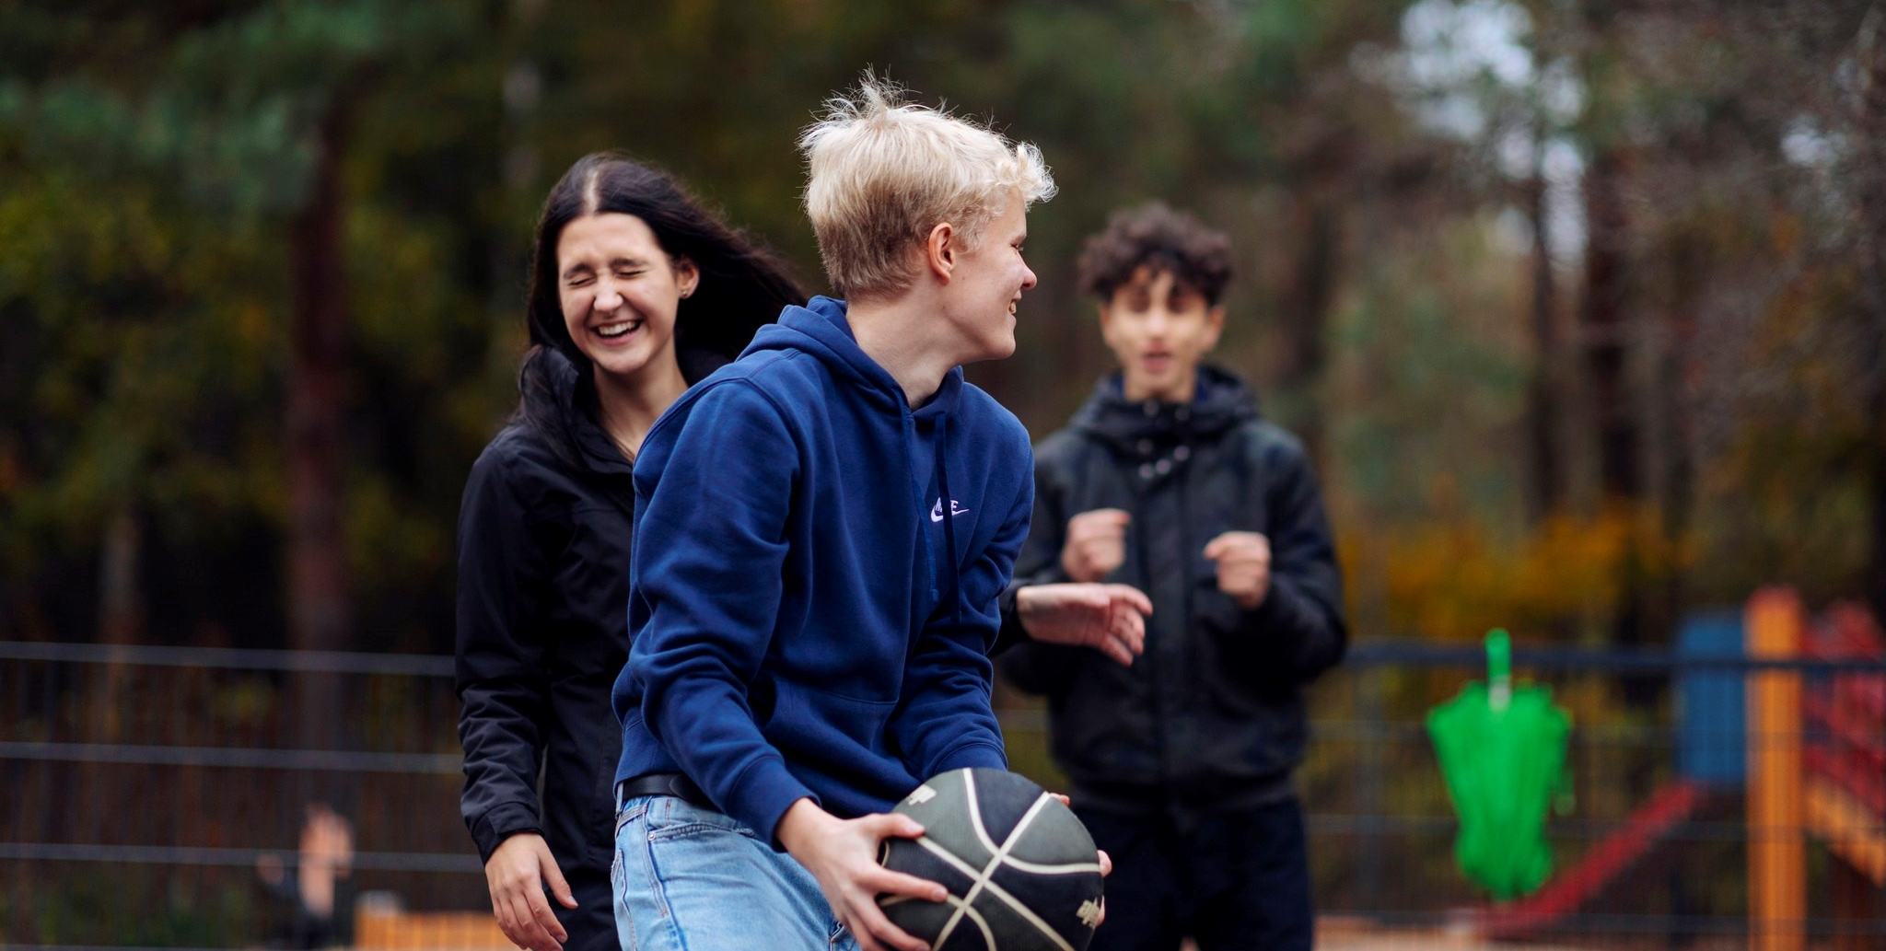
Mental Health Training for youth workers by MIELI
Mental Health Power – promotion and skills that support mental health 3h – 1 day
Young people, crisis and coping skills 3 h
Suicide prevention and young people 1,5 h
Strengths supporting mental health (based on VIA theory of character strengths)
Neurological variety and mental health promotion (→School youth work)
Promoting friendships and preventing loneliness (Board Game, ”Buddy in mind”)
Well-Being of the youth workers
Mental health and resilience
Hope and optimism supporting mental health
Recovery orientation (→Outreach and targeted youth work)
Climate anxiety and climate emotions and mental health; supporting young people
Mental health first aid 1 and 2 and Young Mind Mental Health First Aid
Notes:
Mental health and motivation

Slide 22
Mental Health Power
3 h during covid online – 6 h before covid live
Mental Health as a Positive Resource
  Everyday choices supporting mental health
Emotions and emotional skill supporting mental health
  The role of emotions and mental health
Strengths and self appreciation
Friendships and interaction skills and mental health
Practical applications and ideas

Slide 23
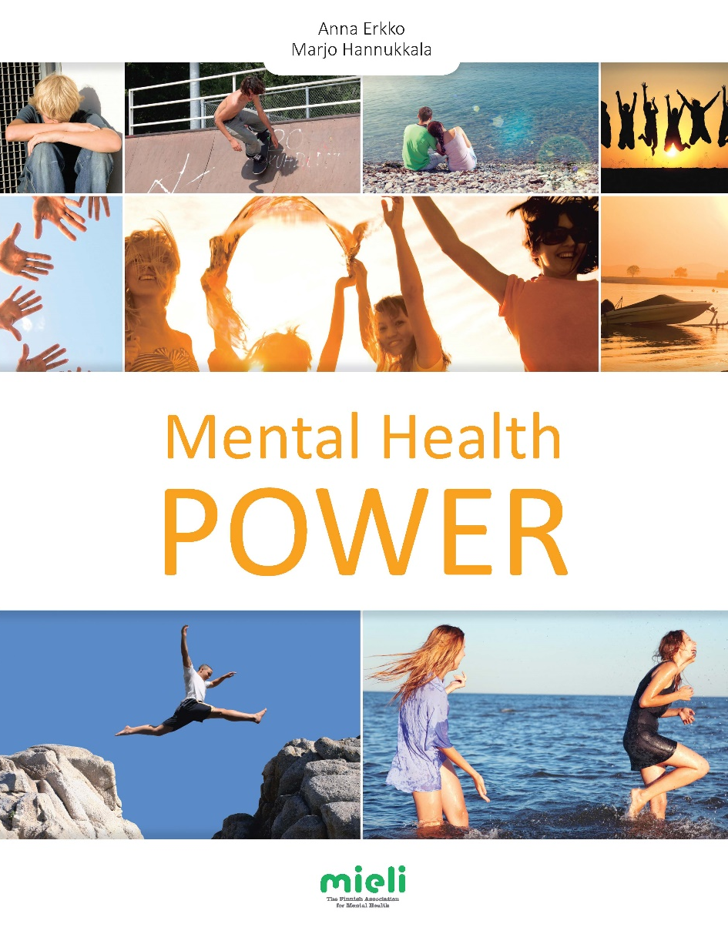
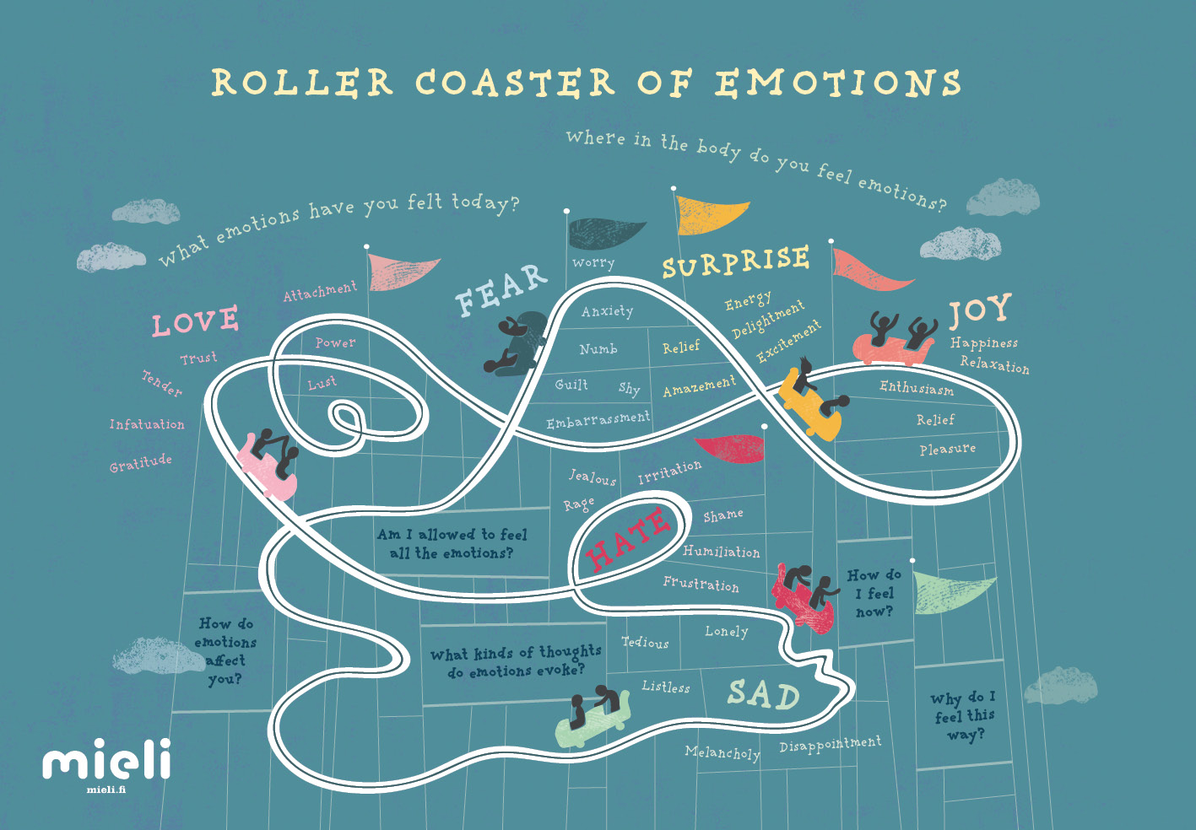
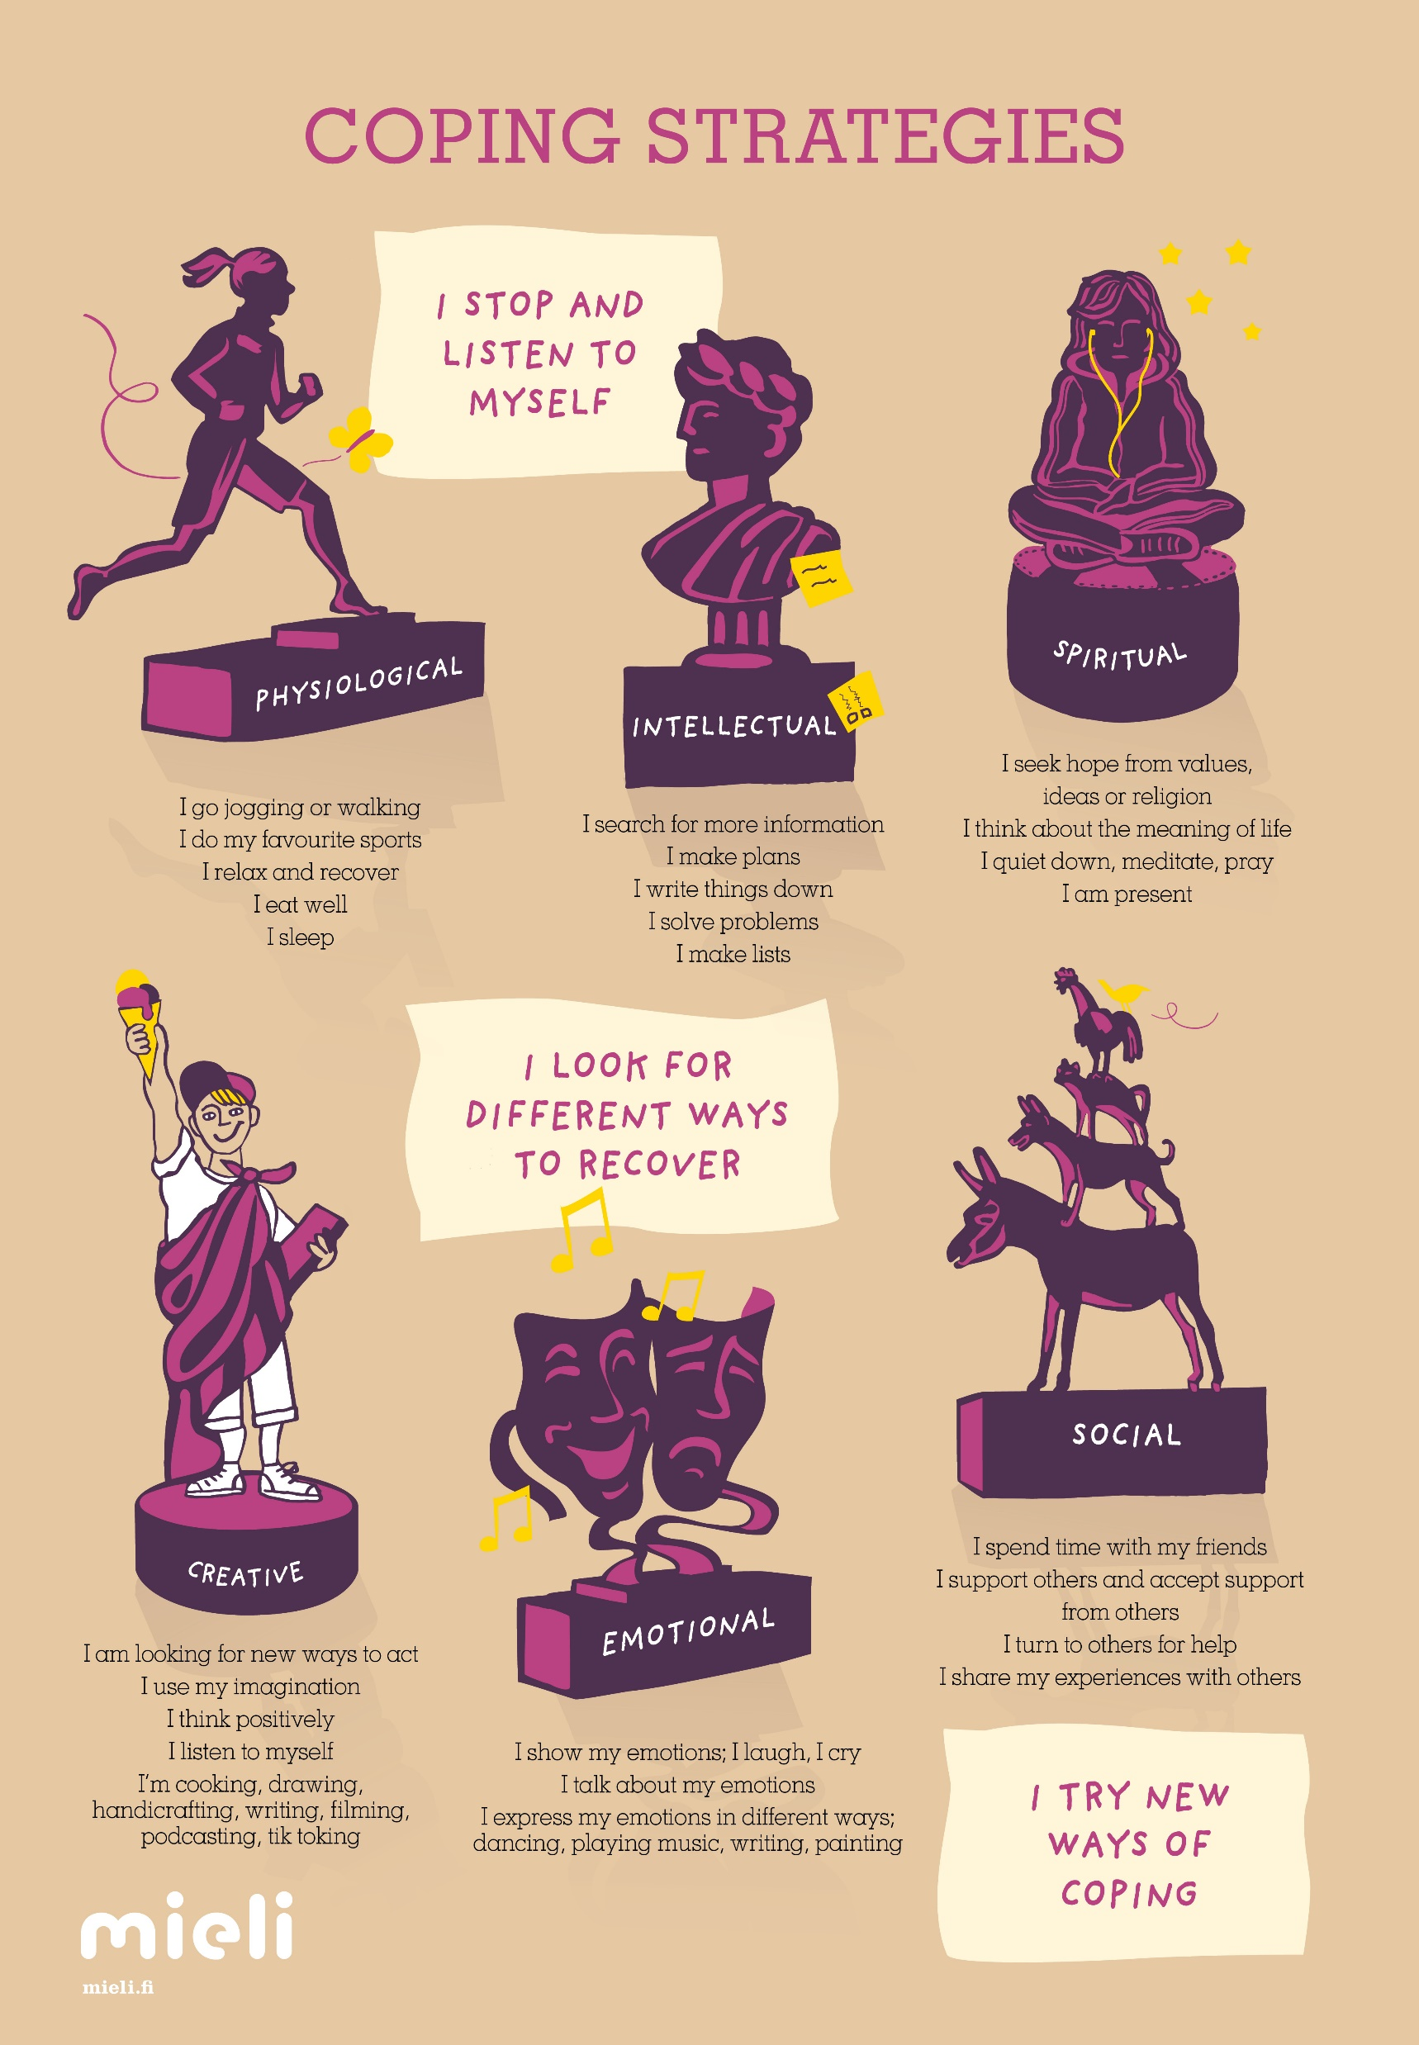
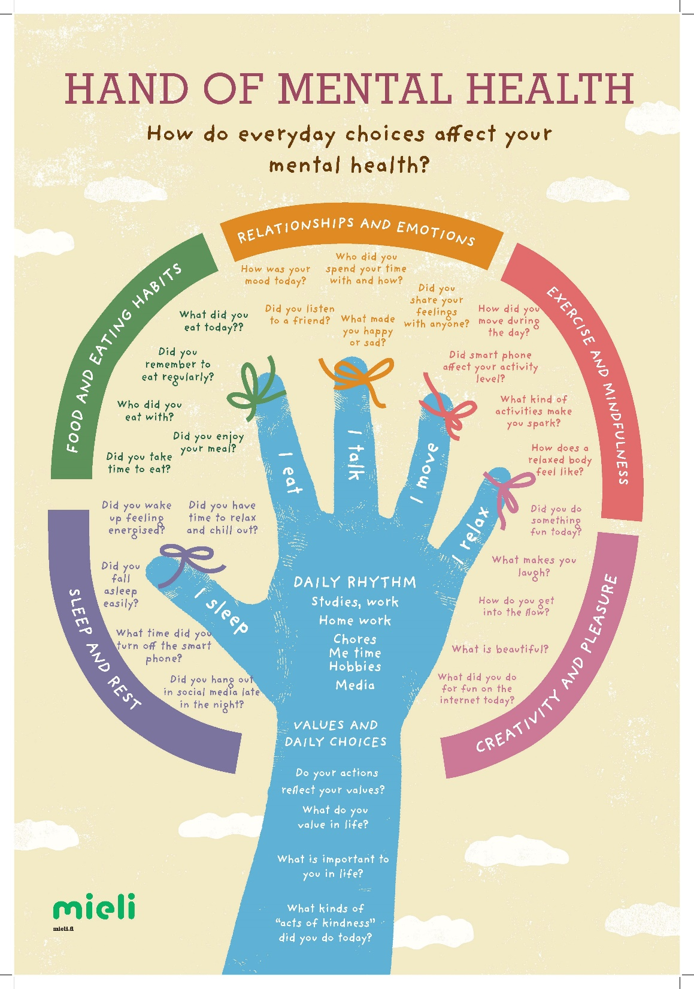
Material for youth work to promote mental health:
Handbooks
Posters
Board games
Strength cards
Workbooks
“Buddy in Mind” -classes
Online course

Slide 24
Youthworkers’ material promoting mental health:
Handbooks
Posters
Board games
Buddy in mind -classes
Strength cards
Workbooks
Online course

Slide 25
Mental Health Power
Youthworkers’ guide for promoting mental health
240 pages
What is mental health as promotion?
Young people and mental health
Adolescent development
Emotions and emotional skills
Relationships and social skills
Safety net
Young people and coping skills
Vulnerable mind
Values and mental health
Cooperation as a strength
Being used also as an educational material in educating youth workers
Available in Finnish, Swedish and English. Available online:

Slide 26
Everyday choices and mental health
Talking about the daily choices and how they affect our mental health
Your own daily choices and habits
Ideas to use this with young people
Reflecting your own Hand of mental health
Wellbeing of the adults:
If the adults don’t feel well, they don’t have the energy to be interested in and care for the young people.
Psychologist, researcher Marko Manninen THL
Notes:
Tässä kohtaa ryhmäkeskustelu 3-4 hengen ryhmiin:
hmissuhteiden merkitys, luonto ja ulkoilu, ympäristöasiat tulleet uuteen valoon;
Hyvän tekeminen, vapaaehtoistyö ja ystävälliset teot vahvistavat mielenterveyttä
Voimavarat = hyvää tuottavia ja jaksamista tukevia asioita (ihmiset, tunteet, toiminta, vahvuudet…)
Tukevat etenkin haastavissa tilanteissa, myös perusarjessa
Mielenterveyden voimavaroja käytetään ja kulutetaan päivittäin, eli tulee myös vahvistaa päivittäin
Voimavarojen pohdinta:
Mistä olet kiitollinen?
Mitkä asiat ovat tuoneet tällä viikolla hyvää mieltä? (treenivihko apuna)
Miten tyytyväinen olet elämääsi asteikolla 4-10? Mikä olosi on nyt asteikolla 4-10?
Mistä olo koostuu? Miksi tunnet näin?
Minkä asian pitäisi muuttua, jotta pääsisit 7:sta 7+?
Mitä positiivista pitäisi olla enemmän?
Mitä negatiivista vähemmän?”
Mitä voit itse tehdä muutoksen eteen?
Millaista apua kaipaat?
Mihin kiinnität huomiota?

Slide 27
Emotional skills
Vocabulary; important to have a rich vocabulary to describe your emotions
Thoughts and emotions;
Accepting your emotions

Slide 28
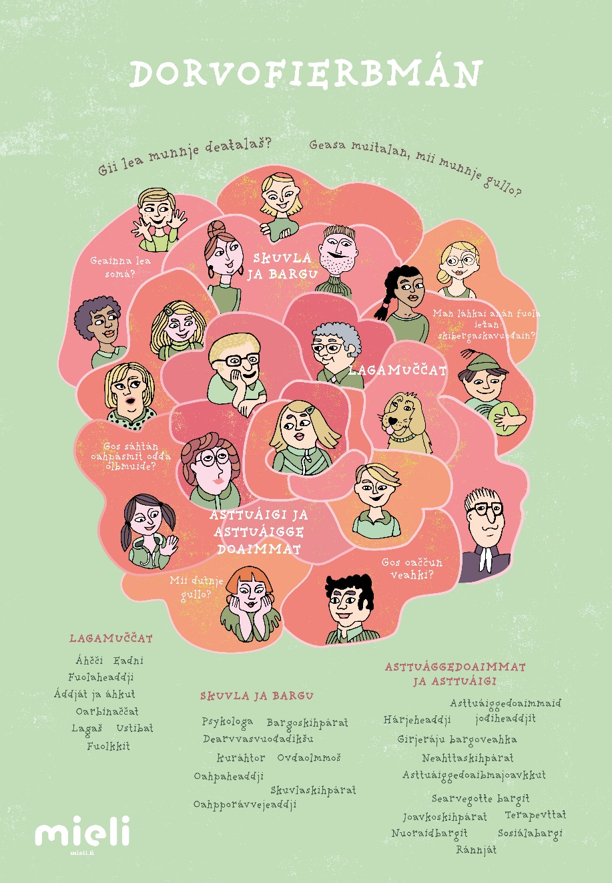
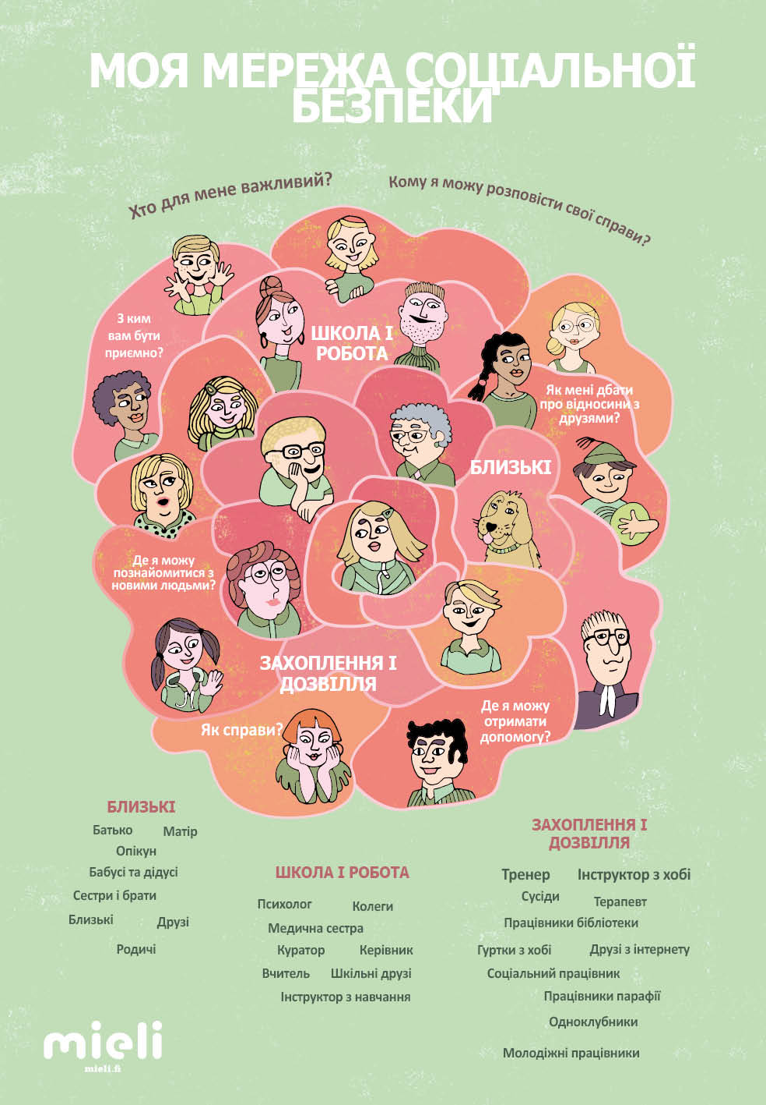
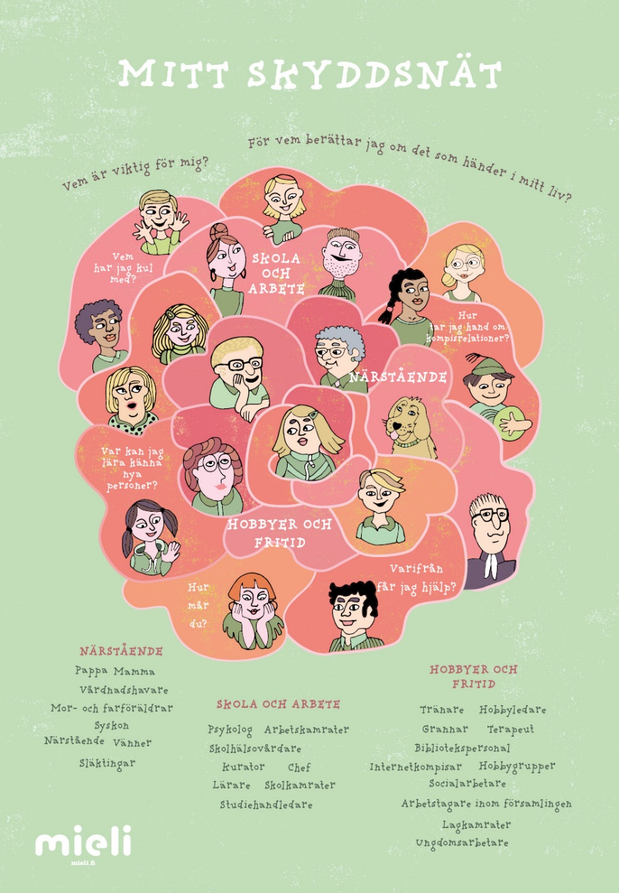
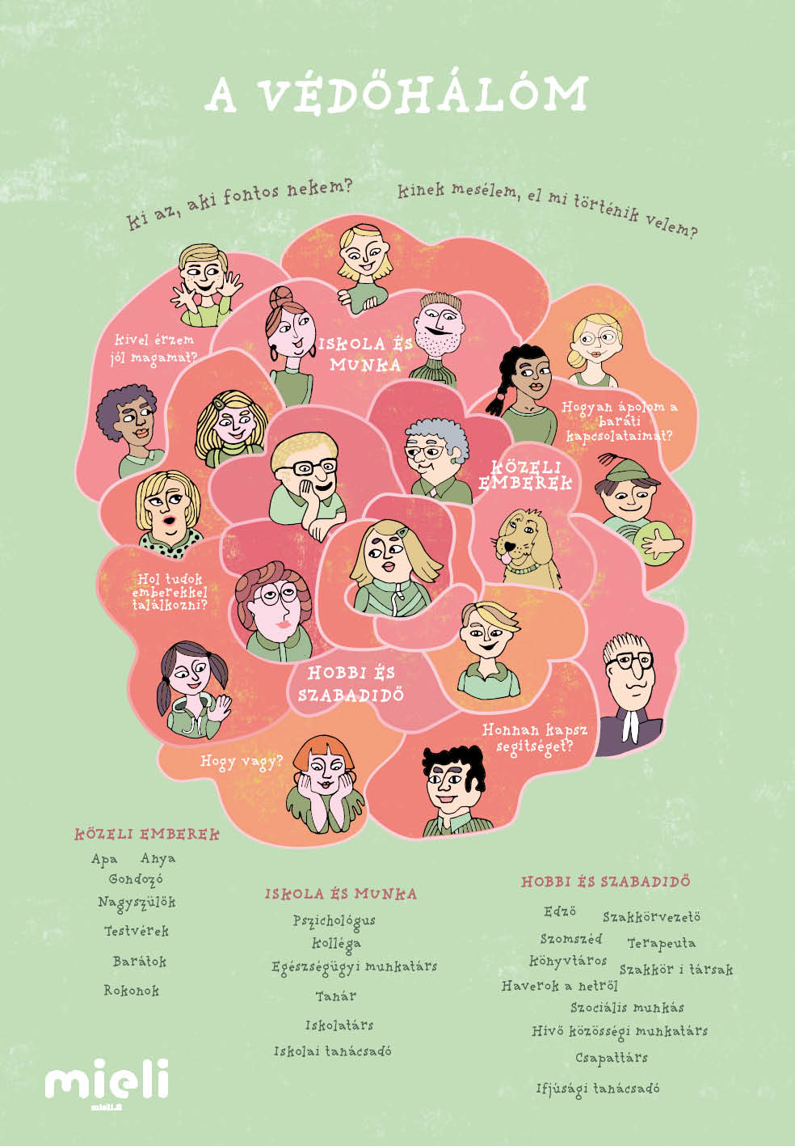
Safety net -poster
All posters are available in:
Sami-language
English
Swedish
Ukrainian
Hungarian
German
Dutch
Turkish (in progress)
Your language? ☺

Slide 29
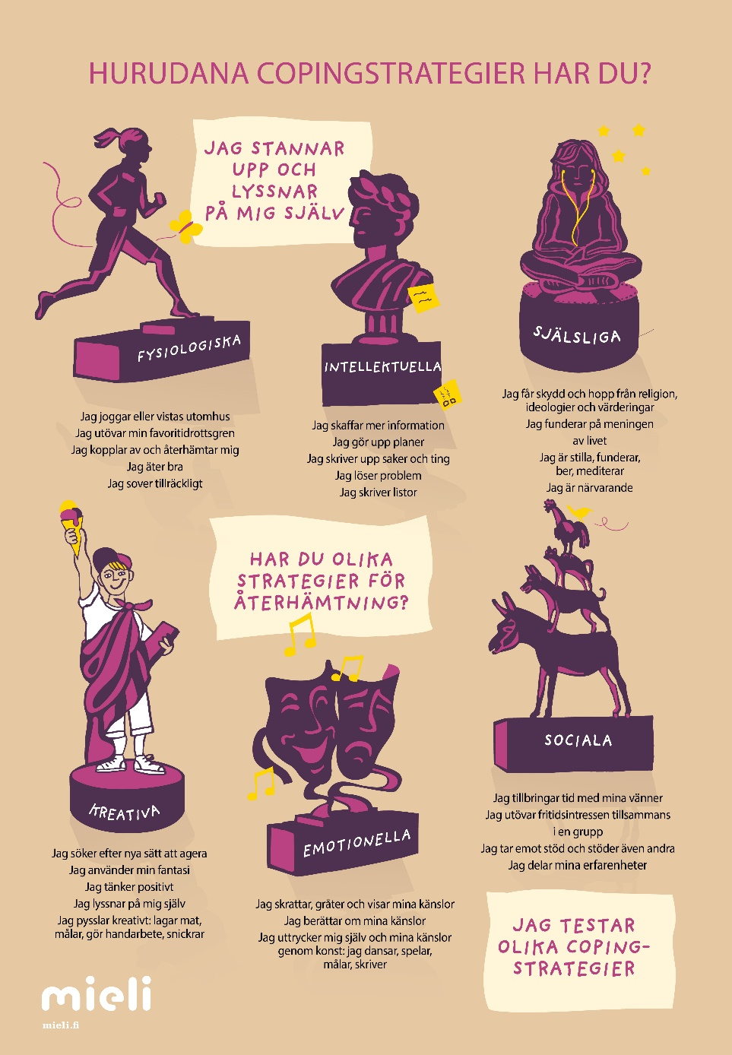
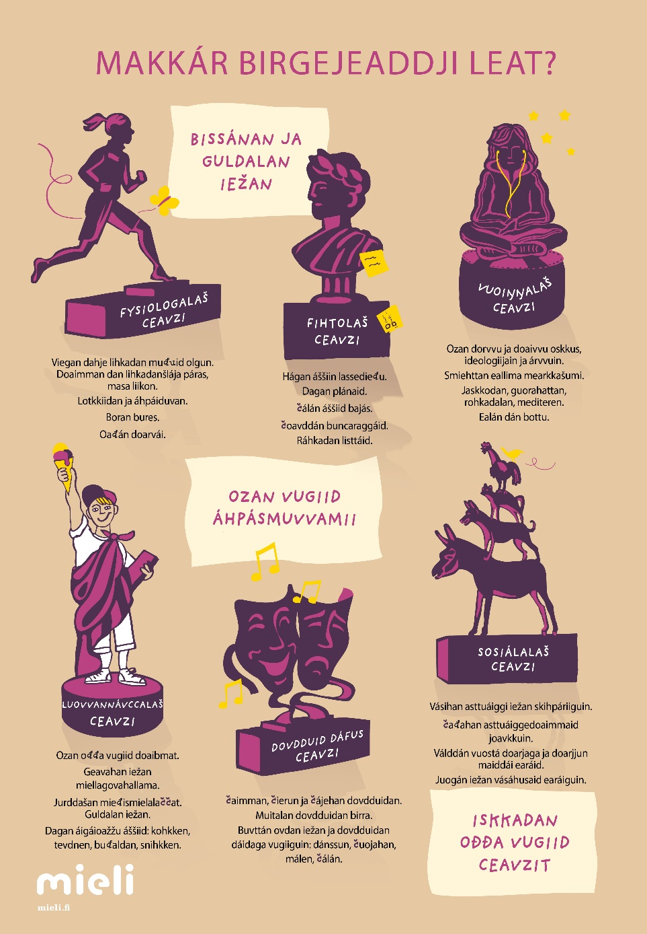
We all need coping skills
A tool to discuss about crisis and different ways we deal with them.
What are your coping skills?

Slide 30
Cooperation with youth work education
Trainees working in MIELI
Thesis work various subjects
Development work
    New material; board game, strength cards
    Training young prisoners; 10 week mental health power training for young men in prison.
Notes:
So, we owe much to the students that bring us new ideas

Slide 31
Hand of mental health –poster
How do everyday choices and habbits affect your mental health?
Sleep and rest
Food and eating habits
Relationships and emotions
Exersice and mindfulness
Creativity and pleasure
Values and daily choices
Daily rhythm
A tool to raise discussions and have practical exercises.
Self reflection tool; it is good for all of us to think about the choices and habbits we have

Slide 32
Mental Health Training for Youth Workers
Mental Health Power –training
Young people and crisis and coping skills
Promoting friendships and preventing loneliness (Board Game)
Suicide prevention and young people
Mental health and motivation
Well Being of the youth workers
Online training during Covid-19.

Slide 33



Youth Work material to train mental health skills
Train your positive mind; manual for youth workers
Mental health skills –year plan
Train your positive mind

Slide 34
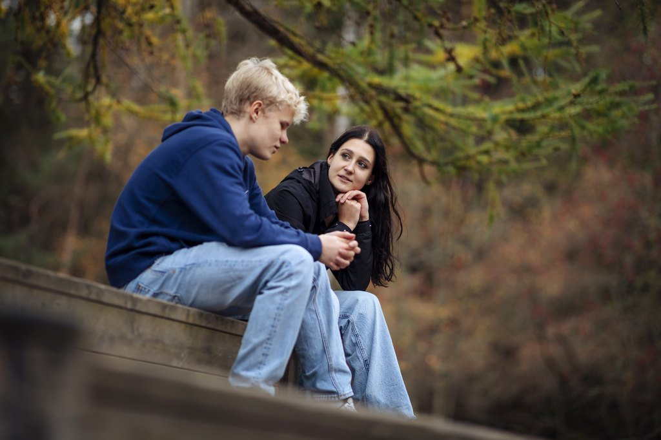
KAMU ”FRIEND” ”BUDDY in Mind”
”How to support my friend”? –classes. School Youth Worker
  FRIEND/BUDDY CLASSES (4*45 min) are created for the young people on 7th, 8th, and 9th grades (13-16 years of age)
  Classes are a tool for youth workers and other professionals in schools
  Goals: Young people will learn about how to take care of their own mental health, coping and stress management, the importance of talking about worries with their friends, and they will also learn when it is
  important to tell to the adults in schools
  Action activities and discussion activities
  You can modify them also for longer periods
  (e.g. 60 min, 75 min
Notes:
mKAMU-tunnit on suunniteltu ensisijaisesti nuorisotyöntekijän ja koulun muiden
ammattilaisen työparitoiminnan välineeksi. and Nuori saa välineitä omasta jaksamisesta ja mielenterveydestä huolehtimiseen, kaverin tukemiseen, huolen puheeksi ottamiseen kaverin kanssa sekä siihen, milloin kaverin tilanne on vietävä aikuisen tai ammattilaisen tietoon.
Tunnit sisältävät tietoa, pohdintatehtäviä sekä toiminnallisia harjoitteita.Tunnit ovat muokattavissa sopivaksi myös pidemmille tuokioille/oppitunneille
(esim. 60 min, 75 min)
KAMU-tunnit löydät www.mieli.fi –verkko-
sivuilta.

Slide 35
FRIEND / BUDDY in Mind classes consist of 4 sessions led by school youth workers
”What makes me feel good?”
In this section you will get tips and information about taking care of your own mental health and stress management
”How can I support my friend??”
In this section you will discuss about your socio-emotional skills
”How to listen? How to raise concern if needed?
In this section you will increase your understanding of empathetic listening and you will learn about talking about worries with your friends
”When do we need help from adults?”
In this section you will learn to recognise when you need to seek help from adults or profesionals and you will learn about different places to get help from
Notes:
KAMU Kaveri mielessä -tuntien osiot
DIA 3
Aika: 3 min
Kerro, mitkä ovat Kamu-tuntien osiot ja mitä ne pitävät sisällään.
”Mikä auttaa minua voimaan hyvin?”
Tässä osiossa saat vinkkejä, miten omasta mielenterveydestä ja jaksamisesta voi huolehtia.
”Miten voin tukea kaveriani?”
Tässä osiossa pohdit kaveritaitojasi ja tunnetaitoja.
”Miten kuuntelen empaattisesti ja otan huolta aiheuttavan asian puheeksi?”
Tässä osiossa lisäät ymmärrystä empaattisen kuuntelemisen tärkeydestä sekä saat vinkkejä siihen, miten huolta aiheuttavan asian voi ottaa puheeksi kaverin kanssa.
”Milloin tarvitaan aikuisen tukea?”
Tässä osiossa opit tunnistamaan, milloin aina tarvitaan aikuisen tai ammattilaiset tukea ja apua ja saat tietoa eri auttamistahoista.

Slide 36
Feedback from the young people:
”I learnt a lot about friendships and about taking care of them and I also learnt to seek help if I need it”
”I realised that I have to talk to the adults about different issues even though I feel that it doesn’t help”
”I might help someone.”
”I learn to consider about asking for help from adults.”
Notes:
Oppilaid
”Opin tunneilla paljon kaverisuhteista ja niiden ylläpitämisestä sekä tarvittaessa avun hakemisen opin.”
”Oivalsin tunneilla että joistakin asioista on pakko puhua aikuiselle vaikka kokisi että siitä ei olisi hyötyä.”
”Voin ehkä auttaa jotain.”
”Opin miettimään että koska pyydän aikuiselta apua.”
en palautteita – Mitä oivalsin tunneilla?

Slide 37
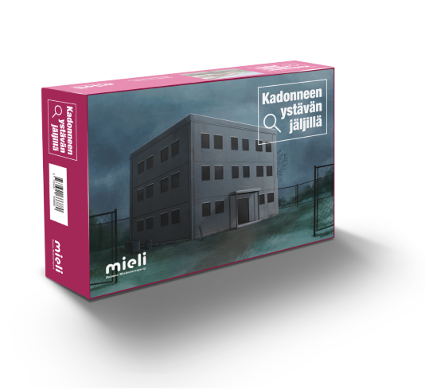
GAME: Searching a lost friend
IN COOPERATION WITH A SCHOOL OF YOUTH WORK
Designed for young people in 7th, 8th and 9th grade
2-6 persons can play as a group.
They try to solve an enigma of a lost friend called Myrsky
Duration of the game
30-60 min.
Notes:
Peliä kehitettiin yhteistyössä Stadin ammattiopiston ja HUMAK:n kanssa
Mukana Petra Schneider ja Suvi Suomela
Pelikoulutuksen tallenteen löydät
täältä.
Kehitetty yläkouluikäisille mielenterveystaitojen vahvistamiseen
Peliä voi pelata kerrallaan 2-6 henkilöä, jotka toimivat pelissä ryhmänä ja koettavat selvittää kadonneen ystävän, Myrskyn, arvoitusta.
Pelin kesto 30-60 min.

Slide 38
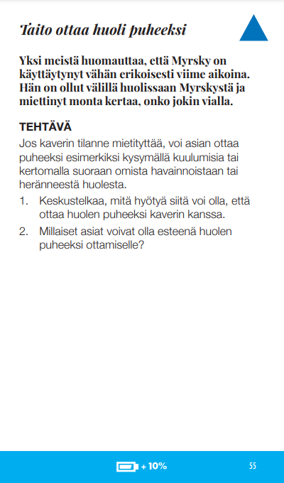
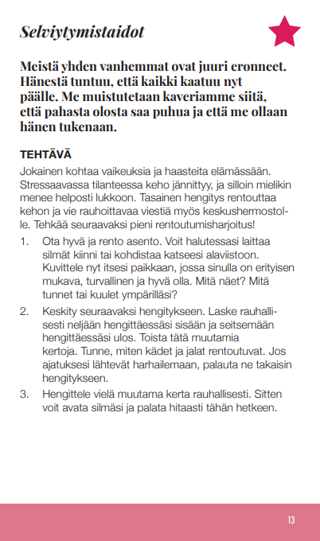
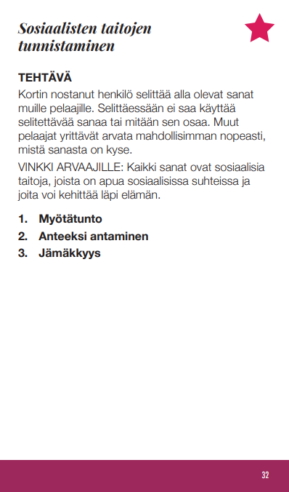
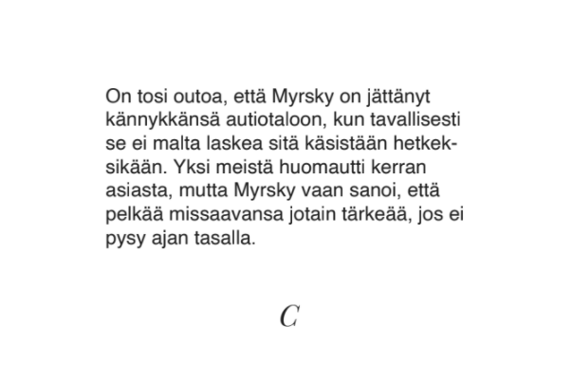





You practice mental health skills by playing
Emotinal skills
Social skills
Daily habbits
Coping skills
Self-knowledge
Mindfulness skills
  30 different tasks
  6 story cards
  9 different endings
Notes:
Tunnetaitoja
Sosiaalisia taitoja
Arjen taitoja
Selviytymistaitoja
Itsetuntemuksen vahvistamisen
taitoa
Tietoisuustaitoja

Slide 39

IN COOPERATION WITH SCHOOLS OF YOUTH WORK
MENTL HEALTH POWER CARDS 2.0
65 new pictures
A discussion tool
Pictures are taken by young people studying in vocational school
Graphic design by graphic design student
Includes ideas
Included in the training

Slide 40
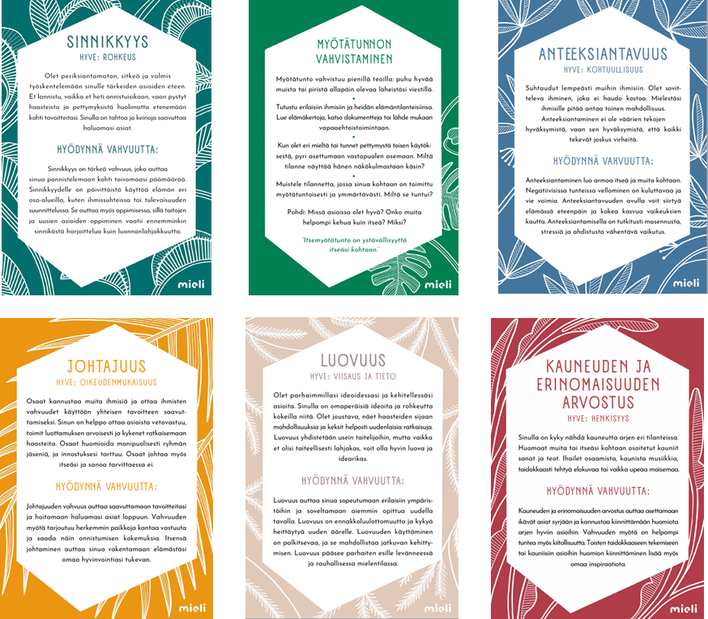

IN COOPERATION WITH SCHOOLS OF YOUTH WORK
26 cards, 6 virtues
Information about the character strengths and the research
Tips and ideas for strenghtening the strenghts
VIA-test
Included in training

Slide 41
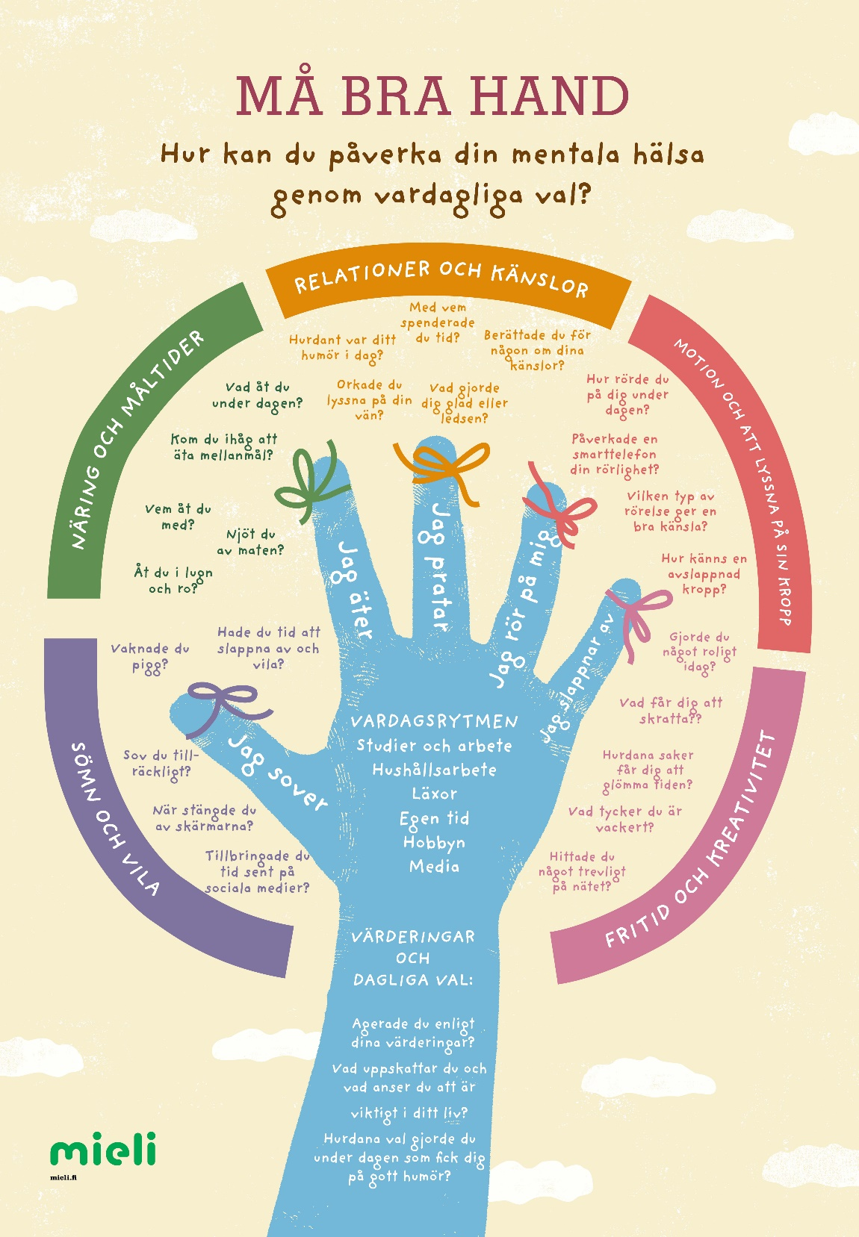
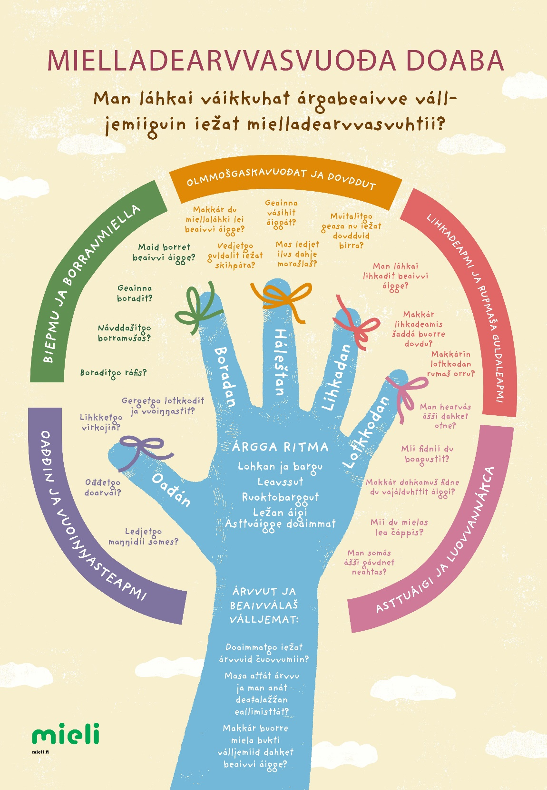

Slide 43
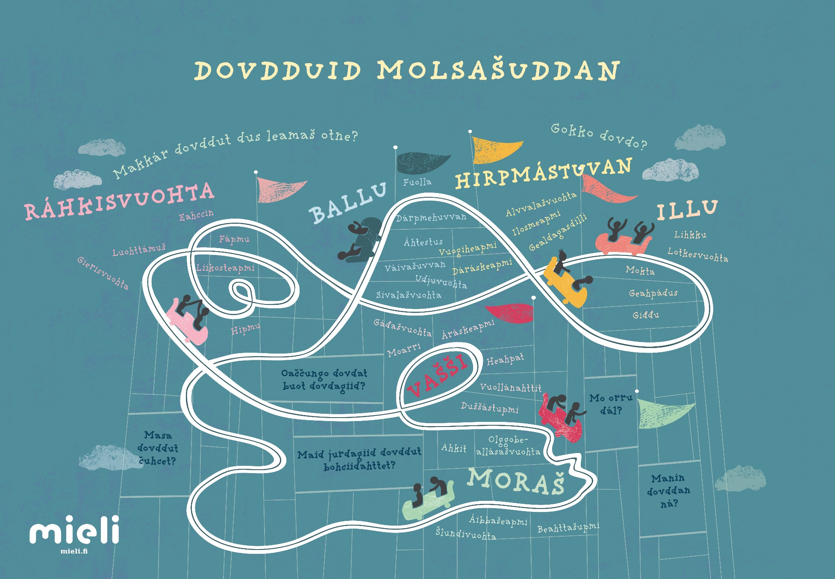
Emotional skills poster

Slide 44
Impacting on different levels
Professional growth of youth workers’
Creating environments that promote mental health;
Cooperation with vocational schools and university level education of youth workers
  Impacting the curriculum
  Thesis work about mental health promotion and youth work
  Students practical training within MIELI Mental Health Finland
  One example: mental health skills training for young people in prison by a youth work student who then did her third training period in prison with young people.
Web-based training and online courses

Slide 45
→ THIS CREATES GROWTH MINDSET ABOUT MENTAL HEALTH
Joy and optimism increases
I can:
teach
learn
support
strengthen
make a difference
ask ”How are you?”
I am:
motivated to promote mental health
hopeful and feel optimistic
caring
focused on the solutions
Motivated to take care of my own mental health skills
Notes:
Growth mindset motivation

Slide 46
I got information about the skills that strengthen mental health
Empowerment: my work is important
I got concrete tools which I can use
Reminded me of the value of my work
Feedback from the professionals
Reminded me of the importance of taking care of my own mental health skills.
I got new ideas and vision for my work
Our youth workers wellbeing at work is important
Widened my perspective about mental health
I feel that promoting mental health is not complicated. It is easy.
Notes:
I am happy that we have Mari’s and Åses research. They have made visible the effects on students in many ways.

Slide 47
Psychiatric
Services
Prevention
Early recognition of the problems, Help services, crisis services, services should be raedily available if problems occur
Promotion;
Parents, Early education, Schools, Youth work, Libraries, Communal places, Swimming halls, Hobbies, Sports, Rehabilitation centres, Day centres etc.
The stronger the base, the less need for corrective services
Notes:
Ruohonjuuritason työ on kaikkein tärkeintä ja jokainen pystyy siihen.
Ohjaamojen työ myös vihreää..rajapinnassa
Mielenterveyden edistäjä ei toimi ”parantajan” roolissa sillä promootion ala on lääketieteellisen määrittelyn ja hoidon tuolla puolen.
Ihmistä lähestytään voimavaroin varustettuna kokonaisuutena. Arkikontekstit tulevat keskiöön.
Riskiryhmien kartoittamisen sijaan edistämistyössä edistetään ja vahvistetaan kaikkien ihmisten terveystekijöitä.
Kun vaikutetaan koko ikäryhmään, se vaikuttaa myös huonompiosaisiin. Lapsen köyhyys työryhmästä esimerkki: mitä enemmän on karsittu yleisiä tukia ja panostettu erityistukiin, on huomattu, että apu tulee liian myöhään.
Mitä vahvempi harmaa kaikille tarkoitettu palvelu on sitä vähemmän tarvitaan erikoishoitoa

Slide 48
Mental health promotion is not a sprint: patience, patience, patience
Long term results of promotion:
Total N = 260.000 students
4th grade 10 years (87%) of all
5th grade 11 years (87 %)
8th grade 14 years (77 %)
9th grade 15 years (77 %)
Gymnasium; 16 and 17 years
Vocational school 16 + all who are under 21 years of age (34%)
School health surveys in Finland (done every other year).

Slide 49
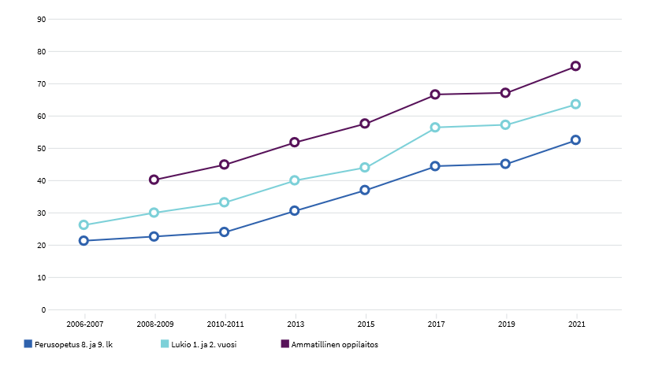
”I feel that the teachers care about me” 2006–2021
52,5% of 14 and 15 yrs
Basic education: 14 and 15 yrs young people
Gymnasium
Vocational school
Notes:
Myös opettajilla on toivoa! Indikaattori tuottaa tietoa niiden nuorten osuudesta (%), jotka ovat täysin samaa mieltä tai samaa mieltä siitä, että opettajat rohkaisevat heitä ilmaisemaan oman mielipiteensä oppitunneilla, opettajat ovat kiinnostuneita siitä, mitä heille kuuluu ja opettajat kohtelevat oppilaita oikeudenmukaisesti.

Slide 50
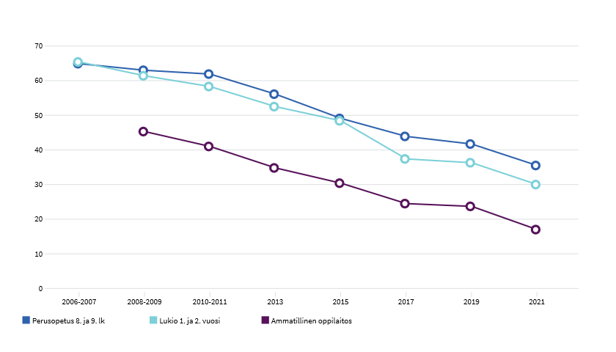
I feel that teachers do NOT care about how I feel 2006–2021
65,5 % (14-15 yrs)
35,5 % (14-15 yrs)
Basic education: 14 and 15 yrs young people
Gymnasium
Vocational school
Notes:
Jotain on tehty oikein, mitä on tehty oikein? Joskus voidaan kysyä, mitä me oikein on onnistuttu tekemään oikein?

Slide 51
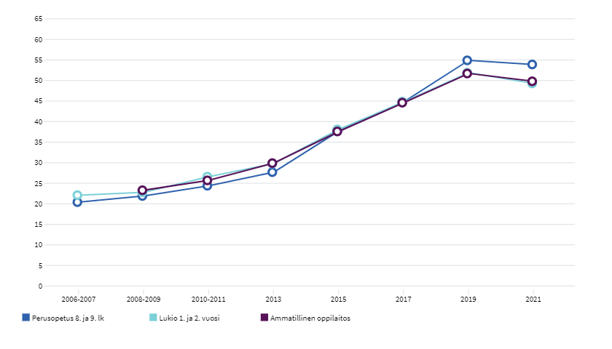
BOYS: ”I have good communication with my parents” 2006–2021
55 % 8th and 9th graders
Basic education: 14 and 15 yrs young people
Gymnasium
Vocational school

Slide 52
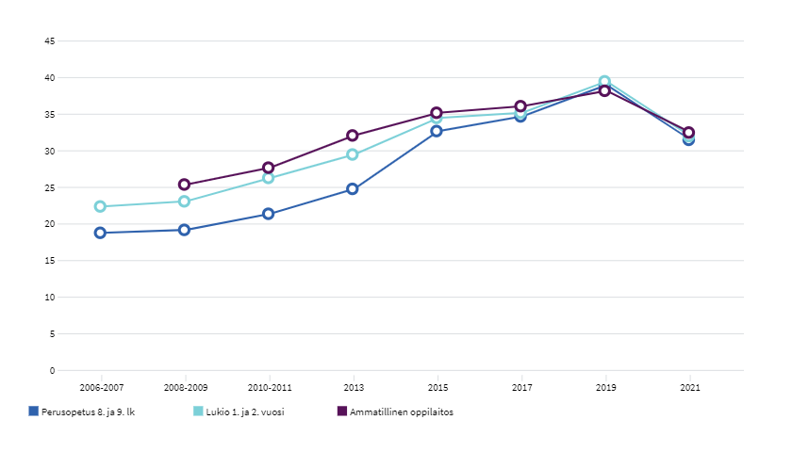
GIRLS: ”I have good communication with my parents” 2006–2021
Dropped during pandemic
Basic education: 14 and 15 yrs young people
Gymnasium
Vocational school
Notes:
Usein me keskitytään miettimään sitä, mitä ollaan tehty väärin ja siksi voisi välillä vahvistaa ja miettiä, mitä olemme tehneet oikein?

Slide 53
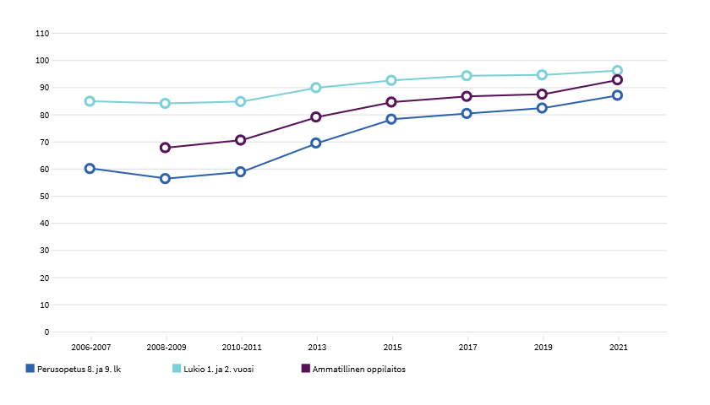
Student has not bullied 2006–2021
From 60% → 87,5%
of 14 and 15 years who have not bullied
Basic education: 14 and 15 yrs young people
Gymnasium
Vocational school
Notes:
Usein me keskitytään miettimään sitä, mitä ollaan tehty väärin ja siksi voisi välillä vahvistaa ja miettiä, mitä olemme tehneet oikein?

Slide 54
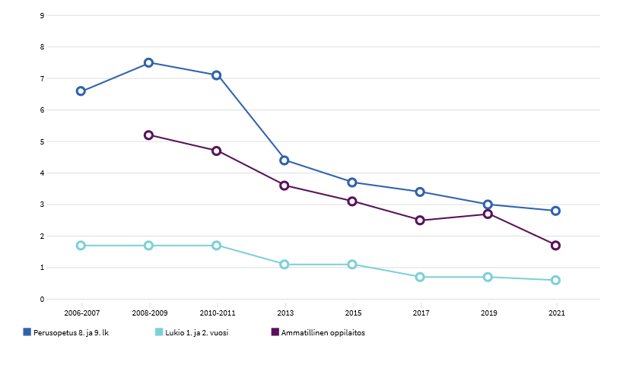
Student has bullied at least once a week 2006–2021
From 7,5% to under 3 % (8th and 9th graders)
Basic education: 14 and 15 yrs young people
Gymnasium
Vocational school

Slide 55
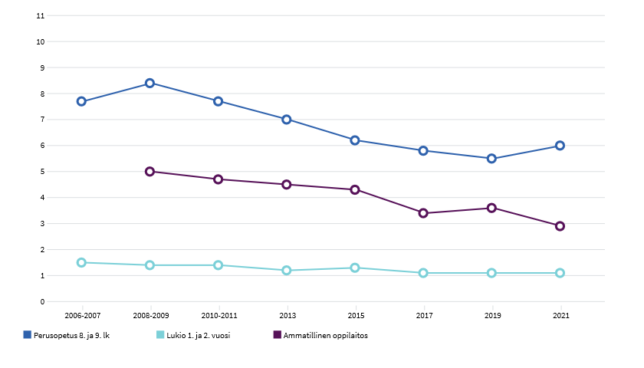
Student is being bullied at least once a week 2006–2021
Basic education: 14 and 15 yrs young people
Gymnasium
Vocational school
Notes:
Usein me keskitytään miettimään sitä, mitä ollaan tehty väärin ja siksi voisi välillä vahvistaa ja miettiä, mitä olemme tehneet oikein?

Slide 56
The importance of every day, basic level became visible during pandemic
Psychiatric
Services
Therapy guarantee law is in the process, Low threshold therapy,
Easy access to therapy services → Walk-In Psychology Services in Helsinki Health Care for ages 13 →
Prevention
Early recognition of the problems, Help services, crisis services, services should be raedily available if problems occur
Everyone can and should do this.
The stronger the base, the less need for corrective services
Promotion;
Early education, Schools, Youth work, Libraries, Communal places, Swimming halls, Hobbies, Sports, Rehabilitation centres, Day centres etc.
Notes:
Ruohonjuuritason työ on kaikkein tärkeintä ja jokainen pystyy siihen.
Ohjaamojen työ myös vihreää..rajapinnassa
Mielenterveyden edistäjä ei toimi ”parantajan” roolissa sillä promootion ala on lääketieteellisen määrittelyn ja hoidon tuolla puolen.
Ihmistä lähestytään voimavaroin varustettuna kokonaisuutena. Arkikontekstit tulevat keskiöön.
Riskiryhmien kartoittamisen sijaan edistämistyössä edistetään ja vahvistetaan kaikkien ihmisten terveystekijöitä.
Kun vaikutetaan koko ikäryhmään, se vaikuttaa myös huonompiosaisiin. Lapsen köyhyys työryhmästä esimerkki: mitä enemmän on karsittu yleisiä tukia ja panostettu erityistukiin, on huomattu, että apu tulee liian myöhään.
Mitä vahvempi harmaa kaikille tarkoitettu palvelu on sitä vähemmän tarvitaan erikoishoitoa

Slide 57
Psychiatric
Services
The importance of every day, basic level became visible during pandemic
Prevention
Early recognition of the problems, Help services, crisis services, services should be raedily available if problems occur
Crisis telephone
Crisis chat
Everyone can and should do this.
The stronger the base, the less need for corrective services
Promotion;
Early education, Schools, Youth work, Libraries, Communal places, Swimming halls, Hobbies, Sports, Rehabilitation centres, Day centres etc.
Notes:
Ruohonjuuritason työ on kaikkein tärkeintä ja jokainen pystyy siihen.
Ohjaamojen työ myös vihreää..rajapinnassa
Mielenterveyden edistäjä ei toimi ”parantajan” roolissa sillä promootion ala on lääketieteellisen määrittelyn ja hoidon tuolla puolen.
Ihmistä lähestytään voimavaroin varustettuna kokonaisuutena. Arkikontekstit tulevat keskiöön.
Riskiryhmien kartoittamisen sijaan edistämistyössä edistetään ja vahvistetaan kaikkien ihmisten terveystekijöitä.
Kun vaikutetaan koko ikäryhmään, se vaikuttaa myös huonompiosaisiin. Lapsen köyhyys työryhmästä esimerkki: mitä enemmän on karsittu yleisiä tukia ja panostettu erityistukiin, on huomattu, että apu tulee liian myöhään.
Mitä vahvempi harmaa kaikille tarkoitettu palvelu on sitä vähemmän tarvitaan erikoishoitoa

Slide 58
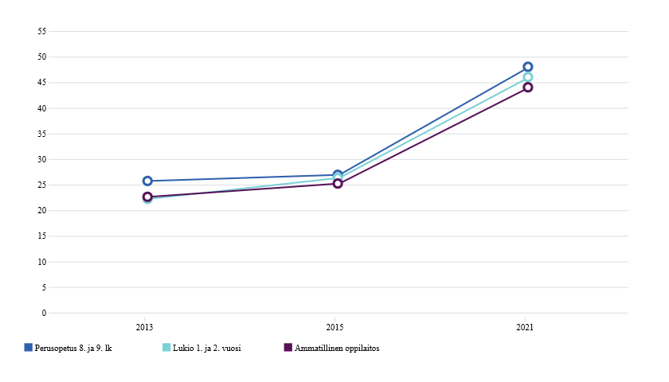
Social anxiety of girls 2013-2021:
Basic education: 14 and 15 yrs young people
Gymnasium
Vocational school
Notes:
Pojat 7,9 % 8. – ja 9. luokkalaisista
Tytöt 30,3 % kaikissa ikäluokissa
Yhteensä 19,7 %

Slide 59
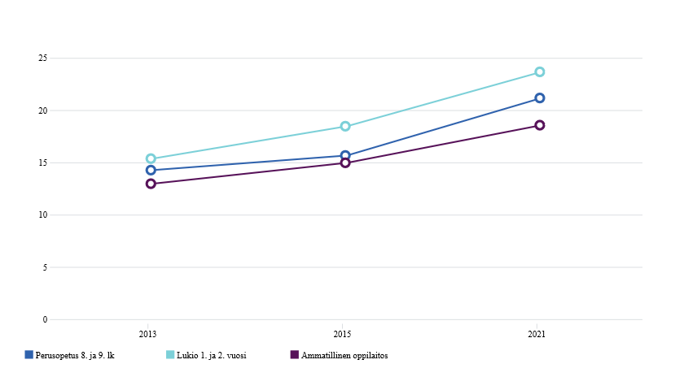
Social anxiety of boys 2013-2021:
Basic education: 14 and 15 yrs young people
Vocational school
Gymnasium
Notes:
Pojat 7,9 % 8. – ja 9. luokkalaisista
Tytöt 30,3 % kaikissa ikäluokissa
Yhteensä 19,7 %

Slide 60
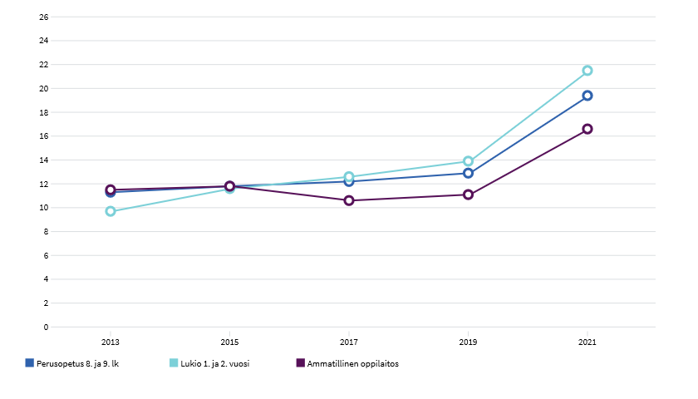
Overall anxiety of boys and girls 2013-2021
8th & 9th grade girls 30,3 % anxiety
Pandemic-time
On average
8th & 9th grade boys 7,9 % anxiety
Boys 5,7 %
Basic education: 14 and 15 yrs young people
Gymnasium
Vocational school
Notes:
Pojat 7,9 % 8. – ja 9. luokkalaisista
Tytöt 30,3 % kaikissa ikäluokissa
Yhteensä 19,7 %

Slide 61
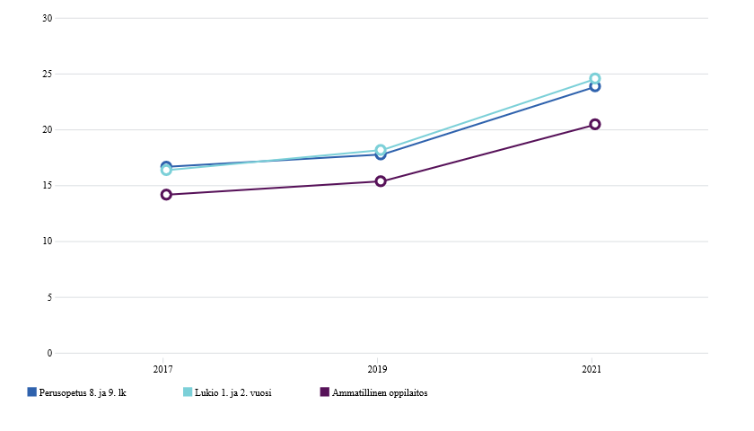
Depression that has lasted min. 2 weeks of boys and girls 2013-2021:
8th & 9th grade girls 33,6 % depression in 2021
On average
8th & 9th grade boys 13,5 % depression in 2021
Basic education: 14 and 15 yrs young people
Gymnasium
Vocational school
Notes:
Pojat 7,9 % 8. – ja 9. luokkalaisista
Tytöt 30,3 % kaikissa ikäluokissa
Yhteensä 19,7 %

Slide 62

Back to basics!
Psychiatric
Services
Prevention
Early recognition of the problems, Help services, crisis services, services should be raedily available if problems occur
Therapy guarantee law is in the process, Low threshold therapy,
Easy access to therapy services → Walk-In Psychology Services in Helsinki Health Care for ages 13 →
Everyone can and should do this.
The stronger the base, the less need for corrective services
Promotion;
Early education, Schools, Youth work, Libraries, Communal places, Swimming halls, Hobbies, Sports, Rehabilitation centres, Day centres etc.
Notes:
Ruohonjuuritason työ on kaikkein tärkeintä ja jokainen pystyy siihen.
Ohjaamojen työ myös vihreää..rajapinnassa
Mielenterveyden edistäjä ei toimi ”parantajan” roolissa sillä promootion ala on lääketieteellisen määrittelyn ja hoidon tuolla puolen.
Ihmistä lähestytään voimavaroin varustettuna kokonaisuutena. Arkikontekstit tulevat keskiöön.
Riskiryhmien kartoittamisen sijaan edistämistyössä edistetään ja vahvistetaan kaikkien ihmisten terveystekijöitä.
Kun vaikutetaan koko ikäryhmään, se vaikuttaa myös huonompiosaisiin. Lapsen köyhyys työryhmästä esimerkki: mitä enemmän on karsittu yleisiä tukia ja panostettu erityistukiin, on huomattu, että apu tulee liian myöhään.
Mitä vahvempi harmaa kaikille tarkoitettu palvelu on sitä vähemmän tarvitaan erikoishoitoa

Slide 63
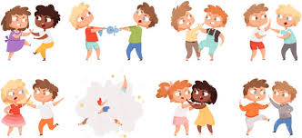
CASE STUDY: Laakavuori school grades 1-6 (ages 7-12): (according to National School Health Survey)
MANY RISK FACTORS FOR MENTAL HEALTH
Did not enjoy being with each other
Loneliness and bullying
No skills to solve small arguments
Emotion regulation was a constant problem
Temper tantrums
Working together was a problem
Racism was common
MENTAL HEALTH SKILLS INTERVENTION
Notes:
14% of children did not enjoy being with each other
12% felt that tehy have no skills to solve small arguments
60 % of the teachers felt that emotion regulation was a constant problem among pupils; temper tantrums were common
33 % of teachers felt that working together was not good
71% of teachers reported about racism in the class room
Concentration on school work improved (!!)
Social skills and emotion regulation improved greatly.
Almost all children learned to solve small arguments.
Racism, bullying, temper tantrums and bad mood decreased.
Helping others increased.
You can all imagine how your mental health is affected if you are being bullied, or left out of the group, or constantly arguing with your work buddies

Slide 64
Systematic teaching results in Laakavuori school in two years (ages 7-12):
HEALTHY ENVIRONMENT FOR MENTAL HEALTH
Class atmosphere improved.
Cooperation and group working skills improved
Concentration on school work improved (!!)
Social skills and emotion regulation improved greatly.
Almost all children learned to solve small arguments.
Racism, bullying, temper tantrums and bad mood decreased.
Helping others increased.

Slide 65
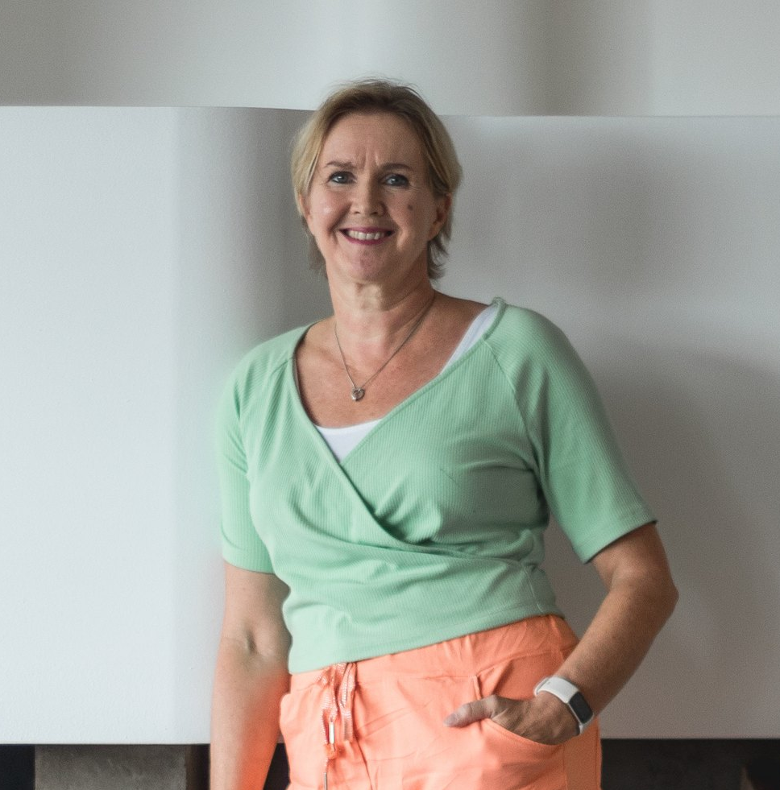
Thank you!
Let’s all promote mental health together
Elina Marjamäki
Mental Health Promotion
MIELI Mental Health Finland
www.mieli.fi
Contact:
elina.marjamaki@mieli.fi
Tel: +358-40-678 7295

