Slide 1

HIGHER EDUCATION IN YOUTH WORK
IN LATVIA

Slide 2
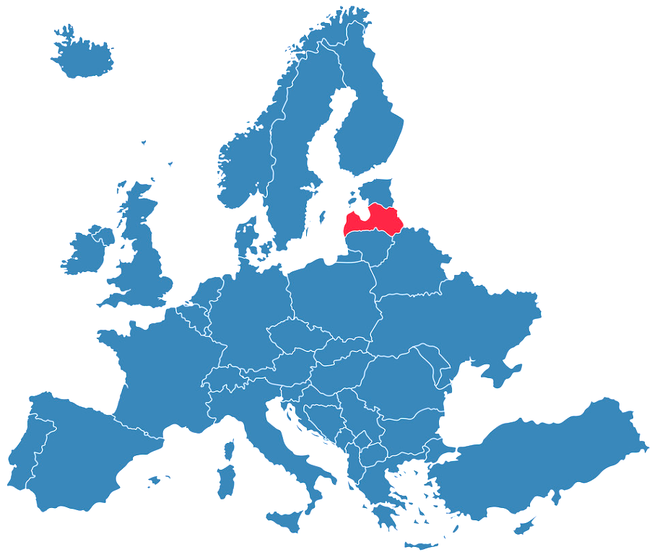

Key Facts About Higher Education in Latvia
16 public HEI’s*
9 public colleges*
11 private HEI’s
8 private colleges
5000 academic staff members
2 study programmes related with youth work
Institutions
*Funded both by the government and study fees

Slide 3
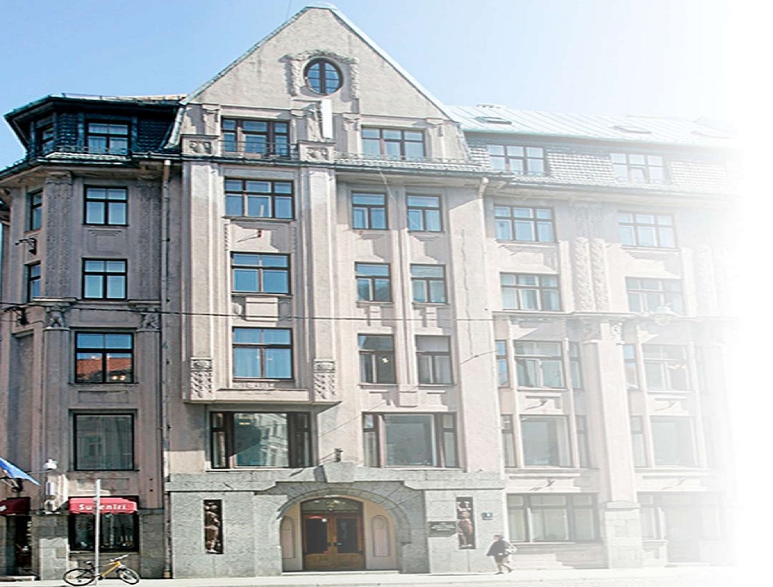
Ministry of Education and Science of Republic of Latvia
Education
Science
Sport
Youth
National language

Slide 4
Youth policy and legislation
Youth Law
Youth affairs specialist - a person who plans, performs, and coordinates youth work
If a youth affairs specialist ensures youth work in the local government, he or she shall be trained in accordance with the procedures stipulated by the Cabinet.
Children, Youth and Family development strategy 2022. – 2027.
Youth worker – a person who works with youth
Improvement of higher education study opportunities for youth workers

Slide 5
Changes in the Youth policy
Ammendments to the Youth Law
Revision of Youth Workers and Youth affairs specialists profesional standarts

Slide 6


THANK YOU!

