Slide 1

Mikko Röman -
Coordinator of Digital Youth Work
Notes:
Mikko Röman, coordinator of digital youth work. City of Helsinki.
I've been a coordinator for a year now as a substitute – but I just got selected to be a permanent coordinator and we can now start to make a plan for digital youth work (we don’t have an actual documented plan yet for that) – and I will also compile a group for developing our digital youth work in the future
I've been working as a youth worker for 6 years before switching to being a coordinator. My tool in youth work has been making music in recording studio and other cultural methods.
My goal today is to
open up the concept of digital youth work
present what's being done in that field here in HKI youth service
give some material and links to different kind of stuff related to this subject
So, you will get my slides afterwards for further examination

Slide 2
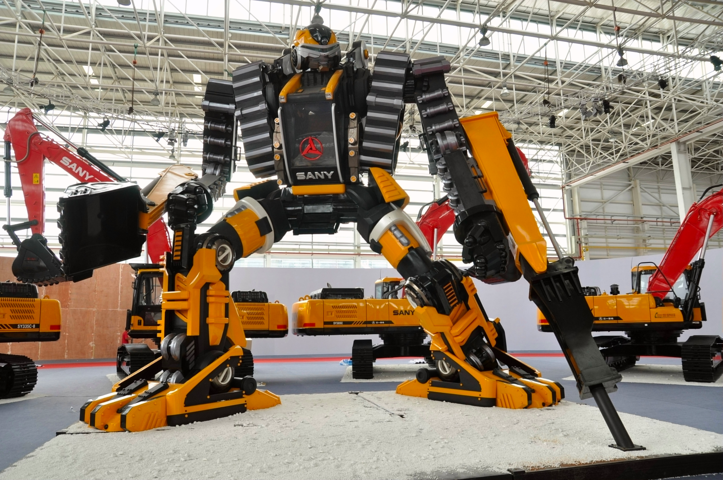



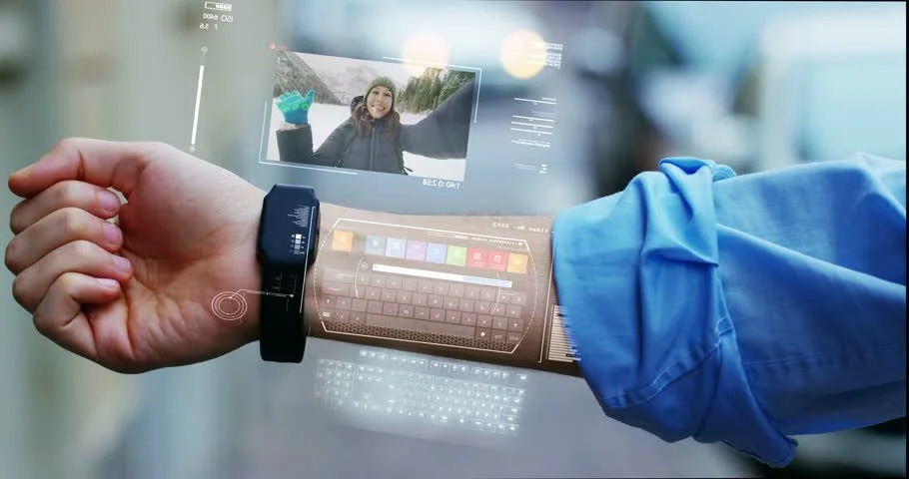
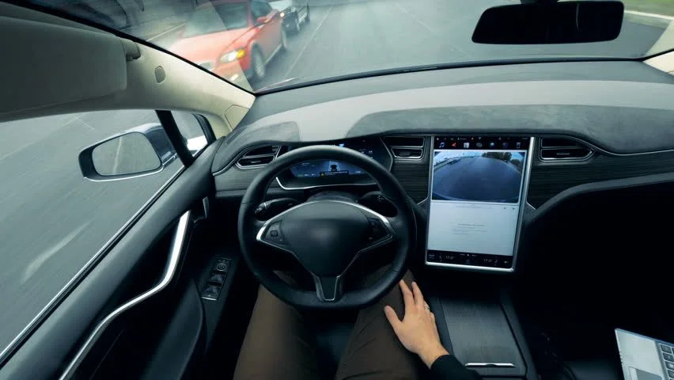


2030
Notes:
In 2030:
Robots do most of our physical work
Robotics come a part of human bodies
Artificial intelligence (AI) is our co-worker at the office
Services and entertainment are available in metaverses
We have augmented reality (AR) giving us instructions over the physical world - I could for example see my notes for this presentation through my classes and would not have to watch this screen all the time
Cars are driving themselves and we just sit and relax
5G connects all things together - my clock would tell my coffee machine to make stronger coffee since I did not sleep well last night
Flying drones will fly my lunch to me from my window when I'm hungry

Slide 3

Notes:
The truth is that no one knows for sure how the future will be and what does it look like
* But those things mentioned were not completely out of my imagination
– lot of those things are already here or they are about be true in some form or another
One thing seems to be almost certain - we and the youngsters we work with in youth work field -> continue being surrounded by technology now and in the future
Of course anything can happen, but it seems unlikely that we reject all our digital devices and move to the woods

Slide 4
“We tend to overestimate the effect of a technology
in the short run and underestimate the effect in the long run.”
-Amara's Law
Notes:
Roy Amara was an American scientist
one of the goals of youth work is to help young people to be members of the society and make them feel that their lives are meaningful -> we will ran into digital world - and that of course is the reason we need to have youth workers willing to acknowledge and use technology in their work with youths

Slide 5

Digital Natives
Digital natives are a myth
(RMIT University – article)
Notes:
- The term "digital native" comes from Mark Prensky's article On the Horizon – released 2001 – where he claims that people born after 1980's are more capable to learn the usage of technology then older people.
- However, research published in 2017 has found that the idea of a digital native is a myth and there is no significant difference between millennials and older generations regarding their skill in using technology
- Therefore we need to help young people with the use of technology and media skills – they don't born with those skills
- You can read more about this subject by reading article by R M I T university from the link

Slide 6
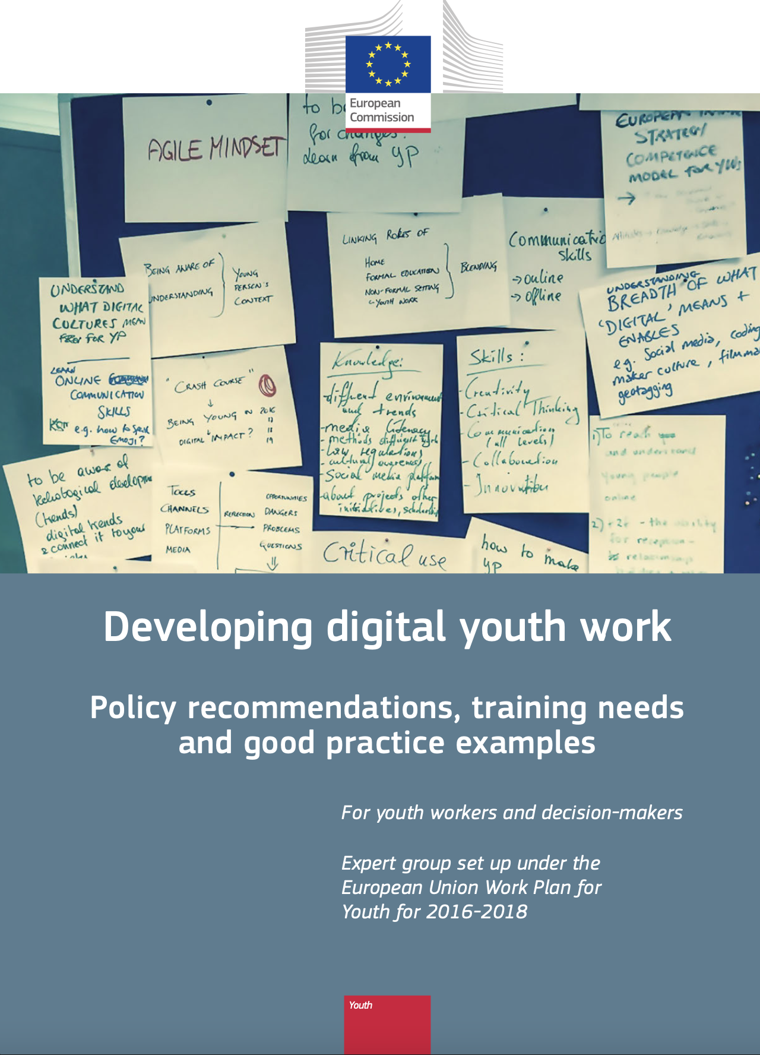
What is digital youth work?
Digital youth work means proactively using or addressing digital media and
technology in youth work.
- Digital youth work is not a youth work method – digital youth work can be included in any youth work setting (open youth work, youth information and counselling,
youth clubs, detached youth work…)
- Digital youth work has the same goals as youth work in general, and using
digital media and technology in youth work should always support these goals.
https://op.europa.eu/en/publication-detail/-/publication/fbc18822-07cb-11e8-b8f5-01aa75ed71a1
Notes:
This is how group of experts determine digital youth work in European union – in the document Developing digital youth work:
Digital youth work means proactively using or addressing digital media and
technology in youth work.
- Digital youth work is not a youth work method – digital youth work can be included in any youth work setting
(open youth work, youth information and counselling, youth clubs, detached youth work…)
- Digital youth work has the same goals as youth work in general, and using
digital media and technology in youth work should always support these goals.

Slide 7
What is digital youth work?
- Digital youth work can happen in face-to-face situations as well as in online environments – or in a mixture of these two. Digital media and technology can be
used either as a tool, an activity or a content in youth work.
- Digital youth work is underpinned by the same ethics, values and principles as youth
Work.
https://op.europa.eu/en/publication-detail/-/publication/fbc18822-07cb-11e8-b8f5-01aa75ed71a1
Notes:
- Digital youth work can happen in face-to-face situations as well as in online environments – or in a mixture of these two. Digital media and technology can be
used either as a tool, an activity or a content in youth work.
- Digital youth work is underpinned by the same ethics, values and principles as youth
Work.
*Theres a link to the whole document if you want to read it

Slide 8
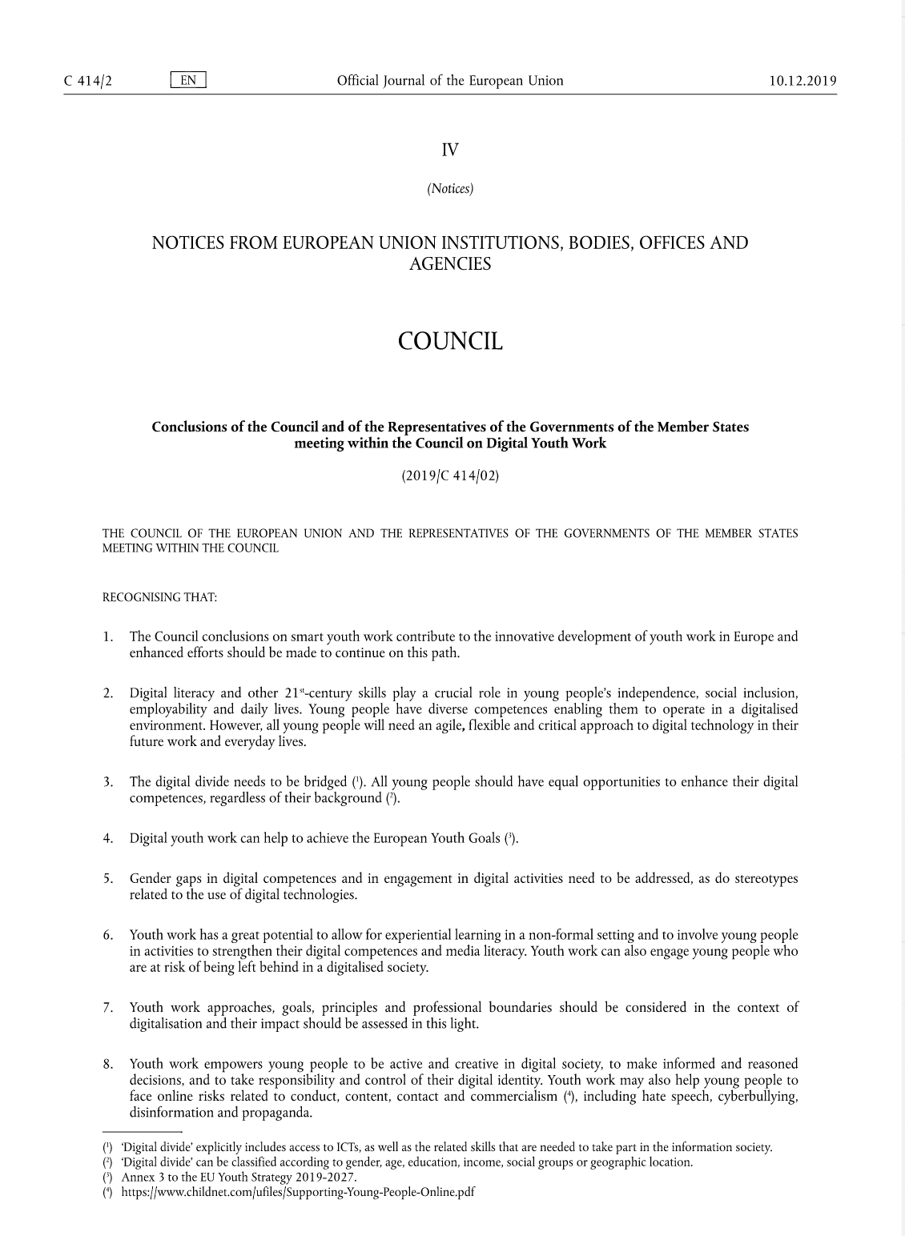
Structure of this presentation
1. Conclusions of the Council and of the Representatives of the Governments of the Member States meeting within the Council of Digital Youth Work
2. #hashtags
3. Examples and/or links
Notes:
I will use some conclusions from a journal called: Conclusions of the Council and of the Representatives of the Governments of the Member States meeting within the Council of Digital Youth Work
- I know – sounds exhausting – but there happens to be good points in it!
Then I will have some hashtags, examples of work and / or links to useful stuff

Slide 9
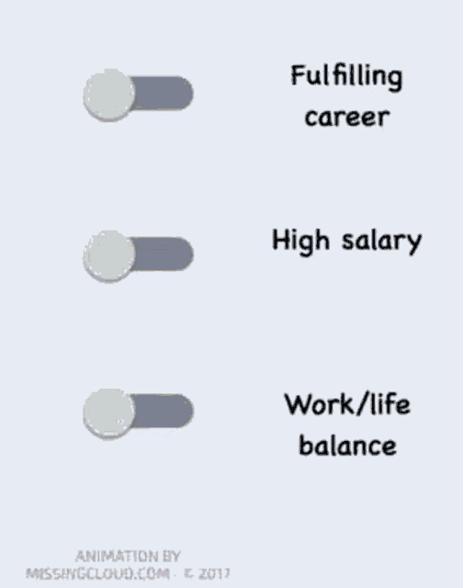
Digital skills
CONCLUSION:
Digital literacy and other 21st-century skills play a crucial role in young people’s independence, social inclusion, employability and daily lives. Young people have diverse competences enabling them to operate in a digitalised environment. However, all young people will need an agile, flexible and critical approach to digital technology in their future work and everyday lives.
Notes:
So, here is the first conclusion:
Digital skills
Digital literacy and other 21st-century skills play a crucial role in young people’s independence, social inclusion, employability and daily lives.
Young people have diverse competences enabling them to operate in a digitalised environment.
However, all young people will need an agile, flexible and critical approach to digital technology in their future work and everyday lives.

Slide 10


Digital skills
The Youth Budget gives youth the opportunity to have their say in the budgeting of the city’s Youth Services.
(digital inquiries and AI)
#digital CV
#LinkedIn
#digital bank services
#digital social services
#digital authentication
#inclusion
#voting
#digital payments
Ohjaamo Helsinki is a guidance center for every 15-29 –year-old.
It’s a place where you are heard, a government agency that doesn’t feel like one, a place to go when you don’t know where to go.
(Discord, Instagram, Jodel (anonymous chat based on topics and locations)
Notes:
Related to this we have The youth budget –system in Helsinki that uses technology. This is the first year they are using artificial intelligence to analyse the answers from the inquiry.
Then I also wanted to put Ohjaamo Helsinki in the spotlight. Ohjaamo Helsinki is a guidance center for every 15-29 –year-old.
It’s a place where you are heard, a government agency that doesn’t feel like one, and a place to go when you don’t know where to go.
They also do their work via Discord, Instagram and Jodel. Jodel is a anonymous chat platform based on different subjects and locations.

Slide 11

Digital divide
CONCLUSION:
The digital divide needs to be bridged. All young people should have equal opportunities to enhance their digital competences, regardless of their background
Notes:
The digital divide needs to be bridged. All young people should have equal opportunities to enhance their digital competences, regardless of their background

Slide 12


Digital divide
#access to technology
#age
#digital natives
#grown ups don't play games
#income
#bring your own computer
#everyone has a smart phone
#geographic location
#provide online activities
#travel to provide digital activities to villages
The City of Helsinki offers young people gaming activities in all manner of forms. At youth centres, you can play PC, console, board, role-playing and card games!
Helsinki Central Library Oodi:
At the Urban Workshop on the second floor, you can create new things and personalise old ones. At your disposal is a wide range of tools from a electronic workstation to a laser cutter, not forgetting traditional handicrafts.
Notes:
Here is some of our activities trying to tackle the issue of digital divide.
We widely offer gaming possibilities and technology for youths and citizen to use through out the city.
We have 7 youth houses which all have great equipment for computer gaming. We also have console gaming available at all youth houses.
Then we can also use technology in libraries too. For example Helsinki Central Library Oodi has a wide range of tools from a electronic workstation to a laser cutter.
But that's just one of our libraries. If one wants to use 3D printer – there is 36 of them available in libraries in Helsinki.

Slide 13

Equality
CONCLUSION:
Gender gaps in digital competences and in engagement in digital activities need to be addressed, as do stereotypes related to the use of digital technologies.
Notes:
Gender gaps in digital competences and in engagement in digital activities need to be addressed, as do stereotypes related to the use of digital technologies.

Slide 14

Equality
#social groups
#coding is for nerds
#education
#you need to have skills to attend
#gender
#only boys play videogames
#girls don't like building robots
LGBTQAI+ gaming activities
Open game nights with PC and console games. Gaymers’ night is for sexual and gender minority gamers between the ages of 15-25-years-old
Notes:
I have to mention that all of these themes mentioned at the hashtag sections are of course subjects that youth worker talk about with youngsters in everyday life too.
And then we have also these examples I'm presenting here. Like this one – While we have gaming equipment everywhere in the city - we provide gaming activities also just for gender minorities in Gaymer's nights.

Slide 15

Non-formal learning
CONCLUSION:
Youth work has a great potential to allow for experiential learning in a non-formal setting and to involve young people in activities to strengthen their digital competences and media literacy.
Youth work can also engage young people who are at risk of being left behind in a digitalised society.
Notes:
Youth work has a great potential to allow for experiential learning in a non-formal setting and to involve young people in activities to strengthen their digital competences and media literacy.
Youth work can also engage young people who are at risk of being left behind in a digitalised society.

Slide 16

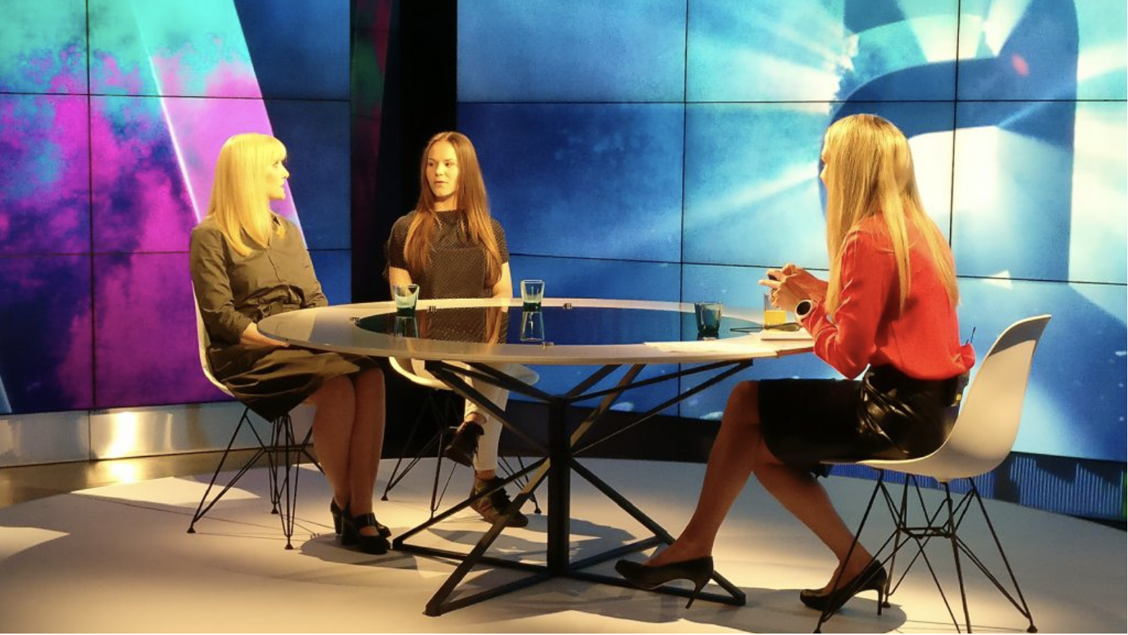

Non-formal learning
#free knowledge
#learn by trying
#learn by doing
#maker culture
#podcast
#video
#music
#robots
#AI
#media literacy
#fake news
#deep fake
"In media activities, you pass into the wonderful world of the media with professional instructors and good new friends!"
Voice of the Young Editorial Board
Helsinki Unity Music – network of young musicians, producers and music studios
Notes:
In our media activities youth can for example take portraits in a photo studio, shoot short films and music videos, make effects on videos in a green screen studio, and edit videos with professional programs. They can also broadcast a radio show or podcasts and take part in multi-camera streaming.
In the Voice of the Young Editorial Board, young people make newspaper articles, TV stories and blog posts for Finland’s largest media organs and stimulate social discussion in social media.
And in the Helsinki Unity Music – network we have 10 professional music studio facilities in 8 different locations with guidance available.
All of these activities are free-of-charge and include the necessary guidance!

Slide 17

Activism and acquirements
CONCLUSION:
Youth work empowers young people to be active and creative in digital society, to make informed and reasoned decisions, and to take responsibility and control of their digital identity.
Youth work may also help young people to face online risks related to conduct, content, contact and commercialism, including hate speech, cyberbullying, disinformation and propaganda.
Notes:
Youth work empowers young people to be active and creative in digital society, to make informed and reasoned decisions, and to take responsibility and control of their digital identity.
Youth work may also help young people to face online risks related to conduct, content, contact and commercialism, including hate speech, cyberbullying, disinformation and propaganda.

Slide 18


Activism and acquirements
#knowledge-based argumentation
#activism
#hacktivism
#discrimination
#don't ignore bullying
#how to report grooming
#sexting
#conspiracy theories
#who is behind article/video/news
#who benefits
Poster campaign design by youths. Funded by the Youth Budget
Translation: Intervene bullying early
#do not ignore
The Finnish Society on Media Education – supports and provides activities helping professionals working with youths and kids.
Notes:
The upper picture is a poster from a campaign designed by youths to other youths to intervene bullying on a early stage.
Project got money from our own youth budget –process.
And then there is a link to Finnish Society on Media education which supports and provides activities helping professionals working with youths and kids.
Theres also some material in english in their website!

Slide 19
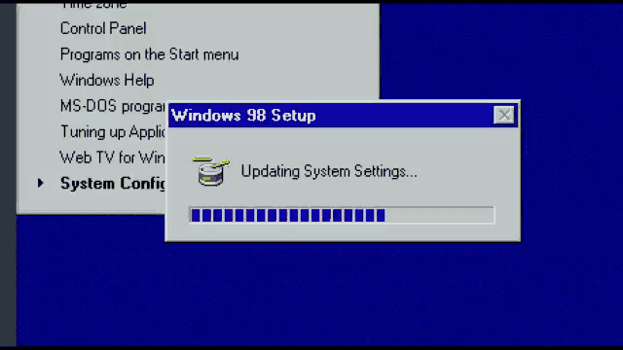
Continuous learning
CONCLUSION:
Digitalisation of youth work has often been understood as the use of social media. However, new digital technologies are emerging rapidly.
Artificial intelligence, virtual reality, robotics
and block-chain technology, inter alia, are
affecting our societies beyond the sphere
of communication. Not only basic digital
competencies are required, but also
specific digital competencies enhancing
the employability of young people are important.
Youth work should be able to
address the challenges of convergence
between the digital and physical
environments and benefit from the
opportunities offered by the digital transformation, while at the same time facing challenges in regard to services.
Notes:
Digitalisation of youth work has often been understood as the use of social media. However, new digital technologies
are emerging rapidly.
Artificial intelligence, virtual reality, robotics and block-chain technology, inter alia, are affecting our societies beyond the sphere
of communication. Not only basic digital competencies are required, but also specific digital competencies enhancing the employability of young people are important.
Youth work should be able to address the challenges of convergence between the digital and physical environments and benefit from the opportunities offered by the digital transformation, while at the same time facing challenges in regard to services.

Slide 20
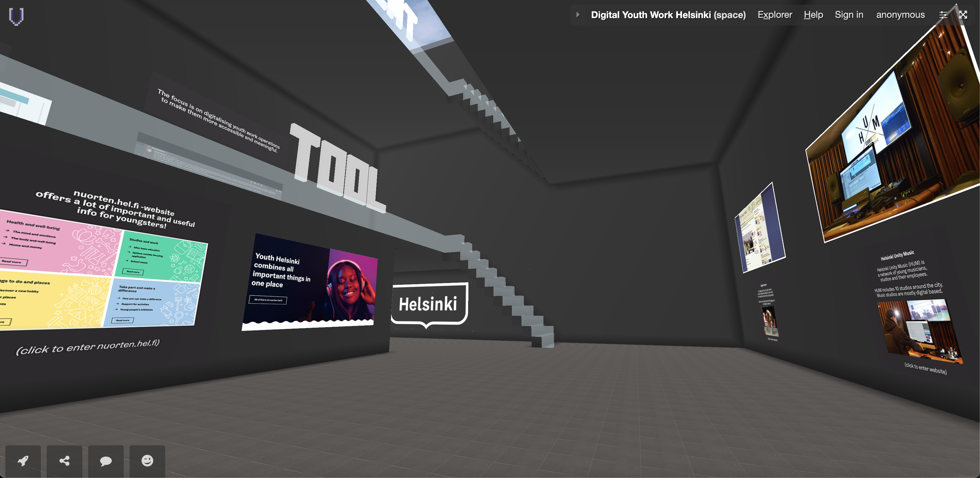
Continuous learning
#my co-worker is a robot
In metaverse:
#shopping
#gaming
#attend to a gig
#visit museum
#design a house
#increasing possibilities
#cryptocurrency
#blockchain
#digital well-being
#is this app/content good for me?
#acknowledge addiction
Visit metaverse that introduces digital youth work in Helsinki
(made with free Voxels –account)
Notes:
If we have time – visit the metaverse briefly.
Here's a tip: Provide basic know-how on some virtual space (Minecraft, AltspaceVR, Voxels...) and ask students to introduce something by using virtual space.

Slide 21

Culture of experimentation
CONCLUSION:
(We should) consider, where appropriate, experimental and innovative approaches and new co-operation models, to deliver digital youth work activities and services.
Notes:
(We should) consider, where appropriate, experimental and innovative approaches and new co-operation models, to deliver digital youth work activities and services.

Slide 22

Culture of experimentation
#try new things
#learn by trial and error
#embrace your mistakes
#share your process
#generate development
Trying New Things
Why new experiences are so important to have.
(Article from Psychology Today)
Notes:
My example regarding this subject is still on my desk. Me and two of my colleague wanted to combine theatre, virtual space and teaching emotional skills to youth.
We came up with an idea to have a theatre show within a 3D environment – you move at the space using VR-glasses.
In the virtual hallways you have to decide (by choosing on route) where the story goes and those choices will have their consequences on what videos you see.
We try it and if we fail – we try something else. But if we succeed – we will have a new way to teach emotional skills – and we had fun doing it.

Slide 23

Online work
CONCLUSION:
(We should) promote better access for young people, in particular those with fewer opportunities and those living in rural and remote areas, or where face-to-face access is not feasible, to youth work services through the use of digital technologies.
Notes:
(We should) promote better access for young people, in particular those with fewer opportunities and those living in rural and remote areas,
or where face-to-face access is not feasible, to youth work services through the use of digital technologies.

Slide 24


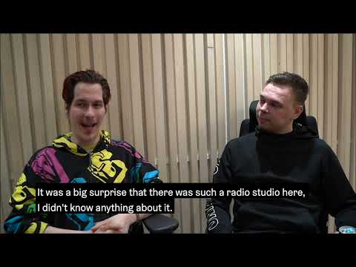
Online work
Video: Outreaching youth work in game environment
(you can also find this video from Voxels Space)
#work via social media
#game environments
#video calls
#hybrid meetings
#chat services
#show your premises
#live feed
#videos
#youth club in metaverse?
Video: Digital Youth Work in Munkkiniemi
(you can also find this video from Voxels Space)
Video: Digital Youth Work in Munkkiniemi
(you can also find this video from Voxels Space)
Notes:
If youth is living in Helsinki – they live nearby of a youth house.
But there is some other barriers that can prevent one to participate on youth services. Such as anxiety, panic disorder, other mental issues and physical issues.
Here is three videos and especially the first one tackles these barriers. It's an interview of outreaching youth worker who works only in game environment and Discord.
The middle one is about Digital Youth Work in Munkkiniemi youth house and the third one is a short documentary about our media activities in Itäkeskus. Third one is made by one of the youths using our facilities there.

Slide 25

Basic skills
CONCLUSION:
The rapid advances in digital media and technology in recent years have also influenced youth work. However, a significant number of youth work practitioners lack digital competences and knowledge to make the best possible use of digital technologies in delivering high-quality youth work due to financial, structural, material or administrative reasons.
Notes:
The rapid advances in digital media and technology in recent years have also influenced youth work.
However, a significant number of youth work practitioners lack digital competences and knowledge
to make the best possible use of digital technologies in delivering high-quality youth work due to financial, structural, material or administrative reasons.

Slide 26
Basic skills
#basic skills
#positive attitude
#ongoing learning
#ask when needed
#curiosity
#learn with youths
#learn from youths
"I don't know how, but let's find out"
Digital Youth Work -project website
Inclusion and Diversity in Digital Youth Work
Skill IT - Digital pathways for youth work
Keep it going! Online Tools Review for Erasmus+ and European Solidarity Corps National Agencies
HOP online learning
Safe, Secure and Empowered (YouthLink Scotland)
Report on Good Practice Case Studies of Online Youth Work Practices
Notes:
By now we probably do agree on the fact that everyone in the youth work field should have the basic skills to cope with technology.
I think the most important things needed for youth worker are positive attitude towards technology, curiosity and ability to ask for help when needed.
If youth wants to build a website and youth worker doesn't know how -> worker can always say the words: "I don't know how, but let's find out"
That is also the most important sentence of this whole presentation and the one thing I would like to give for every student who is going to work with youngsters.
Here is a small link list for further examination.

Slide 27

THANK YOU!
Mikko Röman
Coordinator of Youth Work
Youth Services, Helsinki
mikko.roman@hel.fi
+358403348092
Notes:
Thank you! There is my info if you have anything you think I can help with.

