Slide 1


How we cooperate with universities
Katrin Olt, Chief Expert
Youth and Talent Policy Department

Slide 2

Pre-primary and general education
Vocational education
Higher education
Adult education
Research
Language policy
Youth and talent policy
Educational leadership and teachers’ policy
Eight pillars of the MoER

Slide 3
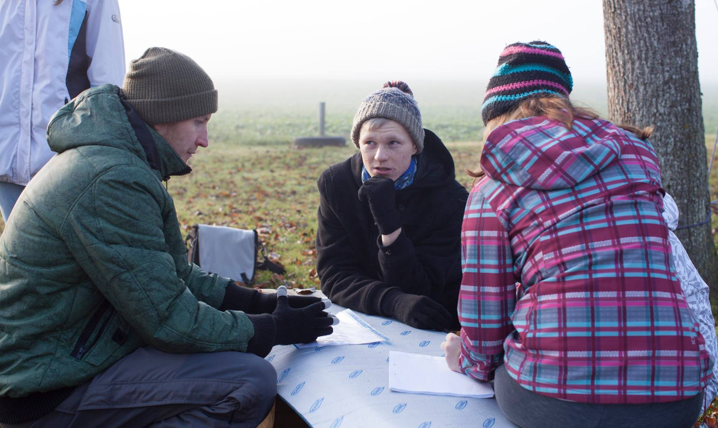

There is no vocational education in youth work
Youth work is taught in the Tallinn University and the University of Tartu
Youth work education and training
Training paths are connected to the HEIs, NGOs, local municipalities or the Education and Youth Board

Slide 4
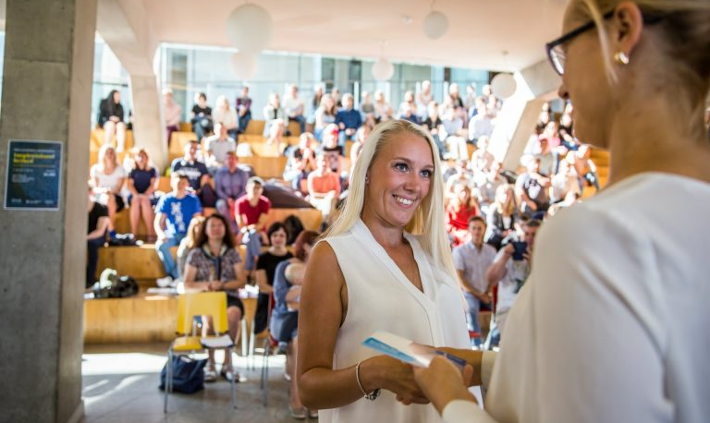

The MoER has administrative agreements with HEIs
The skills that meet the current and future needs of the labour market must be ensured through education
Levers of the MoER (I)
To gather information about the labour and skill needs, there’s OSKA, a monitoring and forecasting system
Notes:
Our administrative agreement system is built on the example of Finland. The agreements are concluded for the 3-year periood. This is followed by a report by the universities.

Slide 5


HEIs must follow the recommendations in the analyses of OSKA
Whether or not the recommendations have been complied with is monitored every 2-3 years
Levers of the MoER (II)
HEIs may get observations through institutional accreditation
The external members of programme boards may be representatives of the MoER
Notes:
Responding to labour market needs is the autonomy of universities. The universities are faster to react than the ministry.

Slide 6

A regulation currently drafted, intended to support HEI-s by the payment of a scholarship that is to be awarded to up to 10 Master’s students a year, aming to improve the quality of theses relevant to the youth sector and prioritised by the MoER, i.e. 7-8 focuses are to be set by the ministry every year
Measures from the state budget
Notes:
The ministry is not so much engaged in the quality development of higher education as in supporting research and development activities - mainly the capacity of youth work research, but to some extent also youth research.
To apply for the scholarship, students do not have to study in the Master’s programme in youth work.

Slide 7
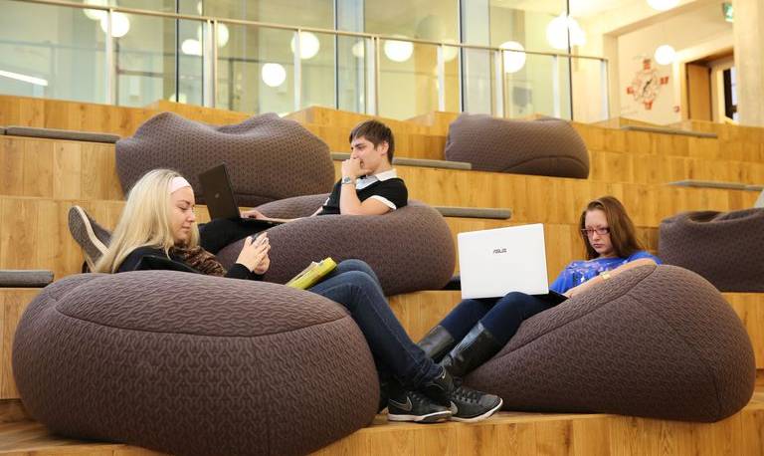
Writing camps of 3 days are held every spring for up to 20 Master’s students
Studies, analyses and theses are regularly added to the youth research database: http://edu.ee/uuringud
Measures from the ESF
Cooperation between the University of Tallinn and the Finnish Youth Research Society is supported
Notes:
20 students with supervisors are brought together, giving them access to awesome researchers they wouldn't otherwise meet. Workshop sessions are held during the camp, where Master's students can discuss things with other supervisors from other universities, which is also the point, because their own supervisors are accessible anyway. Participants can also be from other disciplines, because the condition for participation is that the Master's theses are about young people or youth work. The cost of a camp is of 15,000 euros. The organisation of the camps will be outsourced to the University of Tartu.
A book on the methodology of youth and youth work research is to be published and an international seminar to be held to launch the book.

Slide 8
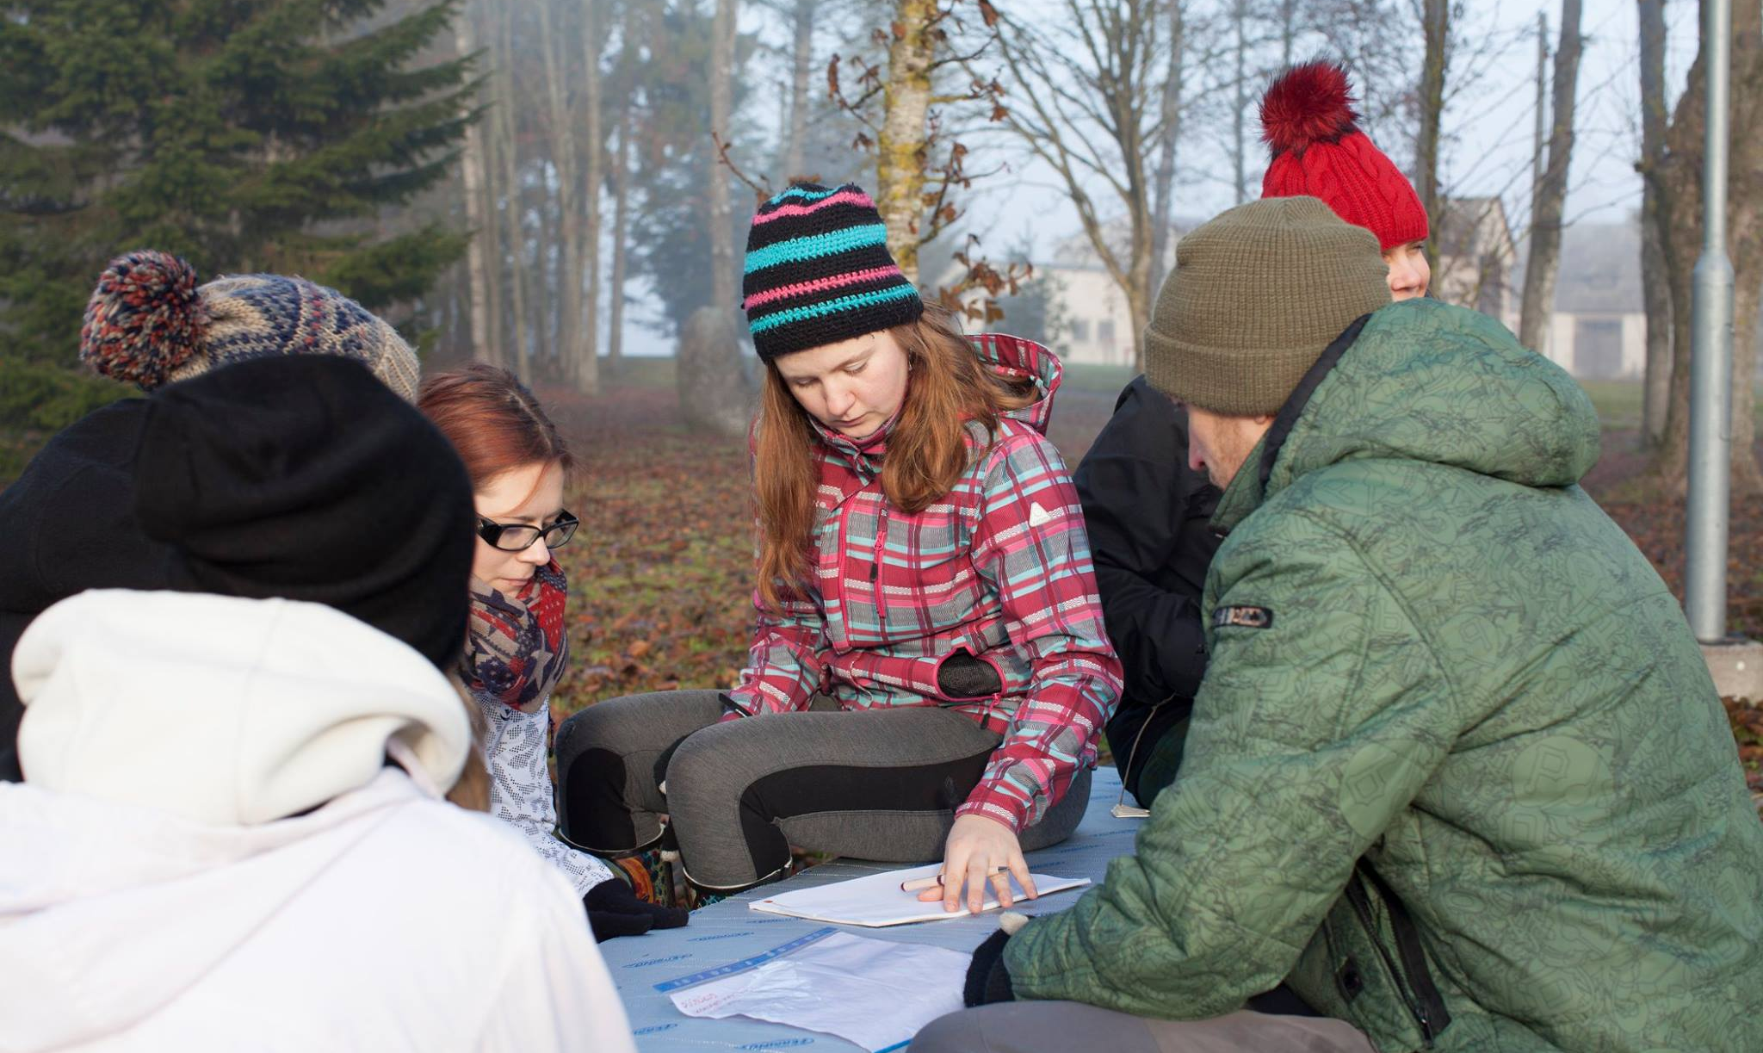
Development of a research-based model for improving services for young people in the risk of exclusion in cooperation with the Tallinn University
Partnership agreements with HEIs
Development and piloting of a research-based model for increacing youth participation in cooperation with the Tallinn University
Notes:
The aim of the project Task-U is to help the local level to empower young people who have been socially excluded, using a model that describes how youth workers can build trust with young people:
Trust, Agency, Social participation, Knowledge & skills for employability, Youth
Additional analyses have been performed to refine the second model. During the project, 8 reports on youth participation have been submitted. In October, group discussions for 16-22-year-olds, so-called imitation games, will take place. Several materials have been published about the project, but they are all in Estonian.

Slide 9
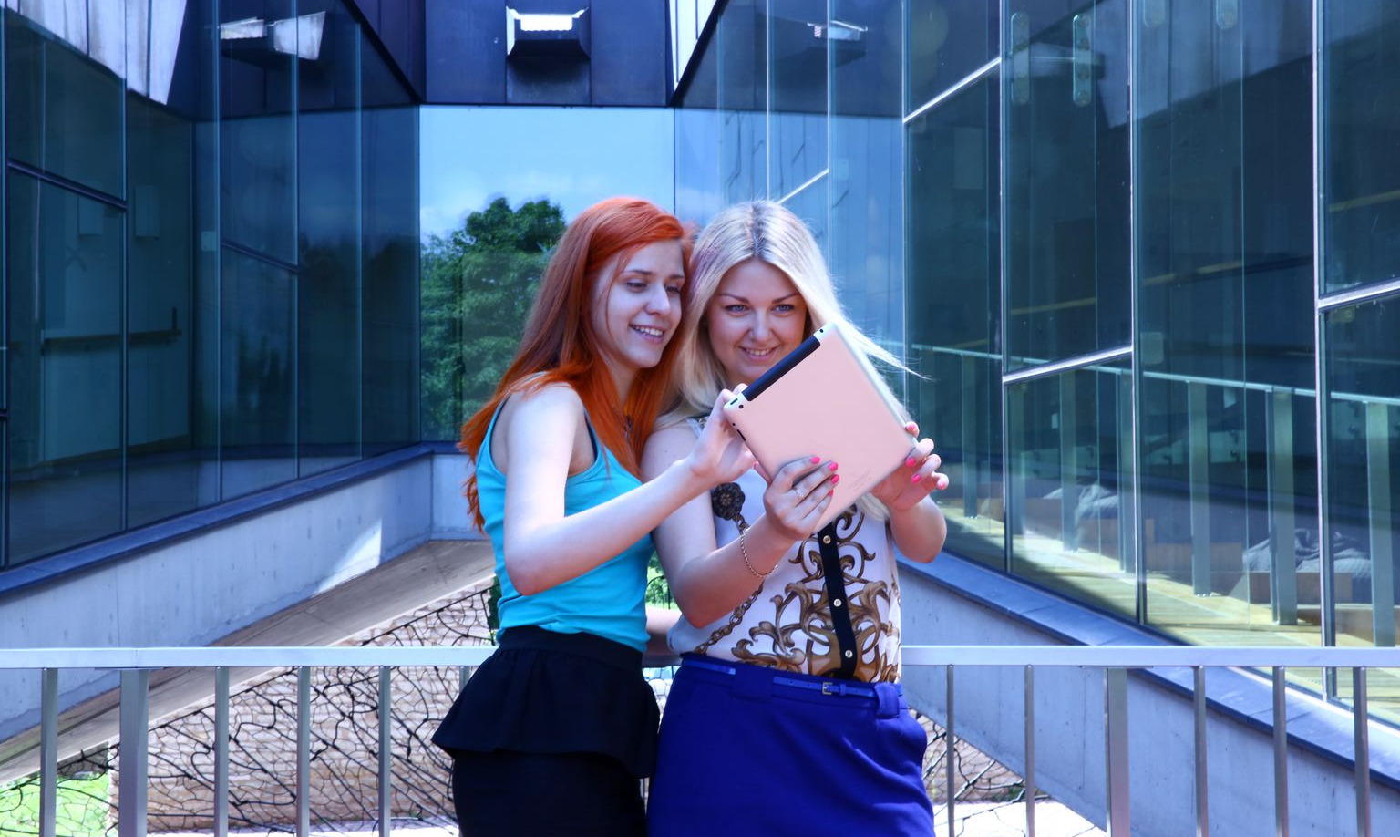
Development and piloting of a research-based model of youth work organisation at the local level based on a youth-centered approach – University of Tartu
Partnership agreements with HEIs
Notes:
As part of the project N-telg, a lab was launched to find out the perceptions of young people and youth workers regarding the relevance of a value-based approach.

Slide 10


Long notice of upcoming tenders due to faculty overload, to allow them to plan their time better in advance, so that they are more likely to participate
What else can we do or have we done?
Surveys, studies or analyses, formulation of principles
Emphasis on the quality and impact of youth work in the goals of national youth sector development plan

Slide 11


Creation of the concept of training system development and a steering committee having representatives from HEIs
Other future activities
Providing trainings for youth workers and leaders of youth work institutions and youth organisations, and publication of textbooks and training materials in cooperation with HEIs

Slide 12
Thank you
Let’s keep in touch
hm.ee
@haridusministeerium
@haridusmin

