Slide 1
BRING TO LIFE
Complexity of youth work education
Katherina Nugent
Dundalk Institute of Technology
Expert Meeting on higher education in youth work, Helsinki, 20-23rd September 2022

Slide 2

BRING TO LIFE
‘from grey to colour’

Slide 3
BRING TO LIFE
Starting with what I am not discussing !
Critical pedagogy
Learning outcomes
Literature
Module mapping

Slide 4

BRING TO LIFE
Why? Why did I study youth work?? WHY Didn't I do accountancy or medicine or something easier than youth work!!!
A hysterical student ( final year 2018)

Slide 5
BRING TO LIFE
What has worked? What are our strengths?
Experienced team in the field of youth and community work
Story telling – or the example of…
Excellent practice partners in provision of placement
Shared values and principles across a teaching team
Programme practices ‘the united front’

Slide 6
BRING TO LIFE
Innovative, energetic, madcap field trips where ‘others’ tell the story of youth work!
Serious promotion of self-care – expectations of third level and the sector
Model Behaviours – live youth work principles
Foster networks -

Slide 7
BRING TO LIFE the 10 year learning curve!
Recognise and track changes…. Subtle as they are
Promote and model honest dialogue
Problem solving – being honest with self and others!
Hold centrally the value that young people are our number one priority so only the best will do!

Slide 8
changes
Reading as opposed to scrolling
Mental health – emotional wellbeing and the link to fitness to practice
Provision of short stories
Screenings and discussions

Slide 9
Learn from ‘out there’!
Able to manage difficult situations – conflict
Fun
Fearless
Developed understanding of theory and why it matters in the life of a young person

Slide 10
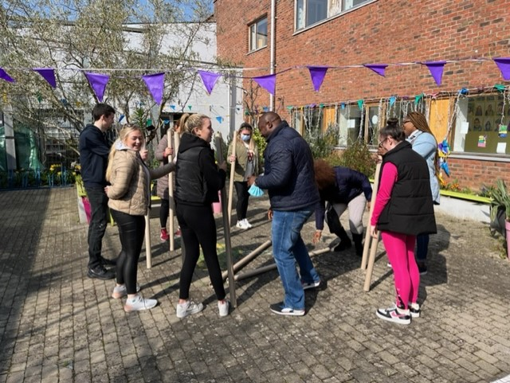
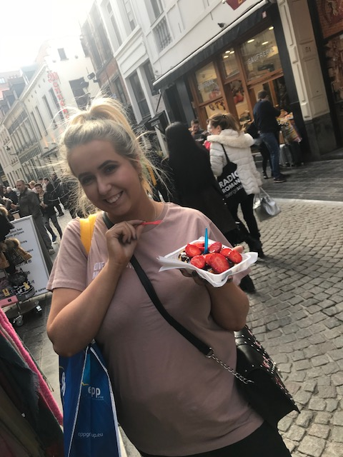
Small beautiful acts

Slide 11
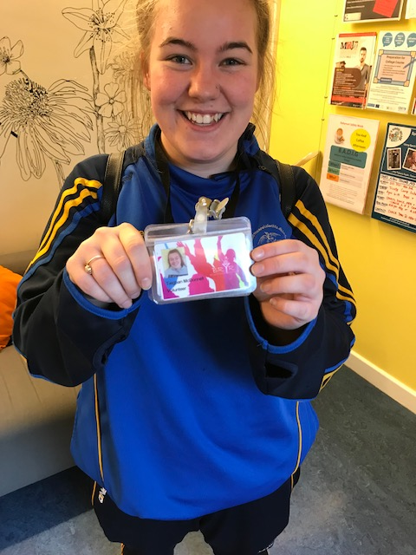
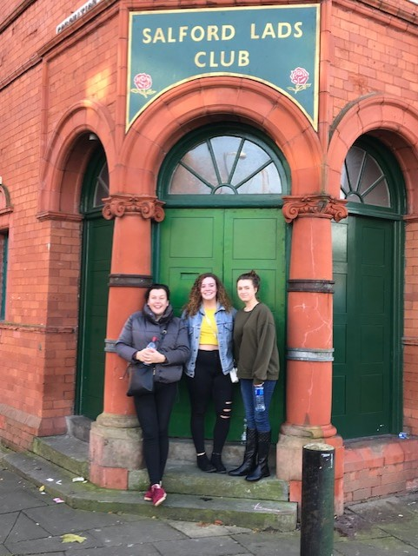
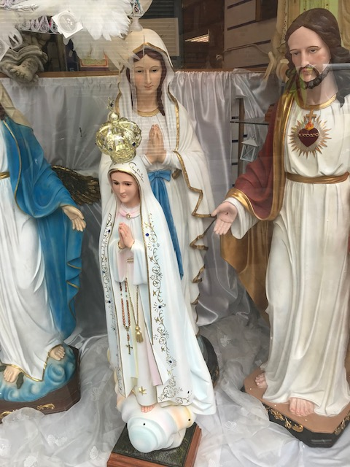
Small beautiful acts

Slide 12
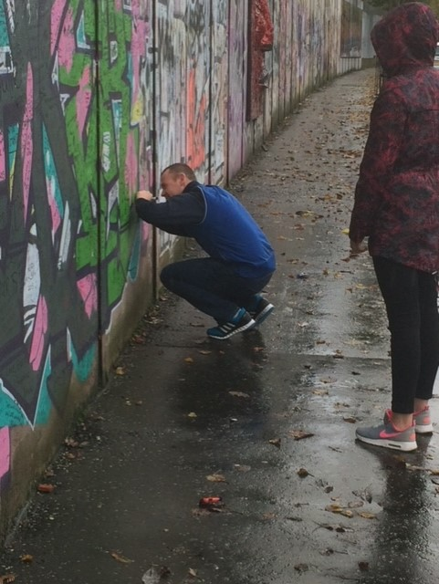
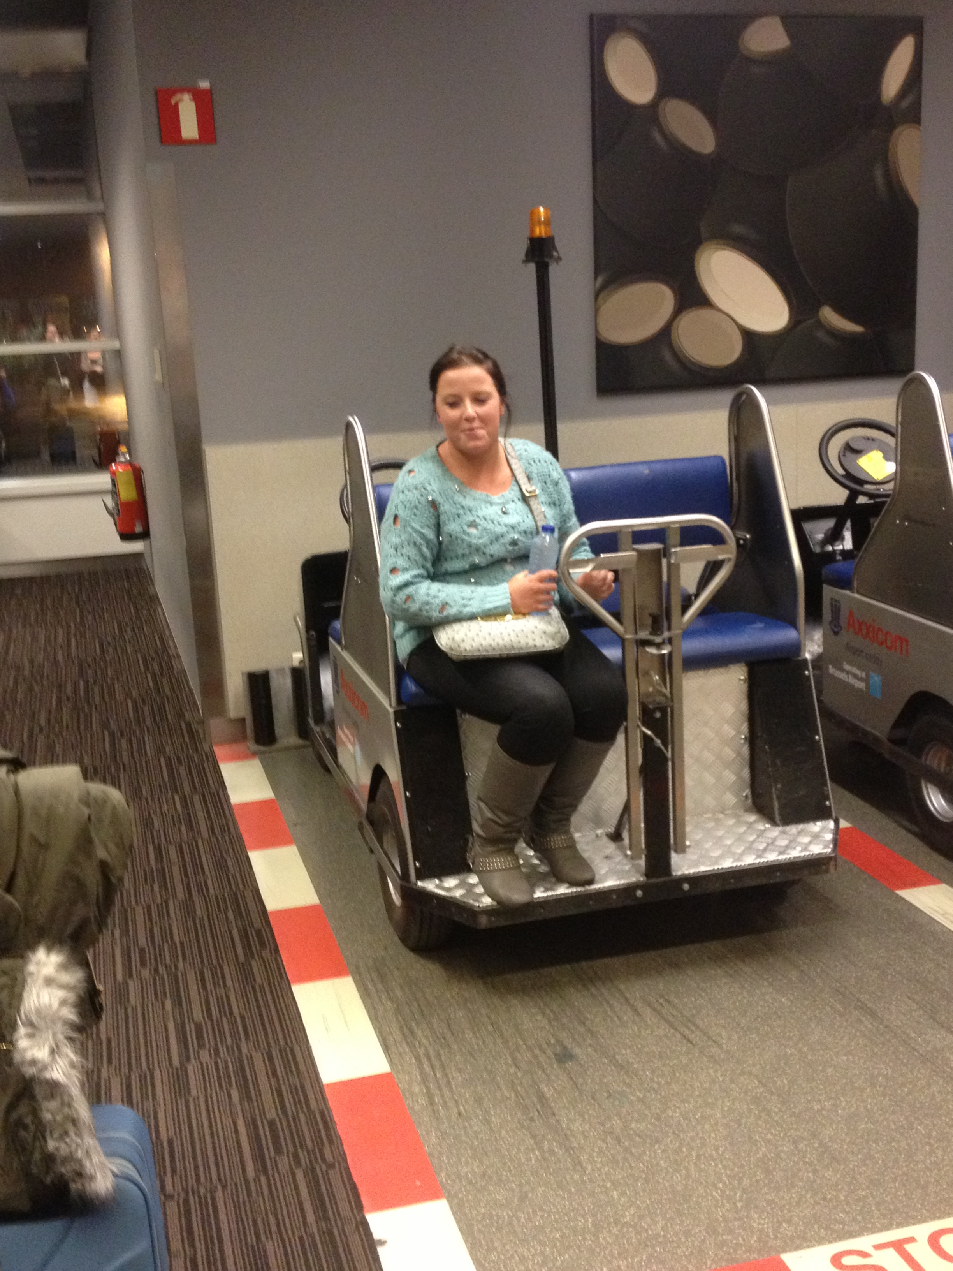
SMALL BEAUTIFUL ACTS

Slide 13
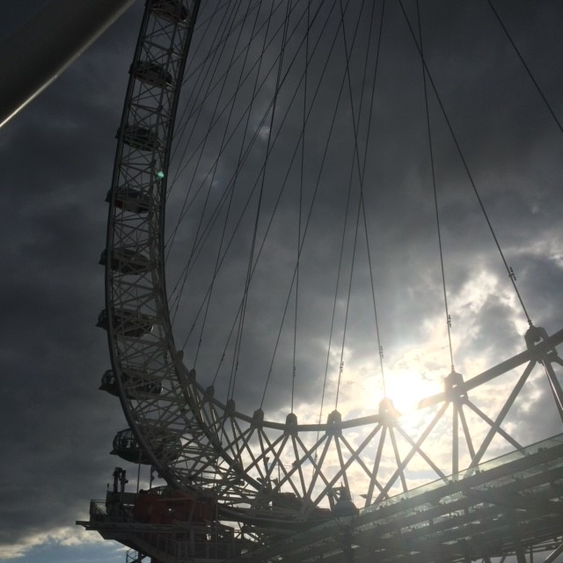
SMALL Beautiful acts

Slide 14
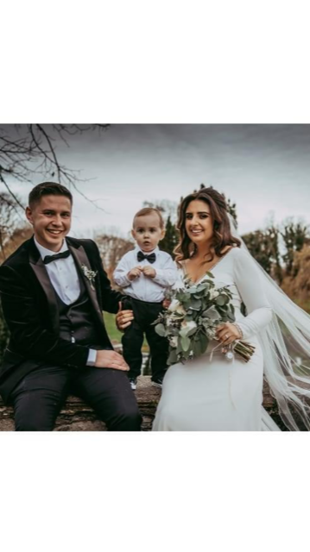
Small beautiful acts

