Slide 1
Youth work in Scotland
Howard Sercombe, Jim Sweeney, Ted Milburn, Marcus Liddell, Rory McLeod, Phil Denning

Slide 3
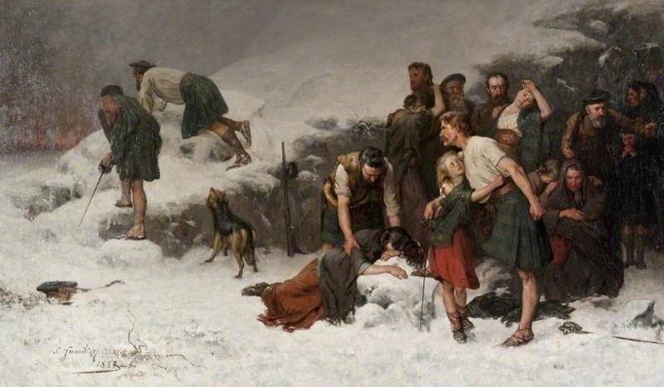

Slide 5
Definitions
Youth
Youth work
Social category created by delaying social accreditation as adult (citizen, autonomous actor, agent) to biologically adult persons.
Professional practice which engages young people in their social context to facilitate their agency

Slide 6
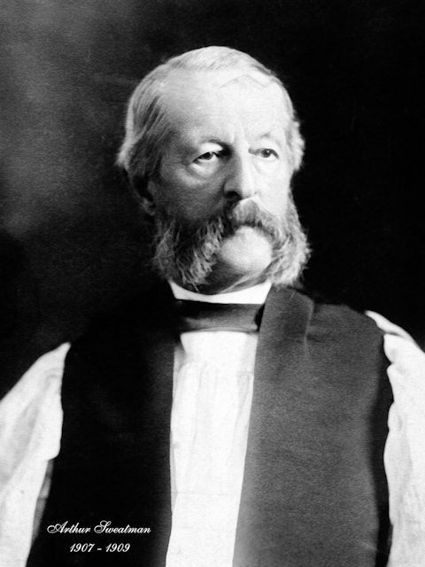
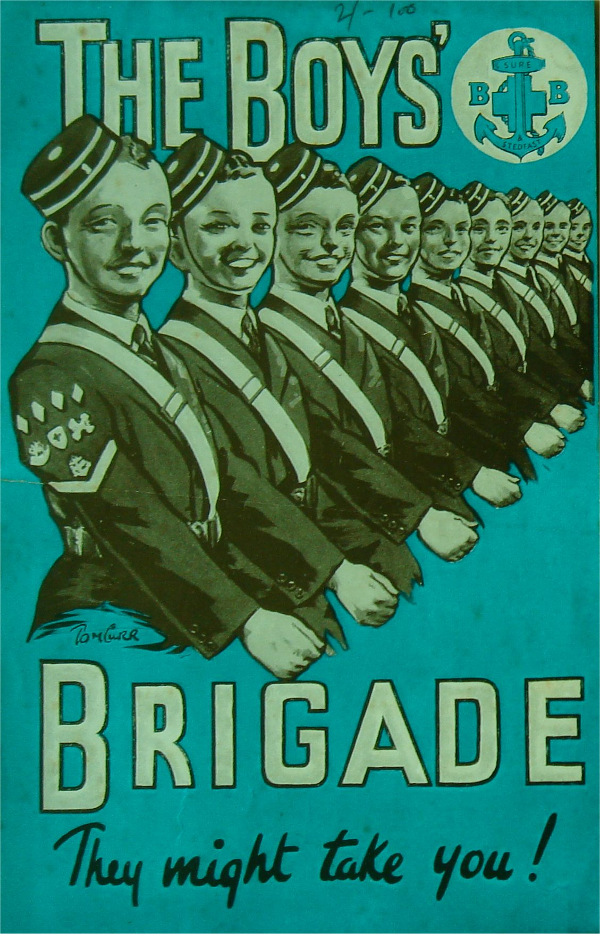
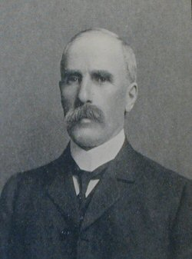
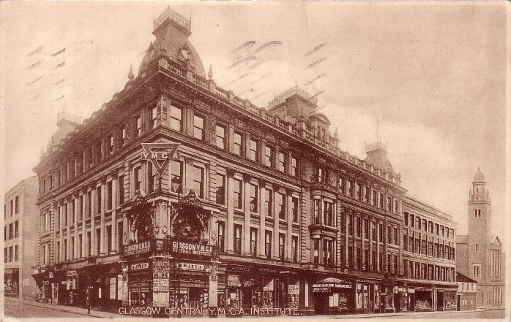
David Naismith (1799-1839)
William Alexander Smith (1854-1914),

Slide 7
The Albemarle Report
Discourse: The frameworks of knowledge and power that create the conditions of possibility for speaking and writing. Discourse is not just how we speak to one other… it is more a question of what is sayable and what gets counted as truth.
Carrington 1993
Albemarle establishes the discourse of British youth work, including its founding axioms of informal education, association, the voluntary principle.

Slide 8
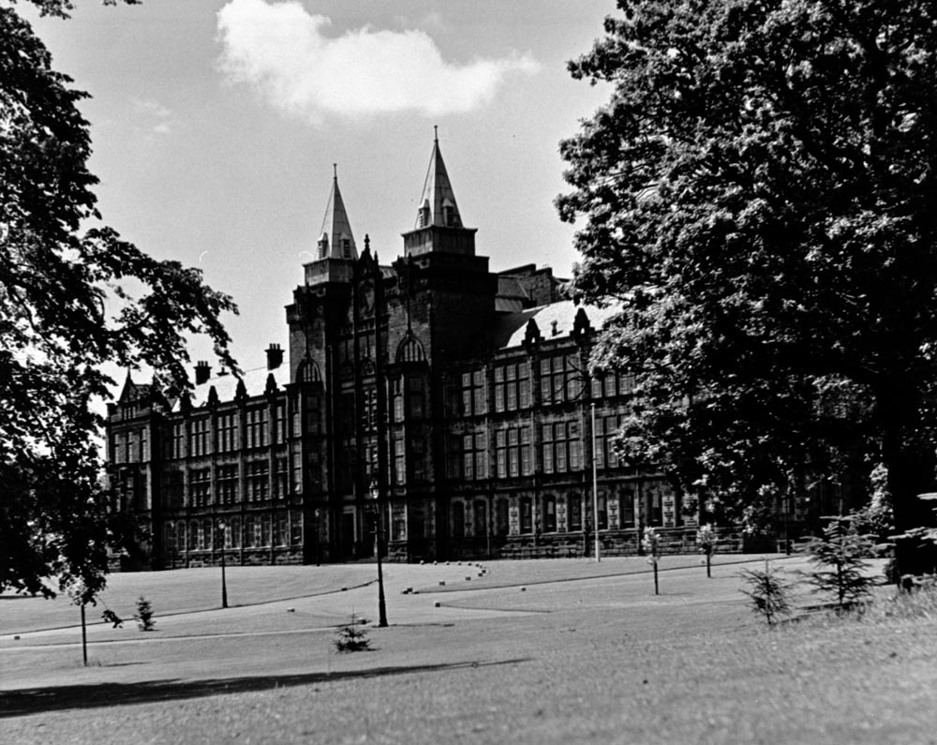
Jordanhill College
Moray House

Slide 10
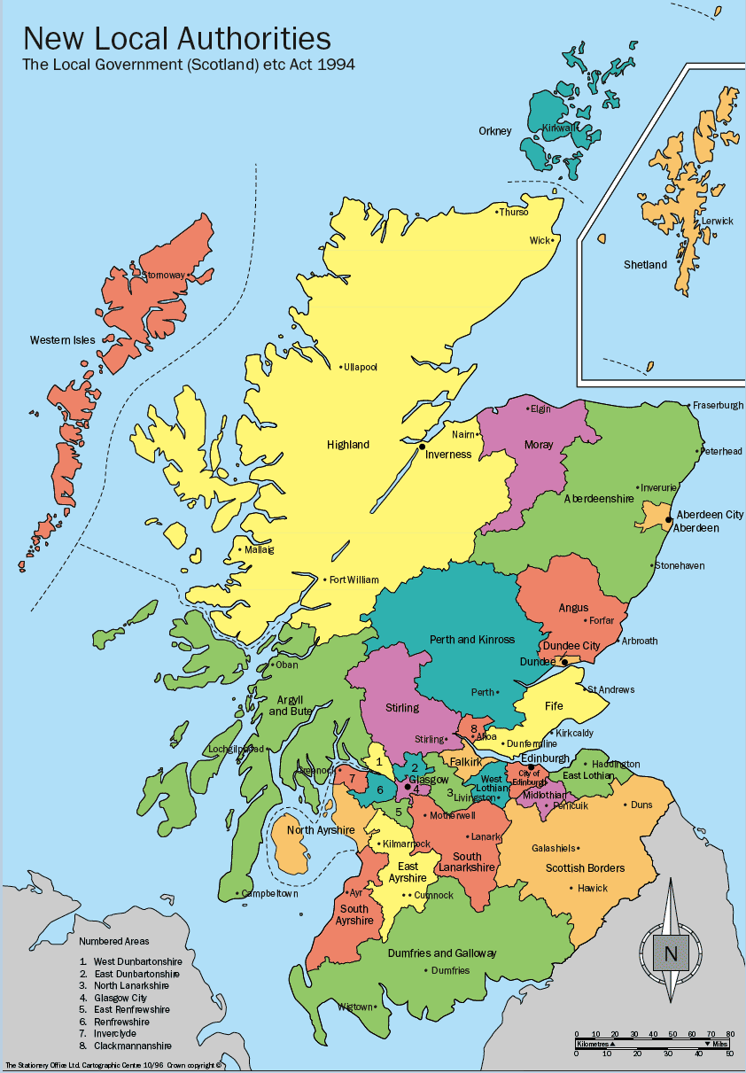

Slide 12
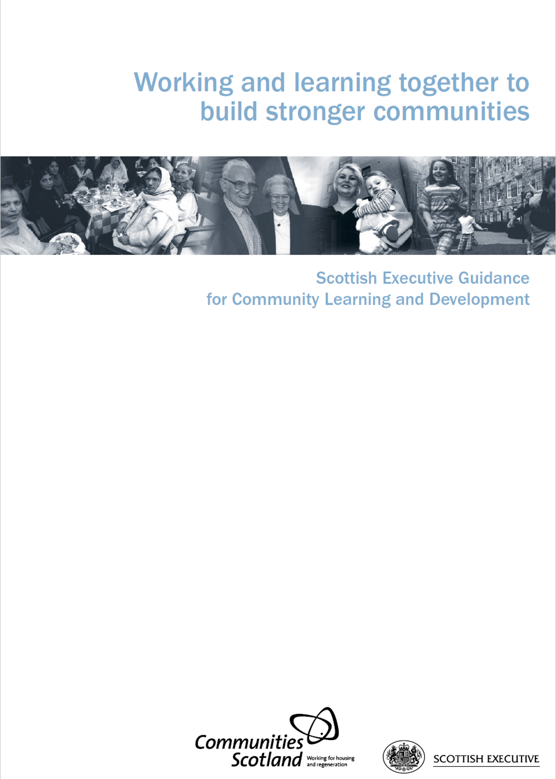

Slide 13
