Slide 1


Considerations on European citizenship and access to equal opportunities for young people in Europe
Symposium '(Un)Equal Europe? Responses from the youth sector’
30 MAY - 2 JUNE 2016 BUDAPEST
Alexandra Severino
Sergio Marques

Slide 2
Considerations on European citizenship and access to equal opportunities for young people in Europe
AIM: to identify the aspects regarding the promotion of equality among youth and as a consequence, to potentially measure the levels of the European (Union) citizenship;
METHODOLOGY: surveys in Portugal, Germany for students (16-18 years old) in two schools per country (a high social background + a low social background) while reflecting on the legal dimension of European citizenship and Europe's policies for youth.

Slide 3
Youth and equality within the legal framework of the EU
- Art. 21 CFREU (non-discrimination)
- The only rule where there is a “crossed” reference between youth and equality
Considerations on European citizenship and access to equal opportunities for young people in Europe

Slide 4
Brief considerations on EU citizenship
- Art. 20 TFUE
Citizens of the Union shall enjoy the rights and be subject to the duties provided for in the Treaties
Considerations on European citizenship and access to equal opportunities for young people in Europe

Slide 5
Considerations on European citizenship and access to equal opportunities for young people in Europe
Article 20 TFEU
The right to vote and to stand as candidates in elections
Right to move and reside freely
Every person holding the
nationality of a Member State shall be a citizen of the Union

Slide 6
Considerations on European citizenship and access to equal opportunities for young people in Europe

Slide 7
Considerations on European citizenship and access to equal opportunities for young people in Europe

Slide 8
Considerations on European citizenship and access to equal opportunities for young people in Europe

Slide 9
Considerations on European citizenship and access to equal opportunities for young people in Europe

Slide 10
Considerations on European citizenship and access to equal opportunities for young people in Europe

Slide 11
Key conclusions
- Similarity in the patterns of the answers is much more linked with the socioeconomic background than the country
-This pattern it the opposite when it comes to the question of whether refugees may threaten the access to equal opportunities
Considerations on European citizenship and access to equal opportunities for young people in Europe

Slide 12
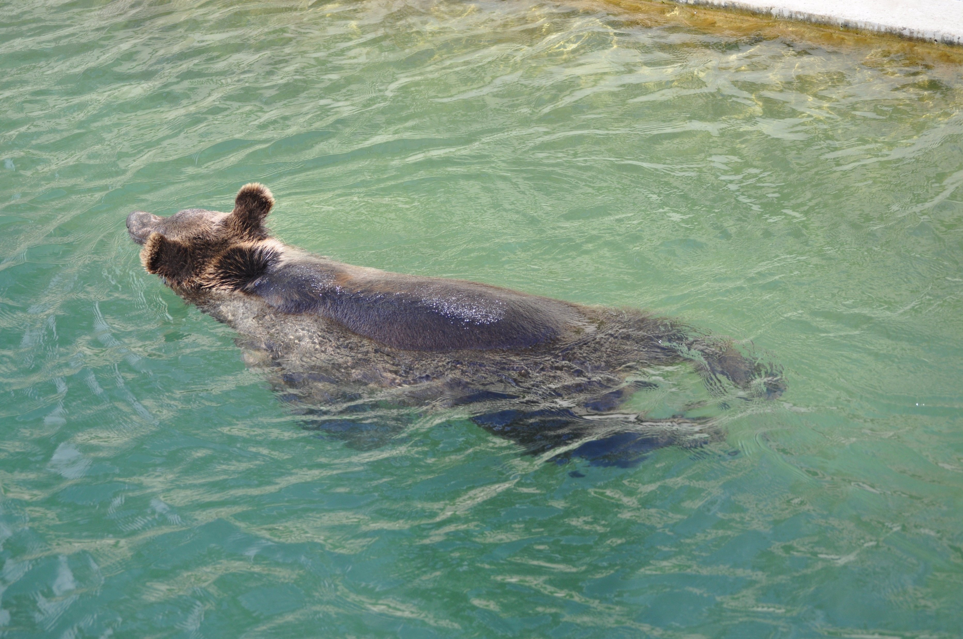
Euroskepticism is boring;
let’s get weird!

Slide 13
Thank you!
Symposium '(Un)Equal Europe? Responses from the youth sector’
30 MAY - 2 JUNE 2016 BUDAPEST

