Slide 1
Tips for Strategic Interventions
By Tony Geudens
SALTO Inclusion Ressource Centre
www.salto-youth.net/inclusion/
tony@salto-youth.net

Slide 2
What is SALTO-YOUTH
Support and Advanced Learning and Training Opportunities within the Erasmus+ Youth in Action programme
Network of 8 resource centres on European priority topics
Support youth work: training, manuals,…
Research: what works, what doesn’t,…
Support policy development (NAs, COM)
www.salto-youth.net/inclusion/

Slide 3
SALTO & Inclusion Diversity Strategy
European Commission's Inclusion & Diversity Strategy for the youth field (Erasmus+)
Stakeholder questioning (NGOs-NAs)
Developing drafts
Submitting for approval – green light
Implementing – who does what
Spread the word
ID Steering group
www.salto-youth.net/inclusion/

Slide 4
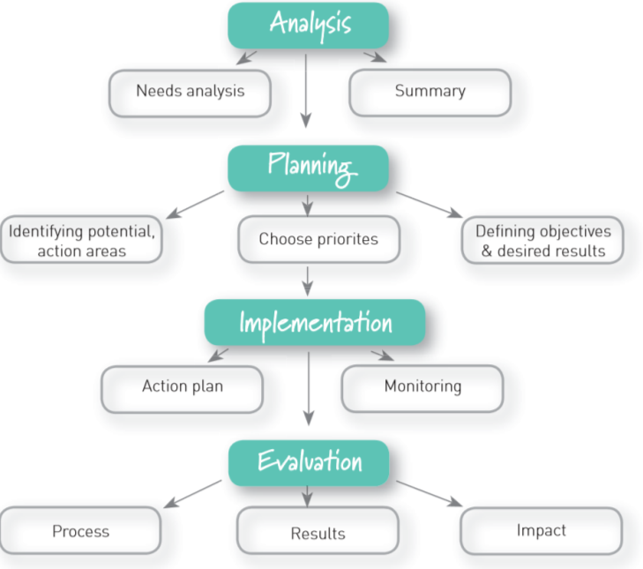
Shaping
Inclusion

Slide 5
Tips for Strategic Interventions
www.salto-youth.net/inclusion/

Slide 6
Tips for Strategic Interventions
Make sense of the puzzle
Nothing about them, without them
Put the money where your mouth is
www.salto-youth.net/inclusion/
Notes:
Make sense of the puzzle
Nothing about them, without them

Slide 7
Tips for Strategic Interventions
Youth work/policy is NOT an island
Someone in the driving seat
Pistachio effect
www.salto-youth.net/inclusion/
Notes:
Make sense of the puzzle
Nothing about them, without them

Slide 8
Tips for Strategic Interventions
Get the message out
Tailor-made interventions
www.salto-youth.net/inclusion/
Notes:
Make sense of the puzzle
Nothing about them, without them

Slide 9
Tips for Strategic Intervention
Proportionality
Show the impact
> www.salto-youth.net/InclusionResearch/
www.salto-youth.net/inclusion/
Notes:
Make sense of the puzzle
Nothing about them, without them

Slide 10
Questions?
tony@salto-youth.net
SALTO Inclusion Ressource Centre
www.salto-youth.net/inclusion/

